Slide 1
Class 9
Errors Failures Risks
Keith A. Pray
Instructor
socialimps.keithpray.net
Notes:
Here’s the title slide. Excited already, aren’t you?
What is the point of this assignment? (Did SW Teams from the reading pick good test strategies? Will you be able to support your choices if something goes wrong?)
What errors? – Have student record list on board
Who looked for existing test strategies?
Who looked for directions on how to test currency?
Paper Reminders:
Use #’s and facts instead of “great, a lot, numerous, many, most, much…”
Avoid absolutes unless quoting facts “always, never, must, will…”
Make organization clear, avoid CP R, CP R through out whole paper.

Slide 2
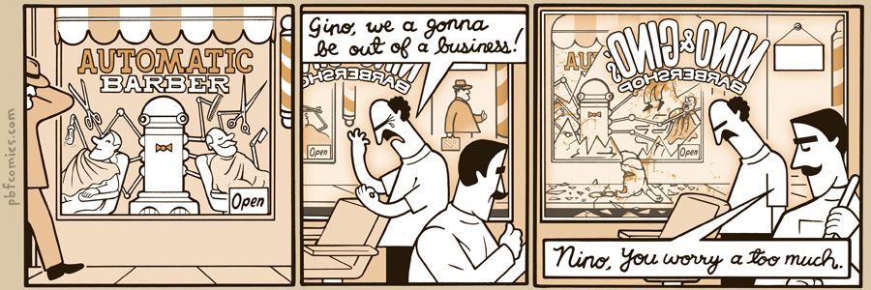
http://pbfcomics.com/197 (2014-09-26)
Notes:
10 – Errors, Failures, Risks
If not used in previous class
Why Electronic Voting is a BAD Idea - Computerphile
https://www.youtube.com/watch?v=w3_0x6oaDmI

Slide 3
Overview
Review
Assignment
Students Present
Guest Speaker
Notes:
We can also discuss articles listed on Security Discussions under documents of course web site.
ADD QUIZ AS BACKUP IF CLASS DISCUSSION OR GUEST SPEAKER FAIL

Slide 4
My Reading Notes
pp. 366 Any false arrests since 1989?
pp. 368 Argument assumes DB cannot exist without existing inaccuracies.
pp. 373 This is not to keep the PATRIOT system from responding to false alarms.
pp. 375 Always encapsulate units!
pp. 378 Why did the Tokyo Stock Exchange refuse?
pp. 380 Republicans and Florida?
pp. 381. Do the second thoughts on DRE machines make the interview at end Chapter’s end less relevant?
pp. 389 No simulation examples since 2002?
pp. 390 Did The Limits to Growth predictions motivate people to change?
pp. 392 What happened to Verification?
pp. 394 “satisfies the specification” = verification. “needs of the user” = validation.
pp. 395 SW quality since 2007?
pp. 396 Gender bias nice addition!
pp. 406 21, source form 2004, is it implemented yet? 23 like game release question in next chapter.
Questions I liked: 10, 12, 16, 17, 18, 20, 21

Slide 5
Assignment – 1 Page Paper
ACM COPE Code 2018 Project
http://ethics.acm.org/code-of-ethics/code-2018/
24 Clauses. For your assigned clause:
What parts of The Code no longer make sense, due to changes in technology or society? What could be done to make them better fit the current context?
Are there any blind spots in The Code? Principles that ought to be contained in The Code that are currently missing?
In the area of technology where you are most expert, what have been the greatest changes since 1992, and how might The Code be updated to reflect these changes?
What parts of The Code are confusing, ambiguous, or likely to be mis-interpreted?

Slide 6
Overview
Review
Assignment
Students Present
Guest Speaker
Notes:
We can also discuss articles listed on Security Discussions under documents of course web site.
ADD QUIZ AS BACKUP IF CLASS DISCUSSION OR GUEST SPEAKER FAIL

Slide 7
Misuse of medical Robots
Kevin A. Valente-Comas
Are medical robots truly the Holy Grail or medical revolution many have made it out to be?
No, when many realize this they start opposing this technology.
Notes:
There is a lot of controversy on Medical Robots on the internet. Many believe medical robots to be the Holy Grail or the instigator of a medical revolution. That is not the case and when they realize this they take a completely opposite position and begin to slander the technology.

Slide 8
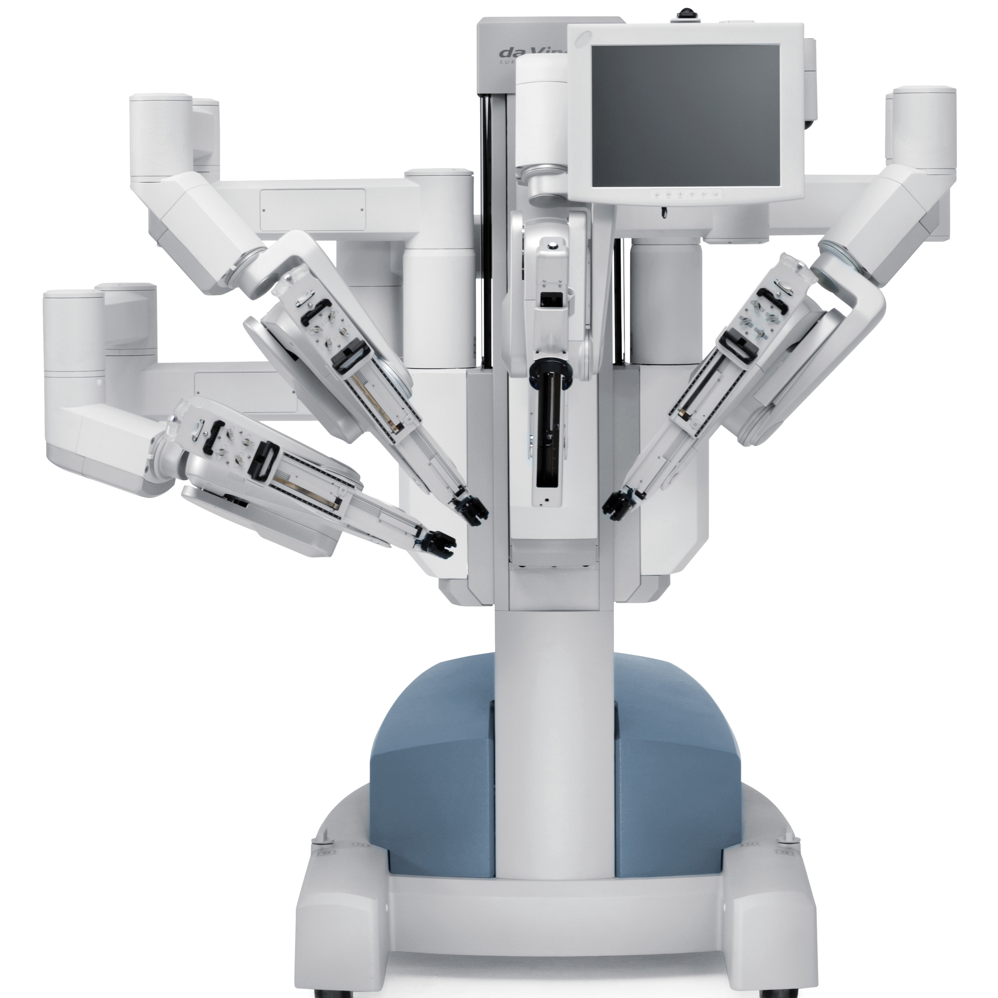
Types of medical robots
Kevin A. Valente-Comas
Logistics
Prosthetics
Rehabilitation
Surgery Robots
Images from [1]
Notes:
There are four types types of medical robots. This presentation will focus on surgery robots. Reasons: a rough approximate of 80% of the results you could get from Google using the words medical robotics at least reference surgical robots. The biggest topic of controversy on the web.

Slide 9
Pros
Kevin A. Valente-Comas
Short term
  Reduced pain and blood loss
  Smaller incisions
  Effective cancer control
  More precision and control
      Note: this is true for several types of robotics-assisted surgeries not all of them
Long Term
  ???
Notes:
Why include pros on a presentation of misuse? To prove a point. Here we can see all the benefits of robotic surgery. Oh wait, in the fine print it says, these benefits are not true for all types of robotic-assisted surgery. This ties in to the first misuse, aggressive advertisement. In it the company “sells” their products to the patients, who then push the product to the hospital forcing them to either buy or lose a lot of prospective patients. No known benefits for long term. The Da Vinci has been out since 2010, however, all the research done have been subpar. One article exaggerated this and said, “ the only questions asked are can you walk up those stairs and does it hurt anywhere”.

Slide 10
Misuse and negative effects
Kevin A. Valente-Comas
Aggressive advertisement
Inadequate studies/research
Cost
  Da Vinci System: $0.6M-$2.5M/robot
  Instruments & accessories: $700-3.2K/procedure
  Annual service: $100k-$175k/year
Insufficient training
Inadequate insulation
Notes:
The cost for the Da Vinci system $0.6M-$2.5M per robot. Instruments & accessories $700-$3.2k per procedure. Annual service $100k-$175k per year. A study in hysterectomies for benign gynecologic disorder found an average cost for robotic-assisted hysterectomies were $2,189 more expensive than traditional approaches. Some articles, medical research papers and news articles, say that Intuitive Surgical have been encouraging hospitals to reduce the training required before a doctor can perform robotic-assisted surgery without supervision. Tools that come into contact with patients that become hot or electrical discharge emanated from the arm can cause minor to severe burns on organs and other tissues.

Slide 11
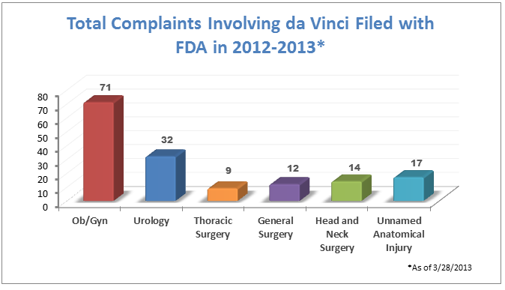
Conclusion
Robotic surgery is a relatively new technology with several benefits and potential.
Policies need to change and more concern should be placed in improving its defects.
For now though the technology is used so little, the negative impact is insignificant.
Image from [1]

Slide 12
References
Kevin A. Valente-Comas
[1] Stephen Gomez, The da Vinci Robot Expert Witness: A Litigation Guide, https://www.theexpertinstitute.com/the-da-vinci-robot-expert-witness-a-litigation-guide/ (September 10, 2016)
[2] NA, Patient Information: da Vinci surgical system facts, http://uchealth.com/services/robotic-surgery/patient-information/benefits/ (September 10, 2016)
[3] Arabel Luscombe, Medical Robots-the future of surgery?, http://lifemag.org/article/medical-robots-the-future-of-surgery (September 10, 2016)
[4] Brian Davies, Robotic Surgery – A Personal View of the Past, Present and Future
http://arx.sagepub.com/content/12/5/54.full.pdf+html (September 10, 2016)
[5] Baowei Fei, Wan Sing Ng, Sunita Chauhan, Chee Keong Kwoh, Reliability Engineering & System Safety (Elsevier, August 2001), Volume 73, Issue 2, Pages 183-192
[6] http://www.intuitivesurgical.com (September 16 2016)
[7] Intuitive Surgical, Investor Presentation, http://investor.intuitivesurgical.com/phoenix.zhtml?c=122359&p=irol-IRHome (September 16, 2016)
[8] Bruce Carlson, Over 232 Million Surgeries Performed Worldwide in 2013: Report, http://www.kaloramainformation.com/about/release.asp?id=3519 (September 16, 2016)
[9] Marshall Allen, How Many Die from Medical Mistakes in U.S. Hospitals?, http://www.scientificamerican.com/article/how-many-die-from-medical-mistakes-in-us-hospitals/ (September 16, 2016)
[10] Carol Peckham, Medscape Malpractice Report 2015: Why Most Doctors Get Sued, http://www.medscape.com/features/slideshow/public/malpractice-report-2015 (September 22, 2016)

Slide 13
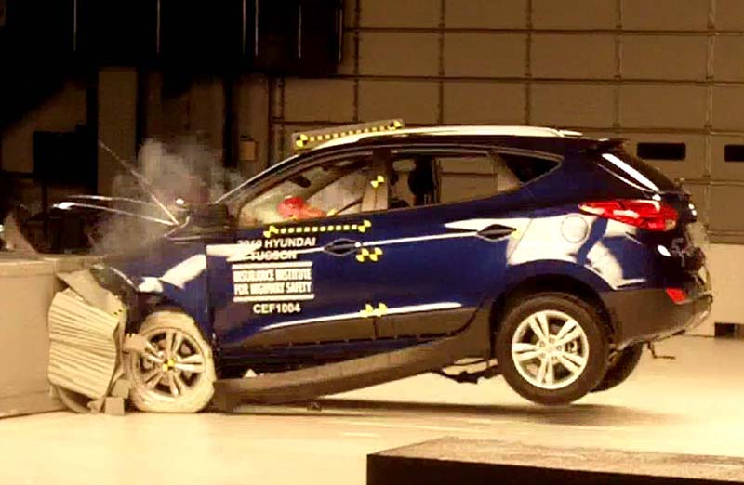
Autonomous car safety
Nicholas S .Bradford
How does it impact me?
[1]
Notes:
Hi everyone, I’m Nick, and I’m here to talk about how autonomous car safety is going to impact you.

Slide 14
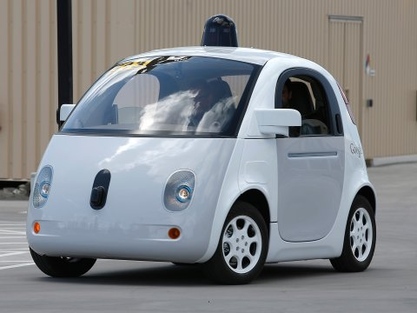
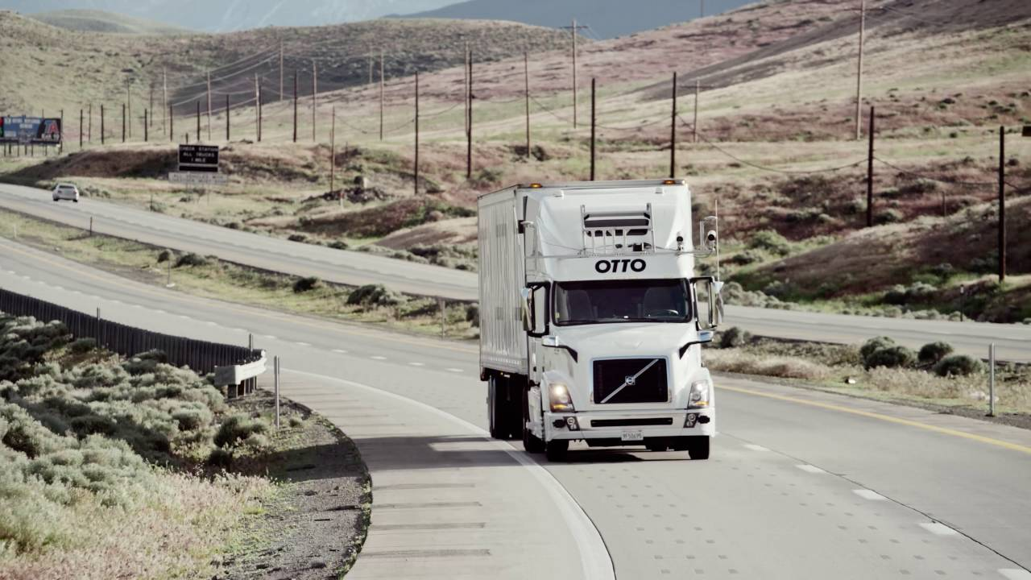
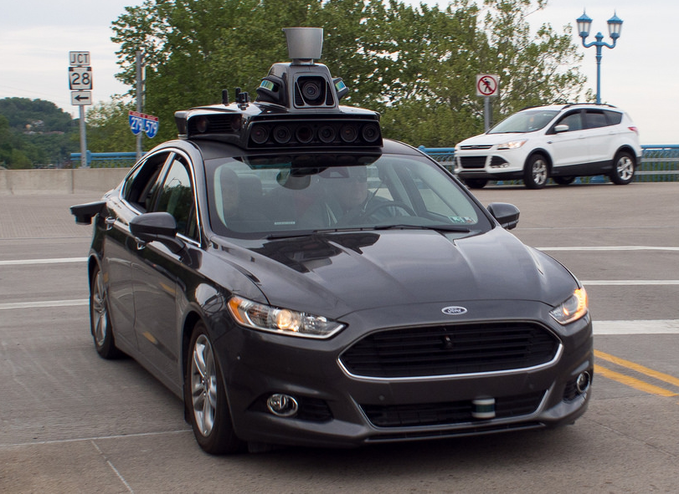
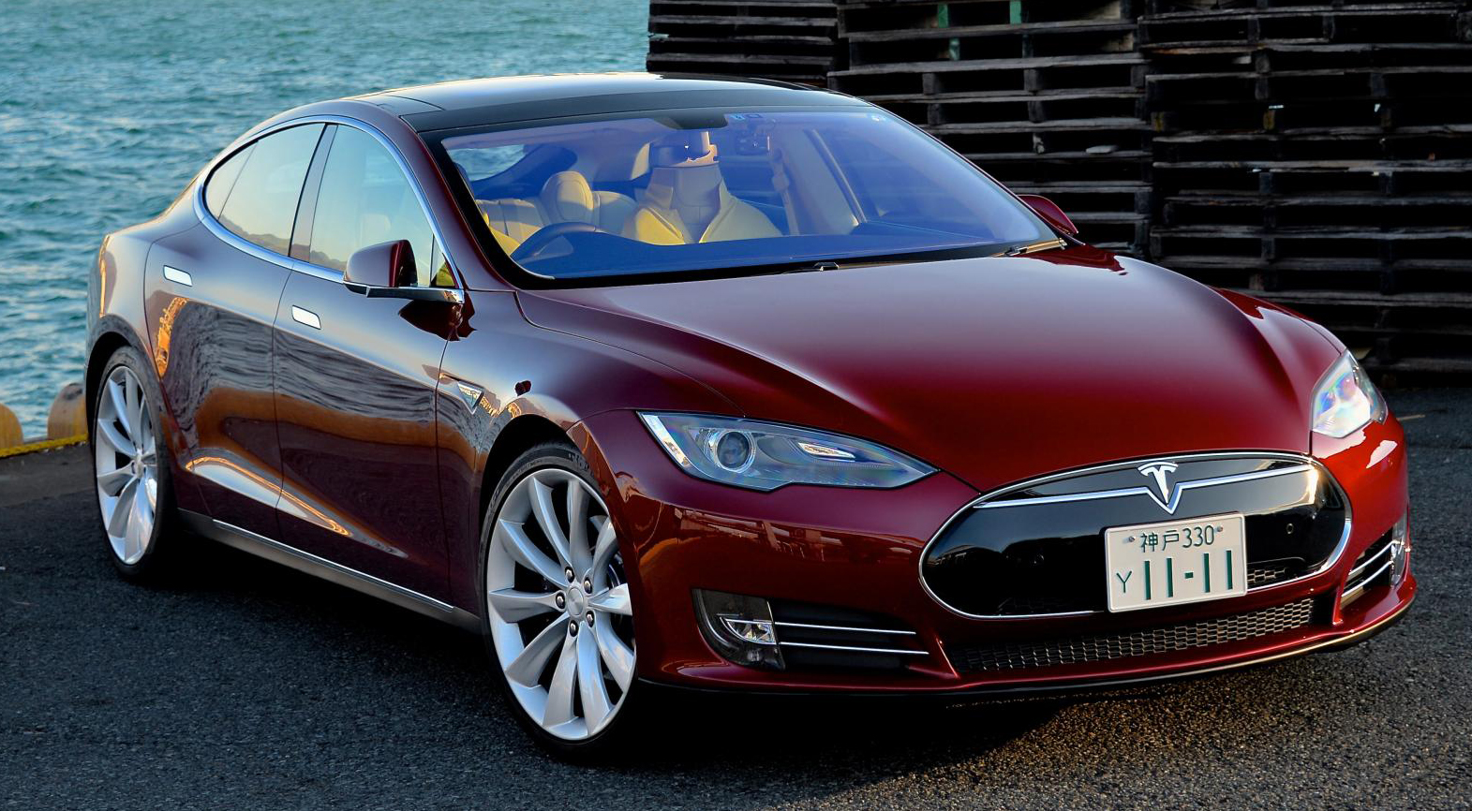
Why autonomous vehicles?
Nicholas S .Bradford
95% of accidents are because of human error
  30,000+ vehicle deaths/year
  $400 billion+ damages /year
Google has 1 accident/1.3 million mi.
[2], [5], [7], [8], [9]
Notes:
So, first some background. Why spend all this effort to create autonomous vehicles?
Well, as it turns out, humans are terrible at driving: 95% of all accidents are because of human error. This means over 30,000 vehicle fatalities per year in the U.S. alone, with accidents costing over $400 billion annually.
Autonomous vehicles can reduce these risks: for example, the Google self-driving car program has reported only 1 at-fault accident in over 1.3 million miles of driving.

Slide 15
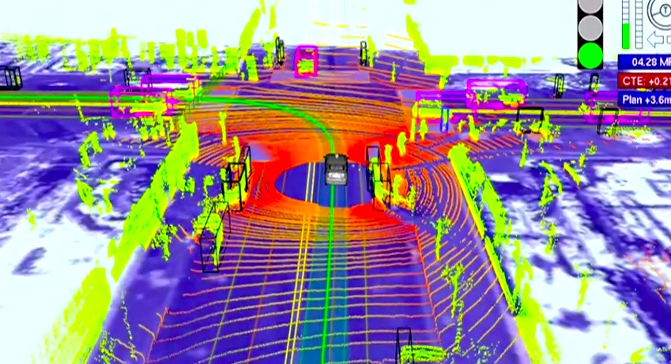
How do they work?
Nicholas S .Bradford
Sensors
  LIDAR
  Radar
  Cameras
  GPS
  Wheel encoders
Limitations
  Unusual obstacles
  Police hand signals
  Heavy rain/snow
[10], [11]
Notes:
Now, understanding how autonomous vehicles work is important to understanding their safety implications. While setups vary across different manufacturers, typical setups will include LIDAR (which is like radar but with lasers and much more detailed), cameras, radar, GPS, and wheel encoders. The major limitations currently include strange obstacles (like a pile of trash bags), interpreting gestures, and inclement weather.

Slide 16
Regulations
Nicholas S .Bradford
8 states (and D.C.) now have legislation:
  Nevada, California, Florida, Louisiana, Michigan, North Dakota, Tennessee, Utah, and Washington D.C.
  Typically requires human operator
Automation Levels (2013 by NHTSA)
  0: No automation
  1: Function-specific
      brake-assist
  2: Combined function
      adaptive cruise control, lane centering
  3: Limited self-driving
      Tesla Autopilot
  4: Full automation
      Google car
[4], [6]
Notes:
Now, as is often the case, laws are lagging behind technology. Only 8 states have laws explicitly relating to autonomous cars, which typically require a human operator to be present in the case of an emergency.
These laws are complicated by the varying types of autonomous vehicles, described by the National Highway Traffic Safety Administrations 5 Levels: No automation, function-specific, combined function, limited self-driving, and full automation. Tesla is an example of the limited self-driving as it expects a human is always paying close attention with a hand on the steering wheel, while the Google self-driving cars have begun to actually remove the steering wheel and pedals.

Slide 17

Who is responsible for a crash?
Nicholas S .Bradford
The company’s software?
  Still waiting for a lawsuit…
  Different Levels make things tricky
States have all the power
[7]
Notes:
Now, the interesting part of the law is the answer to the question, “who is responsible if an autonomous car gets in an accident?” And it turns out that there is still not a definitive answer on this! It’s assumed at this point that the company producing the software is at fault, but we are still waiting for an actual lawsuit to occur to establish some sort of precedent. This matter is further complicated by the different levels of automation present on self-driving cars, which I’ll go into more detail on shortly.
The big issue now is that it’s the States that have all the power with setting laws in these respects (you know, they issue Driver’s Licenses too).

Slide 18
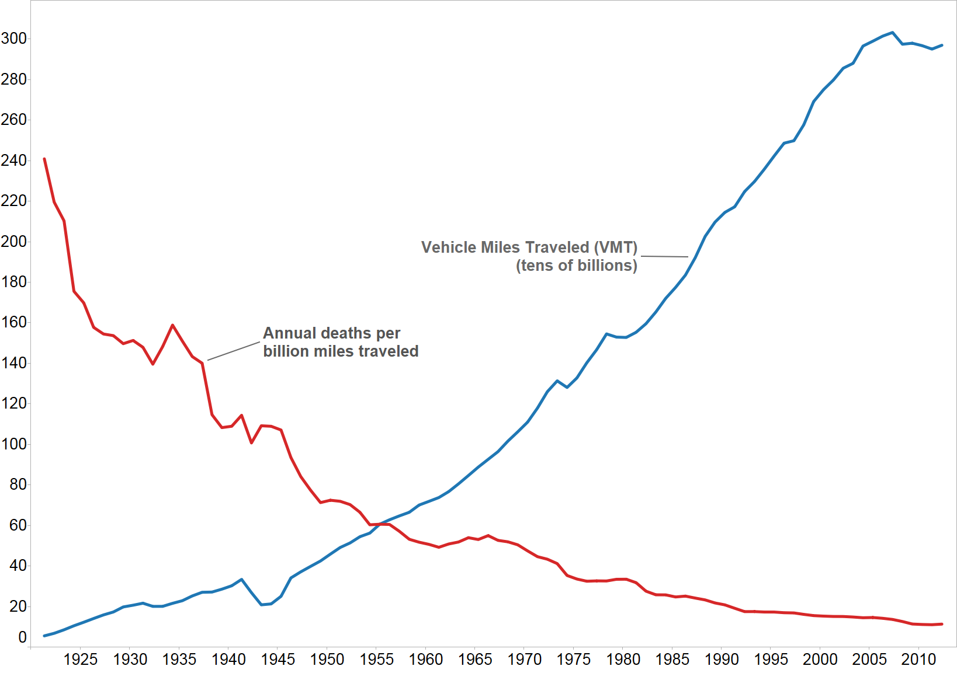
Timeline of U.s. vehicle fatalities
Nicholas S .Bradford
1934: First crash test (GM)
1994: Crash tests are mandatory
1959: First 3-point seat belts (Volvo)
1995: Seat belt laws in 49 states
[13]
Notes:
Here you can see just how much legislation lags behind technology:
First crash tests conducted in 1934, it doesn’t become mandatory for all vehicles for 60 years!
The 3-point seatbelt is introduced in 1959, it takes 36 years for [nearly] all states to make them mandatory.

Slide 19
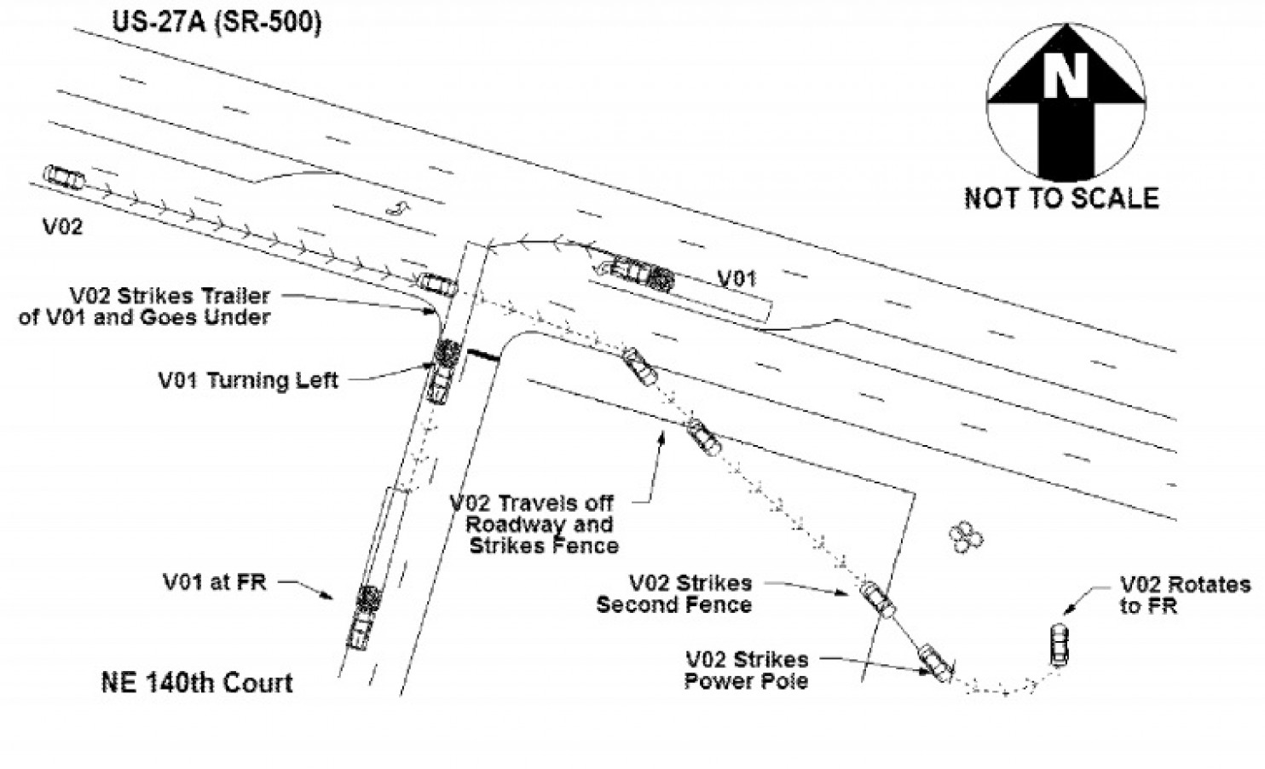
Tesla Fatal accident (May 7th 2016)
Nicholas S .Bradford
Tesla Model S using Autopilot
  Trailer too high for forward radar
  White background blended in with sky
First U.S. Autonomous Car fatality
  130 million miles driven with Autopilot
  U.S. Avg: 1 fatality/94 million miles
Exposed lack of regulations
  Family may have grounds to sue?
Tesla is upgrading radar capability
[2], [3], [11]
Notes:
This lack of regulation was put in the spotlight on May 7th, when a white semi trailer crossed in front of a Tesla Model S using Autopilot. Neither the driver nor the camera and radar system detected the trailer because it was high enough off the ground and blended in with the sky, so the car struck the trailer and had the top of it smashed off.
This was the first autonomous vehicle fatality in the U.S., after over 130 million miles driven with Autopilot. However, it still beat out the U.S. average of one death/94 million miles. Because of the lack of regulations, the implications of this accident are unclear, and there is still a possibility that the family of the driver could sue Tesla. But in the meantime, Tesla is us improving their car’s radar capabilities to ensure that a similar accident doesn’t take place again.

Slide 20
Federal policy released Sept. 20th 2016
Nicholas S .Bradford
“There has been a strong call from state and local governments, industry, safety experts, and average Americans to establish a clear policy for the deployment of automated vehicles” – DOT Secretary Foxx.
15 Point Safety Assessment
  To aid manufacturers in developing, testing, and deploying autonomous cars
Model State Policy
  Goal is a consistent national framework
[5]
Notes:
Now, there is some progress being made on making new legislation. The National Highway Traffic Safety Administration released information on this Tuesday the 20th addressing the hole in the Federal Motor Vehicle standards, and recognizing that “There has been a strong call from state and local governments, industry, safety experts, and average Americans to establish a clear policy for the deployment of automated vehicles” (by the Secretary of the Department of Transportation).
The statement includes a 15-point safe safety assessment to aid manufactures and developers of automated vehicles, that will hopefully soon evolve into a standard. It also included a model state policy and regulations on autonomous vehicles, with the stated goal of creating a consistent national framework.

Slide 21
Conclusion and future questions
Nicholas S .Bradford
Standardize laws and liability → increased safety for everyone
  More experimentation → improvements
Should car collide with a bus or with a pedestrian?
  Unified heuristic for least expected damage
Should cars in the future even allow humans to drive?
  Yes, but only in extreme cases
  Most people should get by with robot Uber
[7]
Notes:
From all of this, it’s pretty clear: we need to better standardize the laws and liability surrounding autonomous vehicles as soon as possible, to accelerate their introduction to the general population and make everyone safer. As we saw with Tesla, the benefits of having a lot of people use these autonomous systems is that they continuously will become better the more experiences they encounter.
Now some ethical questions: if an autonomous car has the choice between two possible targets to hit, say, a pedestrian or a school bus, what is the ethical decision? Something I believe needs to be encoded partially in law is a uniform set of heuristics of causing the least amount of expected damage, at the very least so that vehicles will behave predictably.
Finally, some big advocates of autonomous cars, like Elon Musk, have said that they envision a future where it’s actually illegal to drive a car yourself because of the danger it could cause. However, I believe that the future will see more and more use of autonomous Uber drivers which will become incredibly cheap, and individual cars (and ones that humans are allowed to drive) relegated only to extreme cases.

Slide 22
References
Nicholas S .Bradford
[1] Frontal offset crash test of a Hyundai Tucson. Wikipedia. Accessed 21 September 2016 from https://en.wikipedia.org/wiki/Insurance_Institute_for_Highway_Safety
[2] A Tragic Loss. Tesla Blog. Accessed 21 September 2016 from https://www.tesla.com/blog/tragic-loss
[3] The Technology Behind the Tesla Crash Explained, by Brian Fung. The Washington Post. Accessed 21 September 2016 from https://www.washingtonpost.com/news/the-switch/wp/2016/07/01/the-technology-behind-the-tesla-crash-explained/
[4] U.S. Department of Transportation Releases Policy on Automated Vehicle Development. National Highway Traffic Safety Administration. Accessed 21 September 2016 from http://www.nhtsa.gov/About+NHTSA/Press+Releases/U.S.+Department+of+Transportation+Releases+Policy+on+Automated+Vehicle+Development
[5] U.S. DOT issues Federal Policy for safe testing and deployment of automated vehicles. National Highway Traffic Safety Administration. Accessed 21 September 2016 from http://www.nhtsa.gov/About+NHTSA/Press+Releases/dot-federal-policy-for-automated-vehicles-09202016
[6] AUTONOMOUS | SELF-DRIVING VEHICLES LEGISLATION. National Conference of State Legislatures. Accessed 21 September 2016 from http://www.ncsl.org/research/transportation/autonomous-vehicles-legislation.aspx
[7] Who is Responsible when a Driverless Car Crashes? By Brian Fung. The Washington Post. Accessed 21 September 2016 from http://www.businessinsider.com/who-is-responsible-when-a-driverless-car-crashes-2016-2
[8] What It Feels Like to Ride in a Self-Driving Uber. By Mike Isaac. The New York Times. Accessed 21 September 2016 from http://www.nytimes.com/2016/09/15/technology/our-reporter-goes-for-a-spin-in-a-self-driving-uber-car.html
[9] Otto Self-Driving Trucks. Otto. Accessed 21 September 2016 from http://ot.to/
[10] How Google’s Self-Driving Car Works. By Erico Guizzo. IEEE Spectrum. Accessed 21 September 2016 from http://spectrum.ieee.org/automaton/robotics/artificial-intelligence/how-google-self-driving-car-works
[11] Upgrading Autopilot: Seeing the World in Radar. Tesla Blog. Accessed 21 September 2016 from https://www.tesla.com/blog/upgrading-autopilot-seeing-world-radar
[12] The Driverless Car Debate: How Safe Are Autonomous Vehicles? By Lauren Keating. Tech Times. Accessed 21 September 2016 from http://www.techtimes.com/articles/67253/20150728/driverless-cars-safe.htm
[13] The Evolution of Safety Features in Cars. By O'Connor, Acciani and Levy Law Offices. Accessed 22 September 2016 from http://www.oal-law.com/history-car-safety-features.html

Slide 23

Abstraction in technology:
Higher level thinking or error-prone ignorance?
Annie Hernandez
Does abstraction undermine our understanding of technology?
Is it safe to have and incorporate “black boxes” into our designs?
How do we handle ever increasing complexity?
Abstraction is a necessary design tool that we must take time to understand.
https://en.wikipedia.org/wiki/Black_box
Notes:
Note: Speed through slides 2-6 in like, two minutes. I do feel like I need to explain the various types of abstraction. It’ll come together much more nicely in the end.

Slide 24
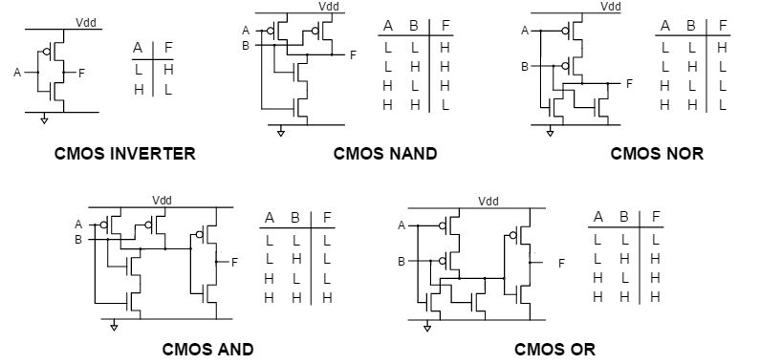
Abstraction in hardware
Annie Hernandez
When it comes to hardware, we are manipulating information in the forms of 0s and 1s.
https://learn.digilentinc.com/Documents/313
Notes:
When it comes to computing, everything can be broken down into 0s and 1s.
We represent this binary with transistors, however...
Transistors are tiny and cumbersome to deal with when designing, so we made logic gates. This allows us to copy-and-paste already known, already widely used transistor setups. Gates enable Boolean algebra, another way to think about circuits. [1]
**There is really only one best way to make a gate, so this is very easy to trust [1]**

Slide 25
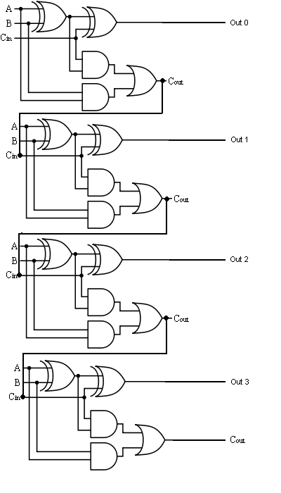
From transistors to gates
Annie Hernandez
While this may have worked in the early days, this is tedious when trying to develop new hardware.
We make templates of commonly used combinations to speed up the design process.
This also leads to Boolean algebra, which can solve any problem with truth tables and Karnough maps.
https://izatxamir.wordpress.com/2010/02/01/4-bit-binary-full-adder-logic-gate/
Notes:
From Boolean algebra we can create many useful functions, such as full adders, registers, and multiplexers. If you want a state machine that detects sequence, all you need are gates. These expressions (A.B)+(~B.C), are Sums of Products, and, yes, any function can be described with SoP logic [2], [3].
**There are multiple ways to make adders and multipliers, as complexity goes up, so does variety. Still, these are small enough objects they are not difficult to trust**

Slide 26
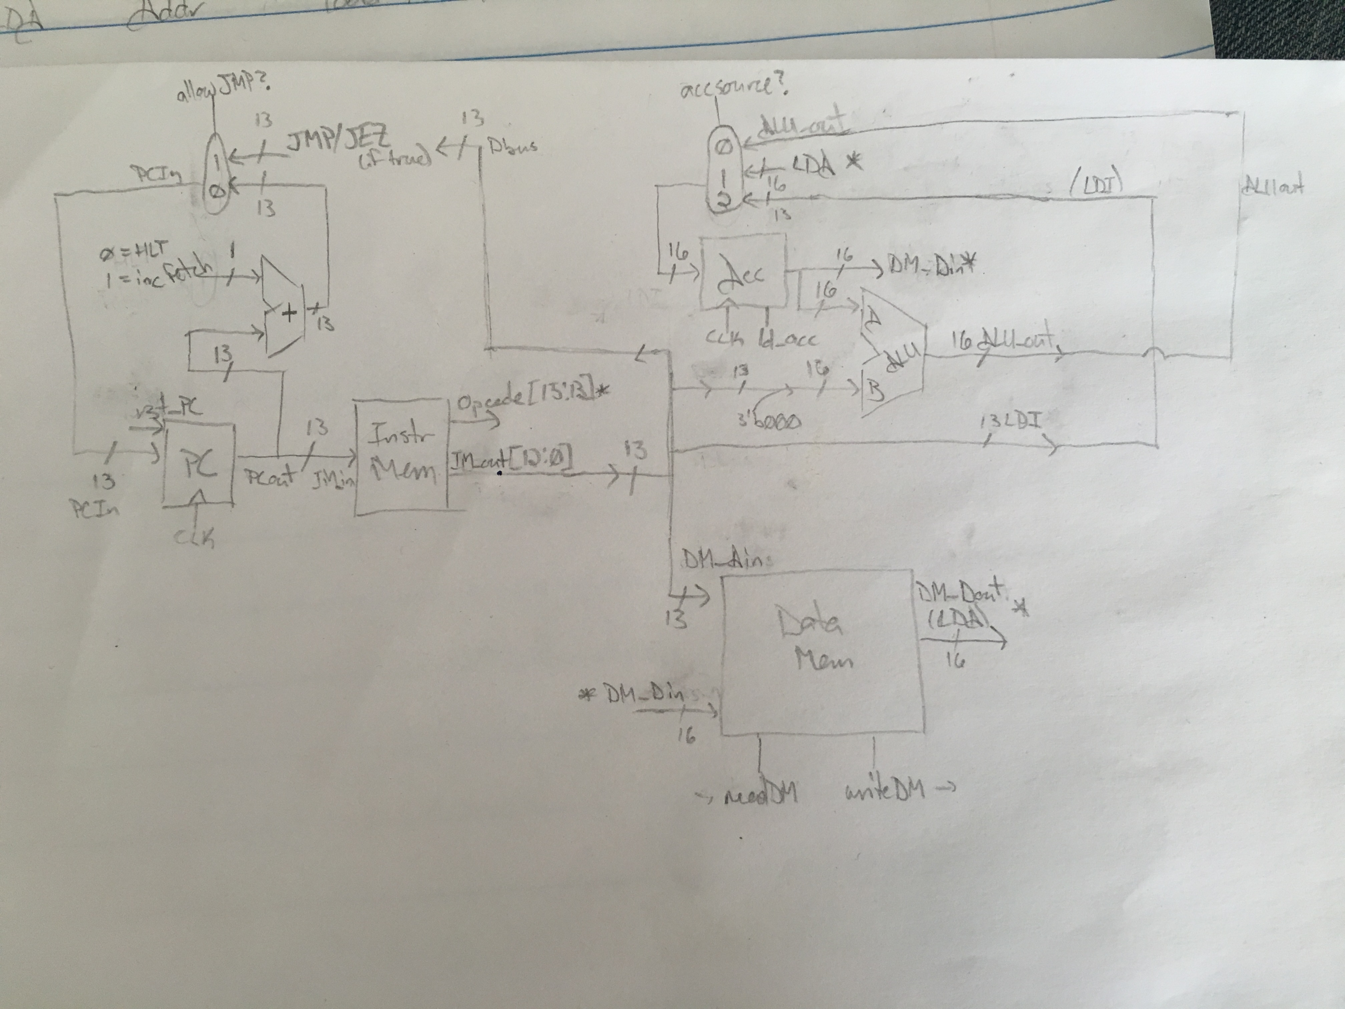
From Gate level to RTL and beyond
Annie Hernandez
Just as we decided transistors are tedious to place, we decide the same for gates.
We already know adders and memory. What if we drag and drop in a block of RAM? An ALU?
We can go even further into transaction level modeling (TLM) by using C++ to algorithmically generate our RTL blocks for us.
Own coursework from ECE505: Computer Architecture
Notes:
Now, just as we could make anything out of transistors, we can make anything out of gates, though wouldn’t it be nice if we didn’t have to do Boolean algebra and truth tables all the time?
We abstract up another layer and take what we’ve made in the gate level and already know well (adder, multipliers, registers), and make those our new “legos”.
Now we can stack registers easily to make various memories. We can have controllers route signals to various parts of the design.
Processors nowadays use literally billions of transistors – good thing we’ve moved up, eh? Apple’s A8X and A10 both have over 3 billion transistors [4], and the SPARC M7 microprocessor has approximately 10 billion! [5]
**There are very many ways to make CPUs, both in components and instructions they can execute. This is where the notion of trust truly comes into play.**

Slide 27
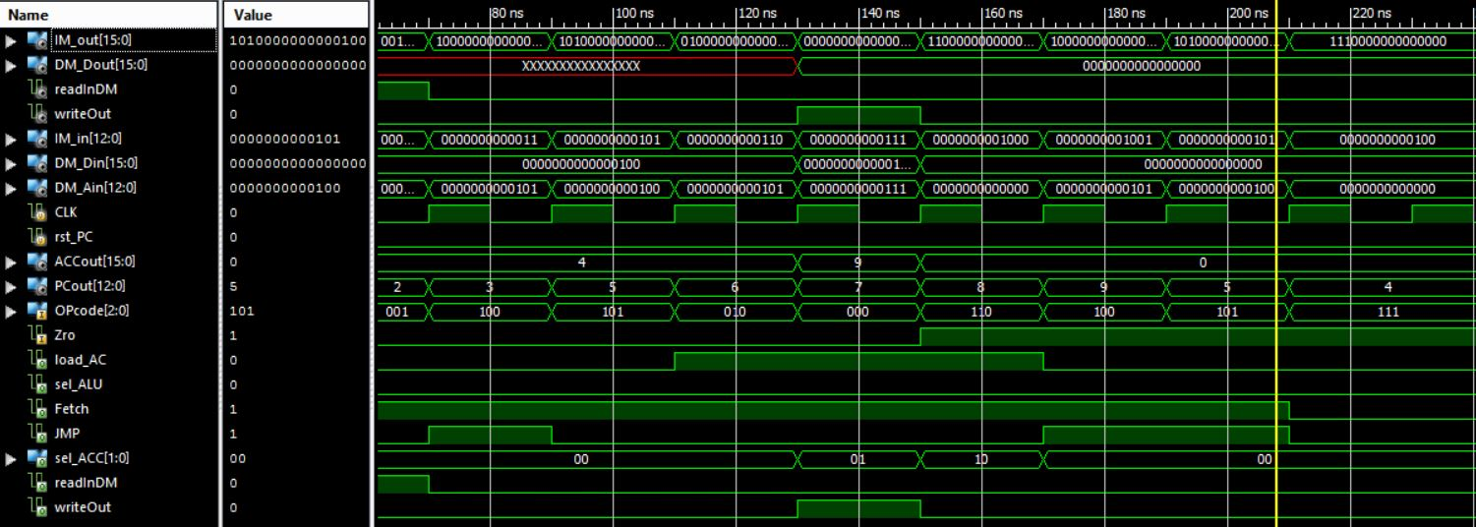
How to triage errors?
FPGAs and simulations reveal logic errors and accidental mis-wiring.
We can see every signal
in every bus to find where connections fail.
WPI offers an entire, graduate-level course (ECE5724) for finding faults and designing extensive tests to check all transistors and timing.
Own coursework from ECE505: Computer Architecture
Notes:
From smaller modules (gates, adders) to CPUs, we use simulation to ensure every wire is connected properly and the results add up to what they should.
Here you see the Verilog simulation of my very simple CPU from the previous slide.
If we see in our CPU that when we run LDA (for obtaining data from memory) we get the wrong information, we can go into that sub-module and check what’s happening. Test the submodule itself and check the contents of each sector and each wire.
You see now how the black boxes build up and get harder to test, can hide errors from you or lead you looking in the wrong places. Just like programming can often times.

Slide 28
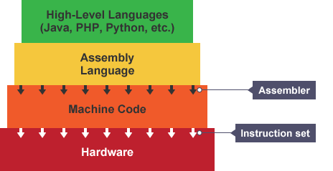
Abstraction in software
Annie Hernandez
Software also has abstraction, mostly in nested methods.
Data abstractions include having classes and polytypes.
Various languages and their predefined functions are abstractions of assembly, too!
Also uses encapsulation to hide intricacies from users.
http://www.bbc.co.uk/education/guides/zgmpr82/revision/2
Notes:
Each small function you make can also be viewed as black boxes. Once you want to use it in another program, you just know inputs, outputs, and how they should relate to eachother.
High-level programming languages are also abstractions of assembly and machine code in that we’re “not working with transistors anymore”. We don’t need to jump back to previous instructions, we can have while loops.
Imagine writing every program in assembly or machine code. Imagine implementing SLAM or artificial intelligences.
Encapsulation is a different form of abstraction that’s more security-oriented – hiding objects from users and not allowing direct access [6]

Slide 29

Problems with Abstraction
Annie Hernandez
The higher the level of abstraction, the more complex and varied the boxes become.
You require trust for modules made by others to work as described.
Problems can be obfuscated by abstraction and lead you astray.
Compatibility issues
http://www.123rf.com/photo_15661598_needle-in-a-haystack-close-up.html
Notes:
There are so many black boxes. Every IC is a black box, really, and the more abstracted you become, the more complex they get.
Every box is different, and unlike transistors to gates where there is only one right answer and trust is easy to give, there is no such thing when it comes to processors, or to mapping applications. How do you decide who to trust then? Once you buy an IC, it’s solid, you can’t modify it.
You’ve read about the Mars case, where one team gave an output in foot-pounds, but the other team expected an input of newtons. The two systems were incompatible in this regard, and created a catastrophic failure that went unnoticed. [7]
It is imperative all components are compatible. This can be seen commonly in ambitious PC builders who realize late too late their graphics card can’t even plug into their motherboard. In the late ‘90s, there well Dell PCs whose motherboard-to-power supply had a standard connector, but nonstandard pins. Replacing the power supply with a standard ATX would seem fine, right up until it was powered and the motherboard fried. [8]
Also, finding an error can quickly become akin to finding a needle in a haystack with bad directions. We’ve all encountered errors that don’t point you to where the actual error’s source. “As a failure is propagated to higher levels of abstraction, the failure itself is also abstracted” [9]

Slide 30
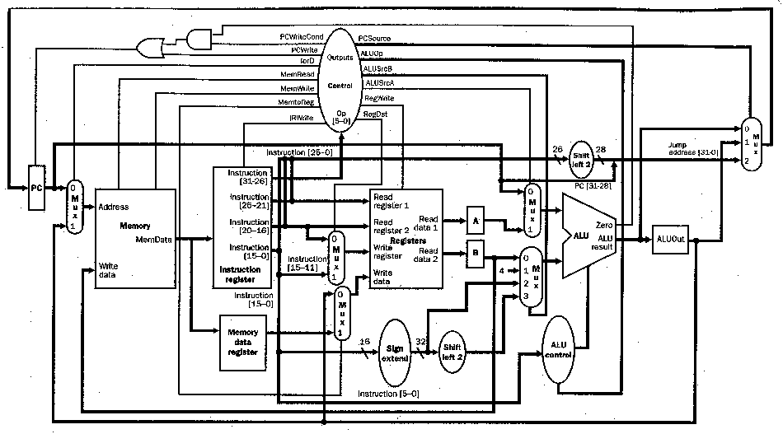
Advantages of abstraction
Annie Hernandez
Allows for specialists to worry only about their specialty.
Ideas can be formed much more quickly when you don’t have to reinvent the wheel every project.
The black box model is the best simplification. Details can be looked up in the user guide.
Testing and simulations are quick to run, edit, and rerun digitally.
https://www.cise.ufl.edu/~mssz/CompOrg/CDA-proc.html
Notes:
Thorough testing when making new products is necessary and will reveal key flaws.
When it comes to larger projects, you can choose your trusted manufacturers (iPhone 7 uses house processors and audio ICs, Intel’s transceivers, modem and power management, Samsung’s DDR4, Toshiba’s’ flash memory, Murata’s WiFi/Bluetooth, Broadcom’s GPS, TI’s power management and battery charger, and Bosch’s pressure sensor.) [10]

Slide 31
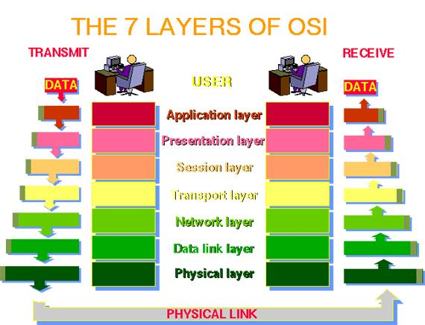
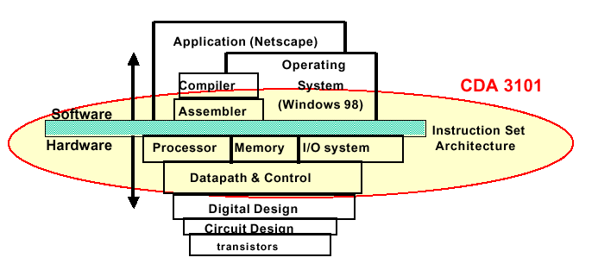
Abstraction as layers
Annie Hernandez
Many departments use various layers to create specialties.
  Computer Science
  Networks Engineering
https://www.cise.ufl.edu/~mssz/CompOrg/CDAintro.html
http://computermasters66.blogspot.com/2015/10/what-is-osi-open-systems.html
Notes:
Networks use the seven layer OSI model (physical, data link, network, transport, session, presentation, and application layers, each of which have their own industry and hardware.) [11]
It is everywhere, abstraction is simply –how we get things done-

Slide 32
Conclusion
Annie Hernandez
Abstraction is one of the most useful engineering tools we have and allows us to accomplish much greater feats, even if it does require trust in others.
This trust must be earned over time – companies will only go with well-known, well-respected names to ensure quality.
Notes:
While there may be some worries about connections between layers, that is simply another thing to look out for. You test each module and each connection when assembling to ensure a working product. You make sure you read the spec. sheet and use the right pins/units/etc.
Trying to do without abstraction is like trying to do without staples or wrenches – the negative impacts on quality and time consumed greatly outweigh the slight increase in peace of mind.

Slide 33
References
Annie Hernandez
[1] "Learn.Digilentinc." Introduction to CMOS Technology. Accessed September 22, 2016. https://learn.digilentinc.com/Documents/313.
[2] Ferdjallah, Mohammed. Introduction to Digital Systems : Modeling, Synthesis, and Simulation Using VHDL (1). Hoboken, US: Wiley, 2011. Accessed September 22, 2016. ProQuest ebrary.
[3] "Boolean algebra." World of Computer Science. Gale, 2007. Science in Context. Web. 22 Sept. 2016.
[4] "Apple A8X IPad SoC." Notebook Check. Accessed September 22, 2016. http://www.notebookcheck.net/Apple-A8X-iPad-SoC.128403.0.html.
[5] "Oracle Cranks Up The Cores To 32 With Sparc M7 Chip." EnterpriseTech. 2014. Accessed September 22, 2016. http://www.enterprisetech.com/2014/08/13/oracle-cranks-cores-32-sparc-m7-chip/.
[6] "Abstraction." Lecture, Cornell, Ithaca, NY, September 22, 2016.

Slide 34
References (Cont.)
Annie Hernandez
[7] Hall, E. C. "Reliability History of the Apollo Guidance Computer." NASA Technical Reports Server. 2013. Accessed September 22, 2016. http://ntrs.nasa.gov/search.jsp?R=19750004273.
[8] Thompson, Robert Bruce., and Barbara Fritchman. Thompson. Building the Perfect PC, pg. 5. Farnham: O'Reilly, 2010.
[9] Frey, Heinz H. Safety of Computer Control Systems 1992 (SAFECOMP '92) ; Computer Systems in Safety Critical Applications ; Proceedings of the IFAC Symposium, Zürich, Switzerland, 28-30 October 1992. Oxford: Pergamon Press, 1992.
[10] "IPhone7 Teardown." IFixIt. September 16, 2016. Accessed September 22, 2016. https://www.ifixit.com/Teardown/iPhone 7 Teardown/67382.
[11] "What Is OSI (Open Systems Interconnection) Model?" ComputerMasters. October 13, 2015. Accessed September 22, 2016. http://computermasters66.blogspot.com/2015/10/what-is-osi-open-systems.html.

Slide 35
Class 9
The End
Keith A. Pray
Instructor
socialimps.keithpray.net
Notes:
This is the end. Any slides beyond this point are for answering questions that may arise but not needed in the main talk. Some slides may also be unfinished and are not needed but kept just in case.

Slide 36
Reliability Of Statistics
Are other factors controlled?
Is enough time covered?
Is all data reported?
Use Intuition
  Are results reasonable?
Notes:
Power line dangers. Electromagnetic fields? PCBs in transformers?

Slide 37
Cost-Benefit Analysis
How much does it cost?
What do I get for this cost?
Notes:
Like a social contract.

Slide 38
Risk-Benefit Analysis
What could go wrong?
How likely is it?
How costly are the consequences?

Slide 39
Limitations to
Risk-Benefit Analysis
Hard to quantify probabilities
Hard to quantify costs
Who bears the costs?
Are the potential benefits worth it?
Notes:
What is the value of a human life?
What is the value of a species?
E.g. future generations, poor people.
Omelas

Slide 40
Some Measures
Mean Time To Failure (MTTF)
Mean Time Between Failures (MTBF)
Mean Time To Repair (MTTR)
Notes:
Is it repairable?
What does it mean to repair? Running again? Data fixed? Caught up?
Restoring the GBC Web site.

Slide 41
Relying Too Much
Limits of modeling reality
Limits of precision
Limits of algorithms
Limits of interpretation
Notes:
Battle of the X-Planes
Trusting the statistics. Are differences significant?
Colin Chapman’s Lotus 7 chassis.

Slide 42
Producing Good Software
Good specifications
Good usability
Good design
Robustness
Good implementation
Testing
Notes:
Specs: Know what you are going to do. Often difficult. What does the customer want? What does the customer need?
Usability: Logical and intuitive, Consistent, Helpful, Complete, Accessible, Disability. Complete—not have to write things down.
Design: Logical, Modular, Consistent, Well-specified, Flexible, Extensible, Adaptable, New features, new platforms.
Robustness: Tolerant of data errors, Tolerant of human errors, Tolerant of network errors, Enough detail / not too much. Stack trace vs. “?” “A script error has occurred. Do you want to debug?”
Implementation: Adequate hardware (E.g. memory, storage, speed), Adequate software (Languages, OS, libraries), Internal and external documentation
Testing: Should be at all phases of the development cycle. Plan ahead for it. Consistent, repeatable, documented. Regression testing.

Slide 43
Plan For The Long Term
Version control
Future development
New platforms
Patches
Security
Training
Customer support

Slide 44
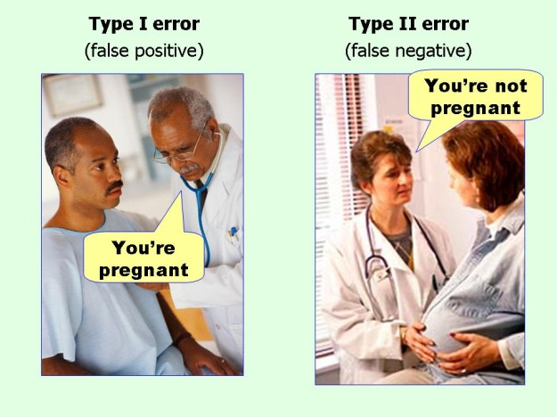
marginalrevolution.com/marginalrevolution/2014/05/type-i-and-type-ii-errors-simplified.html (2016-04-11)

Slide 45
Assignment – 1 Page Paper
From Chapter 9 In-class Exercises # 24.
Should the company produce the game?
Use the SWE Code Of Ethics as the basis for your argument.
The SWE Code of Ethics should not be the sole source for your premises.
OR

