Slide 1
Class 8
Crime
Keith A. Pray
Instructor
socialimps.keithpray.net
Notes:
Here’s the title slide. Is anyone not excited?
Paper Reminders:
5 High quality sources
Conclusion, Argument, Counter Point, Response
Try reading paper aloud
Paper average 6.5

Slide 2
Survey Results
Notes:
I did not decide on the 4-6 class time, but I’ll pass the suggestion along.
Seems different people like different things for papers.
Please bring current events into the class discussion.
I will post an example essay on the course web site this weekend.

Slide 3
Overview
Review
Assignment
Students Present

Slide 4
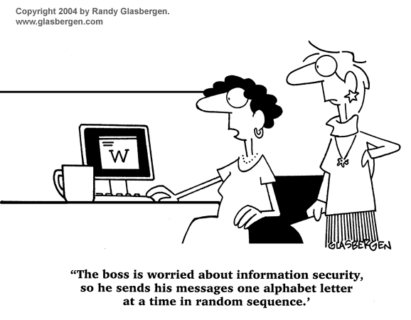
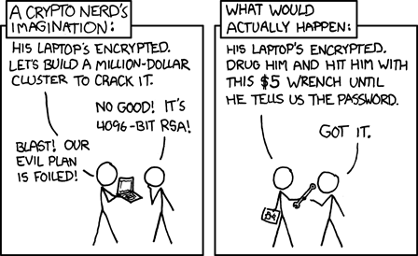
http://xkcd.com/538/ (2010-11-14)
Notes:
Are there any questions on the assigned reading?
Use the slides ahead to explain any of the attack methods from the text.
If there are no questions you can skip those slides.

Slide 5
My Reading Notes
pp. 321 Might be interesting to compare password guidance over the years.
pp. 323 How does Firesheep always get a user photo?
pp. 328 Not current or virus unknown…
pp. 330 Goals include infect 3 machine per LAN and as many computers as possible? Never make last minute changes before release. Were they related to the defects?
pp. 332 Do people use the Internet as an experimental laboratory these days? Shutdown right after booting, “benign” doesn’t seem like the right word.
pp. 334 “send reports back to a host computer”?
pp. 335 Firewalls often not running on same machine as malware, routers?
pp. 337 Have 2003 fears of cyber terrorist attacks been realized?
pp. 345 How is online voting a moral issue?
pp. 346 Is Internet access due to financial restrictions still relevant? Could issue specific, unrelated code for each vote.
End of Chapter questions:

Slide 6
Group Quiz
A denial of service attack shuts down a bunch of retailer, stock brokerage, large corporate entertainment and information web sites. Possible guilty parties:
  Terrorist who aimed to cause billions of damage to U.S. economy.
  Protest organization opposing commercialization of the web and corporate manipulation of consumers.
  Script kiddie just having fun with tools he found on the web.
  Show off hacker in search of bragging rights.
State what penalties are appropriate for each.
Explain your answer to 1. using a single Ethical Theory for all.
Name the laws/acts under which these parties could be prosecuted.
Notes:
Works well as small group exercise.
Note: short answer format expected.
Note: 2. only one argument needed, should include logic for all parties
Note: 3. same law(s) should be applicable to all parties

Slide 7
Assignment
Code Testing 1 Page Paper 1/2
Given code you did not write yourself, you all should (hopefully) feel the need to test and potentially break said code.
For this assignment, you will be given the following snippet and asked to unearth as many bugs possible.
There will be major and minor bugs worth noting. Once you have unearthed as many bugs as you can find, decide if your ways of testing were adequate and explain why.
Consider the weaknesses in your testing methods as a counter argument and address how you could have done things differently as well.
Please include explanations of bugs, how you would fix them, and explain why leaving these errors in the code could be problematic if put into production.
Working example: http://socialimps.keithpray.net/assignments/index.jsp?content=Code_Test.jsp
Notes:
The online working example source code is best not viewed with IE though looking at the source for the page will reveal the implementation.
If guest presenter coming next class remind students to prepare questions for him.
Remember to work on groups projects.
Each group should have material on their sites for the topics we’ve covered so far.
OLD Prompt:
Design tests for the code on the following slide.
Contains at least one major defect and several minor ones.
Write a paper (1 page not counting any source code) including :
Did you choose a good test strategy? (This is your conclusion.)
The inputs and expected outputs
What defects you found
How you would fix the defects (you may include fixed source)
Why would that fix the problems?
What could happen if the defects are not found before the code is put into production?

Slide 8
Assignment
Code Testing 2/2
import java.text.NumberFormat;
public class SalesFun {
public static double calculateSalesTotal ( double amount, double discountRate, double taxRate ) {
double discount = amount * discountRate;
double total = amount - discount;
double tax = total * taxRate;
double taxedTotal = tax + total;
NumberFormat numberFormat = NumberFormat.getCurrencyInstance();
System.out.println ( "Subtotal : " + numberFormat.format ( amount ) );
System.out.println ( "Discount : " + numberFormat.format ( discount ) );
System.out.println ( "Total : " + numberFormat.format ( total ) );
System.out.println ( "Tax : " + numberFormat.format ( tax ) );
System.out.println ( "Tax+Total: " + numberFormat.format ( taxedTotal ) );
return taxedTotal;
}
}
} Lines of interest
Notes:
Bold lines are real focus.
Example input:
amount = 100.05;
discountRate = 0.10;
taxRate = 0.05;
OR
0.70, 0.0, 0.05
95.67, 0.20, 0.7

Slide 9
Overview
Survey
Review
Assignment
Students Present

Slide 10

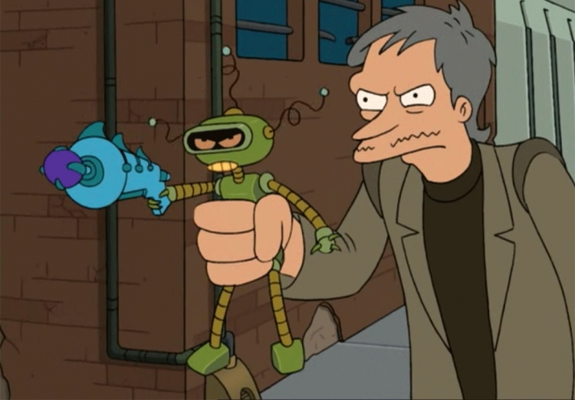
ROBOTIC CRIME
Alora Hillman
Should a person be prosecuted if they are somehow connected to a robot or piece of software that violates the law?
[1]
Notes:
question I am addressing is… should a person be prosecuted if they are somehow connected to a robot or piece of software that violates the law?
Going to look at the random darknet shopper

Slide 11
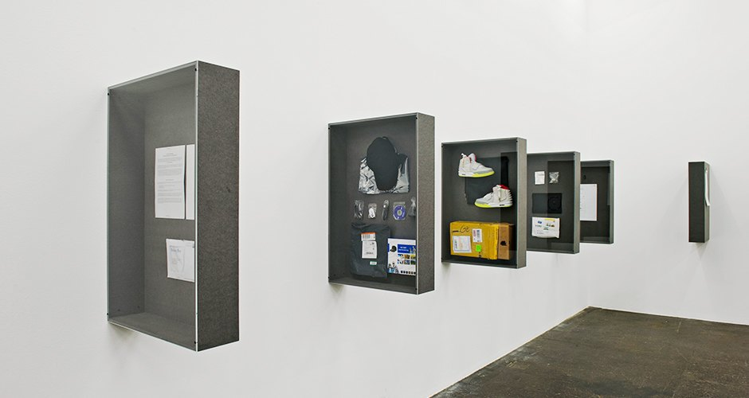
!MEDIENGRUPPE BITNIK
Alora Hillman
Random Darknet Shopper
Items bought include:
  Mastering the Art of French Cooking (book)
  Car locksmith tools
  Tutorial on how to hack a Coca Cola machine
  1.8 Million US email addresses
  10 pills of ecstasy
[2], [3]
Notes:
Random Darknet Shopper
-project created as an art installation in switzerland
-spent $100 in bitcoins every week to purchase random items from the deep web
-items were sent to the museum where they were put on display
-most of the items purchased were completely legal
-controversy when it purchased ecstasy

Slide 12
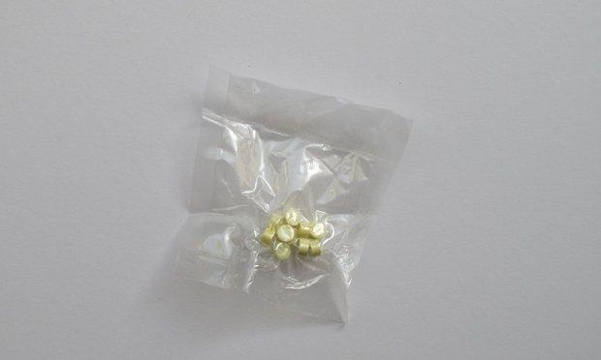
WHO IS RESPONSIBLE?
Alora Hillman
“We are the legal owner of the drugs - we are responsible for everything the bot does, as we executed the code”
Intent of the creators
[4], [5]
Notes:
Who is responsible for this purchase?
One of the creators of the bot said “We are the legal owner of the drugs - we are responsible for everything the bot does, as we executed the code”
Is this true?
Another approach would be to look at the intent of the creators
Did they intend for the bot to purchase something illegal to make the exhibit more exciting?
was it negligent for them to give it free reign of the deep web when they knew it could purchase something illegal?

Slide 13
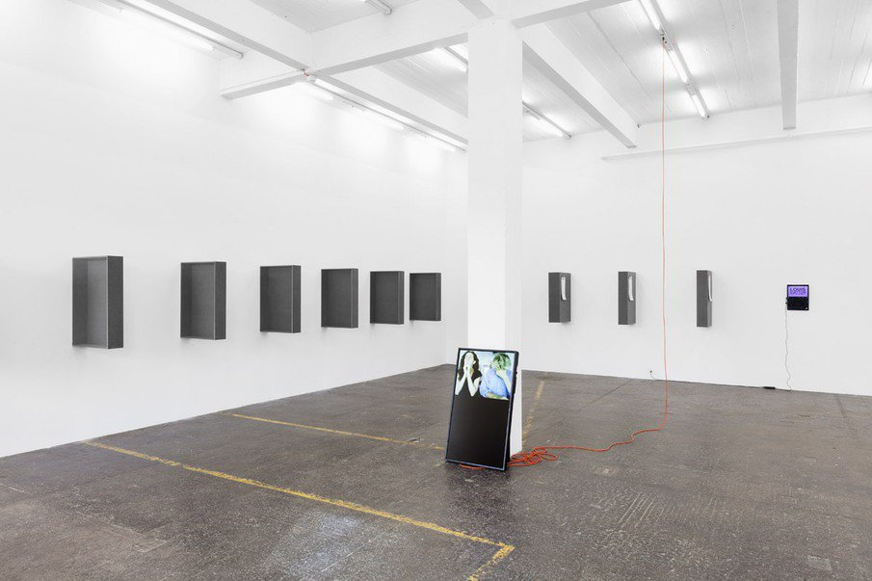
RANDOM DARKNET SHOPPER OUTCOMES
Alora Hillman
After the exhibit closed:
Random Darknet Shopper seized along with items purchased
Ecstasy destroyed
Random Darknet Shopper returned to its creators
No legal actions taken against the creators
Ongoing project
[2], [6]
Notes:
After the exhibit closed:
- Random Darknet Shopper seized along with items purchased
- Ecstasy destroyed
- Random Darknet Shopper returned
- No legal actions taken against the creators
- Ongoing project
“They were unwilling to press charges against the bot. They decided that within the realm of art it should be possible to look at such things within an exhibition.”

Slide 14
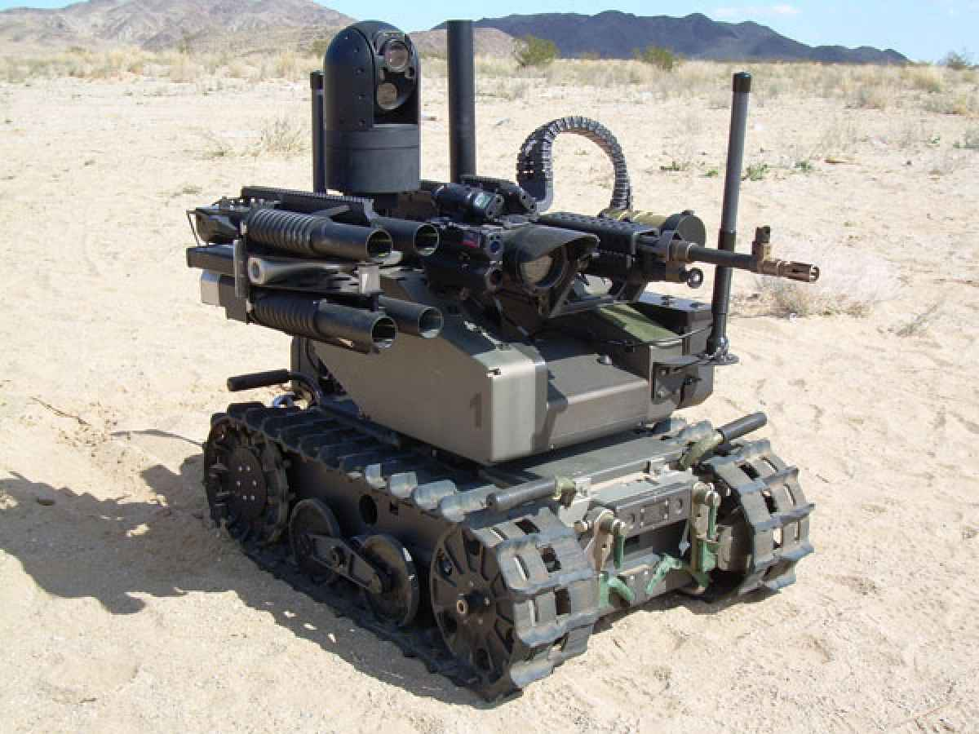
ROBOTIC WAR CRIMES
Alora Hillman
Who is held accountable for the actions of fully autonomous weapons?
Computer programmers
Manufacturers
Military personnel
Victims can be provided with compensation
~5-39 killed in drone strikes in 2012
Up to $5000 paid for death
[7], [8], [15]
Notes:
Who is held accountable for the actions of fully autonomous weapons?
Computer programmers
Manufacturers
Military personnel
Victims can be provided with compensation (not necessarily accepting responsibility)
~5-39 killed in drone strikes in 2012 in Afghanistan
Up to $5000 paid for death
~$1 million paid every year in compensation

Slide 15
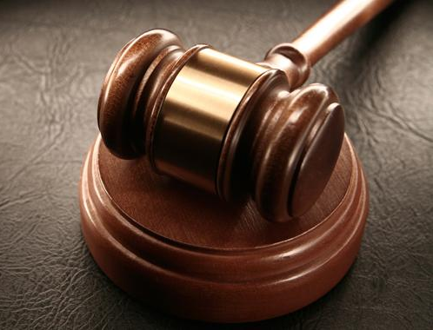
PROBLEMS WITH THE LEGAL SYSTEM
Alora Hillman
“No accountability means no deterrence of future crimes, no retribution for victims, no social condemnation of the responsible party.”
  Harvard Law School International Human Rights Clinic report [8]
Legal system lagging behind the current technology
  Steam Engine (1698) → Railroads (1827)
  Eminent Domain (late 1800s)
[7], [9], [10], [16]
Notes:
first quote - From a Harvard Law School International Human Rights Clinic report
legal system lagging behind the current technology
Example: Steam engine (1698).
When it was being produced there were no laws about property over track, liability for damaging cattle or land, and the power of the state to forcibly acquire land for public use.
Federal eminent domain power was first seen in the late 1800s

Slide 16
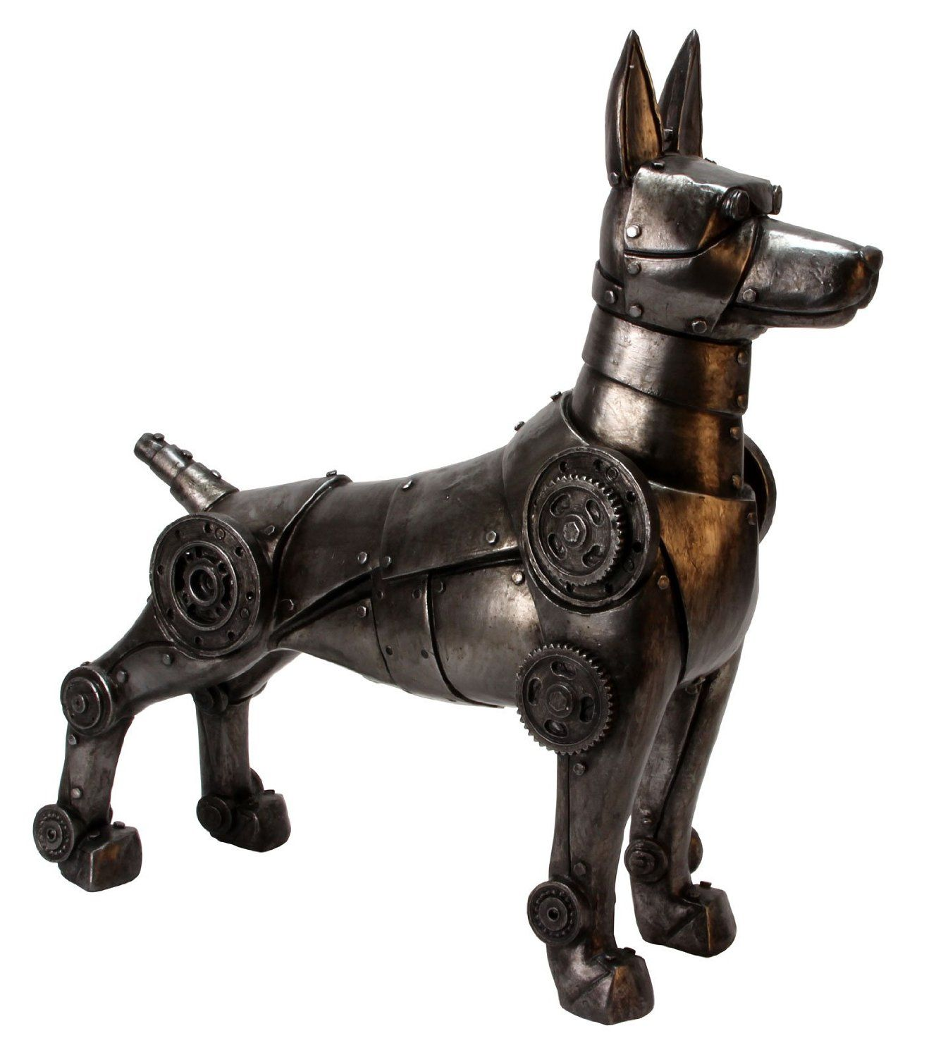
CONCLUSIONS
Alora Hillman
Robots should be legally treated similarly to pets
Pet Laws
Based on expected/past behavior
‘Negligent ownership’
‘One-Bite’ rule
[11], [12], [13]
Notes:
Example of a pet law court case: A dog owner lets his dog loose in his yard, and the dog runs into the street and hits a motorcycle, seriously injuring the riders. Ruled: Because the dog did not have a history of chasing vehicles, the dog owner was not negligent.
One-Bite Rule: As soon as a dog bites once, the owner knows it is dangerous and is responsible for any later bites

Slide 17
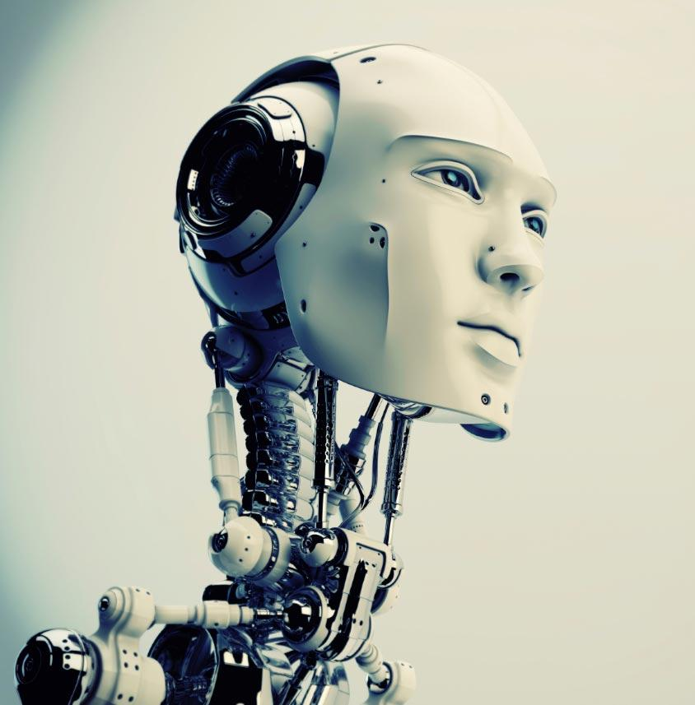
FUTURE CONSIDERATIONS
Alora Hillman
Should robots with artificial intelligence have rights similar to humans?
Or should their creators be responsible for their actions?
How would robots be punished for their actions?
[14]
Notes:
Questions society has to ask in the future as robots develop

Slide 18
REFERENCES
Alora Hillman
[1]http://www.fudzilla.com/media/k2/items/cache/7d7bfb4d5fe3aeb87156b2aeef7e66dd_XL.jpg (9/18/16)
[2] !Mediengruppe Bitnik, Random Darknet Shopper (2014-Ongoing), https://wwwwwwwwwwwwwwwwwwwwww.bitnik.org/r/ (9/18/16)
[3]http://lamcdn.net/hopesandfears.com/post_image-image/ufktfnrO5sMPgH8olfsT8A-wide.jpg (9/18/16)
[4]Power, Mike, “What happens when a software bot goes on a darknet shopping spree?”, https://www.theguardian.com/technology/2014/dec/05/software-bot-darknet-shopping-spree-random-shopper (9/18/16)
[5]https://i.guim.co.uk/img/static/sys-images/Guardian/Pix/pictures/2014/12/5/1417781635713/d8d4a658-e6f5-4164-9c79-d3d50370e5ca-620x372.jpeg?w=620&q=55&auto=format&usm=12&fit=max&s=dabee45d12816ead8857fe63f08f1b87 (9/18/16)

Slide 19
REFERENCES
Alora Hillman
[6]https://wwwwwwwwwwwwwwwwwwwwww.bitnik.org/media/news/kunsthalle_darknet/thumb/KHStGallen_Darknet_2014-10_MG_3230_LowRes_905.jpg (9/18/16)
[7]Wellen, Russ, “When Robots Commit War Crimes”, http://fpif.org/robots-commit-war-crimes/ (9/18/16)
[8]http://fpif.org/wp-content/uploads/2016/01/Robot-Modular-Advanced-Armed-Robotic-System-popsci.com_.jpg (9/18/16)
[9]http://bangthegavel.com/wp-content/uploads/Gavel-And-Sounding-Board-Bang-The-Gavel.jpg (9/18/16)
[10] Silverstein, Ed, “Legal, ethical questions arise from art exhibit featuring robot that purchased ecstasy pills”, http://www.insidecounsel.com/2015/01/08/legal-ethical-questions-arise-from-art-exhibit-fea?slreturn=1474302499&page=2 (9/15/16)

Slide 20
REFERENCES
Alora Hillman
[11]http://www.mezzalunagifts.com/ekmps/shops/5f96cb/images/futuristic-robot-dog-figurine-cyborg-robotic-armour-ornament-447-p.jpg (9/18/16)
[12]Randolph, Mary, J.D., “A Negligent Dog Owner’s Liability”, http://www.nolo.com/legal-encyclopedia/a-negligent-dog-owners-liability.html (9/18/16)
[13]Randolph, Mary, J.D., “The “One-Bite” Rule for Dogs”, http://www.nolo.com/legal-encyclopedia/the-one-bite-rule-dogs.html (9/18/16)
[14]http://glitch.news/wp-content/uploads/sites/19/2015/12/Robot-Cyborg-Face-Neck-Future-Computer.jpg (9/19/16)
[15] Fisher, Max, ‘Open-source data contradicts Feinstein on ‘single digit’ civilian drone deaths’, https://www.washingtonpost.com/news/worldviews/wp/2013/02/07/open-source-data-contradicts-feinstein-on-single-digit-civilian-drone-deaths/ (9/20/16)
[16] Wadhwa, Vivek, “Laws and Ethics Can’t Keep Pace with Technology”, https://www.technologyreview.com/s/526401/laws-and-ethics-cant-keep-pace-with-technology/ (9/20/16)

Slide 21
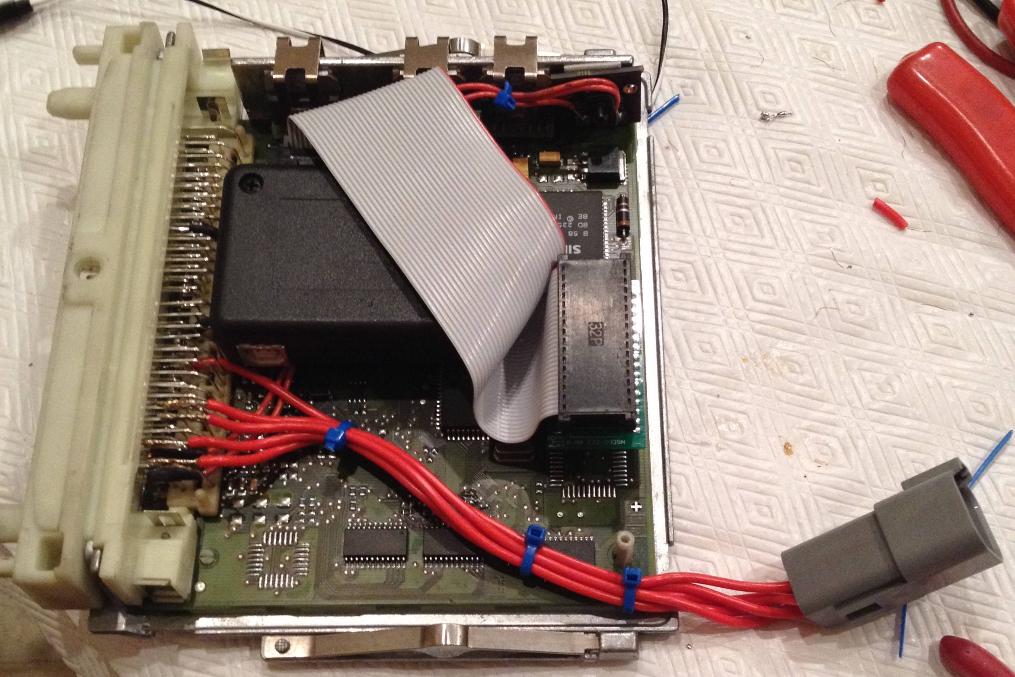
Car Hacking
Matthew Micciolo
Hacking / Modifying Car’s ECUs (Electronic Control Unit)
  Physical Hardware (sensors)
  EEPROM / FLASH
  CANBUS
  Taking over a car’s systems physically or remotely (OnStar)
Big risk today with ECUs controlling everything
<Graphic>
Personal ECU that I have physically “hacked”
Notes:
What do I mean by car hacking?
Can be physically modifying the ECU (Electronic Control Unit) such as memory modifications for different components or adding new sensors
Can also be taking over the ECU either locally or remotely (control of drive by wire, steer by wire, brake by wire, etc). Hacking the CANBUS protocol or other onboard systems / protocols
Big risk today as every new car today is completely controlled electronically and there are dozens of systems.
Image to the right is an image of an ECU I have hacked. I added a EEPROM emulator, MAP sensor and modified the ECU to use coil packs for ignition (big connector on bottom right)

Slide 22
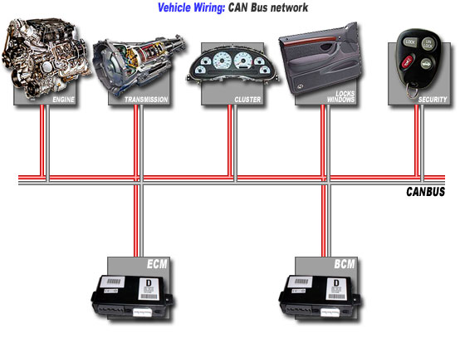
OBDII and CANbus
Matthew Micciolo
OBDII (On Board Diagnosis) [1]
  Self diagnosing and reporting (error codes)
  Vehicle live data (rpm, engine temp)
  Connected to various subsystems
CANBUS (Controlled Area Network) [1]
  Todays standard
  Broadcast system
  Priority system
  Base of physical hacking
<Graphic>
CANBUS Network [2]
[1] and [2]
Notes:
Two Main protocols are used on cars these days, these include:
ODBII
Stands for onboard diagnostics. It is used for vehicle self diagnosing and reporting. These can be things such as error codes (faulty sensors, engine problems) and it also has the ability to stream live data such as RPM, engine temperature, etc. It is connected to all of the various subsystems in the car such as engine, transmission, abs, etc.
CANBUS
Stands for Controlled Area Network Bus. Its todays standard bus in all newer automobiles (usually 2000+). It uses a broadcast system so this means it’s a unit sends a message, all units receive it and decide to respond or not. It also incorporates a priority system, for example a message being sent by the engine control unit may have a higher priority than a message sent by the window / locks unit.
Engine unit, brake unit, transmission, steering, etc
Base of physical hacking, just need access to the two wires of the CANBUS network, CAN-H and CAN-L.

Slide 23
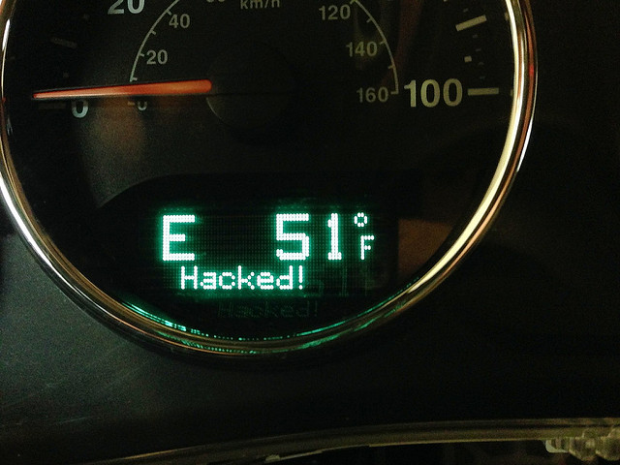
Car hacking (local)
Matthew Micciolo
Easy to hack CANBUS. [3]
  Need access to two wires (H and L)
  Device to sniff protocol (candump)
  Inject packets
Could hack for fun (hobby) [3]
  Add new features
    LCD text
    Switches
Hack for malicious intent
  CANBUS / K-Line, brick ECU, disable other systems
<Graphic>
LCD CANBUS display hacked [3]
[3] and [4]
Notes:
Car Hacking Local
Local car hacking would be defined as getting physical access to the CANBUS network by tapping into the CAN-L and CAN-H wires. Usually these wires to go to every control unit in the car, so it would be possible to tap in at the radio or a window switch, etc.
Can then hookup a device to sniff the network. After enough sniffing is done it is possible to reverse engineering the protocol and the inject your own packets in to the network.
Could be used for fun such as making the LCD display in your car show text such as the image to the right. Could also be used for repurposing switches.
Possibility for hacking for malicious intent as well. If a car jacker / hacker were able to get physical access to the CANBUS network it could be possible for them to disable systems in your car, brick the ecu so you can't use it at all or even start the car and steal it.

Slide 24
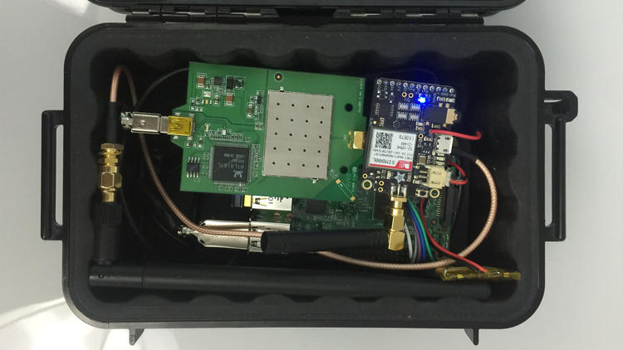
Car hacking (remote)
Matthew Micciolo
Chevrolet OnStar [5]
  Service (app), allows special abilities
Samy Kamkar, $100 hacking device [5]
  Unlock car, trigger horn / alarm, start
  Take over brakes, steering, transmission
  Intercepts communication
  Communication was SSL encrypted, doesn’t check
  Man in the middle attack
  GM took 5 years to fix
<Graphic>
Samy’s $100 box [6]
[5] and [6]
Notes:
Car Hacking Remote
This is also possible and has been made possible by systems such a Chevrolet OnStar. This a service (phone app) that allows you to connect to your car. It allows you to find your vehicle using GPS, unlock and start it all from one smart phone app.
Samy Kamkar developed a $100 device to exploit this app. Using his Wi-Fi hotspot device placed on a car or near it, he was able to connect to cars allowing them to be taken over. He could do the same things the app could such as find the vehicle, unlock it, start it.
Works by intercepting communication between the car and the owners app and tricking the cars Wi-Fi into connecting to his devices instead of the consumers phone. This could all be done remotely away from the car.
App did have SSL encryption but the security certificate isn’t actually checked making a man in the middle attack very easy.
Took GM 5 years to fix this issue because they admitted that they were not ready in 2010 to deal with the threat of car hackersRight is an image of his $100 box

Slide 25
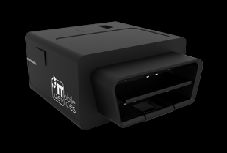
Concerns
Matthew Micciolo
Feds concerned [6][10]
  Growing number of cars connected to internet (35% now, 100% by 2025)
  Large increase in possibility of hacking
  Consumers have been warned
  Risk with 3rd party dongles
Keeping cars safe [7]
  Update software (OnStar OTA)
  Resist rooting / jail breaking phones
  Know what's plugged into you car
<Graphic>
OBDII Dongle [8]
[6], [7], [8] and [10]
Notes:
Concerns
Every day more and more cars and getting connected to the internet, especially with newer models
Possibility of a large increase in your car (especially if newer) being hacked
FBI has warned consumers to be aware of these risks
Hackers have also found ways to exploit 3rd party dongles connected to consumers cars. One example would be a dongle you hookup to one of your kids cars to track where they have been, etc from a smartphone app. It could be possible (assuming there are software flaws in the dongle) for a hacker to take over that dongle and then start sending out packets into the CANBUS network. They could reverse engineer a specific car’s protocol on their own time and then go and target just those specific vehicles.
FBI release tips to keep cars safe, keep software updated, resist / jail breaking and this can open up security holes allowing hackers to exploit apps that connect to your car or dongle. Know what dongles are plugged into your car. Could be possible for a hacker to break into your car, insert a dongle then leave.
OnStar has now developed software to push over the air updates to their cars

Slide 26
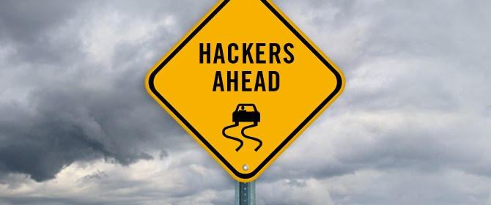
conclusions
Matthew Micciolo
Technology advancing so quickly
  Room for hardware and software flaws
  Everything controlled electronically
More and more cars contain Wi-Fi hotspots
  Easy entry point
Manufactures need put security at a higher priority
Self driving cars such as Tesla?
<Graphic>
[9]
Notes:
Conclusions
Technology is advancing so quickly that there is always the possibilities for manufactures to have hardware or software flaws in their devices creating easy ways for hackers to get into your car
All cars to today and controlled electronically with sub systems for every aspect of the car
More and more cars are connected to Wi-Fi today especially GM cars with OnStar. This creates an easy entry point into the car assuming hardware / software flaws.
Manufactures need to start putting hardware / software security at a higher priority
Especially with self driving cars now being so practical. It would be very bad it there was to be a remote hack on self driving cars causing all of their systems to lockup

Slide 27
References
Matthew Micciolo
[1] http://www.oneminuteinfo.com/2014/02/can-bus-obd-ii-explained-for-dummies.html (9-13-2016)
[2] http://canbuskit.com/what.php (9-19-2016)
[3] http://chadgibbons.com/2013/12/29/hacking-the-jeep-interior-can-bus/ (9-13-2016)
[4] http://jalopnik.com/hackers-can-take-over-your-car-with-this-simple-26-dev-1519896807 (9-19-2016)
[5] https://www.wired.com/2015/07/gadget-hacks-gm-cars-locate-unlock-start/ (9-13-2016)
[6] http://www.planetizen.com/node/85053/feds-worried-about-car-hacking (9-13-2016)
[7] http://www.csmonitor.com/Business/In-Gear/2016/0318/FBI-and-NHTSA-say-car-hacking-is-real-offer-tips-to-keep-you-safe (9-13-2016)
[8] http://www.mobile-devices.com/our-products/c4-obd2-dongle-3/ (9-19-2016)
[9] https://insideinternetsecurity.wordpress.com/2015/02/04/car-hacking/ (9-13-2016)
[10] https://www.statista.com/statistics/275849/number-of-vehicles-connected-to-the-internet/ (9-20-2016)

Slide 28
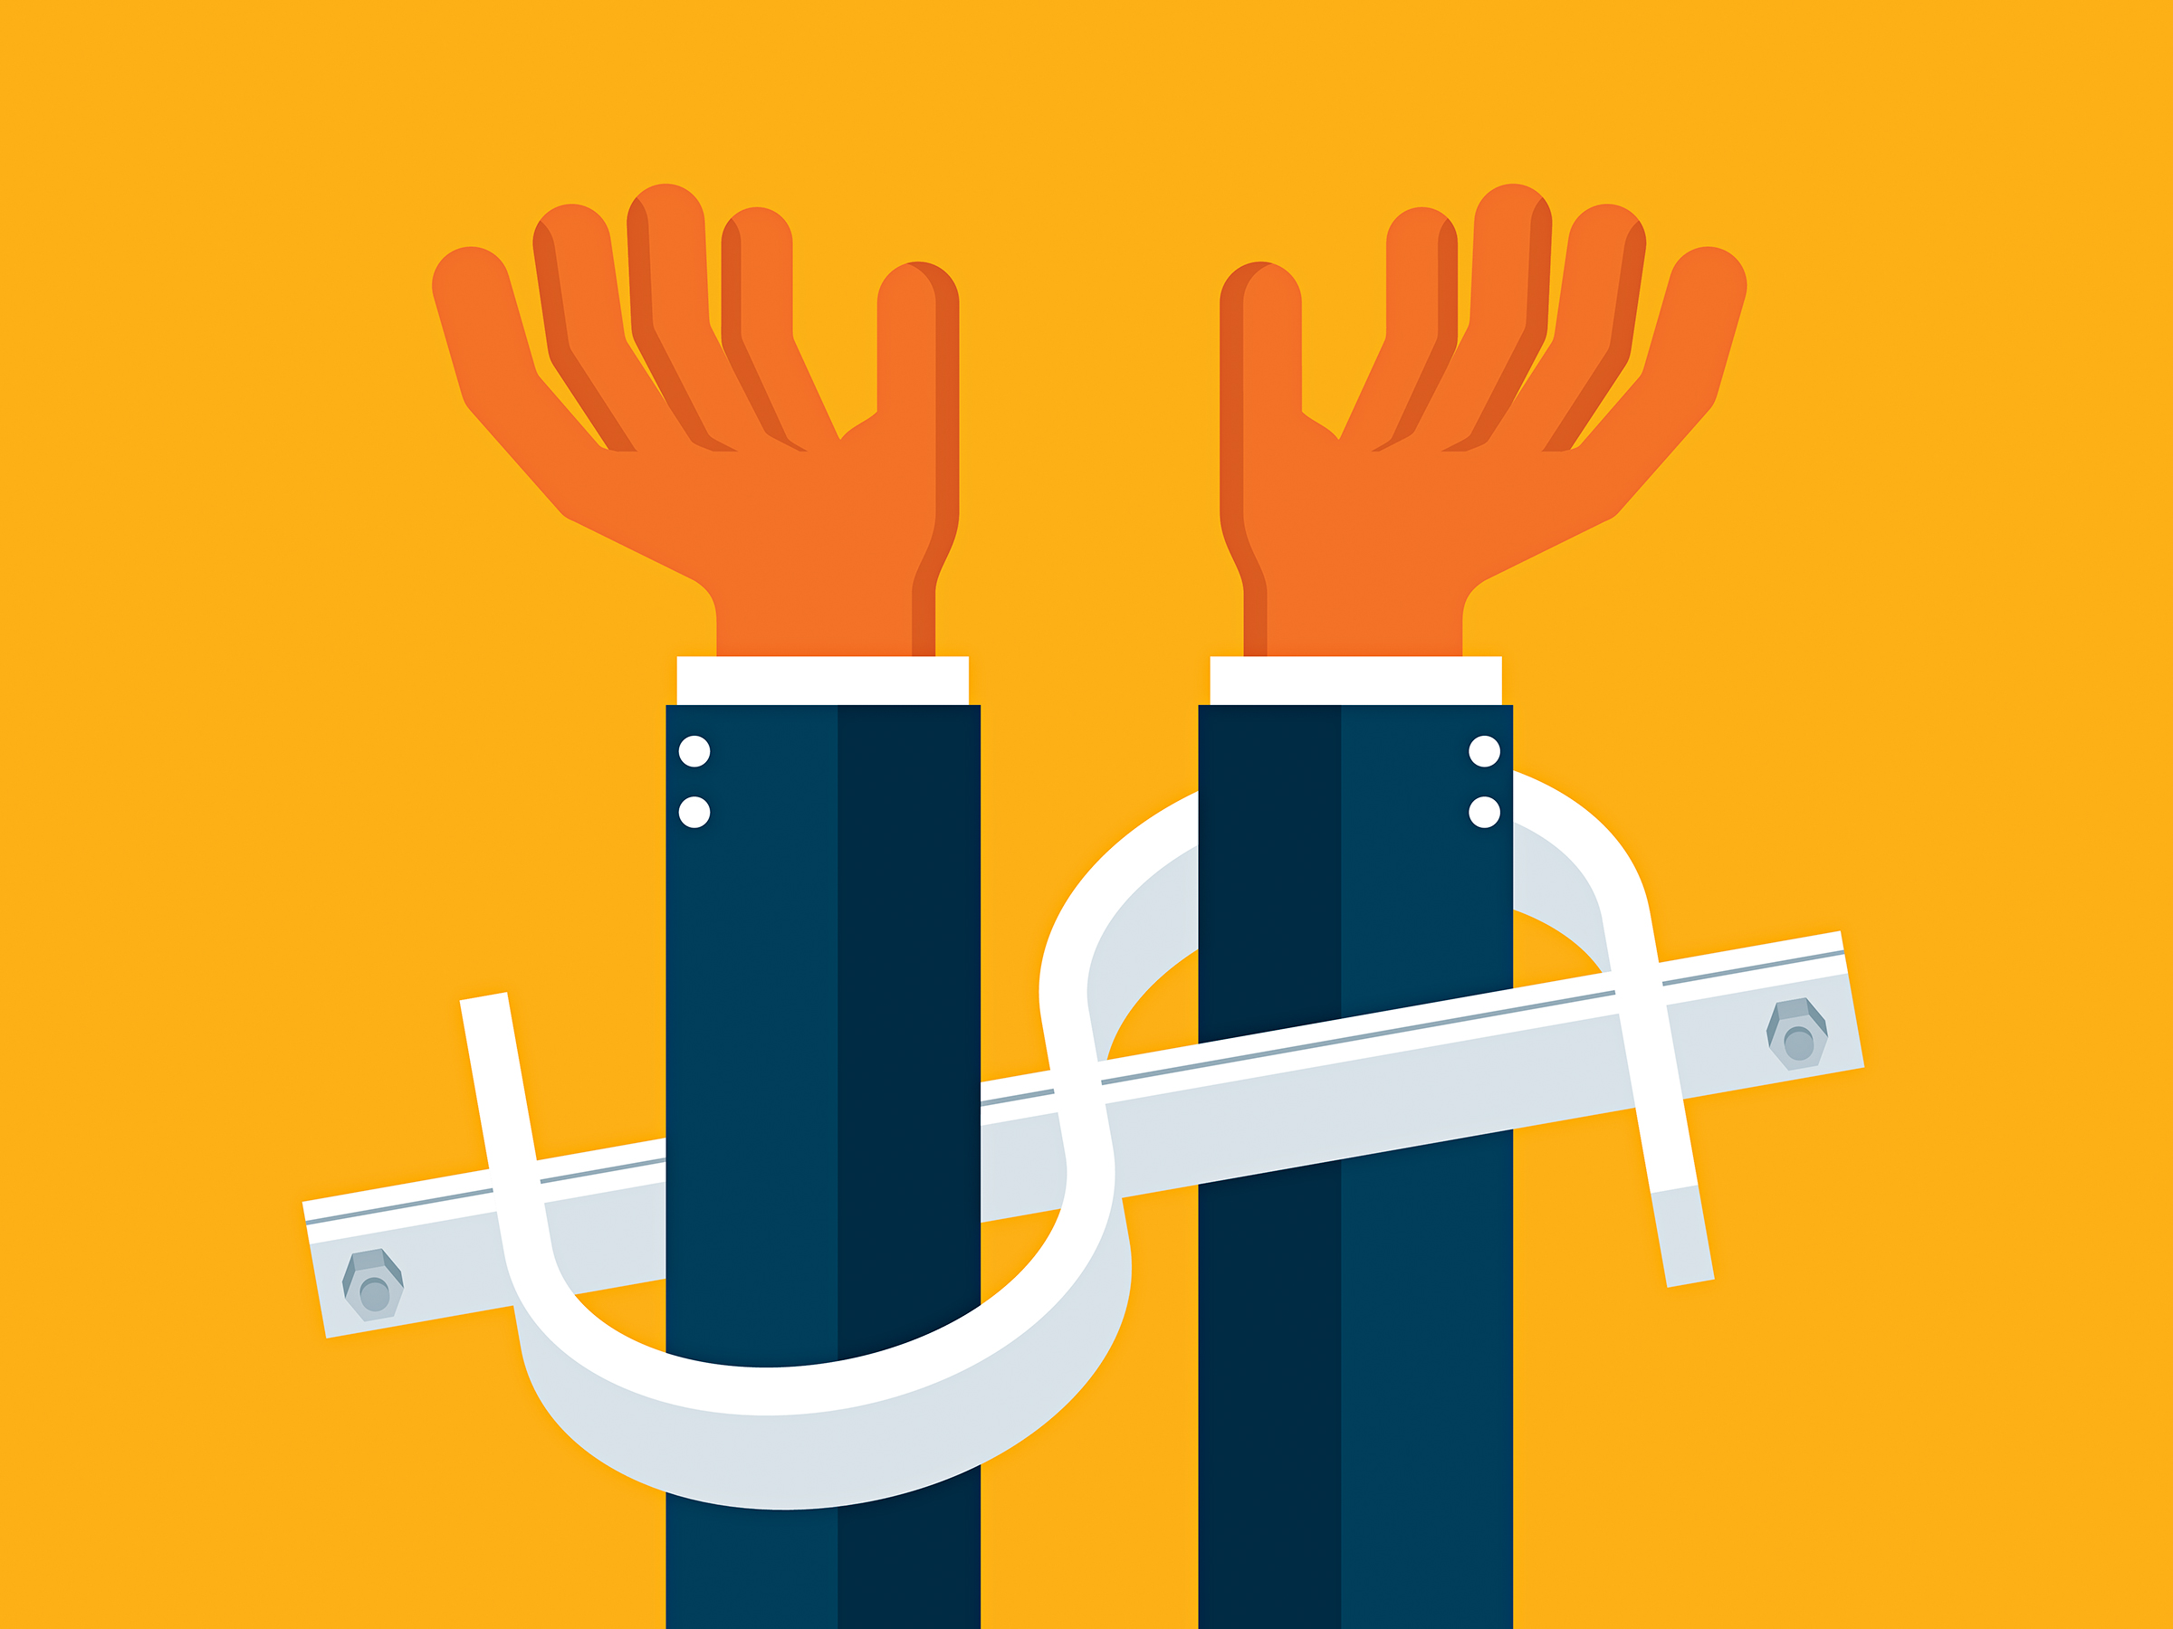
Cryptowall: Would you pay the ransom?
Derek McMaster
https://www.wired.com/wp-content/uploads/2016/05/ransomware-495934588-s.jpg
Notes:
Pose the question to class before presentation to see how presentation shapes their opinion before and after. Keep own conclusion to the end. Possibly ask class whether or not they would.

Slide 29
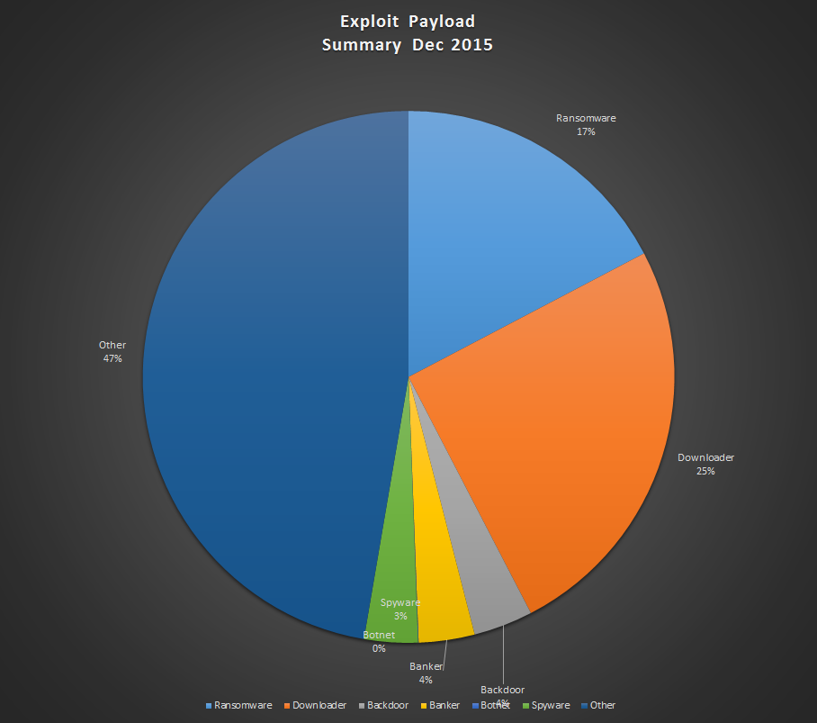
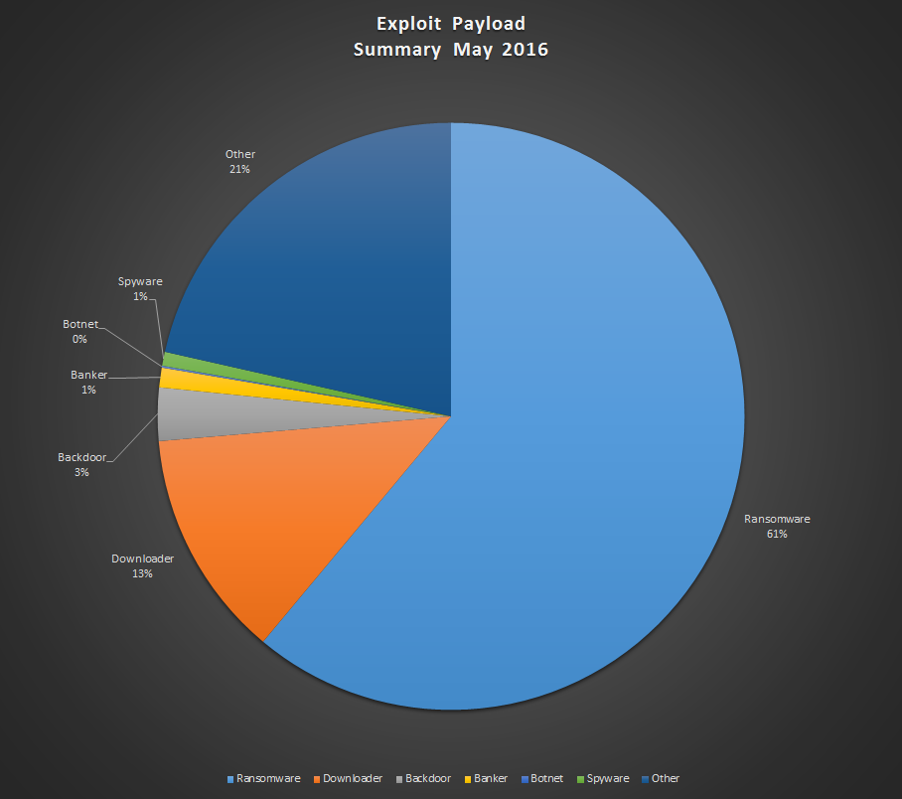
Threat landscape
Derek McMaster
Many types of Malware: Adware, Bots, Rootkits, Virus, Worms, etc.
Cryptowall is ransomware
  Variant of CryptoLocker[2]
https://blog.malwarebytes.com/cybercrime/2016/06/ransomware-dominates-the-threat-landscape/
Notes:
Huge jump in ransomware findings, 259% jump. Talk about move to online storage for many business in passed couple years increasing need for data security. Change in security landscape.
Talk about internship over summer. Head security researcher thought cryptowall to be biggest current threat.

Slide 30
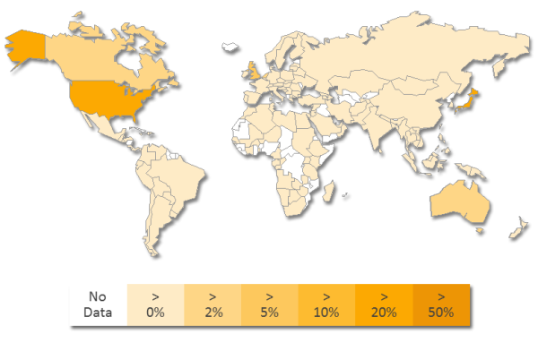
CryptoWall Background
Derek McMaster
Currently only fully deployed for Windows [2]
2048-bit RSA encryption
Commonly found in Java-based remote clients and Adobe Flash
First seen “in the wild” in Early 2014 [4]
  Version 4.0 since October 2015 [6]
Can find on “theZoo”
https://www.symantec.com/security_response/writeup.jsp?docid=2014-061923-2824-99
Notes:
Usually exploited through phishing but also entrenched in older binaries with known, published vulnerabilities.
Symantec reports only seeing it in Windows
Also uses other popular encryption algorithms - md5, sha 1, sha 256 hashing
Relies on C2 sites, usually corrupted wordpress sites.
Later graphs show more European Nations being targeted along with China. Map from 2014 when first seen. Picture is distribution of cryptowall infections by country. Researchers say it is interesting to Note languages it does not support, mainly eastern European countries.
Biggest cases : Big businesses, University of Delaware

Slide 31
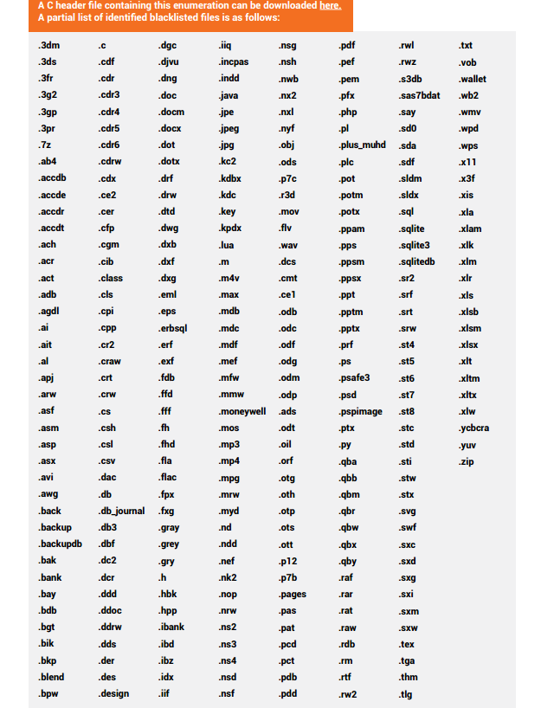
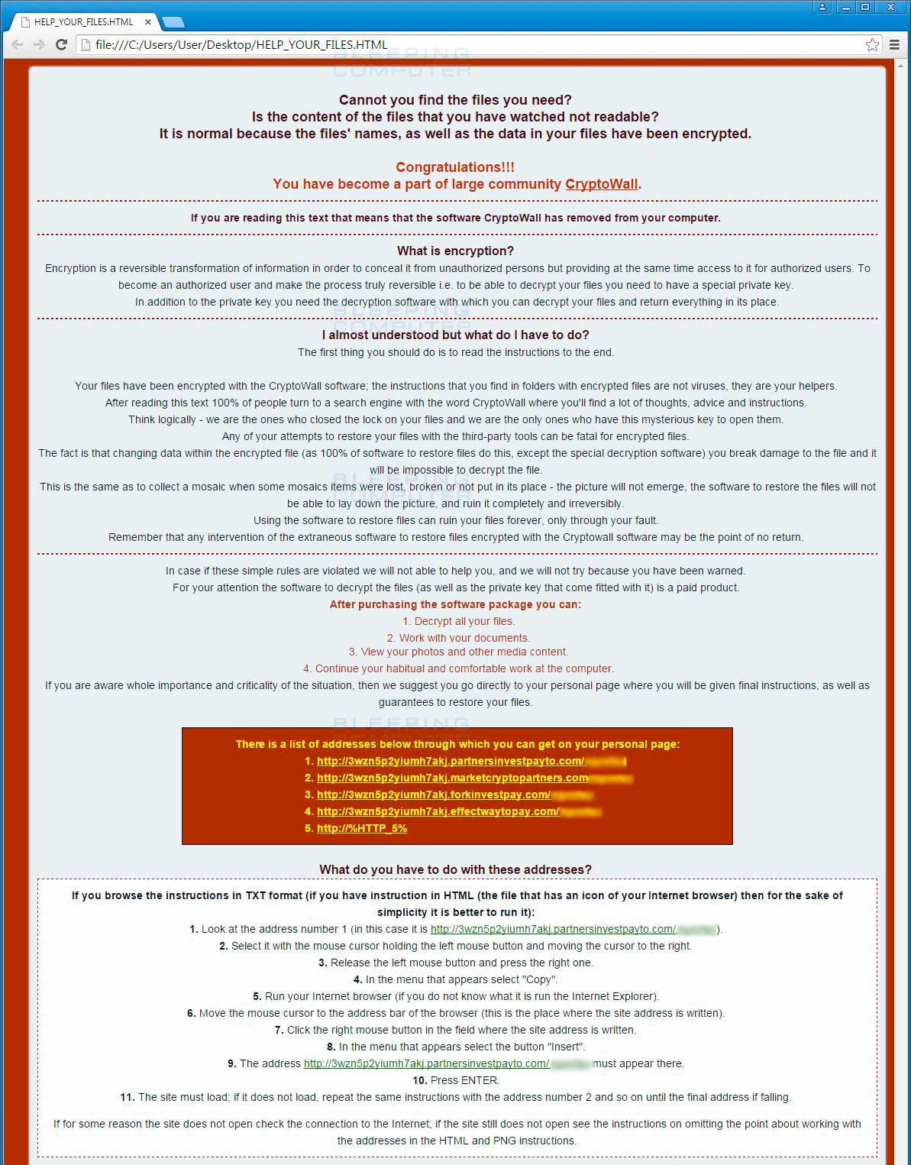
Only encrypts these types of files….
Derek McMaster
Cryptowall 1.0 “Welcome” Message
http://cyberthreatalliance.org/cryptowall-report.pdf
http://blog.talosintel.com/2015/12/cryptowall-4.html
Notes:
File extension chart as of version 3.0
Virtually every major file extension, especially the majority any average computer user would have on their computers.
“Welcome Screen” now Bitcoin instruction with a timer. “help_your_files.html”

Slide 32
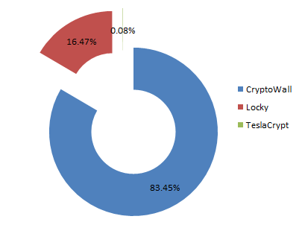
Economics of Ransomware
Derek McMaster
$24 million in 2015, $1 billion expected in 2016 [7]
Typical Cryptowall ransom ranges form $200-$2,000 based on time it takes to pay [9]
Diagram represents 18.6 million infections
https://blog.fortinet.com/2016/03/08/cryptowall-teslacrypt-and-locky-a-statistical-perspective
Notes:
83% of that market is cryptowall, which equates to 830 million dollars.
Ransoms can go up to tens of thousands of dollars, increases every 24 hours. Reports of one person paying $10,000.
TeslaCrypt already outdated. Encryption tools regularly available. Locky just emerged in late December 2015.

Slide 33
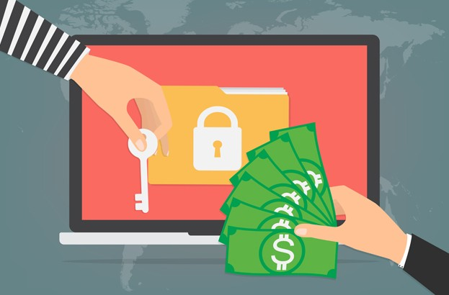
To Pay or Not to Pay?
Derek McMaster
No Guarantees
  Of data or price
FBI recommends “just paying” [10]
Security experts very against payment [11]
Conclusion: Pay the ransom and start to use or improve your use of best practices for data security.
http://www.welivesecurity.com/wp-content/uploads/2016/06/ransomware-phishing-email-attacks-623x410.jpg
Notes:
Cryptowall historically “reliable” about getting data back after payment, other ransomwares could be a gamble. Some less intricate install decryption tool on system you just have to look hard enough for it.
Case by case evaluating to pay. Theoretically if you pay once and take best practices steps from then on it wont be a recurring issue. Security experts tend to have much better security practices before infection. For example security researchers usually have recent backups, know how to mitigate risks, etc. where normal user might not have ever backed up their computer.
Case for paying is there's no way to “beat it”. Case against is that it entices attackers to continue infecting people because they are making enough to sustain.

Slide 34
References
Derek McMaster
[1] Allievi, Unterbrink, Mercer, Accessed 9/13/2016, Threat Spotlight: CryptoWall 4, http://blog.talosintel.com/2015/12/cryptowall-4.html
[2]O’Brien, Morparia, Accessed 9/13/2016, Ransom.Cryptowall, https://www.symantec.com/security_response/writeup.jsp?docid=2014-061923-2824-99
[3]Abrams, Accessed 9/13/2016, CryptoWall 4.0 released with new Features such as Encrypted File Names, http://www.bleepingcomputer.com/news/security/cryptowall-4-0-released-with-new-features-such-as-encrypted-file-names/
[4] Cyber Threat Alliance, Accessed 9/13/2016, CryptoWall Version 3 Threat, http://cyberthreatalliance.org/cryptowall-report.pdf
[5]Sophos, Accessed 9/13/2016, The current state of ransomware: CryptoWall
, https://blogs.sophos.com/2015/12/17/the-current-state-of-ransomware-cryptowall/
[6] Security Week News, Accessed 9/13/2016, CryptoWall 4.0 Spreading via Angler Exploit Kit,
http://www.securityweek.com/cryptowall-40-spreading-angler-exploit-kit

Slide 35
References
Derek McMaster
[7] Vanderburg, Accessed 9/13/2016, The Economics of Cybercrime, https://www.carbonite.com/en/cloud-backup/business/resources/carbonite-blog/the-economics-of-cybercrime-understanding-the-ransomware-market/
[8] Mello Jr., Accessed 9/14/2016, To Pay or Not to Pay, http://www.technewsworld.com/story/80640.html
[9] Dell Secureworks, Accessed 9/14/2016, CryptoWall Ransomware, https://www.secureworks.com/research/cryptowall-ransomware
[10] Paul, Accessed 9/14/2016, FBI’s Advice on Ransomware? Just Pay The Ransom, https://securityledger.com/2015/10/fbis-advice-on-cryptolocker-just-pay-the-ransom/
[11] Ducklin, Accessed 9/14/2016, Ransomware – Should you pay?, https://nakedsecurity.sophos.com/2015/03/19/ransomware-should-you-pay/

Slide 36
Class 8
The End
Keith A. Pray
Instructor
socialimps.keithpray.net
Notes:
This is the end. Any slides beyond this point are for answering questions that may arise but not needed in the main talk. Some slides may also be unfinished and are not needed but kept just in case.

Slide 37
Buffer Overrun
Run time stack
Local Variables
Return Address
Parameters
Variable Attack
buffer
Target Variable
Stack Attack
buffer
Return Address
code
Return Address
Notes:
Retire slide. Most students have this in depth from new class now.
When a function call is made, local variables, return address, parameters stored on run time stack. Local variables occupy lower memory addresses.
Variable attack – change variable value. Program expects user to input character and allocates a buffer for them. Attacker supplies too many characters and ends up over writing a variable.
Stack Attack – goal is to change value of return address so execution control goes to code which the attacker has provided in the input buffer.
Prevention – add checks against array bounds being exceeded, or modify operating system to not execute instructions stored on run time stack.

Slide 38
Run Example Code
Notes:
Retire demonstration. Most students have this in depth from new class now.
> imps
> assembly
> 123456789qwerty1

Slide 39
Buffer Overrun Code
#include <stdio.h>
#include <string.h>
int main ( void ) {
char buff [ 15 ]; int ace = 0;
printf ( "\n Enter best class ever : \n" );
gets ( buff );
if ( strcmp ( buff, "imps" ) ) {
printf ( "\n %s is wrong! You should FAIL! \n ace=%i\n", buff, ace ); }
else { printf ( "Correct! \n") ; ace = 1; }
if ( ace ) { printf ( "You get an A! \n" ); }
return 0; }
} The Naughty Line
Notes:
Retire slide. Most students have this in depth from new class now.

Slide 40
TCP Three-way Handshake
SYN
SYN-ACK
ACK
Notes:
Retire slide. Most students have this in depth from new class now.
SYNchronize
SYNchronize ACKnowledgement (socket reserved awaiting ACK)
ACKnowledgement
TCP socket connection established

Slide 41
SYN Flood Attack
SYN
SYN-ACK
Notes:
Retire slide. Most students have this in depth from new class now.
Attacker spoofs the IP address so the SYN-ACK is sent to a different machine that cannot respond to the SYN-ACK.
This leaves the connection half open on the server machine decreasing the resources (sockets, memory, threads/processes) available to respond to legitimate clients.
The attacker send many such spoofed SYN messages.

Slide 42
Ping Attack
Target
Attacker
ping
ping
Notes:
Retire slide. Most students have this in depth from new class now.
Attacker finds routers that support broadcasting messages to all computers on their local area networks.
The attacker sends a spoofed ping message, which the routers echo to the spoofed address.

Slide 43
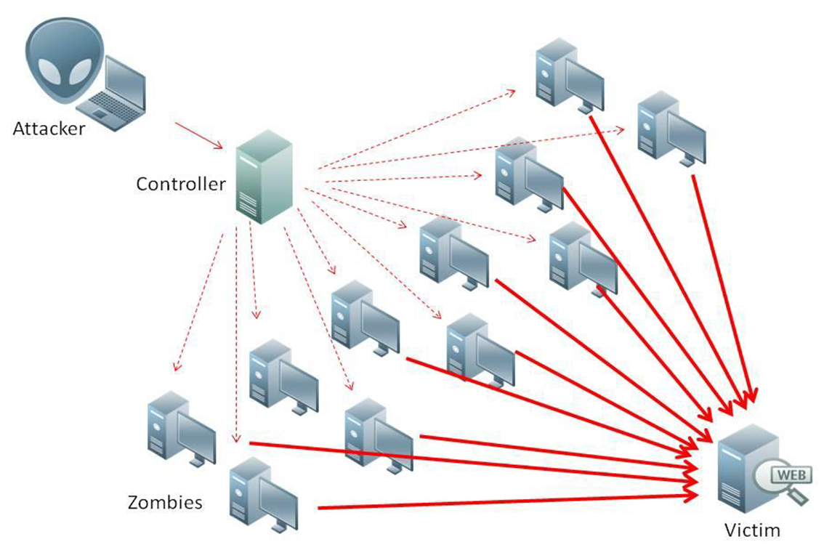
What is Denial of Service (DoS)
Attempts to make target unavailable by flooding with traffic
If victim has to filter attack, it’s too late
Internet Providers have no incentive to help
  Businesses get affected, but would not pay provider enough to make worthwhile
  This is why Cloudflare, e.g., exists
Many ways to perform this attack
Notes:
Contributed by Brett Ammeson.
https://www.cloudflare.com/ddos/reflection-attack-1.png
https://i.imgur.com/lxYv8cF.png

Slide 44
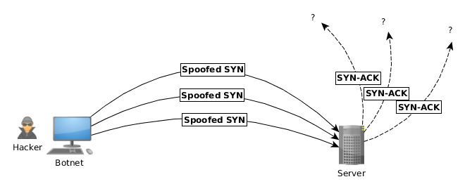
Distributed DoS Vectors
TCP SYN attack
  SYN packets are small, low difficulty for attacker
  Leaves half-open connections on server
  SYN cookies mitigate this
DNS amplification attack
  DNS requests are small
  Can request all records on server
  Crippled by proper configuration
Ingress/egress filtering will reduce effect
Notes:
Contributed by Brett Ammeson.
TCP SYN: https://www.cert.org/historical/advisories/CA-1996-21.cfm
DNS amplification: https://www.cert.org/historical/incident_notes/IN-2000-04.cfm
Ingress/egress: www.giac.org/paper/gsec/705/egress-filtering-keeping-internet-safe-systems/101588

Slide 45
Crime How
Technical and Non-Technical
  Break into computer.
  Prevent access to computer.
What things make computer related crime easy?
Notes:
Exploit security holes, Break encryption, Spoofing
Social Engineering: Guess passwords, Find out passwords and procedures
Poor passwords, Insecure protocols, Program limitations (buffer overruns), Eavesdropping (Email, Interactive), Insecure files

Slide 46
Crime Bane
Trojan Horse
Virus
Worm
Bot Network
Buffer Overrun
(Distributed) Denial Of Service Attack
How do they work?
How harmful are they?

Slide 47
Crime Why
Why?
Notes:
Money: stolen credit cards, change records, stolen property.
Political, military, economic.
Challenge, Revenge, Mean
Why do at all? Have motivation, think about it, think it will help, think it’s acceptable.
Feel forced. Don’t agree. Don’t care.

Slide 48
Crime Time
What is different now compared to:
  10 years ago?
  20 years ago?
  30 years ago?
  40 years ago?
Notes:
More computers. Unsophisticated owners. More complex software. Greater connectivity. Easy access to cracking tools. Incentives. File-sharing
In ’60s and ’70s, access was mostly localized.
Modems. Wardialing.
Some Arpanet and Usenet.

Slide 49
Crime Doers
Hacker or Cracker
  Pre-1980 - Golden Age ☺ ?
  Eighties
  Nineties
  Naughts
Criminal Hacking == Cracking?
Notes:
Script kiddies
Phreakers
Security analysts
Packet monkey

Slide 50
Crime Gain
Justifications for Computing Crimes?
What can be done after access is gained?
  What resources are available?
  How valuable are they?
Notes:
Machines are unused. No harm done. Education. Exposes security holes. Exposes abuses.
Use computer and/or resources. Take data. Destroy data. Alter data. Lock out others. Attack other computers.
Equipment, Processor Time, Disk space, Printer time / paper, Bandwidth

Slide 51
Crime Pay
Computer Fraud and Abuse Act (1986)
  Bans :
    unauthorized access or use of computers, copying, modifying, or destroying data, disclosing of passwords.
    disrupting government and utilities.
  Covers government, financial, medical, and interstate systems.
USA Patriot Act (2001)
  Raised penalties.
  Permits freer surveillance and monitoring to detect illegal activity.
Electronic Communications Privacy Act
  Illegal to intercept telephone, email, other data transmissions, access stored email messages without authorization
Assign Cybercrime Treaty (2006), Wire Fraud Act, National Stolen Property Act, Identity Theft and Assumption Deterrence Act
Notes:
Are either of these laws still in effect? Have they been changed?
For additional legislation ask for presenting volunteers to brief recent incidents/cases.
Also ask for volunteers to find out laws from their home country/state.

Slide 52
Crime Stop
Technical
  Protect Data
  Protect Machine
  Protect Access
Non-technical?
  Social?
  Legal?
Notes:
Encryption, Authentication, Biometrics, Anti-virus, File integrity checking (E.g. Tripwire), Virtual private networks, Point-to-point networking (Twisted-pair Ethernet vs. Coax vs. wireless)
Security through obscurity, physical access required, not on network, behind locked doors.
Remove desire, remove incentives
Legalize, increase penalties, increase chance of getting caught.

