Slide 1
Class 6
Information Privacy
Keith A. Pray
Instructor
socialimps.keithpray.net
Notes:
Here’s the title slide. Excited already, aren’t you?
How did the self search paper go?
Who: found a lot, very little, surprised, not surprised, creepy, share conclusions

Slide 2
Logistics
We need to schedule Groups present days.
  Send preference via email, first come first serve
Address email to entire course staff for quickest response time
Turn extra credit paper in on myWPI and hard copy in class like regular papers
Notes:
Not needed this time:
Send presentations via email as attachment.
Send your group web site URL and choice of day via email.
Do not change the format, footers, etc. in the template slides.
Paper writing process: Sources → Notes → Conclusion → Argument → Counter Point → Response
Use Presentation Guidelines on course web site
Presentations are due 24 hours before class

Slide 3
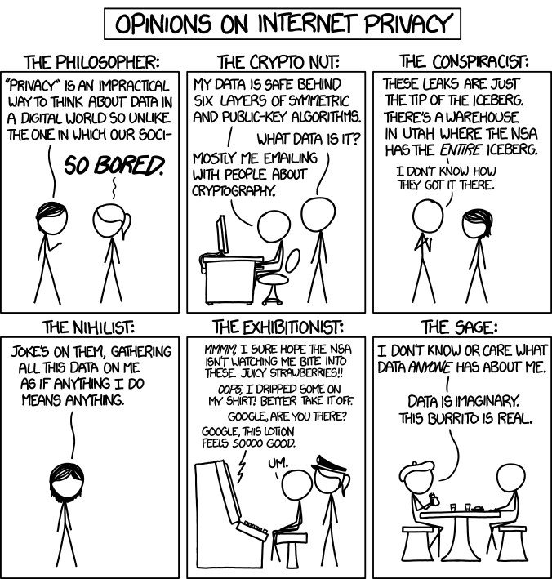
Overview
Review
Assignment
Students Present
http://xkcd.com/1269/
Notes:
1 – Accessed 2014-04-14
Personal Information Privacy

Slide 4
My Reading Notes
pp. 230 who videotapes anymore?
pp. 231 “businesswoman” nice change. Moral capitol – source published in 1984, “taking away” “1984”
pp. 238 “…privacy…in their own homes…” != nanny to expect privacy “…when… insides Sullivans’ home.
pp. 244 Human chip implant sources getting old, 2002, 2004, 2007, 2010
pp. 255 Why did Apple not enforce policy of asking permission in the API?
pp. 245 “…by 2015” did it happen?
pp. 246 Web Browsers put cookies on on your hard drive, not Web Servers.
pp. 250 why is bills – responsibility assumption flawed?
Notes:
Find out what your DNA says about you and your family.
https://www.23andme.com/
Jimmy Kimmel Live – What is your password? (2:49)
https://www.youtube.com/watch?v=opRMrEfAIiI

Slide 5
Assignment
One Page Paper
Would a National ID System be a good thing?
  Feel free to reference or build upon your self search work if it helps your argument.

Slide 6
Overview
Review
Assignment
Students Present

Slide 7

Targeted Advertisements
Ryan Orlando
Advertisements - Mediated persuasion aimed at an audience rather than one-to-one communication with potential customers
Targets
  People who already use your product
  Those who use the competitors’ brand in your category
  Heavy user for your product category
1 5 7
Notes:
Define the subject.
Ask the Class “Who owns a dog?”
Prime problem of advertisements
Three types of people you what to see the ad.
People in your market.
wasted resources for people not interested
Introduce your self.
Define Advertising, (use onscreen definition)
Not sales man, not between two people where it can be curtailed
meant fore large audience.
Let’s look at the primary problem of advertising.
A quick show of Hands “Who has a Dog?”
So if Whole Paws had payed me to put an ad on there screen, and I said about 20 people would see it.
There missing there mark with this.
Advertises only have three type of people that they want to see there adds
People who already use Whole Foods
People who use a competitors such as pedigree.
And people that consume large amounts of dog food, such as a dog clinic
Here they would only get ___ number of people that could be persuade by there ad.
It does not matter how good there ad is the people that don’t own dog’s wont get whole Paw
So they need top Target there audience using all the information they can gather
Targeting is a an integral part of advertising.

Slide 8
Targeting is In all Advertisements
Ryan Orlando
Scoreboards, Direct Mail, NASCAR, Billboards, Radio, TV
Less information, before information age
Pinnacle for TV’s advertisements in the 1960’s
  Easily reach 90% of Americans
1, 2
Notes:
Run through advertisements that used targeting.
Explain the smaller demographic the had to work with.
Sports Fans
Based of the time of radio
Direct Mail – some locational
TV was best advertisements in the 1960s
Advertise on ABC, CBS, and NBC, and you hit 90% of Americans
Had commercials for specific shows to hit certain demographics
More channels less TV hold on advertisements
Chanels From 3 – 189 (on Average)
This is true for all types of advertising, it is not recent invention with comptuers.
Ads in stadiums aimed at Sports Fans (Not gonna have ads for board games)
Ads on radio base on the program to decide who to listen (Not gonna have ads for metal concert at on a classical station)
Direct Mail – some locational (Gather information on the residence and slow figure out a demographic for them
There was simply less information to go off of before so people did not fell it as much.
In the 1960’s the peak of advertisements was TV
Advertise on the three channels ABC, CBS, and NBC, and you hit 90% of Americans
Still targeted
Had embed commercials in shows.
Show times
As Time moved on thou TV lost it’s hold on advertisement, because there number of channels grew.
Then 3
Now average 189
Look for New options for advertisments

Slide 9
Potential For Internet Advertisements
Ryan Orlando
Advertise avoid squandering advertising dollars
Internet can be a different experience for each user, and keeps the big audience
In 2005 there was not enough data to narrow down the user’s demographics
1, 2
Notes:
In Early 2000s
Internet had potential to have TV size audience while, personalization of the of direct mail.
Not enough Data
used:
Noteworthy word type in search engines.
Geographical location
Domain type
This problem with vanish soon
Many advertises saw the potential in the internet as a new medium of advertisements around the turn of the century
Internet to send individualized content to each viewer, like direct mail while have a huge audience like TV
Thus it was possible to not have to waste money advertising to non-consumer of there products
But in 2005 there was limited data to have add reach the right demographics
Noteworthy word type in search engines.
Geographical location
Domain type

Slide 10
Internet Business Model
Ryan Orlando
Finical model Choices:
  Ads
  Customers
Ads based answer to
  Invertors
  Advertisers
3
Notes:
At Same time
Internet companies decide there models
Ads – give the company revenue
Customers – pays mouthy of flat fees
Customer
Though customers have to pay, they are the only responsibility the company has to worry about.
Ads
shift company focus to Investors, and Advertisers
But is free to user
But Internet Business also had to want to advertise in order for this to work.
The business had to separate models to decide how to finice there companies/
Based on Ads Or Customers
They could Charge there customer some kinda of fee, flat, or mouthly.
Or they could have a free product with advertisements in there content
This change who the companies would be responsible towards, the customers, or advertises
Most companies, like google and Facebook, decide on ad based revenue, and most companies to come later followed there exampls.

Slide 11

Advertisement Compensation Methods
Ryan Orlando
pay-per-view
pay-per-lead
pay-per-sale
4,9
Notes:
Explain Each with Ad bellow
View – a user loading it a seeing it
Lead – Referees them to there website
Sale – Referred customers actually buying some thin
Even More pressure to hit the right demographic
Companies push to have even more targeted advertisements
Let’s quickly explain how these payment to the company worked.
There are three types
pay per view
pay per lead
pay per sale
If Creative Coverings pay me for this ad
view – each person loading this ad to see it
lead – actually click on the ad to go to there site
sale – go from my ad to there site and buy a swatch book.
With the last two it put pressure on the companies to make sure the ad is show to the right audience
Encouraging them to target their ads as best they can

Slide 12
Limited Market
Ryan Orlando
Short attention span
Other advertisements take away from each other
Seeing same advertisements does not change much
Demising returns
Barrier to Entry
4,5,9
Notes:
Talk about advertisement: not as effective together, nor a second time.
There is an externality here.
Advertisements take way form each other.
Seeing same advertisements.
Yet Most internet companies are running on ads based models
Demising returns from ads
Most of the is revenue goes to big guys
Keep new start ups from easily entering market
The big problem with all these internet companies funding them selves through ads, is that it is a limited market
Look at two ads
they take away form each other, they have an externality
people hade short attention spans as more is shown the less they pay attention
Along with see the same add does not change much for the audience
There is demising return on these ads
On top of that most of the revenue goes to the big names, like google and Facebook
This creates a barrier to entry for new web starts up that expect there revenue to come from advertisements
Some hope that the internet can change to a model there would have less barrier to entry and focus more on the customers, by charging small micro fees.
because the consumer would want more privacy.

Slide 13
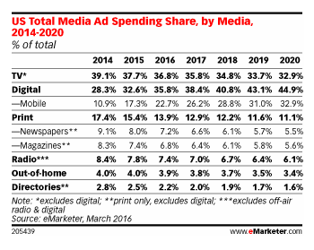
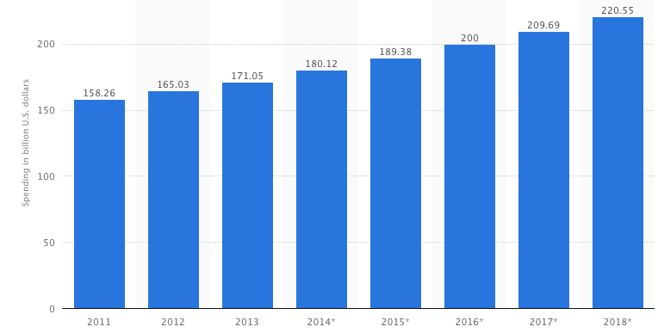
The Price for Internet
Ryan Orlando
71.6 Billon Dollars
Privacy
Media Spending
4, 6, 7
Notes:
Some think it is possible for market to shift, away from AD base business and towards customers paying for it.
Money in Ads shift to the Internet, and app, add overall is increasing as you can see in the charts.
71.6 Billion Dollars where spent on app and internet adds
~ $45 a month per broadband household
Culturally we don’t want to pay for our apps, our websites,
But There is allows a Cost, And it’s in our privacy
Society made the choices
Is it That bad
With how the market has evolved the price for using the internet and it’s many big players, our it’s ads, that invades your privacy
Although consumer has little choose: the cost of using the internet, is your privacy, but only so they can manipulate you to enjoy what we enjoy. Is that so bad?
Sad truth is the data would suggest the opposite
Advertisement money has increasing years go by in America as well as more of it perceptually is going to the internet advertisements.
71.6 Billions dollars were spent on internet advertisements this year.
~45$ a monthly per household broadband connection
But societally we have an expectation that website, and apps should be free, hard enough to get some one to buy a 1 $.
There is another cost instead our privacy.
Societally we have picked between there two options
Sadly for some it is not an individuals choice but as a whole.
The price to use all the internet has to offer just is your privacy.
Is it real that bad
We are just being manipulated to like what we like?
TO see ads that actually matter use
Suggests other things to buy that we might also like.
If we don’t value our privacy its not a bad deal

Slide 14
References
Ryan Oralndo
[1] Hite, Kenneth C., et al. "System and method for delivering targeted advertisements to consumers." U.S. Patent No. 5,774,170. 30 Jun. 1998: September 11 2016
[2] Swix, Scott R., John R. Stefanik, and John C. Batten. "Method and system for providing targeted advertisements." U.S. Patent No. 6,718,551. 6 Apr. 2004: September 11 2016
[3] By Stephen J. Dubner Produced By: Christopher Werth. "Is the Internet Being Ruined? - Freakonomics." Freakonomics. N.p., 13 July 2016. Web. 12 Sept. 2016.[4] reference 4
Notes:
Ask For Questions
Go past our slides for next presentor.

Slide 15
References
Ryan Orlando
[4] Ghosh, Arpita, and Mohammad Mahdian. "Externalities in online advertising." Proceedings of the 17th international conference on World Wide Web. ACM, 2008. 11 Sept. 2016.
[5] Whole Paws Advertisement: 11 Sept. 2016 http://petphotosbynicole.com/wp-content/uploads/2013/10/WholePaws-RegisterGraphics_400x600_Dog.jpg
[6] "Digital Ad Spending to Surpass TV Next Year - EMarketer." Digital Ad Spending to Surpass TV Next Year - EMarketer. N.p., 08 Mar. 2016. Web. 12 Sept. 2016: http://www.emarketer.com/Article/Digital-Ad-Spending-Surpass-TV-Next-Year/1013671

Slide 16
References
Ryan Orlando
[7] Statista. Web. 12 Sept. 2016[2]: http://www.statista.com/statistics/272314/advertising-spending-in-the-us/
[8] Inteegris Marketing, Creative Covering Advertisment, 12 Sept. 2016 : http://integrismarketing.com/wp-content/uploads/2010/01/CC-Catersource-AnimatedBannerAd.gif

Slide 17
China real-name system of internet
Ziyao Xu “Joe”
Something you should know…
  Intranet?
  21.1 % VS 8.4 %
  89% are happy!
  4 new tech-startup are created every minute
2015.3.1: real-name registration rules
[2]
Notes:
How much do you know about the internet in China?
Great Firewall? Censorship from government?
unfamiliar with the internet in China,
Opinions based on the stereotype from the media.
1.clarify some common misunderstanding 2. use data to present a clear image
Is it a intranet?
Sadly Yes. No google, no Facebook, no twitter, life is sad..
but all of them has some alternative services from local tech companies and some of them are great.
The Internet is a HUGE thing in China.
Globally, 21 percent of internet users are Chinese
compared to 8.4 percent from united states.
And most people are happy with what they had
survey conducted in 2011,
89 percent of Chinese internet users
agree that they have “full access to all of the information that is available on the Internet”.
And surprisingly, with all of the government regulations and censorship, the internet sector are still very active, and
experiencing a startup boom.
remember, all of these are under the a significant degree of control from Chinese government
Opposite to the general idea of the internet control
2015 March 1st
A step Further
Officially launch the real-name registration rules,
aim to build a real-name system across internet in China

Slide 18
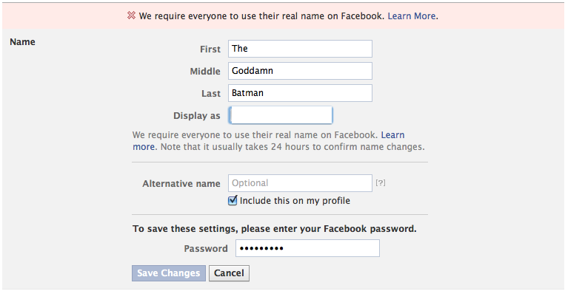
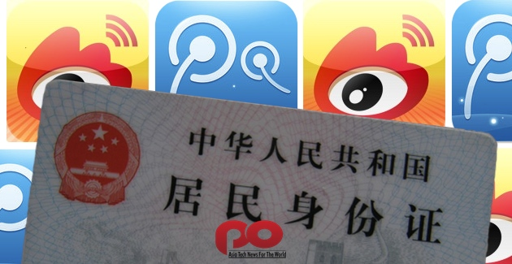
The Real-name system
Ziyao Xu “Joe”
Facebook
  Very Different
South Korea, China
Weibo
  50 % of China internet users
  64,000 posts per minute
  Fighting corruption
  Rumor and violence
  Real Name Registration started in 2012
[2],[3]
Notes:
What is the real-name system?
Facebook
Most people should be familiar because of Facebook
A policy that Facebook enforced since beginning
Every user need to use their real identity on their website
Difference
Ok to use nickname
have to provide real names to register
Encrypted in website’s backend
Associate with National ID
2 month ago, phone number can be used
South Korea
Started 2009
User shifting to google, Facebook
Security Issue
Ended 2012
Weibo
China first implemented on Social Media platforms: weibo

Slide 19
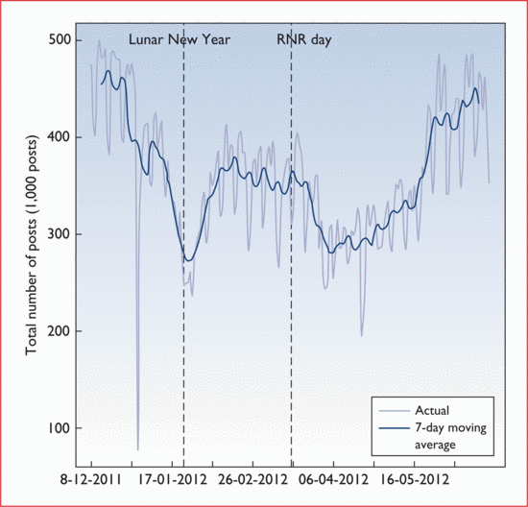
Ziyao Xu “Joe”
[3]
Notes:
Surprisingly, weibo’s total number of post was not effect significantly after the new rule was introduced!

Slide 20
Good side…
Ziyao Xu “Joe”
True anonymity does not exist for most users
Citizenship and responsibilities
Control rumors and violence
Online & Offline
[1], [4], [5]
Notes:
When registering for home or business internet access, real name registration is already required.

Slide 21
Ziyao Xu “Joe”
Negative views…
Personal Data Security
Freedom of Speech
Anonymity
Technology Difficulty
Notes:
When registering for home or business internet access, real name registration is already required.

Slide 22
Ziyao Xu “Joe”
Conclusion…
Real Name System can bring positive impact to internet
However, it is not mature and need more consideration in the future
Black Box?
Notes:
When registering for home or business internet access, real name registration is already required.

Slide 23
References
Ziyao Xu “Joe”
[1] King-Wa Fu, Chung-Hong Chan, Michael Chau, “Assessing Censorship on Microblogs in China: Discriminatory Keyword Analysis and the Real-Name Registration Policy”, IEEE Internet Computing, May-June 2013.
[2] G. Yang, The Power of the Internet in China: Citizen Activism Online, Columbia Univ. Press, 2009.
[3] Cho, Daegon, Real Name Verification Law on the Internet: A Poisonor Cure for Privacy? Economics of Information Security and Privacy III, 2009.
[4] David A. Caragliano, REAL NAMES AND RESPSONIBLE SPEECH: THE CASES OF SOUTH KOREA, CHINA, AND FACEBOOK, Stanford University, March 11-12, 2013
[5] Ralph Gross, Information revelation and privacy in online social networks, WPES ’05

Slide 24
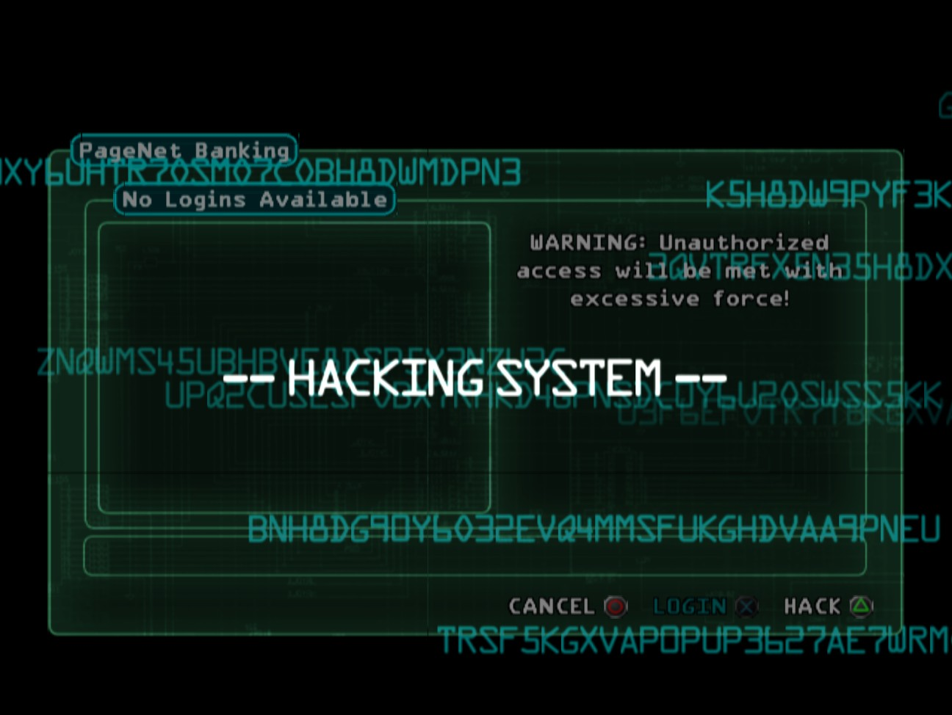
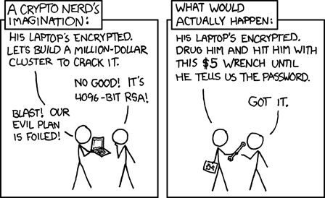
Government hacking
James Piatt
On the rise for a while now
Recording telephone conversations, whistleblowers persecuted[1]
Lack of oversight?
No politics!
Deus Ex, Eidos Interactive
Notes:
Government surveillance and such is a big issue. They do wiretapping and hacking, often without court orders or transparency. A few people over the years have come forward and exposed huge illegal schemes by the NSA or CIA or whomever. Really, this shouldn’t devolve into a political argument.

Slide 25
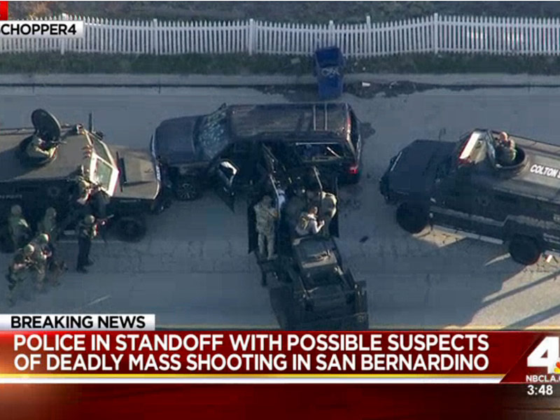
San Bernardino shooting iphone
James Piatt
A man and a woman killed 14 people on December 3, before police killed them.[5]
  We’re not focusing on the attack
Couldn’t get into IPhone, asked Apple to make tool to do it. Apple refused[2.]
Apple: tool getting leaked, inevitable, general security, bad precedent.[2]
FBI: Save lives[2], bank vault comparison.
People.com
Notes:
It was considered an act of terror. One of the gunmen had an IPhone that investigators couldn’t get into. An IPhone will let you try to enter the password something like ten times before wiping the device. Apple provided SOME data, but refused to crack the phone, despite a court order. FBI mostly just wanted them to turn off the auto-wipe feature, and specifically granted them ‘wiggle room.’ Apple gave a few good, general arguments as to why they wouldn’t, about precedents and public security and ‘dangerous powers,’ while the FBI gave specific down-to—earth arguments about saving American lives and such.

Slide 26
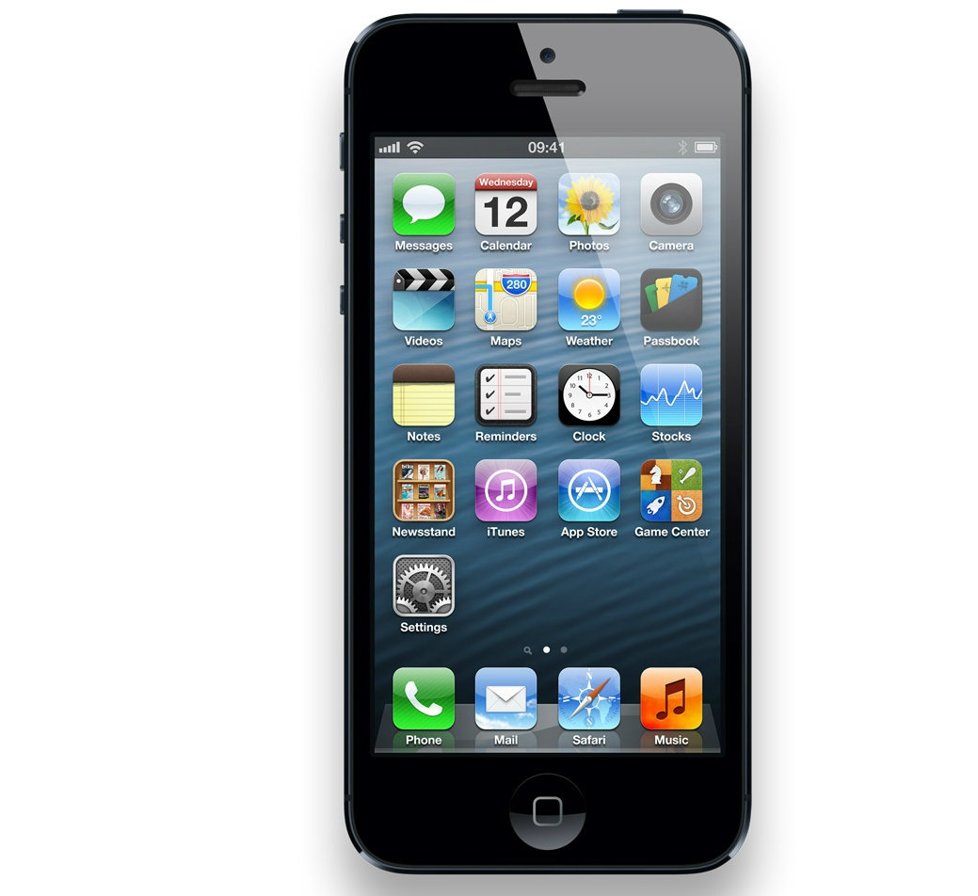
San Bernardino shooting iphone
James Piatt
Who do you think is right?
Would you help them make the tool?
  For money, obviously. Or not!
  Probably you would, 52% of cybersecurity experts said they would.[4]
  Someone did! 1.3mil, nothing important found.[3]
  FBI refused review, didn’t understand their new tool.[3]
Apple
Notes:
9 percent said they’d do it just to show they could, 23 percent were talking more about 50 million. There are actually differing accounts as to how much money the FBI spent, some say less than a million. All for nothing, they say. And the FBI doesn’t understand how to use what they bought.

Slide 27
References
James Piatt
[1] Judy Woodruff, NSA Collects ‘Word for Word’ Every Domestic Communication, Says Former Analyst, PBS, August 1 2013,
[2] James Martin, How an iPhone became the FBI's public enemy No. 1 (FAQ), CNET, February 25 2016
[3] Michelle Meyers, FBI to stay mum on iPhone-hacking method, CNET, April 27 2016
[4] Nidia Cavazos, 52 percent of cybersecurity experts would help the FBI hack iPhone, The Daily Dot, August 30 2016
[5] Tara Fowler, San Bernardino Shooting: Suspects Dead, Victims Still Not Identified as 14 People Killed and 21 Injured, People, December 3, 2015

Slide 28
Class 6
The End
Keith A. Pray
Instructor
socialimps.keithpray.net
Notes:
This is the end. Any slides beyond this point are for answering questions that may arise but not needed in the main talk. Some slides may also be unfinished and are not needed but kept just in case.

