Slide 1
Class 5 Intellectual Property
Keith A. Pray
Instructor
socialimps.keithpray.net
Notes:
Here’s the title slide. Excited already, aren’t you?
Weird Al Yankovic “Don’t Download This Song” (3:53)
https://www.youtube.com/watch?v=zGM8PT1eAvY
Reminders:
Do not change the format, footers, etc. in the template slides.
Paper writing process: Sources → Notes → Conclusion → Argument → Counter Point → Response

Slide 2
Overview
Review
Assignment
Students Present
Guest Speaker

Slide 3
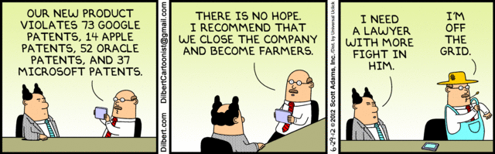
Notes:
Comments, observations, questions on IP Chapter?

Slide 4
My Reading Notes
pp. 165 “...ownership of ideas...” not quite right
pp. 168 public domain year 1997/1999 from source published in 1996?
pp. 170 SaaS, Google Search example? “…before he gave them the plot.”? “…cannot erase the memories...” Paycheck (2003)
pp. 180 4.4 #2 preferred?
pp. 186/196 revenue != profit
pp. 190 blocking 100% seems impossible
pp. 194 Any legitimate BitTorrent use examples since 2005?
pp. 197 “licensing agreement … hardware”?
pp. 198 4.7.3 references?
pp. 205 Perhaps friends should not ask you to break the law?
Any successful industries operate as a support service?
pp. 207 Is Perl still most popular? Quality study from 2003, change?
pp. 209 who uses tape?
pp. 210 “human-readable, lawyer-readable…”
pp. 223 Interview has nothing to do with computing

Slide 5
Group Quiz For each On the left answer a–d on Right
Trademark
Copyright
Patent
Trade Secret
What kind of IP does it protect?
What qualifications does the IP have to meet to be protected?
How long does the protection last?
Give a specific example of IP currently protected?
Notes:
Trademark
Used to denote a product or service.
Apply in specific areas of commerce. Only applies in specified area of business
Indefinite term as long as in use and protected against becoming a common noun or verb.
You do not have to register a trademark unless you want to bring litigation before a federal court (there are other benefits too, but what are they?)
Copyright
Expression, not ideas: Fuzzy. E.g. derivative works, characters, merchandising, plots.
Mickey Mouse, Tarzan.
US Default : Original Author, Exception: work for hire, Transferred: yes
Rights: Publication, Performance / exhibition, Adaptation to other media, Excerpting, Attribution, Derivative works
US Term: Lifetime of author plus 70 years., 95 years for companies.
Governed by US law and international treaties (e.g. WIPO).
Fair Use: News reporting, reviews, etc., Scholarly / educational use, Private, non-commercial use, Lending libraries and archives
Fair Use restrictions: Admission charge, Re-transmission
In general, you can: Read, view, play, etc., Copy for personal use., Time-shift, Space-shift
In general, you cannot: Copy for others., Transfer to someone else but keep a copy., Show / perform it publicly.
What about video rentals?
Rationale: Encourage creativity. Encourage dissemination. Balance between private and public good. It’s a social contract.
Patent
A mechanism, process, or composition of matter.
Must be: Novel. Useful. Non-obvious. Described clearly. Must do what it says.
Usual term 20 years.
Utility and plant patents: 20 years.
Design patents last 14 years. (ornamental design of functional item)
Provisional patent gives 1 year, before full patent
Trade Secret
You must take steps.
Enforceable by: Contracts, Laws against industrial espionage.

Slide 6
Overview
Review
Assignment
Students Present
Guest Speaker
Notes:
But first take a look at:
CGP Grey
Copyright: Forever Less One Day (6:27)
https://www.youtube.com/watch?v=tk862BbjWx4
Tom Scott
http://tomscott.com
Welcome To Life (2:44)
https://www.youtube.com/watch?v=IFe9wiDfb0E&feature=youtu.be

Slide 7
Assignment - Self Search 1/3 Discussion Board
Post ways one can search for information about a person. Do not repeat entries.
Use each search method listed to produce 2 profiles as an appendix of your paper. Provide a brief description if you’d rather not list the details.
Profile 1: all information someone might think is you
Profile 2: all information you know is you.
You are not responsible for methods posted less than 24 hours before class.
For each search method result consider:
Exactly how did the data get there?
How can this data be used?
Is this a secondary use?
Did you authorized use of the data? If not and you want to, request its use be discontinued and post the correspondence.
Dig deeper than a basic search engine’s (Google, etc.) results.

Slide 8
Assignment - Self Search 2/3 1 Page Paper
Use your search results to help support your conclusion.
This assignment requires you revisit the Discussion Board frequently as new search methods are posted, subscribe to it.
Conclusion idea examples (not comprehensive):
What impression would a potential employer have of you given these results, assuming they also had a resume and possibly a cover letter from you?
What would your elder family members (or equivalent) think?
Are you comfortable with what you found or did not find?
Do you believe protecting your privacy is important or needed?
5 High quality sources still required

Slide 9
Assignment - Self Search 3/3
Profile 2
Is You
1 Page
Paper
Filter
Inspiration
Search Methods
…
…
…
…
Filter
Profile 1
Could Be You

Slide 10
Overview
Review
Assignment
Students Present
Guest Speaker

Slide 11
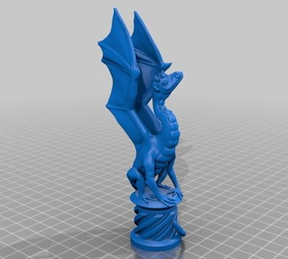
3D Models and Public Domain
Alex Ruggiero
Loubie’s model was among a 1000 of models listed on eBay for purchase by just3Dprint
Loubie claims its against CC license her model is under
just3Dprint claims its uploaded on the internet therefore “public domain”
[3] Driggers
Notes:
Let me set the scene. Meet Louise Driggers, aka. “loubie”. She posted her creations on thingiverse, where here files are given a Creative Commons Non Commercial license. She browsed eBay on a night in February and found her model being sold on Ebay for a 3D print of it. Her photos she uploaded along with here model on thingiverse are also posted with the ad. She contacted the shop, just3Dprint, and asked to take their ad down as it is in violation to her model’s CC license. Just3Dprint argues that by uploading her model on thingiverse, it is in public domain and you lose all rights to it. He also claims that CC is not a valid license as it goes against America’s Intellectual Property laws.
Why did this happen? Why was “Public Domain” used as an excuse?
[Discussion]

Slide 12
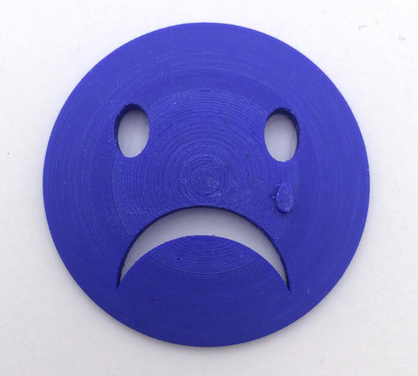
3D Models and Public Domain
Alex Ruggiero
CC is a valid license in IP law
Giving credit isn’t enough
Uploading to Thingiverse is not a license to everyone.
[2] Driggers
Notes:
Micheal Weinberg, an IP Expert with Shapeways, took to his blog to discuss the issues. He even contacted just3Dprint to get the full story and explanation for their actions. Here are some conclusions
1. Yes CC is a valid license in the USA. In fact, it was designed to work with existing IP laws instead of contradicting them. If any model is protected by a copyright, that copyright is as valid as any other copyright.
2) Giving Credit isn’t enough. Just listing the creator’s name and link to their model isn’t enough. Because loubie had her model under non-commercial use, you cannot sell it for commercial purposes since the license doesn’t give you permission. Unless you have the owners permission, don’t try to sell it
3) Uploading to Thingiverse is not a license to everyone. When an object is uploaded to Thingiverse, you adhere to the Terms of Use giving them all rights to it. You aren’t granting rights to any third part or even the public domain. Loubie’s model is protected not only by CC but also Thingiverse.

Slide 13
3D Models and Public Domain
Alex Ruggiero
Could this happen again?
When is enough is enough?
Notes:
Could this happen again? Unfortunately yes, and we are guilty of it. How many of you searched for a free textbook for a class? How many of you used torrents to watch the new episode of Game of Thrones for free? How many of you downloaded music for free, even if it was illegal? At what point do we draw the line on copyright infringement?
[Discussion]
Thank you

Slide 14
References
Alex Ruggiero
[1] Creative Commons License Deed. (n.d.). Retrieved September 06, 2016, from https://creativecommons.org/licenses/by-nc/3.0/
[2] Driggers, L. (2016, February 18). Sad Face! IMPORTANT NOTICE! Retrieved September 6, 2016, from http://www.thingiverse.com/thing:1350837
[3] Driggers, L. (2015, April 12). Aria The Dragon (for dual extrusion). Retrieved September 6, 2016, from http://www.thingiverse.com/thing:767823
[4] M. (2016, February 19). Abusing Models on Thingiverse, or The Plight of Thing 1350837. Retrieved September 06, 2016, from http://michaelweinberg.org/post/139607754335/abusing-models-on-thingiverse-or-the-plight-of
[5] M. (2016, February 20). The Plight of Thing 1350837 continued. Retrieved September 06, 2016, from http://michaelweinberg.org/post/139675844685/the-plight-of-thing-1350837-continued

Slide 15
Protect Software with patents Or Not?
Aditya Nivarthi
Software should not be protected with patents
Notes:
Should we protect software with patents?
I believe we should not have software patents because they negatively impact a variety of aspects of the software industry.

Slide 16
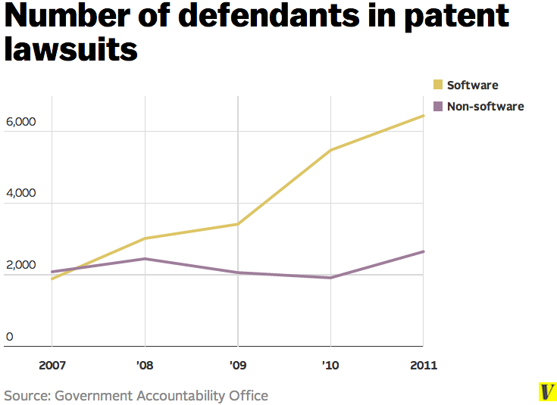
Aditya Nivarthi
[8], [9]
Notes:
Software patents are causing more and more lawsuits. The number of defendants in patent lawsuits has risen in recent years.
The source of this graph says the software related lawsuits caused 89% of the increase within this time period.
Software companies are giving up time for these lawsuits which could be going towards research and new features.

Slide 17
How much do lawsuits cost?
Aditya Nivarthi
Average lawsuit
Risk between $1 - $25 million
Cost
Between $1.6 - $2.8 million
Case | Costs
Microsoft vs. Samsung | $1,000,000,000
Apple vs. Samsung | $890,000,000
VimetX vs. Apple | $626,000,000
[10], table from [11], [12], [13], [14]
Notes:
The numbers provided for average lawsuit costs are not something any small to medium sized company would be able to easily afford. The large tech giants may have this kind of money, but startups would not be able to handle this kind of hit on monetary resources.
The table shows the extreme cases and how much in royalties was paid from one company to another.
The Apple vs. Samsung case cost Apple $60,000,000 in lawyer fees.
Software companies are giving up money for these lawsuits which could be going towards research and new features.

Slide 18
Increase in software lawsuits
Aditya Nivarthi
Software patent laws are not clear
Level of detail and specificity is not defined
Vague and abstract patents being sent for publication
[8]
Notes:
Why the increase in lawsuits? Software lawsuits are caused by the fact that software patent laws are not clear enough for companies to understand how to properly patent software.
Due to uncertainty on patent laws, there are vague patents being submitted, such as the ones on the next slide.

Slide 19
Broad, Vague or abstract patents
Aditya Nivarthi
Apple “portable electronic device”
“In some embodiments, if the user activates songs icon 4312 (e.g., by a finger tap on the icon), the songs category will be displayed (FIG. 21G).” [2]
Alice Corp v. CLS Bank International
“CONTRACT APP stakeholders may be required to utilize specified computer hardware and/or software mechanisms” [3]
[2], [3], [4], [5]
Notes:
Here are some examples of actual software patents that were submitted.
[Maybe briefly read the excerpts, explain what the patent is for]
First patent is Apple’s way to patent their mobile device operating system and its functionalities.
Second is Alice Corp.’s patent on a way to reduce risk on foreign currency trades, using software.

Slide 20
Reform the patent laws
Aditya Nivarthi
Is software too abstract?
Software industry is different from other industries
[6]
Notes:
You might think we can just reform patent laws since they are the main cause of vague patents, uncertainty in infringement, and lawsuits.
One of the big discussions happening is that we are not sure if software is too abstract to patent, and there is no agreement on the answer.
The other case is how the software industry is different from other industries, and the patents do not have the same positive impact.

Slide 21
Software vs. other industries
Aditya Nivarthi
Low overhead for software iteration
Easier to make changes and improve
Software can use many techniques and have many features
Forces many different pieces under one patent
Lack of patentable techniques causes gridlock
[6], [7]
Notes:
Patents in the software industry is that they cannot be applied in the same way as other industries, because the software industry functions differently.
In physical systems, making improvements cannot happen in a few minutes. Changing a material to reduce weight needs time, construction and testing before being sure it works. Software can be changed and tested in a few minutes for a new fix or feature. In other industries, having patents helps to cover the cost of iteration. In software, the iteration process is so short that having patents last 20 years lasts far longer than the iteration process. Having patents also be as short as the iteration time is not feasible due to the costs of patents. Filing patents can range anywhere from $5000 to over $16000.
In pharmaceuticals, making a drug/medicine requires specific steps, chemicals, substance and testing methods for the end goal. The specific combination of substances will only be used in that medicine, and rarely will you recycle other drugs in entirety for a new drug. Software does not follow that logic. Many techniques or features are reused over and over, even across unrelated products (Bluetooth for phone connectivity, car systems, speakers).
Since software techniques are used over and over across different software applications, if all the software were to be patented, eventually all the reusable techniques would also be patented, thus creating a gridlock for developing new software [7]. The gridlock occurs because new software cannot reuse existing technologies/features because everything has been patented, and either the software cannot be released because the cost of licensing would be too high, or it would be in development for too long because every component is being reinvented to prevent infringement.

Slide 22
Conclusion
Aditya Nivarthi
Software patents negatively affect software industry
Unclear laws
Vague and abstract patents
Time and money spent on lawsuits
Software patent law reform not enough to resolve issues
Software too abstract?
Software industry functions differently
Notes:
Patents in the software industry is that they cannot be applied in the same way as other industries, because the software industry functions differently.
In physical systems, making improvements cannot happen in a few minutes. Changing a material to reduce weight needs time, construction and testing before being sure it works. Software can be changed and tested in a few minutes for a new fix or feature. In other industries, having patents helps to cover the cost of iteration. In software, the iteration process is so short that having patents last 20 years lasts far longer than the iteration process. Having patents also be as short as the iteration time is not feasible due to the costs of patents. Filing patents can range anywhere from $5000 to over $16000.
In pharmaceuticals, making a drug/medicine requires specific steps, chemicals, substance and testing methods for the end goal. The specific combination of substances will only be used in that medicine, and rarely will you recycle other drugs in entirety for a new drug. Software does not follow that logic. Many techniques or features are reused over and over, even across unrelated products (Bluetooth for phone connectivity, car systems, speakers).
Since software techniques are used over and over across different software applications, if all the software were to be patented, eventually all the reusable techniques would also be patented, thus creating a gridlock for developing new software [7]. The gridlock occurs because new software cannot reuse existing technologies/features because everything has been patented, and either the software cannot be released because the cost of licensing would be too high, or it would be in development for too long because every component is being reinvented to prevent infringement.

Slide 23
References, 1
Aditya Nivarthi
[1] Quinn, Michael J. Ethics For The Information Age. Boston: Pearson/Addison-Wesley, 2005. Print.
[2] "United States Patent: 8223134". Patft.uspto.gov. N.p., 2016. Web. Retrieved from http://patft.uspto.gov/netacgi/nph-Parser?Sect1=PTO1&Sect2=HITOFF&d=PALL&p=1&u=%2Fnetahtml%2FPTO%2Fsrchnum.htm&r=1&f=G&l=50&s1=8,223,134.PN.&OS=PN/8,223,134&RS=PN/8,223,134. Retrieved on 7 Sept. 2016.
[3] "United States Patent: 5970479". Patft.uspto.gov. N.p., 2016. Web. Retrieved from http://patft.uspto.gov/netacgi/nph-Parser?Sect1=PTO2&Sect2=HITOFF&p=1&u=/netahtml/PTO/search-bool.html&r=1&f=G&l=50&co1=AND&d=PTXT&s1=5970479.PN.&OS=PN/5970479&RS=PN/5970479. Retrieved on 7 Sept. 2016.
[4] "IBM, Google Disagree On Alice, Need For Congress To Act". Bna.com. N.p., 2016. Web. Retrieved from http://www.bna.com/ibm-google-disagree-n57982068629/. Retrieved on 7 Sept. 2016.
[5] "Supreme Court Rules In Alice Corp V. CLS Bank: Abstract Ideas Un-Patentable". Fortune.com. N.p., 2016. Web. Retrieved from http://fortune.com/2014/06/19/supreme-court-limits-the-scope-of-software-patents/. Retrieved on 8 Sept. 2016.
[6] "Richard Stallman Interview". Uspto.gov. N.p., 2016. Web. Retrieved from https://www.uspto.gov/web/offices/com/hearings/software/sanjose/sj_stallman.html. Retrieved on 7 Sept. 2016.
[7] "Forbes Welcome". Forbes.com. N.p., 2016. Web. Retrieved from http://www.forbes.com/sites/ericgoldman/2012/11/28/the-problems-with-software-patents/#6a7ebea26545. Retrieved on 8 Sept. 2016.
[8] Bessen, James. "The Case Against Software Patents, In 9 Charts". Vox. N.p., 2014. Web. Retrieved from http://www.vox.com/2014/7/7/5862284/9-charts-that-show-patents-are-bad-for-the-software-industry. Retrieved on 9 Sept. 2016.
Notes:
References

Slide 24
References, 2
Aditya Nivarthi
[9] "Assessing Factors That Affect Patent Infringement Litigation Could Help Improve Patent Quality". GAO Highlights. N.p., 2016. Web. Retrieved from http://www.gao.gov/assets/660/657103.pdf. Retrieved on 9 Sept. 2016.
[10] "Managing Costs Of Patent Litigation". Ipwatchdog.com. N.p., 2016. Web. Retrieved from http://www.ipwatchdog.com/2013/02/05/managing-costs-of-patent-litigation/id=34808/. Retrieved on 9 Sept. 2016.
[11] Warren, Tom. "Microsoft Earned $1 Billion From Samsung Android Patent Licensing Last Year". Theverge.com. N.p., 2014. Web. Retrieved from http://www.theverge.com/2014/10/4/6906789/microsoft-samsung-android-1-billion-royalties. Retrieved on 9 Sept. 2016.
[12] "Apple Spent Over $60 Million On U.S. Lawyers Against Samsung". Reuters. N.p., 2016. Web. 9 Retrieved from http://www.reuters.com/article/us-apple-samsung-fees-idUSBRE9B50QC20131206/ Retrieved on Sept. 2016.
[13] "U.S. Jury Awards Apple $290 Million In Retrial Against Samsung". Reuters. N.p., 2016. Web. Retrieved from http://www.reuters.com/article/us-apple-samsung-verdict-idUSBRE9AK19V20131121. Retrieved on 9 Sept. 2016.
[14] "Jury: Apple Must Pay $626 Million To Patent Troll Virnetx". Ars Technica. N.p., 2016. Web. Retrieved from http://arstechnica.com/tech-policy/2016/02/jury-apple-must-pay-626-million-to-patent-troll-virnetx/. Retrieved on 9 Sept. 2016.
[15] "The Cost Of Obtaining A Patent In The US". Ipwatchdog.com. N.p., 2016. Web. Retrieved from http://www.ipwatchdog.com/2015/04/04/the-cost-of-obtaining-a-patent-in-the-us/id=56485/. Retrieved on 9 Sept. 2016.
Notes:
References

Slide 25
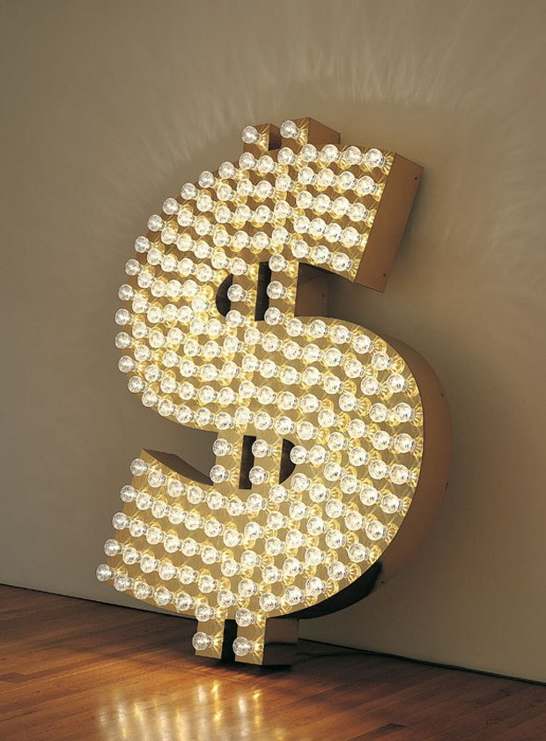
Unregulated Art Market
Isamu Nakagawa
“After drug dealing and prostitution it’s the biggest unregulated market in the world” - Chairman at Phillips Auctioneers [1]
$65 billion-a-year [1]
[6]
Notes:
Problem: Current Art Market Unregulated
[1] -- Matthew Carey-Williams - Deputy Chairman for Europe and Asia at Phillips Auctioneers LLC
65 Billion, global
Major Problems:
Supervisory body non existent
Tricks played by galleries and auction houses
Fakes have surfaced
The image is artwork itself. Sold for $442,339 USD

Slide 26
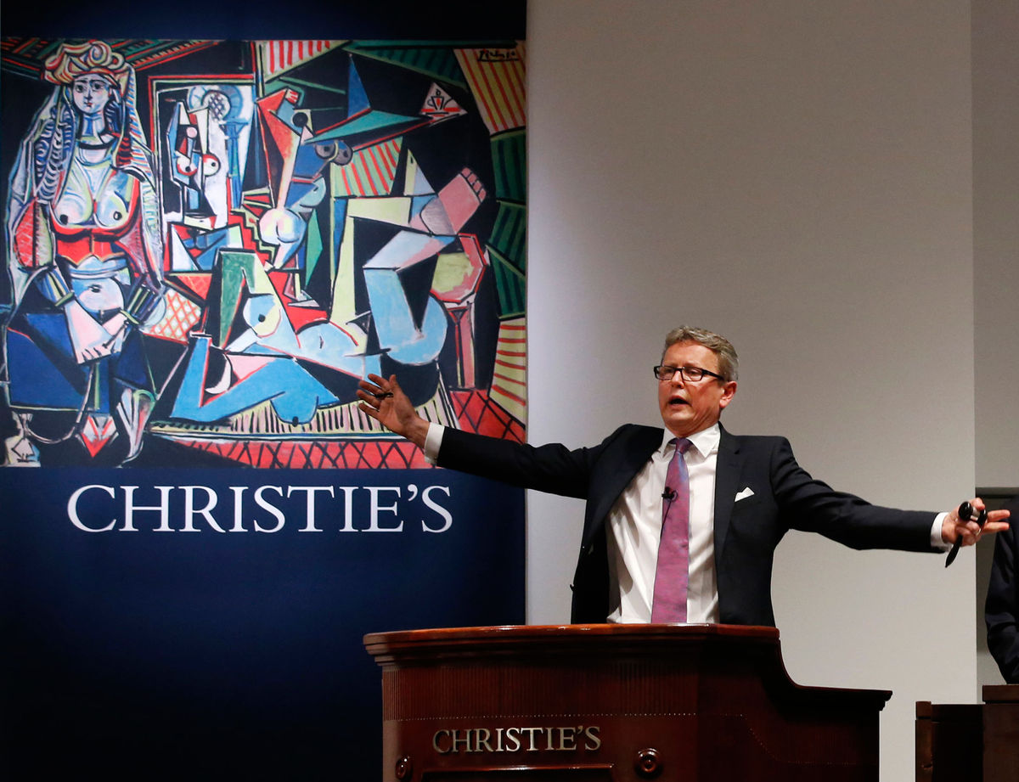
Art Market 2015 Highlights
Isamu Nakagawa
Pablo Picasso, “Les Femmes d’Alger” $179.4 million
Andy Warhol “Colored Mona Lisa,” $56.2 million
Alberto Giacometti, “L’Homme au Doigt,” $141.3 million [2]
http://www.creativetitleforthcoming.com/
Notes:
Only a few of the many works of art sold in 2015. Prices fluctuate all the time.
Examples of big money involved.

Slide 27

How to become a Millionaire?
Isamu Nakagawa
Discover artist
Buy in bulk, $90,000
Rig art sale, $150,000
Curate show
Discreetly sell, $70,000
http://centerforabusedpersonscharlescounty.org/
Notes:
Not only famous artists.
Discover a brilliant young artist on Facebook
Crazy week at my house, make 30 abstract paintings
Buy for a total of $90,000
Enter one into a contemporary day sale, ask two business associates to bid it up to $150,000
Have friend curate show
Now hot young artist
Discreetly sell paintings at auction and privately for an average price of $70,000 each [3]
Image showing art that appears to have little effort applied.

Slide 28
Missed Opportunities
Isamu Nakagawa
“A lot of people are left out of the market who have the potential to buy” [3] - Magnus Resch
“The No. 1 reason for this is the lack of transparency.” [3]
“There is virtually no data on gallery prices” [3] - Magnus Resch
Misleading notions of value, momentary whims of bidders [4]
Identities of the seller, the guarantor, the external bidders and the final buyer remain confidential [4]
Notes:
Why: Many people don’t know current art market
Art is not only for millionaires. Many people have the opportunity to buy but lack the knowledge. If they research online, information is difficult to find. Some services exist but you have to pay. Auction houses and galleries want this
Dealers reluctant to divulge prices -> Scandal relevant because galleries and auction houses do not want prices to be revealed
“A painting might sell at a public auction for more than $100 million, and the identities of the seller, the guarantor, the external bidders and the final buyer will remain cloaked in confidentiality. “ [4]
Referencing previous slide --
“wider world has yet to gain any definitive idea who sold, guaranteed or bought the 1955 Picasso painting “Les Femmes d’Alger” [4]

Slide 29
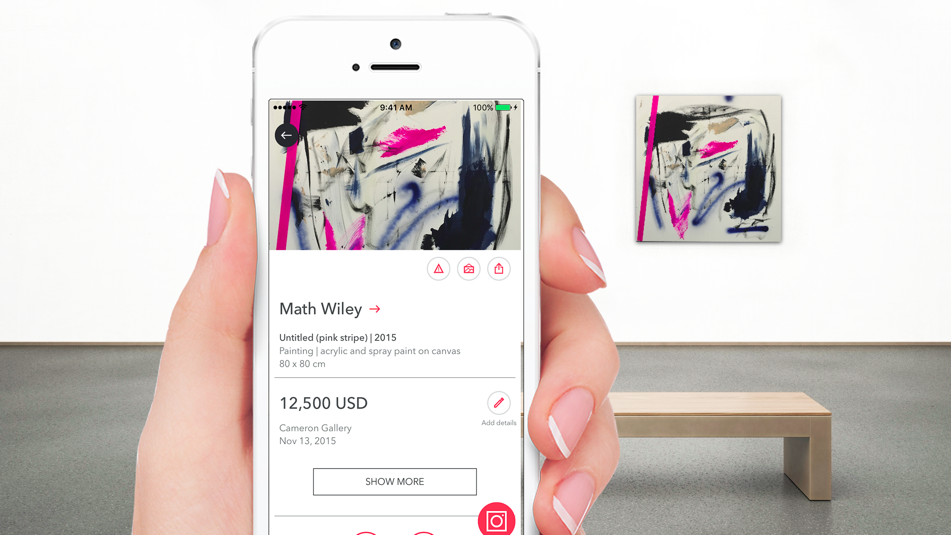
Opening the Curtains of Art Trade
Isamu Nakagawa
Art trade data and prices should be available to all
“Provide access to the art market and democratize it and hopefully enlarge it.” [3] - Magnus Resch
[8]
Notes:
Conclusion:
Prices and Images of Art should be
Magnus opens the art world to more people, and adds stability to market.
For everyone interested in art
Zero Cost
The image is a person using the Magnus app.
You can take a picture of a piece of art and get the name of the artist, gallery price, past dealer and auction prices of other works, and the artist’s exhibition history.

Slide 30
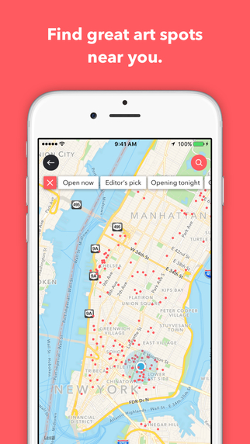
Magnus Stabilizes the Art Market
Isamu Nakagawa
8M gallery and auction prices worldwide since 2013 [2]
Boost confidence
Misleading notions of value
“Chandelier bidding” [7]
Decrease distrust
[8]
Notes:
The data Magnus provides stabilizes the art market.
The data has been collected since 2013.
It will boost the confidence of potential buyers.
Counter tricks auctions play, for example
Chandelier bidding
“The auction house staff get people on the phone, get them to bid against people who have a financial interest in the work that’s being sold.” [1]
Magnus will make it much more difficult for auction to get away with this behavior

Slide 31
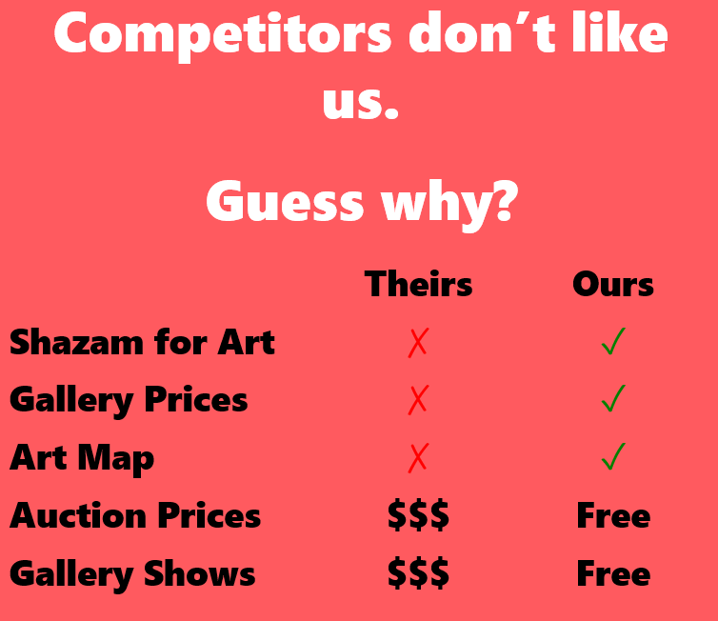
Magnus Illegal and Adds Problems
Isamu Nakagawa
Galleries Sue
Currently banned from App Store [8]
Image and pricing data is gallery IP
“People will look at art solely through the lens of value… [3] - Glenn Scott Wright
“People don’t want the art market to be regulated… fun would be taken out” [4] -- Suzanne Gyorgy
[8]
Notes:
Counter: Magnus is violating IP? People will now pay too much attention to price, overlook art, is it copyright infringement?
Image is explaining why galleries and competitors oppose Magnus
Glenn Scott Wright
“What concerns me most is that it will mean a lot more people will look at art solely through the lens of value,” said Glenn Scott Wright, a co-director of the Victoria Miro gallery in London. “They’ll take a picture, and within three seconds they’ll think they know the resale price of the work.”
People still will not understand why a work is worth what it is worth.
Art trading is fun
Suzanne Gyorgy: “You become part of a game, with insider rules. I would like some more transparency with third-party guarantees. But people don’t want the art market to be regulated, because then all the fun would be taken out of it. Kind of like when Dorothy pulled back the curtain on Oz.”

Slide 32
Transparency is good for the art world
Isamu Nakagawa
Fair Use Defense
Existing companies: Artnet, Artsy
“I don’t see any gallery asking Instagram to take down images.” [10] - Magnus Resch
Magnus will help market to grow [8]
attracting new collectors
giving existing buyers a tool to enjoy art more
Notes:
Counter point response: Fair Use Defence. Still better because transparency is needed
FAIR USE:
Purpose: News Reporting, scholarship
Nature: Nonfiction
How Much: Photo/Price
Affect Market: Stimulate Growth
Authors Guild vs. Google Example (Similar Case)
Magnus will help market to grow, both by attracting new collectors and by giving existing buyers a tool at their fingertips to enjoy art even more. [8]
It’s no longer a level playing field.
Unacceptable for people to be deceived by current methods.
“Art world has nicknamed ‘the Cartel’. The idea is that you buy 20 or 30 artworks … put two or three of them up at auction, and you and your pals bid them up.” [5]

Slide 33
REFERENCES
Isamu Nakagawa
[1] Georgina Adam, Big Bucks: The Explosion of the Art Market in the 21st Century, Lund Humphries 2014.
[2] Katya Kazakina, These 10 Pieces of Art Just Sold for Almost $800 Million, Bloomberg, http://www.bloomberg.com/news/articles/2015-05-14/these-10-pieces-of-art-just-sold-for-almost-800-million Accessed: 9/5/16
[3] Scott Rayburn, An App That Pushes Aside the Art World Curtain, New York Times, http://www.nytimes.com/2016/04/09/arts/international/pushing-aside-the-art-world-curtain.html?_r=0 Accessed: 9/4/16
[4] Scott Rayburn, A Tug of War Over Art-Sales Transparency, New York Times, http://www.nytimes.com/2015/09/28/arts/international/a-tug-of-war-over-art-sales-transparency.html Accessed: 9/4/16
[5] Phoebe Eaton, ‘The art and the deal’, New York Magazine , 24 February 2008, http://nymag.com/news/features/44455/index4.html.

Slide 34
REFERENCES cont.
Isamu Nakagawa
[6] Find Art Info http://www.findartinfo.com/english/list-prices-by-artist/205416/tim-noble-and-sue-webster.html Accessed: 9/6/16
[7] Daniel Grant, Art News, http://www.artnews.com/2007/09/04/legislators-seek-to-stop-chandelier-bidding-at-auction/ Accessed: 9/7/16
[8] Magnus Resch, Artace Inc., http://www.magnus.net/press/ Accessed: 9/7/16
[9] Meaghan Wilson-Anastasios, Evidence Of Auction House Influence Over Buyer Behaviour And Price Formation In The Australian Art Auction Market, UTS Press 2009
[10] Melane Gerlis, The Art Newspaper, http://theartnewspaper.com/news/magnus-app-founder-hits-back-at-critics/ Accessed: 9/7/16

Slide 35
Class 5 The End
Keith A. Pray
Instructor
socialimps.keithpray.net
Notes:
This is the end. Any slides beyond this point are for answering questions that may arise but not needed in the main talk. Some slides may also be unfinished and are not needed but kept just in case.

