Slide 1
Class 10
Professional Ethics
Keith A. Pray
Instructor
socialimps.keithpray.net
Notes:
Here’s the title slide. Excited already, aren’t you? You may not be depending on how you enjoyed the last class.
Paper: not yet

Slide 2
Debate Ground Rules
Before Debate
  15 minutes to converse with your team
  Share argument points, counter points, and responses so everyone can represent
  Decide who will respond to what points from the opposing side
During Debate
  Stand up when speaking
  Only those who have not spoken may respond until everyone has had a turn
  Switch sides at any time when you change your mind
Notes:
Release Game or Not Debate

Slide 3
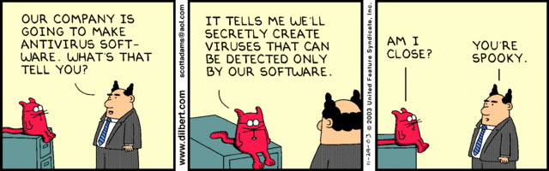
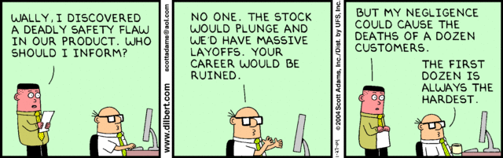
Notes:
Ask how many people in ACM or IEEE

Slide 4
Overview
Review
Assignment
Students Present
Notes:
We can also discuss articles listed on Security Discussions under documents of course web site.
ADD QUIZ AS BACKUP IF CLASS DISCUSSION NOT LONG ENOUGH

Slide 5
My Reading Notes
pp. 409 Can one perform services for one’s self?
pp. 412 1993-1999 Does this seem like a long time?
pp. 413 “errors of omission or commission”?
pp. 422 3. Would people agree – social contract?
pp. 438 So the baby can be left outside and no one is responsible?
Notes:
An error of commission is one where the person responds where they should not. This is compared to an error of omission, where the person fails to respond when they should.

Slide 6
Assignment
Finish all reading
Add analysis to group project website addressing all topics covered to date.
Group Presentation Draft
  Email presentation as attachment to course staff
  Post on group website
Optional Paper: Is the Dark Net good or bad? See Paper Assignment Ideas Discussion Board for details.
Notes:
1 Page Paper – For Good
How will you use your computing related education to do good in the world?
1 Page Paper – Dark Net
Is the Dark Net good or bad?
Extra Credit? Extra Paper?

Slide 7
Overview
Review
Assignment
Students Present
Notes:
Show WPI and/or corporate code of ethics.

Slide 8

Dubious Software Business Model
Hongbo Fang
Background introduction of Baidu, a web service company.
The dubious business and revenue models.
Consequences and public responses to those business models.
Notes:
<speaker notes>

Slide 9
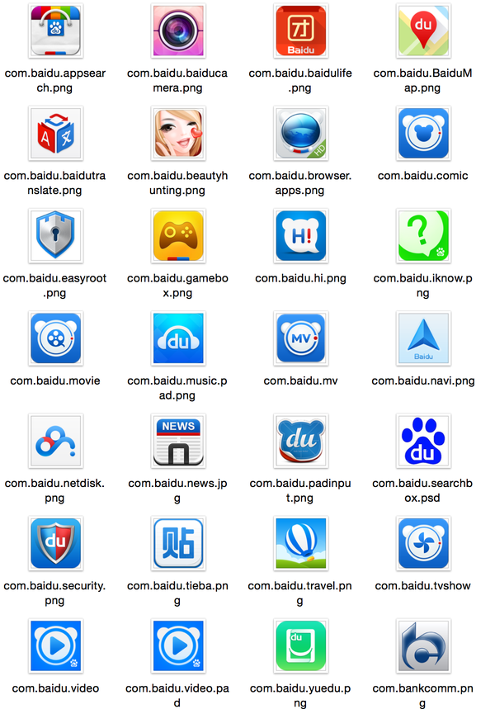
Background introduction of baidu
Hongbo Fang
Primarily famous for search engine service
Net giant in China
  Controls 63% market share in China, twice as Google’s on 2010 [1]
  513 million internet users in China by 2011 [2]
1, 2
Notes:
Compare with Google.
Market share.
Variety of software services. More than 40 other sevices

Slide 10

Software bundle spam
Hongbo Fang
Software product bundle offer
  Inconspicuous checkboxes for software bundle offer
  Software bundle offer in search result download
  Utilized internet explorer security hole to install software bundle in silence [3]
3
Notes:
Sponsoring offer that compared with Youtube downloader example.
Baidu anti-virus is hard to removed.

Slide 11

Software bundle spam
Hongbo Fang
Software product bundle offer
  Inconspicuous checkboxes for software bundle offer
  Software bundle offer in search result download
  Utilized internet explorer security hole to install software bundle in silence [3]
3
Notes:
Example of Brazilian people trying to learn how to remove baidu antivirus
Utilized security hole to promote product

Slide 12
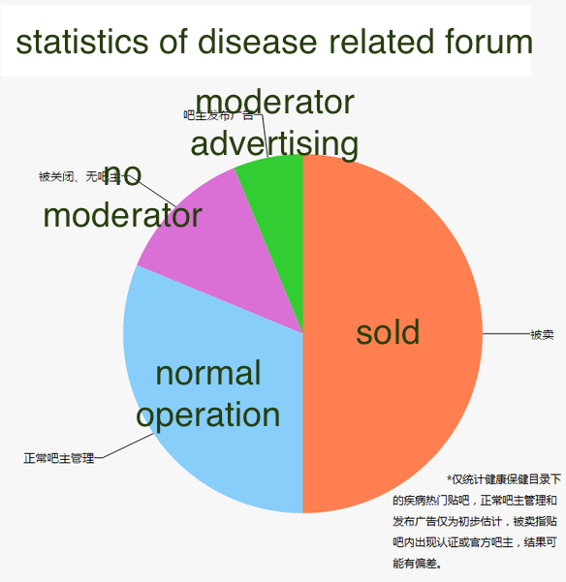
Paid marketing
Hongbo Fang
Baidu Pay Per Click
  Improves search ranking
  Without censorship
Selling forum moderator role for profit
  Disease related forum
  Hemophilia forum
4
4
Notes:
Paid ranking iprovement
Amazon and ebay example.
Censorship.
Trademark conflick
Unlicensed medical provider
Selling forum moderator
game forum
disease related forum

Slide 13
Responses to dubious business model
Hongbo Fang
Penalty issued by government
  Violation of Advertisement Law [5][6]
Exposure by media
Public opinion
  Intense discussion and boycott on Zhihu community [7]
5, 6, 7
Notes:
Government issued penalty for two cases.
Baidu stopped commercial activity to disease related forum
Media expose.- baidu’s market share is still at the top of the list
Zhihu introduction.
500 answers average about Baidu’s topic
33k upvote

Slide 14
Conclusion
Hongbo Fang
Harmful business model
Public opinion played important role in opposing harmful business model
Baidu’s on-going reformation [8]
8
Notes:
Consider harmful for financial lost and medical problem
Public opinion drew government attention
Baidu’s reformation. Innovation products.

Slide 15
References
Hongbo Fang
[1] Barboza, David (January 13, 2010). "Baidu's Gain from Departure Could Be China’s Loss". The New York Times. http://www.nytimes.com/2010/01/14/technology/companies/14baidu.html
[2] Lawton, Tait. (Jan 18, 2012) "Pretty Graphs on Chinese Internet User Demographics, January, 2012". http://www.nanjingmarketinggroup.com/blog/chinese-internet-user-demographics-jan-2012
[3] Utilized internet explorer security hole to install software bundle in silence (Dec 3, 2014) http://www.it.com.cn/news1/2014120312/1156271.html
[4] Google also had sold banned medicine, but it paid half billion dollars, (Jan, 2016), http://zhuanlan.zhihu.com/p/20506004
[5] Legal nature of paid search ranking(May 13, 2014) http://www.saic.gov.cn/gzfw/zjgd/xxzx/201405/t20140513_145074.html
[6] Penalty of Baidu forum (Feb 20, 2016), http://tech.sina.com.cn/i/2016-02-20/doc-ifxprucu3041216.shtml
[7] Why Baidu diminished user experience for Chinese, (Mar 3, 2016) https://www.zhihu.com/question/29740126
[8] Baidu’s reformation (Apr 14, 2016) http://money.163.com/16/0414/08/BKJMTJB300253G87.html

Slide 16
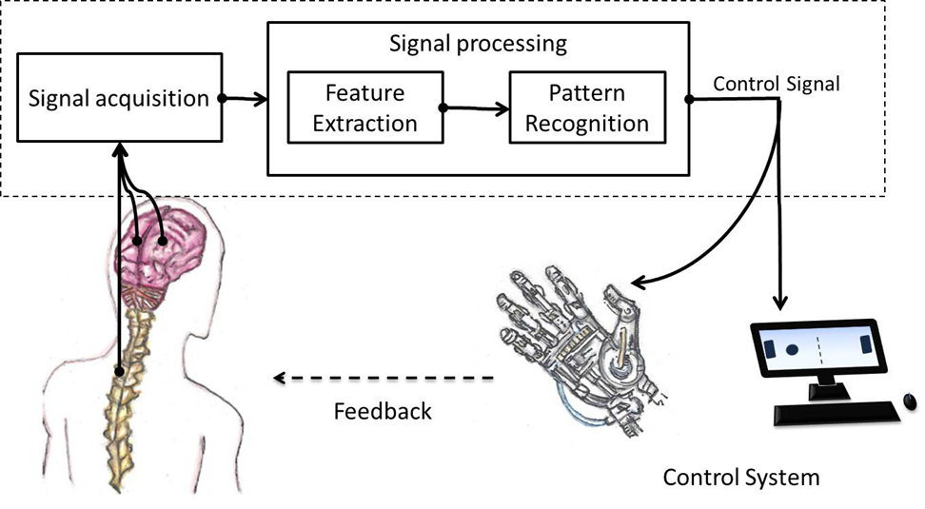
First: some background
Patrick Polley
Communication between neurons and computers == Brain Computer Interfaces (BCI) [1]
Unprecedented control over multifaceted systems [2-6]
Read neurological signals
Readings are quick[1]
  Speed has increased as time progresses[2]
Notes:
Different BCI’s:
EEG (non-invasive)
Brain Implant (invasive)
Control Systems:
Computers
Machinery
Robotic limbs
Aircraft
Virtual Reality
Near-real-time MRI’s
Types of readings:
Fast low resolution. Surface scans
Slow high resolution. Deep scans
Modern speed: 1.3 seconds for detailed reading
In 2006, max speed for this level of detail was 4 seconds

Slide 17

Psychological uses
Patrick Polley
Historically used for mental problems [7]
Can read ALL brain signals (given time) [1]
Developed patterns allow access to subject’s mental state [7]
Could be used to predict how patient will act if you have enough data [7]
Notes:
Used to be used to diagnose some psychological disorders including ADHD and dementia
Process used to be slow, but quick scans can be done in almost real time at this point.
Known mental patterns exist across majority of humans. (NOT ALL)

Slide 18
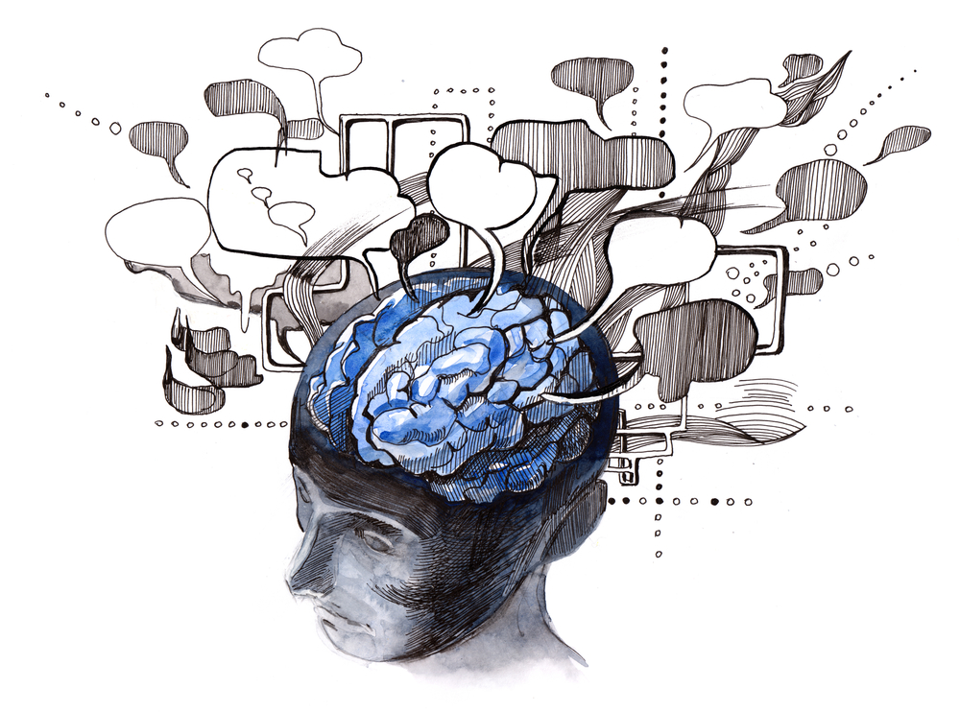
The Question!
Patrick Polley
  Should developers read mental states to predict potential criminal actions?
  Could possibly prevent violent crimes
    Who to profile? Everyone
  People already being profiled.
  Mental states over time -> patterns
  Implications for developers?
  Privacy issue?
Notes:
Should developers be implementing this kind of system into a BCI application? It would offer lots of problems for them morally. Is it OK to skim information off of readings to build patterns?

Slide 19

Strengths
Patrick Polley
Money!
Not just for criminal actions
Could possibly predict possible criminals and crimes.
Hurt some for the good of many?
Worthwhile sacrifice?
  Privacy vs security
People already being profiled
  Consumer patterns vs criminal patterns
Notes:
Profiling could be done automatically through some AI
Could also be used to predict consumerism patters

Slide 20

Problems
Patrick Polley
As stated in the Software Engineering Code of Ethics:
  2.09 “Use the property of a client or employer only in ways properly authorized, and with the client’s or employer’s knowledge and consent.”[8]
    Are thoughts property?
  3.13 “Be careful to use only accurate data derived by ethical and lawful means, and use it in ways properly authorized.”[8]
    False positives?
    How accurate would readings be?
      New technology
Need to profile every user
  Manpower or really good AI
    Expensive either way

Slide 21

Conclusions
Patrick Polley
Could =/= Should
Drawbacks outweigh the potential benefits
BCI’s should be used exclusively for data transfer, not data storage or analysis past translating immediate thoughts to commands.
BCI’s can be used for psychological analysis, but this kind of analysis should be reserved for people who specifically opt in.
Notes:
Just because the technology exists and this is a possible application, does NOT mean that it should be done.
People can already be analyzed through their actions on computing devices, but this kind of profiling would cross the preverbal line in the sand. As soon as you can read thoughts, nothing is private.

Slide 22
Sources
Patrick Polley
Weiskopf, N., Mathiak, K., Bock, S. W., Scharnowski, F., Veit, R., Grodd, W., ... & Birbaumer, N. (2004). Principles of a brain-computer interface (BCI) based on real-time functional magnetic resonance imaging (fMRI).Biomedical Engineering, IEEE Transactions on, 51(6), 966-970.
Baykara, E., Ruf, C. A., Fioravanti, C., Käthner, I., Simon, N., Kleih, S. C., ... & Halder, S. (2016). Effects of training and motivation on auditory P300 brain–computer interface performance. Clinical Neurophysiology, 127(1), 379-387.
Moss, R. (2014, December 18). Quadriplegic successfully uses mind-controlled robotic arm. Retrieved April 14, 2016, from http://www.gizmag.com/quadriplegic-mind-controlled-robotic-arm/35275/
Stockton, N. (2015, March 5). Woman Controls a Fighter Jet Sim Using Only Her Mind. Retrieved April 14, 2016, from http://www.wired.com/2015/03/woman-controls-fighter-jet-sim-using-mind/
Bayliss, J. D., & Ballard, D. H. (2000). A virtual reality testbed for brain-computer interface research. Rehabilitation Engineering, IEEE Transactions on, 8(2), 188-190.
Thibault, R. T., Lifshitz, M., & Raz, A. (2016). The self-regulating brain and neurofeedback: Experimental science and clinical promise. Cortex, 74, 247-261.
Tudor, M., Tudor, L., & Tudor, K. I. (2004). [Hans Berger (1873-1941)--the history of electroencephalography]. Acta medica Croatica: c̆asopis Hravatske akademije medicinskih znanosti, 59(4), 307-313.
Quinn, M. J. (2014). Ethics for the information age. Boston, MA: Pearson/Addison-Wesley.
Graimann, B., Allison, B., & Pfurtscheller, G. (2010). Brain-computer interfaces: Revolutionizing human-computer interaction. Heidelberg: Springer.

Slide 23
Picture Sources
Patrick Polley
http://www.intechopen.com/source/html/46001/media/image1.jpeg
http://cdn.zmescience.com/wp-content/uploads/2015/04/bci.jpg
http://gatherer.wizards.com/Pages/Card/Details.aspx?multiverseid=83035
https://leadinglearner.me/2013/05/31/vision-2040-learners-at-the-centre-ii/
https://chaoticpharmacology.com/2015/06/08/thank-you-again/
http://www.technologybloggers.org/science/how-many-human-brains-would-it-take-to-store-the-internet/

Slide 24

Creation of conscious AI
Nan Zhang
Artificial Consciousness:
  A field related to AI and cognitive robotics
  Synthesize consciousness into an engineered artifact
[5,6,7]
Notes:
Today we will talk about the creation of conscious AI.
Basically, the key to create conscious AI is to invent artificial consciousness. It is a new field related to Artificial Intelligence and cognitive robotics. You basically make the robot have some sort of consciousness.
In order to achieve artificial consciousness, scientists need to synthesize consciousness into an engineered artifact. Scientists can never achieve this without fully understanding of both AI and human consciousness. It is an extremely difficult process which I will explain later.
So let’s now take a deep look at both artificial intelligence and consciousness.

Slide 25

artificial intelligence
Nan Zhang
The study and design of intelligent agent
  A system that perceives its environment and take actions that maximize its chance of success
Make smart decision based on given input
Development Trend: improving AI’s reasoning, learning and decision-making level
[8]
Notes:
Because most of us are CS people, we might hear some concepts of AI before. It is actually the study and design of intelligent agent. An intelligent agent is a system that perceives its environment and take actions that maximize its chance of success. Just like human, the study of AI is to make a robot or a software think humanly and act humanly.
Nowadays, we develop AI because we want it to make smart decisions. One usage of AI is to implement Big Data Analysis. When we have certain input data and we want computer to process it, we would develop a certain software with AI algorithm behind it. After processing all the data, AI might be able to provide us with useful information. It might make a smart decision based on the data we provide.
Scientist right now are working towards improving AI’s reasoning, learning and decision-making level. This is the current development trend of AI. Because reasoning, learning and decision-making abilities are all owned by human, we want to make AI behave more like a real person. Our intent of inventing AI is to facilitate our life.

Slide 26
Consciousness
Nan Zhang
No general consensus as to how to define or measure conscious awareness
An intrinsic property of matter
A sense of selfhood
Executive control system of mind
[3]
Notes:
We will now look at the definition of consciousness. Unfortunately, up to this point, there is no general consensus as to how to define or measure consciousness awareness. We do not know how to define it exactly, but we can actually feel it.
We only agree that consciousness is an intrinsic property of matter. It is a sense of selfhood and it has the executive control of mind.
Consciousness itself is very vague to talk about. Psychologists now are still exploring this area to see how consciousness is created.

Slide 27

Analysis on conscious machine
Nan Zhang
Very little progress.
Focus not on sentience or consciousness, but on computing ability
Keep calm and be careful
<Graphic>
[1,2,3,9]
Notes:
By synthesizing consciousness into machine, we might be able to invent conscious machine. Inventing this kind of machine means that we may not put too much control on it, because it already has some sort of consciousness. In that case, by letting machines have some sort of consciousness, people do not need to put control on the AI.
However, nowadays, scientists have made very little progress on the development of conscious machine. As I said before, this is because they do not fully understand how consciousness works. Because we know so little about creating consciousness on AI, we do not know how it would be if this idea becomes true.
Right now, we invent AI because we want to utilize its incredible computing ability. We do not care whether a machine has consciousness or not. Our main goal is to make it facilitate our life. Although making it conscious would benefit us in some ways, people should realize the limitation of technology. We may build conscious machines until we have total control on them. If we lose the control, they might do something unethical.
For the development of conscious machine, people should keep calm and be careful.

Slide 28

Example for Future application of AI’s computing ability
Nan Zhang
Improvement on Search Engine
  More than 26 millions of page searched for a single question
  Current AI technology does not understand all the pages
  Utilization of AI’s computing ability to go through all of them land answer the question directly.
  Limitation is about understanding all the pages
[3,10]
Notes:
One example for Future application of AI’s computing ability is the usage of search engine.
Right now: for a single question searched on Google, more than 26 millions of page are provided. Google indexes all these pages and use some tricks to figure out which is more important than others. But the main limitation is that it do noes understand anything.
We want to invite a search engine with better AI algorithm that can understand all the material using AI’s incredible computing ability.

Slide 29
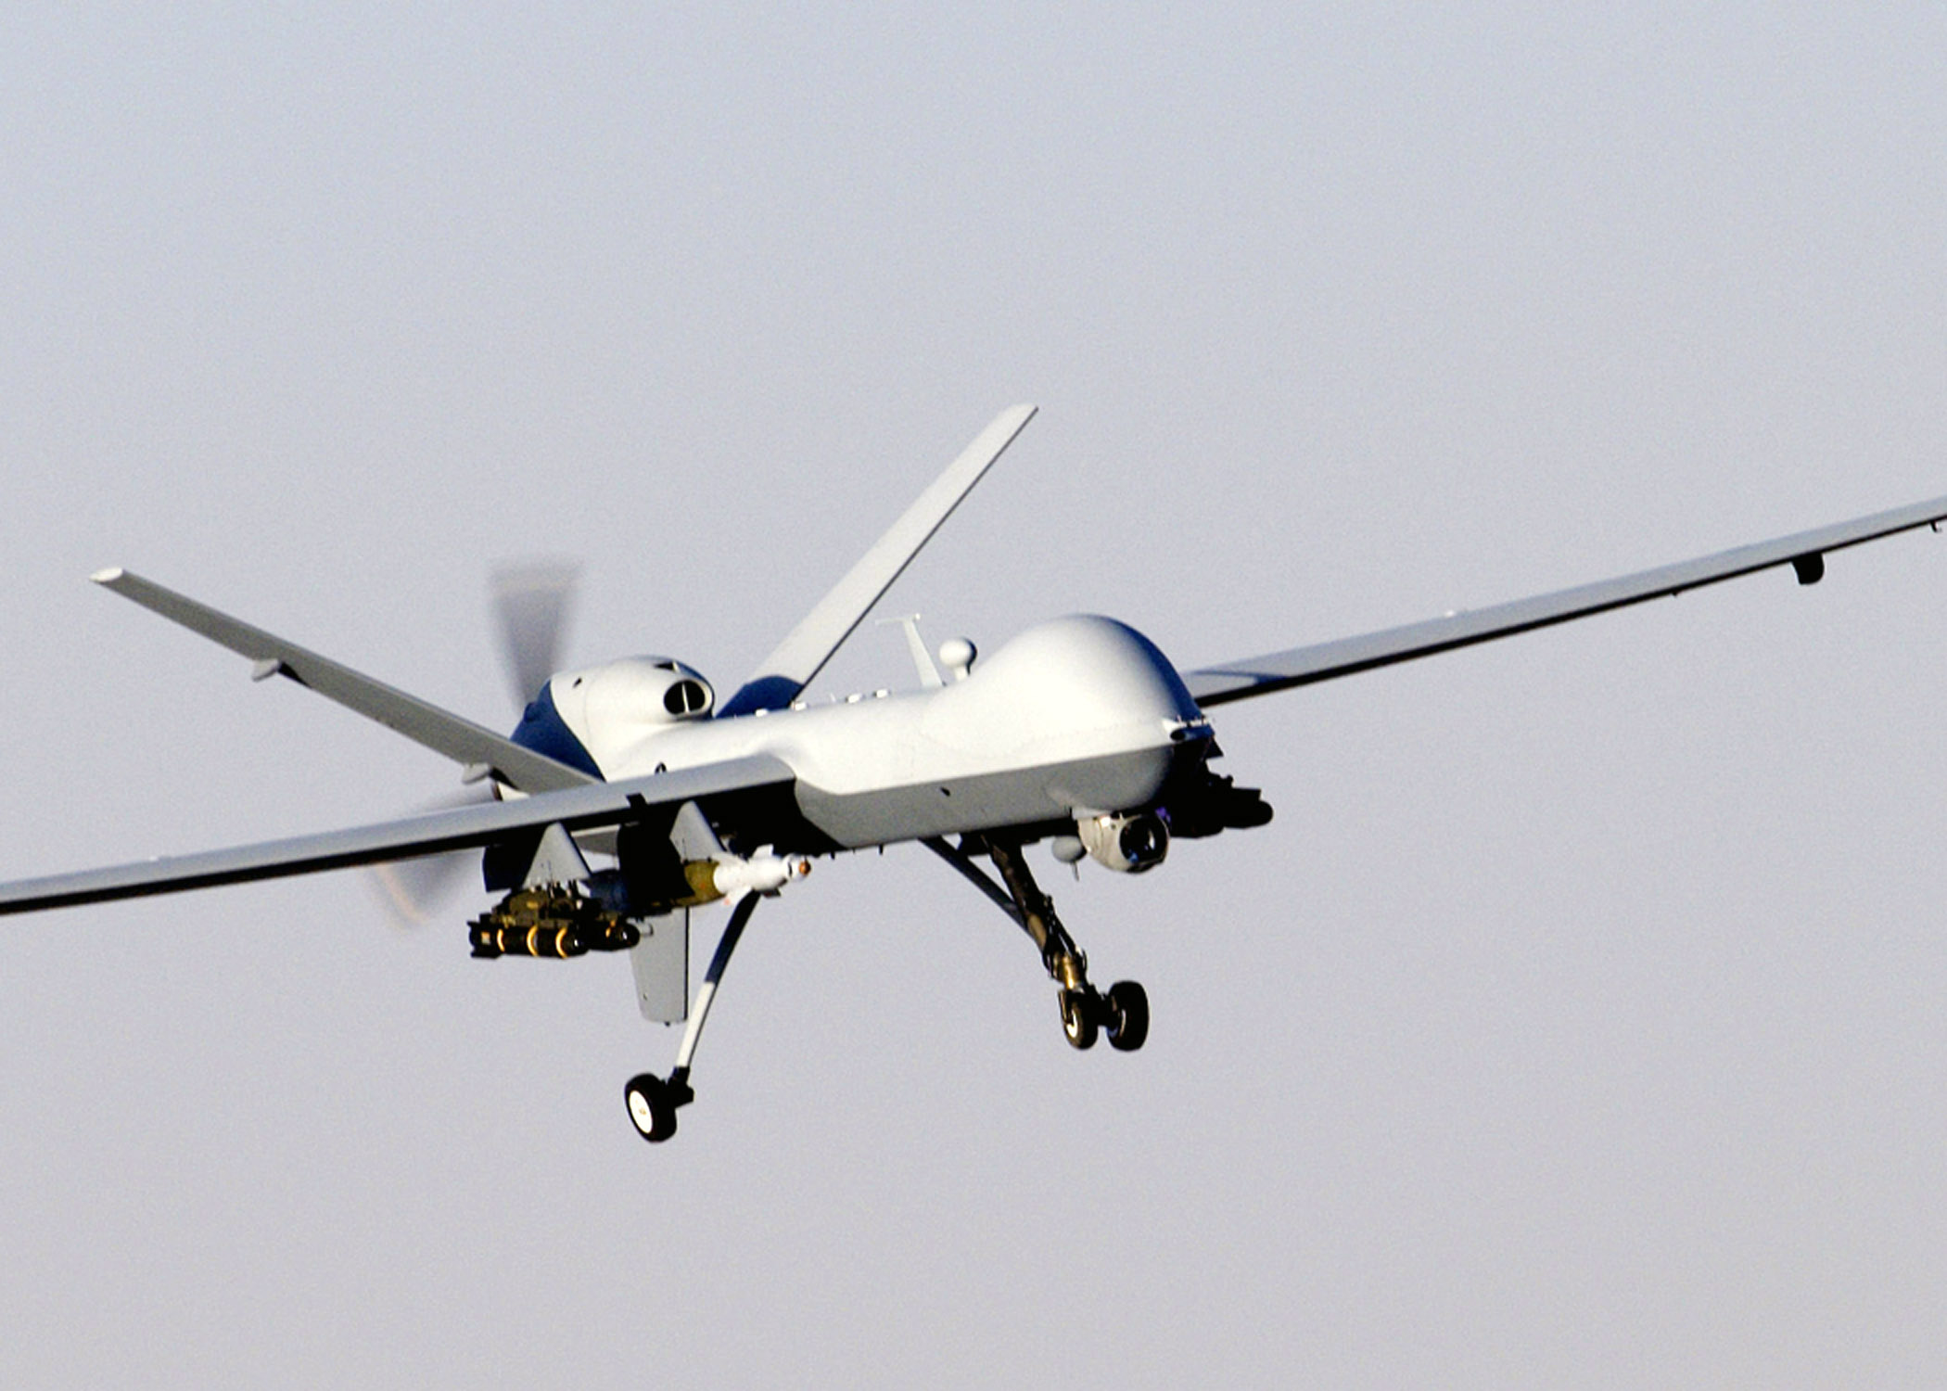
AI Weapon from the idea of conscious machine
Nan Zhang
Military Unmanned Aerial Vehicles
  Robotic planes acting on their own
  Can fire weapons without human permission
[4,11,12]
Notes:
Although conscious machine has not been fully invented. AI weapon sets a bad example of future utilization of conscious machine.
One variation of AI weapon is Military Unmanned Aerial Vehicle. It requires no pilot at all and can act on its own.
One important thing to notice is that it can fire weapons without human permission. We should think about the power we give to this kind of conscious machine. Machine itself should not have the power to decide human’s lives. Control over it is required.

Slide 30
Conclusion
Nan Zhang
Develop conscious machine cautiously
  Keep a careful eye on AI weapon.
Focus more on utilization of AI’s computing ability
Notes:
Because of the limitation of current AI technology, we should develop conscious machine cautiously. We do not know what will happen after the realization of conscious machine. The essential thing is to have full access of control over it. For example, we need to keep a careful eye on AI weapon. It is not ethical to let machines decide the lives of people.
When people talk about super intelligent AI, they're not talking about sentience or consciousness. They're talking about AI’s superhuman ability to make high-quality decisions. So instead of thinking too much about consciousness, we may need to focus more on the utilization of AI’s computing ability. Our main purpose from AI is for facilitation of our lives.

Slide 31
References
Nan Zhang
[1] http://bigthink.com/going-mental/can-computers-be-conscious retrieved on 4/12/2016
[2] https://www.technologyreview.com/s/531146/what-it-will-take-for-computers-to-be-conscious/ retrieved on 4/13/2016
[3]http://www.techinsider.io/artificial-intelligence-machine-consciousness-expert-stuart-russell-future-ai-2015-7 retrieved on 4/13/2016
[4] http://www.theatlantic.com/technology/archive/2015/08/humans-not-robots-are-the-real-reason-artificial-intelligence-is-scary/400994/ retrieved on 4/13/2016
[5] http://www.cs.yale.edu/homes/dvm/papers/conscioushb.pdf retrieved on 4/14/2016
[6] https://aeon.co/essays/could-machines-have-become-self-aware-without-our-knowing-it retrieve on 4/13/2016
[7] image of artificial consciousness: http://www.valuewalk.com/wp-content/uploads/2014/05/artificial-intelligence-AI.jpg retrieve on 4/14/2016
[8] image of AI: http://www.extremetech.com/wp-content/uploads/2015/05/ai-cropped-640x353.jpg retrieve on 4/14/2016
[9] image of conscious of machine: http://cdn.zmescience.com/wp-content/uploads/2015/12/ai-image.jpg retrieve on 4/14/2016
[10] image of search engine: http://cdn.business2community.com/wp-content/uploads/2013/12/search-friendly.jpg retrieve on 4/13/2016
[11] http://www.popularmechanics.com/military/a5383/4347306/ retrieve on 4/13/2016
[12] image of military Unmanned Aerial Vehicles: https://upload.wikimedia.org/wikipedia/commons/b/b0/MQ-9_Reaper_in_flight_(2007).jpg retrieve on 4/14/2016

Slide 32
Class 10
The End
Keith A. Pray
Instructor
socialimps.keithpray.net
Notes:
This is the end. Any slides beyond this point are for answering questions that may arise but not needed in the main talk. Some slides may also be unfinished and are not needed but kept just in case.

