Slide 1
Class 8 Crime
Keith A. Pray
Instructor
socialimps.keithpray.net
Notes:
Here’s the title slide. Is anyone not excited?
Paper Reminders:
5 High quality sources
Conclusion, Argument, Counter Point, Response
Try reading paper aloud
Paper average 4.5 – 5.5 – 5.0 – 6.0

Slide 2
Survey Results
Notes:
Added paper due date and grading rubric to guidelines page
Added individual presentation due dates and grading rubric to guidelines page
Will add participation Grades on myWPI
Anyone spending more than 17 hours per week should come see me for help.
Paper Assignment Ideas Discussion Board

Slide 3
Overview
Review
Assignment
Students Present

Slide 4
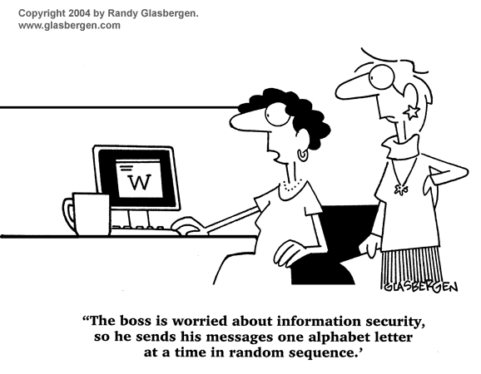
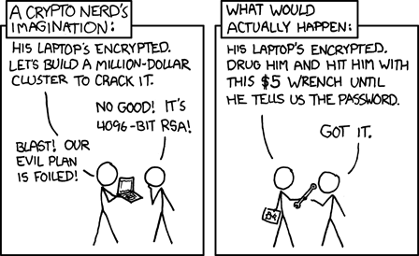
http://xkcd.com/538/ (2010-11-14)
Notes:
Are there any questions on the assigned reading?
Use the slides ahead to explain any of the attack methods from the text.
If there are no questions you can skip those slides.

Slide 5
Buffer Overrun
Run time stack
Local Variables
Return Address
Parameters
Variable Attack
buffer
Target Variable
Stack Attack
buffer
Return Address
code
Return Address
Notes:
Retire slide. Most students have this in depth from new class now.
When a function call is made, local variables, return address, parameters stored on run time stack. Local variables occupy lower memory addresses.
Variable attack – change variable value. Program expects user to input character and allocates a buffer for them. Attacker supplies too many characters and ends up over writing a variable.
Stack Attack – goal is to change value of return address so execution control goes to code which the attacker has provided in the input buffer.
Prevention – add checks against array bounds being exceeded, or modify operating system to not execute instructions stored on run time stack.

Slide 6
Run Example Code
Notes:
Retire demonstration. Most students have this in depth from new class now.
> imps
> assembly
> 123456789qwerty1

Slide 7
Buffer Overrun Code
#include <stdio.h>
#include <string.h>
int main ( void ) {
char buff [ 15 ]; int ace = 0;
printf ( "\n Enter best class ever : \n" );
gets ( buff );
if ( strcmp ( buff, "imps" ) ) {
printf ( "\n %s is wrong! You should FAIL! \n ace=%i\n", buff, ace ); }
else { printf ( "Correct! \n") ; ace = 1; }
if ( ace ) { printf ( "You get an A! \n" ); }
return 0; }
} The Naughty Line
Notes:
Retire slide. Most students have this in depth from new class now.

Slide 8
TCP Three-way Handshake
SYN
SYN-ACK
ACK
Notes:
Retire slide. Most students have this in depth from new class now.
SYNchronize
SYNchronize ACKnowledgement (socket reserved awaiting ACK)
ACKnowledgement
TCP socket connection established

Slide 9
SYN Flood Attack
SYN
SYN-ACK
Notes:
Retire slide. Most students have this in depth from new class now.
Attacker spoofs the IP address so the SYN-ACK is sent to a different machine that cannot respond to the SYN-ACK.
This leaves the connection half open on the server machine decreasing the resources (sockets, memory, threads/processes) available to respond to legitimate clients.
The attacker send many such spoofed SYN messages.

Slide 10
Ping Attack
Target
Attacker
ping
ping
Notes:
Retire slide. Most students have this in depth from new class now.
Attacker finds routers that support broadcasting messages to all computers on their local area networks.
The attacker sends a spoofed ping message, which the routers echo to the spoofed address.

Slide 11
My Reading Notes
pp. 321 Might be interesting to compare password guidance over the years.
pp. 323 How does Firesheep always get a user photo?
pp. 328 Not current or virus unknown…
pp. 330 Goals include infect 3 machine per LAN and as many computers as possible? Never make last minute changes before release. Were they related to the defects?
pp. 332 Do people use the Internet as an experimental laboratory these days? Shutdown right after booting, “benign” doesn’t seem like the right word.
pp. 334 “send reports back to a host computer”?
pp. 335 Firewalls often not running on same machine as malware, routers?
pp. 337 Have 2003 fears of cyber terrorist attacks been realized?
pp. 345 How is online voting a moral issue?
pp. 346 Is Internet access due to financial restrictions still relevant? Could issue specific, unrelated code for each vote.
End of Chapter questions:

Slide 12
Group Quiz
A denial of service attack shuts down a bunch of retailer, stock brokerage, large corporate entertainment and information web sites. Possible guilty parties:
Terrorist who aimed to cause billions of damage to U.S. economy.
Protest organization opposing commercialization of the web and corporate manipulation of consumers.
Script kiddie just having fun with tools he found on the web.
Show off hacker in search of bragging rights.
State what penalties are appropriate for each.
Explain your answer to 1. using a single Ethical Theory for all.
Name the laws/acts under which these parties could be prosecuted.
Notes:
Works well as small group exercise.
Note: short answer format expected.
Note: 2. only one argument needed, should include logic for all parties
Note: 3. same law(s) should be applicable to all parties

Slide 13
Assignment Code Testing 1/2
Design tests for the code on the following slide.
Contains at least one major defect and several minor ones.
Write a paper (1 page not counting any source code) including :
Did you choose a good test strategy? (This is your conclusion.)
The inputs and expected outputs
What defects you found
How you would fix the defects (you may include fixed source)
Why would that fix the problems?
What could happen if the defects are not found before the code is put into production?
Working example: http://socialimps.keithpray.net/assignments/index.jsp?content=Code_Test.jsp
Notes:
The online working example source code is best not viewed with IE though looking at the source for the page will reveal the implementation.
If guest presenter coming next class remind students to prepare questions for him.
Remember to work on groups projects.
Each group should have material on their sites for the topics we’ve covered so far.

Slide 14
Assignment Code Testing 2/2
import java.text.NumberFormat;
public class SalesFun {
public static double calculateSalesTotal ( double amount, double discountRate, double taxRate ) {
double discount = amount * discountRate;
double total = amount - discount;
double tax = total * taxRate;
double taxedTotal = tax + total;
NumberFormat numberFormat = NumberFormat.getCurrencyInstance();
System.out.println ( "Subtotal : " + numberFormat.format ( amount ) );
System.out.println ( "Discount : " + numberFormat.format ( discount ) );
System.out.println ( "Total : " + numberFormat.format ( total ) );
System.out.println ( "Tax : " + numberFormat.format ( tax ) );
System.out.println ( "Tax+Total: " + numberFormat.format ( taxedTotal ) );
return taxedTotal;
}
}
} Lines of interest
Notes:
Bold lines are real focus.
Example input:
amount = 100.05;
discountRate = 0.10;
taxRate = 0.05;
OR
0.70, 0.0, 0.05
95.67, 0.20, 0.7

Slide 15
Overview
Survey
Review
Assignment
Students Present

Slide 16
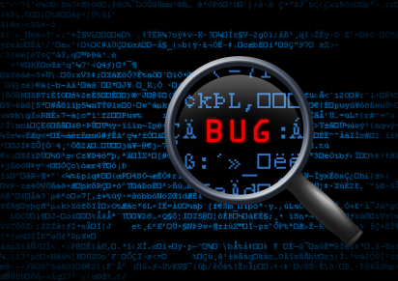
Is Finding Security Holes a good idea
Andrew La Manna
Should vulnerabilities be actively sought out
<http://krebsonsecurity.com/wp-content/uploads/2010/11/bugs.jpg>

Slide 17

Hat colors
Andrew La Manna
Black Hat vs. White hat
Two cases if vulnerabilities are left alone
Black hat discovery
White hat discovery
[2]
Notes:
Black Hats – malicious hackers that intend to exploit vulnerabilities for person gain(they feel since they found they exploit then can use it as they please and make some money off of it)
White hats – People that find vulnerabilities and report them to the proper party or apply the fix themselves (follow what is the “right” thing to do and report the bug)
Gray hats – they look for vulnerabilities in the owners system(with out permission) and will sometimes request a fee for fixing the system

Slide 18
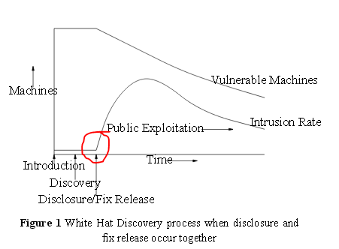
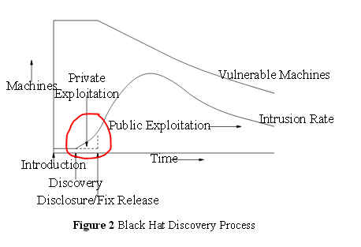
Main take away
Andrew La Manna
System Threat Model
[1]
Notes:
Difference between the two curves is the area circled red. The cost of an intrusion is related to the area under the curve. Although this can be effected by some other variables such as value of the target. One could expect machines compromised during private exploitation to be more valuable. By nature black hats are going to target machines that will make them the most money before they get patched. For example if there are 10 machines that are vulnerable to an exploit and one of those is a bank and will net you as a black hat hacker 20x more than the other 9 machines, you would want to exploit that one machine before it gets patched.

Slide 19
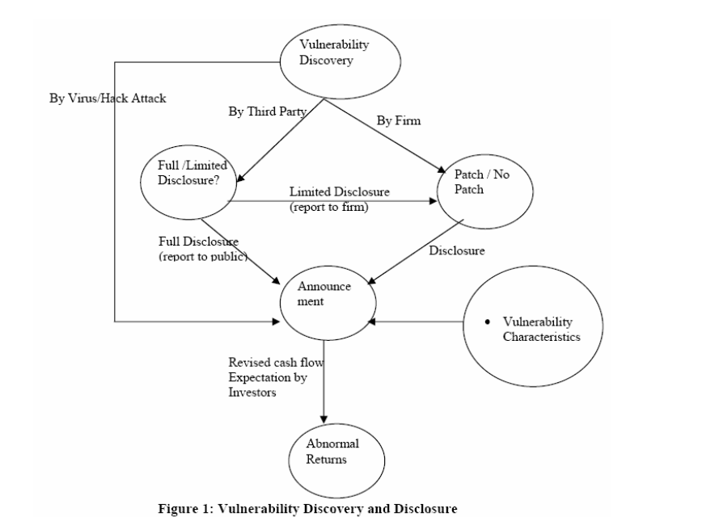
The Problem
Andrew La Manna
Life Cycle
Situations in which revealing vulnerabilities may not be beneficial
Cost of revealing
Spikes in exploited machines
May never be found
[3]
Notes:
Life cycle of a vulnerability
Introduction
Discovery
Private exploitation
Disclosure
Public exploitation
Fix release
Sometimes its better not to reveal the vulnerability. This can occur when the cost of revealing is too high, or there may be large spikes in exploited machines. And in some cases the vulnerability may never be found, so there would be no need to waste the money and time to disclose and patch it.
Negative Cumulative Abnormal Return(CAR) for software stock prices when vulnerability is disclosed (evidence to support not disclosing)
This is just for stock market values, not the actual man power and internal costs needed to find and fix the vulnerability

Slide 20

Things to consider
Andrew La Manna
Cost Analysis
Time to fix
Potential downtime
Don’t apply the fix
Potential emergency response
High Value Targets
Target faces $162 in expenses
[3], http://abullseyeview.s3.amazonaws.com/wp-content/uploads/2014/04/targetlogo-6.jpeg
Notes:
Some things that need to be taken into account when considering the cost is the time needed to fix the vulnerability and the potential downtime of the program.
If the fix is not applied, then the cost of an emergency response cost must be taken into account.
If there a large risk for the target, then it may be better to release the fix and hope the HVT patches quickly
A quick example of how much damage a black hat can do is the target breach in 2013-2014. Target incurred around 162 million dollars in expenses.

Slide 21
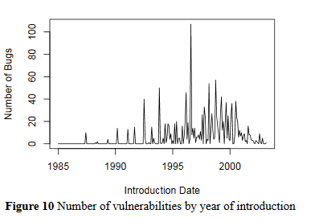
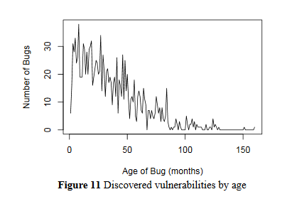
Results and analysis
Andrew La Manna
Is disclosure a good thing
Are vulnerabilities getting depleted
When disclosed intrusions may rise and may not decrease for some time
Effort seems to not be producing significant results
Half Life of Average Vulnerability is 2.5 years
[1]
Notes:
The average half life of a vulnerability is 2.5 years.
Vulnerability depletion is very small since it is very common to find vulnerabilities that have been programs for years.
There could be an infinite amount of vulnerabilities or the rate of depletion could be so slow that it may not be worth it to disclose them
In the best case finding and disclosure doesn’t offset the effort invested(this changes completely if the vulnerability can be fixed with out disclosure)
Top figure shows the number of bugs for software introduced during the represented time period. The large spike represent Windows NT 4.0 and IIS 4.0
Bottom figure show the lifetime of vulnerabilities. It is depleting over time, but this only represents programs released in 1997-2000 so it’s a little biased. Often vulnerabilities are found that were in some of the original 1.0 code. OpenSSH had that problem, bugs survived past the extensive audits of the program and were eventually discovered years later

Slide 22
conclusion
Andrew La Manna
To disclose or Not to disclose
Improve patching so that vulnerabilities cost less
Patch “silently”
Speedy patching
Further analyze vulnerability finding
Notes:
Based on the information gathered its better for a white hat to discover a vulnerability than a black hat
In most cases silent patching is the best option. This is impossible with open source software and in some cases reverse engineering of the patch may be possible
Improve patching either through speed or if possible silent patching
More research needs to be done. A lot of this data was gathered based on statistical models and predictions
Also have to take into account what is better for the customer. Would you be okay if you knew a company was not actively trying to find vulnerabilities in their software
Again this is also highly dependent on potential targets, and how much an emergency response would cost.

Slide 23
References
Andrew La Manna
[1] https://www.dtc.umn.edu/weis2004/rescorla.pdf(4/6/16)
[2] http://community.norton.com/en/blogs/norton-protection-blog/what-difference-between-black-white-and-grey-hat-hackers(4/7/16)
[3]http://infosecon.net/workshop/pdf/telang_wattal.pdf(4/6/16)
[4] http://techcrunch.com/2015/02/25/target-says-credit-card-data-breach-cost-it-162m-in-2013-14/(4/7/16)

Slide 24
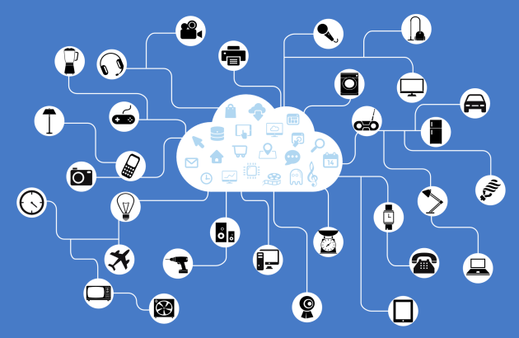
Hijacking The Internet of things
Adilet Issayev
Network of devices that can:
- sense data
- collect /store data
- transmit data
- interact and collaborate using data
The IoT is about connecting things through wireless network
[2,3,4]
Notes:
Questions and quick poll for the audience
What is Internet of Things?
How big is Internet Of Things?
Who owns electronic device that constantly communicate with each other?
The internet is one of the most important and transformable technology ever invented. And there are people who could not live without it
Internet is been around for a while, but it mostly have been the product of people. All the data (images, blogs, emails) was created by people.
This new internet is not just about connecting people, but now about connecting things. And so It’s name the IoT.
How does it work? We take a thing and add the ability to sense, collect, communicate, and control the information. Using this data it will interact and collaborate with other things.
Example: how humans interact with out senses. Things will do the same. Wake Up, Light, Coffee, Car engine.
Why connecting things to the internet is a big deal? Because things will start share the information and data with other things

Slide 25
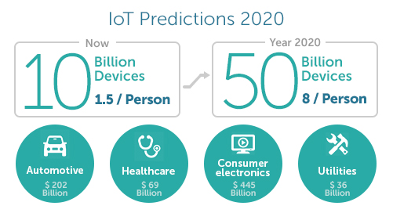
How Big is Internet of Things?
Adilet Issayev
In 2008 there were more devices connected to Internet than people
By 2050 250K vehicles will be connected to the Inernet
Wearable devices has grown 223% in 2015 (Fitbit, Apple Watch)
IoT will add $10-$15 trillion to global GDP in 20 years
[2]
Notes:
In 2008 there were already more devices connected to Internet than people
By 2020 250K vehicles will be connected to the Internet
Wearable device has grown 223% in 2015 (Fitbit 4.4m and Appla watch 3.6m)
Companies keep inventing and investing in smart home devices
IoT will add $10-$15 Trillion to global GDP in the next 20 years
Limitless opportunities for businesses and society
In total, we project there will be 34 billion devices connected to the internet by 2020, up from 10 billion in 2015. IoT devices will account for 24 billion, while traditional computing devices (e.g. smartphones, tablets, smartwatches, etc.) will comprise 10 billion.
Nearly $6 trillion will be spent on IoT solutions over the next five years.
[2]

Slide 26

It Can and will Be Hacked
Adilet Issayev
Your home
Malware in the home
Appliance and Device Malfunction
Harassment
Businesses
Phones/Apps
Cars
Surveillance cameras
Medical Devices
[1,8]
Notes:
Right now IoT lacks safeguards to prevent even basic attacks
DDoS attacks
Security flaws in IoT products have been brought to light by hackers and security researchers. Some of the hacks which made security news were: Smart home, Surveillance cameras, Jeep car (accessed remotely and its engine killed remotely). In addition an airplane’s cockpit controls were accessed via the in-flight entertainment system. As if these weren’t enough, even pacemakers and insulin pumps were demonstrated as being hackable.
iPhone
- it knows where you are
- it knows if you moving
- how you hold your phone
- how much light in the room
- it know what you are saying
- and has the camera to see the surroundings
- and can communicate through the wireless network
FitBit
Thermostats
- what the temperature
- when to change it
- whether people in the house
- and communicates on the network

Slide 27
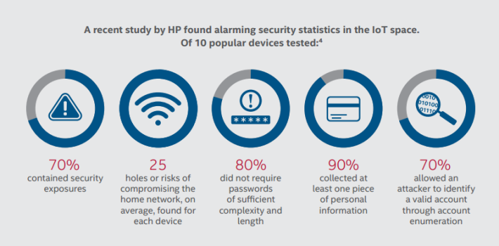
How?
Adilet Issayev
Communication Channels
IoT uses wireless protocols with well known security flaws
Security Problems
Authentication and Authorization
End-to-End encryption
Hardware failures
Unprotected client devices
[1,9]
Notes:
IoT devices mostly communicate wirelessly using protocols like LTE Advanced, Cellular 4G/LTE, 3G GPS/GPRS, 2G/GSM/EDGE, CDMA, EVDO, WIMAX, Weightless, Wifi, Bluetooth, UWB, Z-Wave, Zigbee, 6L0wpan, NFC and RFID. There are known security flaws associated with these protocols, and yet they continue to be widely used. This leaves us with two non-trivial choices:
Fix the issues with these protocols
Come up with better and more secure protocols
Both of the above choices are non-trivial to execute
Authentication and Authorization
Credentials/tokens are essential in the traditional authentication and authorization approach. However, IoT has added new modes: biometrics, sensors, NFC, RFID, and sometimes, surprise surprise: no authentication at all! All these years industry has been struggling with securely storing credentials in one way or another. But now we have a whole new array of authentication and authorization approaches to take care of.
End-to-End Encryption
Mobile apps, messaging apps in particular, first encrypt the user’s data on the device using state-of-the-art industry-standard encryption algorithms. Then anti-snooping, end-to-end encryption techniques are deployed. However, the same approach can’t be taken with IoT devices as the modes of communication are fundamentally different. Here, the communication is not one-to-one but, one-to-many or many-to-many. Data travels through many communication channels and nodes. Also, the security protocols used by devices might vary.
Minor faults in end-to-end encryption may lead to exposure of credentials, tokens, and other sensitive informations. Imagine that you have a router using a state-of-the-art encryption algorithm. This router then communicates with a thermometer, which stores the network password in plaintext. Now, to break into the network, all one would need to do is target the thermometer, thereby bypassing the entire robust network security framework.
Hardware Failures
Preoccupied with creating a sleek and minimalistic design, some manufacturers tend to neglect hardware bugs. These bugs, in turn, can allow attackers to reboot the device(s) and their corresponding hotspots. It is not possible to deliver hardware patches over the air.
Unprotected Client Devices
IoT users’ use of desktops, laptops, tablets, mobiles, etc to operate IoT devices, in turn, opens a remote door to devices. All these devices have a long and notorious history of severe vulnerabilities. Consider a scenario of a company building a smart bulb with all these fancy remote control features. They have a highly compatible, secured mobile app, web interface and embedded hardware. But what if customers have a weak wireless setup, outdated mobile operating system, vulnerable desktop applications? On whom are we going to pin the blame for a breach??!

Slide 28
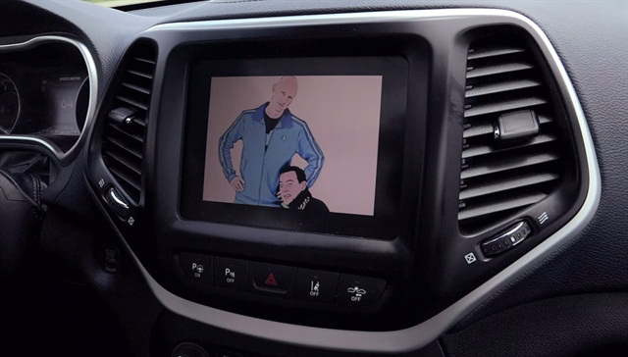
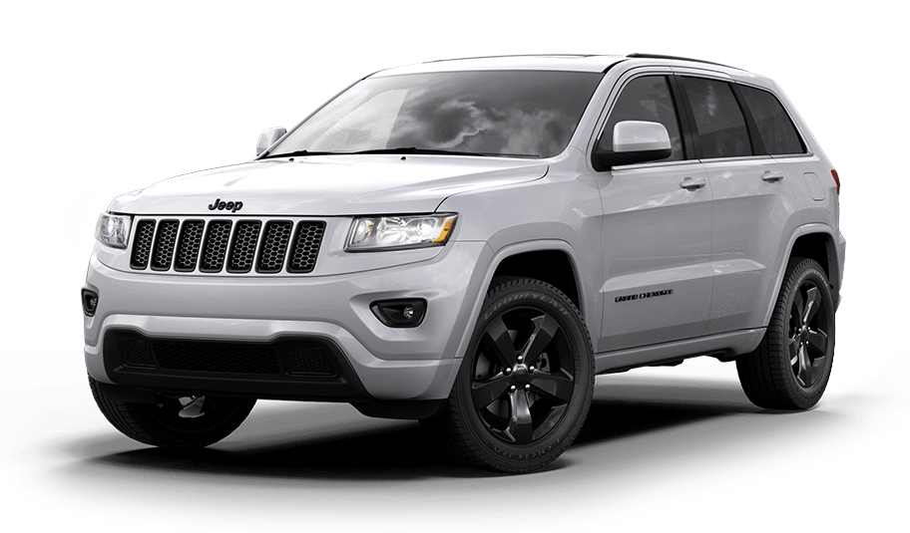
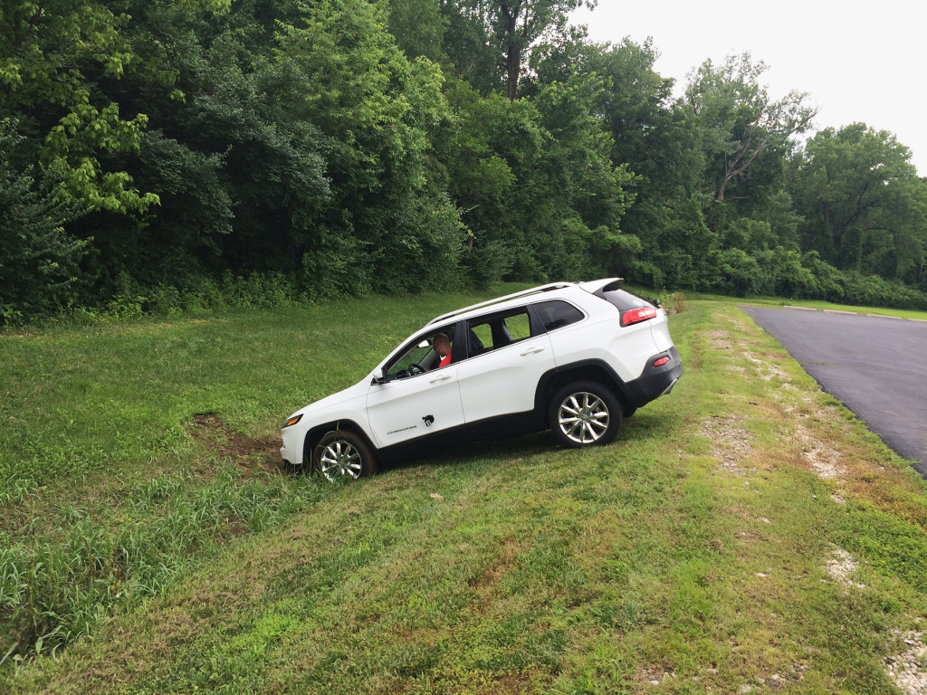
Hijacking Jeep Cherokee 2014
Adilet Issayev
Experiment done in 2014
Remotely killed the engine
No devices were attached
Hacked over internet connection
Take over the steering and transmission
Even the car brakes
Harassed car functionalities
Link to video: https://youtu.be/MK0SrxBC1xs
[7]

Slide 29
Conclusion
Adilet Issayev
IoT always connected , always vulnerable
Hackers can query even more devices for sensitive info and run the commands
Enormous attack surface
Privacy and personal data protection at risk
IoT security is Hard
Complex distributed systems
Just developing application is hard
Securing them is even harder
[9]

Slide 30
References
Adilet Issayev
1. "Security « K7 Blog – Antivirus Software News". Blog.k7computing.com. N.p., 2016. Web. 7 Apr. 2016.
2. Jacob Morgan, “A Simple Explanation Of ‘Internet Of Things’ ”. Forbes. N.p. 2016. Web. 7 Apr. 2016
3."Thinking Products: A Weblog By Clarice Technologies | Demystifying The Internet Of Things". Blog.claricetechnologies.com. N.p., 2016. Web. 7 Apr. 2016
4."Datafloq - The One-Stop Shop For Big Data". Datafloq.com. N.p., 2016. Web. 7 Apr. 2016.
5.The Huffington Post. N.p., 2016. Web. 7 Apr. 2016.
6. Greenough, John. "How The 'Internet Of Things' Will Impact Consumers, Businesses, And Governments In 2016 And Beyond". Business Insider. N.p., 2016. Web. 7 Apr. 2016.
7. Greenberg, Andy. "Hackers Remotely Kill A Jeep On The Highway—With Me In It". WIRED. N.p., 2016. Web. 7 Apr. 2016..
8. Greenberg, Andy and Kim Zetter, How, and How Hacked. "How The Internet Of Things Got Hacked". WIRED. N.p., 2016. Web. 7 Apr. 2016.
Notes:
1. "Security « K7 Blog – Antivirus Software News". Blog.k7computing.com. N.p., 2016. Web. 7 Apr. 2016.
http://blog.k7computing.com/category/security/
2. Jacob Morgan, “A Simple Explanation Of ‘Internet Of Things’ ”. Forbes. N.p. 2016. Web. 7 Apr. 2016
http://www.forbes.com/sites/jacobmorgan/2014/05/13/simple-explanation-internet-things-that-anyone-can-understand/#2c4af7db6828
"Thinking Products: A Weblog By Clarice Technologies | Demystifying The Internet Of Things". Blog.claricetechnologies.com. N.p., 2016. Web. 7 Apr. 2016
http://blog.claricetechnologies.com/2014/03/demystifying-the-internet-of-things/
"Datafloq - The One-Stop Shop For Big Data". Datafloq.com. N.p., 2016. Web. 7 Apr. 2016.
https://datafloq.com/read/how-big-will-the-internet-of-things-be/523
The Huffington Post. N.p., 2016. Web. 7 Apr. 2016.
http://www.huffingtonpost.com/jason-glassberg/will-the-internet-of-things_b_7119650.html
6. Greenough, John. "How The 'Internet Of Things' Will Impact Consumers, Businesses, And Governments In 2016 And Beyond". Business Insider. N.p., 2016. Web. 7 Apr. 2016.
http://www.businessinsider.com/how-the-internet-of-things-market-will-grow-2014-10
7. Greenberg, Andy. "Hackers Remotely Kill A Jeep On The Highway—With Me In It". WIRED. N.p., 2016. Web. 7 Apr. 2016..
http://www.wired.com/2015/07/hackers-remotely-kill-jeep-highway/
8. Greenberg, Andy and Kim Zetter, How, and How Hacked. "How The Internet Of Things Got Hacked". WIRED. N.p., 2016. Web. 7 Apr. 2016.
http://www.wired.com/2015/12/2015-the-year-the-internet-of-things-got-hacked/
9. Mehta, Yash, Yash Mehta, and Yash Mehta. "How Secure Is Internet Of Things (Iot) And M2M Technology?". Iotworm. N.p., 2015. Web. 8 Apr. 2016.

Slide 31
Class 8 The End
Keith A. Pray
Instructor
socialimps.keithpray.net
Notes:
This is the end. Any slides beyond this point are for answering questions that may arise but not needed in the main talk. Some slides may also be unfinished and are not needed but kept just in case.

Slide 32
Crime How
Technical and Non-Technical
Break into computer.
Prevent access to computer.
What things make computer related crime easy?
Notes:
Exploit security holes, Break encryption, Spoofing
Social Engineering: Guess passwords, Find out passwords and procedures
Poor passwords, Insecure protocols, Program limitations (buffer overruns), Eavesdropping (Email, Interactive), Insecure files

Slide 33
Crime Bane
Trojan Horse
Virus
Worm
Bot Network
Buffer Overrun
(Distributed) Denial Of Service Attack
How do they work?
How harmful are they?

Slide 34
Crime Why
Why?
Notes:
Money: stolen credit cards, change records, stolen property.
Political, military, economic.
Challenge, Revenge, Mean
Why do at all? Have motivation, think about it, think it will help, think it’s acceptable.
Feel forced. Don’t agree. Don’t care.

Slide 35
Crime Time
What is different now compared to:
10 years ago?
20 years ago?
30 years ago?
40 years ago?
Notes:
More computers. Unsophisticated owners. More complex software. Greater connectivity. Easy access to cracking tools. Incentives. File-sharing
In ’60s and ’70s, access was mostly localized.
Modems. Wardialing.
Some Arpanet and Usenet.

Slide 36
Crime Doers
Hacker or Cracker
Pre-1980 - Golden Age ☺ ?
Eighties
Nineties
Naughts
Criminal Hacking == Cracking?
Notes:
Script kiddies
Phreakers
Security analysts
Packet monkey

Slide 37
Crime Gain
Justifications for Computing Crimes?
What can be done after access is gained?
What resources are available?
How valuable are they?
Notes:
Machines are unused. No harm done. Education. Exposes security holes. Exposes abuses.
Use computer and/or resources. Take data. Destroy data. Alter data. Lock out others. Attack other computers.
Equipment, Processor Time, Disk space, Printer time / paper, Bandwidth

Slide 38
Crime Pay
Computer Fraud and Abuse Act (1986)
Bans :
unauthorized access or use of computers, copying, modifying, or destroying data, disclosing of passwords.
disrupting government and utilities.
Covers government, financial, medical, and interstate systems.
USA Patriot Act (2001)
Raised penalties.
Permits freer surveillance and monitoring to detect illegal activity.
Electronic Communications Privacy Act
Illegal to intercept telephone, email, other data transmissions, access stored email messages without authorization
Assign Cybercrime Treaty (2006), Wire Fraud Act, National Stolen Property Act, Identity Theft and Assumption Deterrence Act
Notes:
Are either of these laws still in effect? Have they been changed?
For additional legislation ask for presenting volunteers to brief recent incidents/cases.
Also ask for volunteers to find out laws from their home country/state.

Slide 39
Crime Stop
Technical
Protect Data
Protect Machine
Protect Access
Non-technical?
Social?
Legal?
Notes:
Encryption, Authentication, Biometrics, Anti-virus, File integrity checking (E.g. Tripwire), Virtual private networks, Point-to-point networking (Twisted-pair Ethernet vs. Coax vs. wireless)
Security through obscurity, physical access required, not on network, behind locked doors.
Remove desire, remove incentives
Legalize, increase penalties, increase chance of getting caught.

