Slide 1
Class 4
Freedom Of Speech
Keith A. Pray
Instructor
socialimps.keithpray.net
Notes:
Here’s the title slide. Excited again, aren’t you? You should be.
Paper Notes:
Average: ~4.
Quantify
State Conclusion clearly
Missing Counter Point and Response
Try reading paper aloud to proof
Go over paper guidelines and watch video → segues into networked communications

Slide 2
Overview
Review
Assignment
Students Present
Notes:
CPG Grey - This Video Will Make You Angry [Thought Germs] (7:25)
https://www.youtube.com/watch?v=rE3j_RHkqJc
“Weird” Al Yankovic – Word Crimes (3:45)
https://www.youtube.com/watch?v=8Gv0H-vPoDc&list=PLOxFIzka6jMnSdaevIZLuWK2l7EA5_nhR
Cedric Gervais - Hashtag (Original Mix) (3:58)
https://www.youtube.com/watch?v=6OmBKd7X7EE
Dave Audé vs Luciana - You Only Talk In #HASHTAG (3:36)
http://www.youtube.com/watch?v=53wIN87lJn0

Slide 3
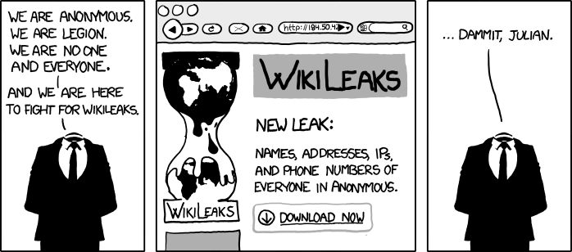
http://www.xkcd.com/834/

Slide 4
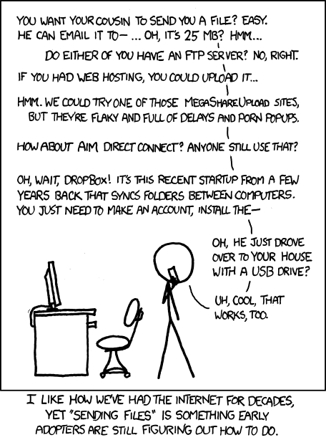
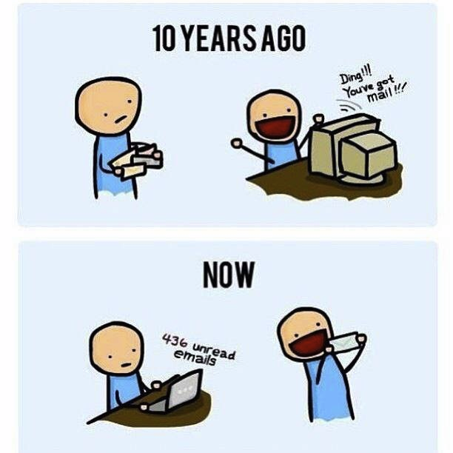
http://poofytoo.com/
20
http://xkcd.com/949/

Slide 5
My Reading Notes
pp. 110 What powers the cell phones and towers? “everyday tasks” not apparent from image.
pp. 111 “over a billion” contradicts pp. 38. [6] from 2008.
pp. 118 [17] from 2005, how is the quality of Wikipedia now?
pp. 131 Is 20% realistic? What will search engines and facial recognition be capable of? Rule Utilitarian ignores the private setting.
pp. 132 Do any filters use imgage processing?
pp. 135 Social Contract - Least restrictive/harmful way to achieve goal?
pp. 138 IM stats from 2002
pp. 139 Sting refs, latest from 2003.
pp. 144 addiction def, ignorance = !addict ?
pp. 146 More accurate to say addicted to single app?
pp. 159 2015 is © of text, time for update
End of Chapter questions I liked: 19, 26 (libel? Yes), 30 (http://en.wikipedia.org/wiki/Wikipedia:Citing_Wikipedia ),

Slide 6
Group Quiz
Name two methods some governments use to control access to information.
A large company has a policy prohibiting employees from blogging about company products.
  Name two possible reasons for the policy.
  Does it violate the First Amendment? Why?
  Is it reasonable? Why?
What does “URL” stand for and what is it?
Notes:
Censorship (religious, governmental, private). Adult authentication. Global dissemination. Freedom of Speech not an absolute right.

Slide 7
Assignment
One page paper
  Global intellectual property laws, friends or foes?
Extra Credit – One page paper
  Is WPI’s IT Acceptable Use Policy morally acceptable?
Remember to work on your group project.
  See full group project description on course website.
Notes:
Or review right now.

Slide 8
Overview
Review
Assignment
Students Present

Slide 9
Introduction
Clark Jacobsohn
How many of you use Twitter?
How many of you have seen or experienced some form of abuse on Twitter?
Notes:
This presentation is about public shaming on Twitter. Before I begin, I would like to warn everyone that there will be some examples of verbal abuse.
First, I would like to ask some questions. First, how many of you use Twitter?
Now, how many of you have seen or experienced some form of abuse on Twitter?

Slide 10
Overview
Clark Jacobsohn
Description of public shaming on Twitter
PyCon 2013 Example
Conclusions
Notes:
For this presentation, I’m going to describe what I mean by public shaming on Twitter. Then, I’m going to show an example and discuss conclusions that can be drawn from it.

Slide 11
Public Shaming on Twitter
Clark Jacobsohn
Special form of abuse that involves:
  An attempt to shame perceived wrongdoer
  Ganging up on that person
Consequences can Include
  Firing
  Widespread verbal abuse
Both accuser and accused can be affected
  Accused are shamed for supposed wrongdoing
  Accusers are shamed for causing consequences (ex. firings)
[1,2,7]
Notes:
Public shaming is a specific version of Twitter abuse that has these characteristics:
First, there is an attempt to shame someone for a perceived wrongdoing. Often, the wrongdoing is simply a distasteful joke.
Second, that shaming is then amplified over Twitter, resulting in people ganging up on that person in a storm of vitriol.
Consequences can include losing one’s job and being subjected to widespread verbal abuse.
These consequences don’t only affect the accused, either. Both the accuser and accused can end up being shamed.
In these scenarios, the accused are shamed for their supposed wrongdoing and the accusers are shamed usually for causing the loss of that person’s job.

Slide 12
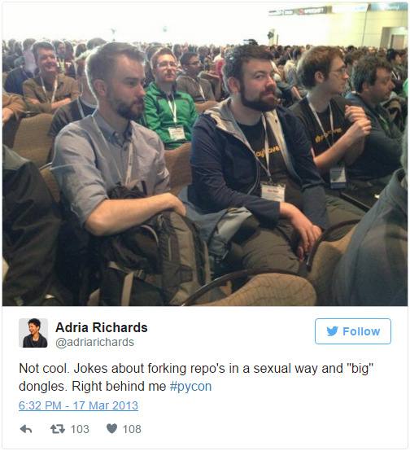
PyCon 2013 Example: Initial Event
Clark Jacobsohn
Adria Richards
  Software Developer
  Overheard two men making crude jokes
The tweet
  Takes a candid photo of the men
  Tweets it with this caption
  As a result, both men are removed from the conference
[1,2,3]
Notes:
One noteworthy example of this phenomenon occurred at PyCon 2013, which, for those that don’t know, is a convention for the Python programming language.
The story begins with this tweet.
Adria Richards, a software developer, overheard two men making some off-color jokes behind her. In an attempt to combat some of the larger issues with gender in tech, Adria posts this tweet along with a picture she took of the two men.
After her tweet, the two men were removed from the conference.
On one hand, Adria was simply trying to make the conference a better place for women, and the two men indeed broke the PyCon code of conduct, specifically a part that states:
“offensive jokes are not appropriate for PyCon”
On the other hand, she didn’t need to confront these men so publicly. Also, the jokes were seemingly supposed to be private, although I guess they didn’t do a good job of that.

Slide 13
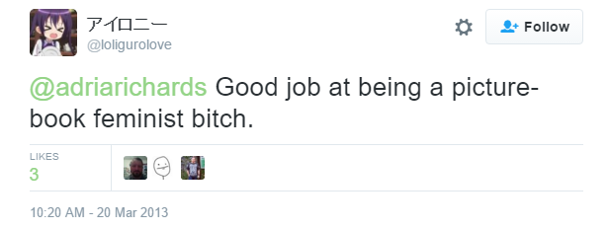
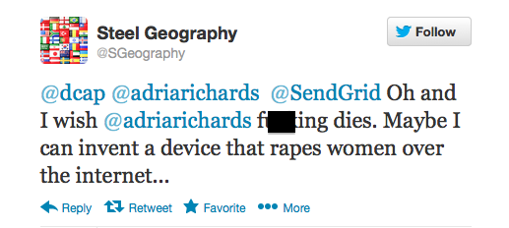
PyCon 2013 Example: Consequences
Clark Jacobsohn
Tweet posted on Hacker News
  One of the men responds
  He lost his job
The internet turns on Adria
  Verbal abuse
  Death threats
In the end
  Both Adria and one of the men lost their jobs
  Despite innocent intentions, everyone lost.
[1,2,3,6]
Notes:
Two days later, Adria’s tweet is posted on Hacker News, a site for programming news with a forum.
In the comments, one of the two men responds to the situation. This is an abridged version of what they wrote:
“Hi, I'm the guy who made a comment about big dongles. First of all I'd like to say I'm sorry. I really did not mean to offend anyone and I really do regret the comment and how it made Adria feel. She had every right to report me to staff, and I defend her position. However, there is another side to this story.”
He then talks about how the forking comment was not meant to be sexual. After, he says:
“My second comment is this, Adria has an audience and is a successful person of the media. Just check out her web page linked in her twitter account, her hard work and social activism speaks for itself. With that great power and reach comes responsibility. As a result of the picture she took I was let go from my job today. Which sucks because I have 3 kids and I really liked that job.
She gave me no warning, she smiled while she snapped the pic and sealed my fate. Let this serve as a message to everyone, our actions and words, big or small, can have a serious impact.”
The internet community then turned against Adria, and she began to receive abusive tweets such as these. She even received death threats.
In the end, Adria ended up losing her job as well. Everybody involved in this situation lost, despite having innocent intentions. The men just made some silly jokes to themselves and one of them ended up losing their livelihood. Adria just wanted a better environment for women in tech and thought she was making a difference. Both points of view have some merit, but both were taken to the extreme, to the detriment of everyone involved.

Slide 14
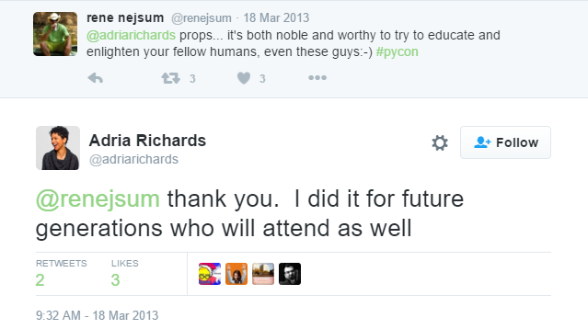
Conclusions
Clark Jacobsohn
With public shaming, everyone loses
  Both accuser and accused face consequences
  Desired effect failed
Public shaming is antiquated
  Shameful exposure
  Pillories
Public shaming is mob mentality
  People join in because they see others
  People rationalize hurting people
[1,2,4,5]
Notes:
The point of this story is to illustrate that:
With public shaming, everybody loses. Nobody walked out of this unscathed. Both the accuser and the accused faced severe consequences. In addition, the original desired effect failed. Look at this tweet from Adria the day after the first tweet. [Read it]
Public shaming is antiquated and wrong. Public shaming was something many civilizations used to do, but grew out of. Examples of historical public shaming include shameful exposure and pillories, which I think we can all agree are wrong. The new form of public shaming, while less physical, can similarly ruin someone’s life. Nobody should have to endure verbal abuse or death threats.
Lastly, public shaming is a form of mob mentality. People get swept up with everyone else on Twitter. On both sides, they think that they are serving social justice, when they are really just rationalizing hurting others anonymously.

Slide 15
Further Information
Clark Jacobsohn
There are more examples, such as Justine Sacco
Jon Ronson Book and TED Talk
  So You've Been Publicly Shamed
[7]
Notes:
Lastly, I want to leave you with some ways to find more information about this topic.
First, by searching for public shaming on Twitter, you can find more examples, such as Justine Sacco’s story, where she made an off-color white privilege joke before boarding an airplane, and when she got off the place and turned on her phone, she realized that she was flooded with abusive messages and had lost her job. It’s a very interesting but heartbreaking story.
There is also a book by British author Jon Ronson called So You’ve Been Publicly Shamed specifically about this topic. He also has a TED talk about his book that recounts Justine Sacco’s story. I recommend it.
Do you have any questions?

Slide 16
References
Clark Jacobsohn
[1] http://www.forbes.com/sites/kashmirhill/2013/03/21/sexism-public-shaming-via-twitter-leads-to-two-people-getting-fired-including-the-shamer/#765881a3eb3e retrieved on 3/24/16
[2] http://arstechnica.com/tech-policy/2013/03/how-dongle-jokes-got-two-people-fired-and-led-to-ddos-attacks/ retrieved on 3/24/16
[3] https://twitter.com/adriarichards/status/313417655879102464 retrieved on 3/24/16
[4] https://twitter.com/renejsum/status/313642139819048961 retrieved on 3/24/16
[5] https://en.wikipedia.org/wiki/Public_humiliation retrieved on 3/24/16
[6] https://news.ycombinator.com/item?id=5398681 retrieved on 3/24/16
[7] https://www.ted.com/talks/jon_ronson_what_happens_when_online_shaming_spirals_out_of_control retrieved on 3/24/16

Slide 17
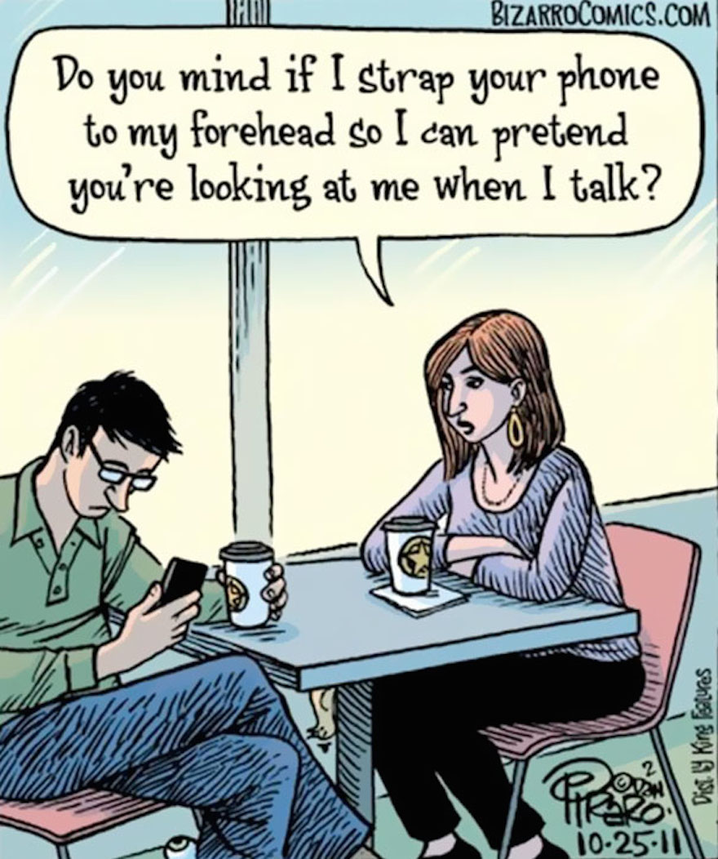
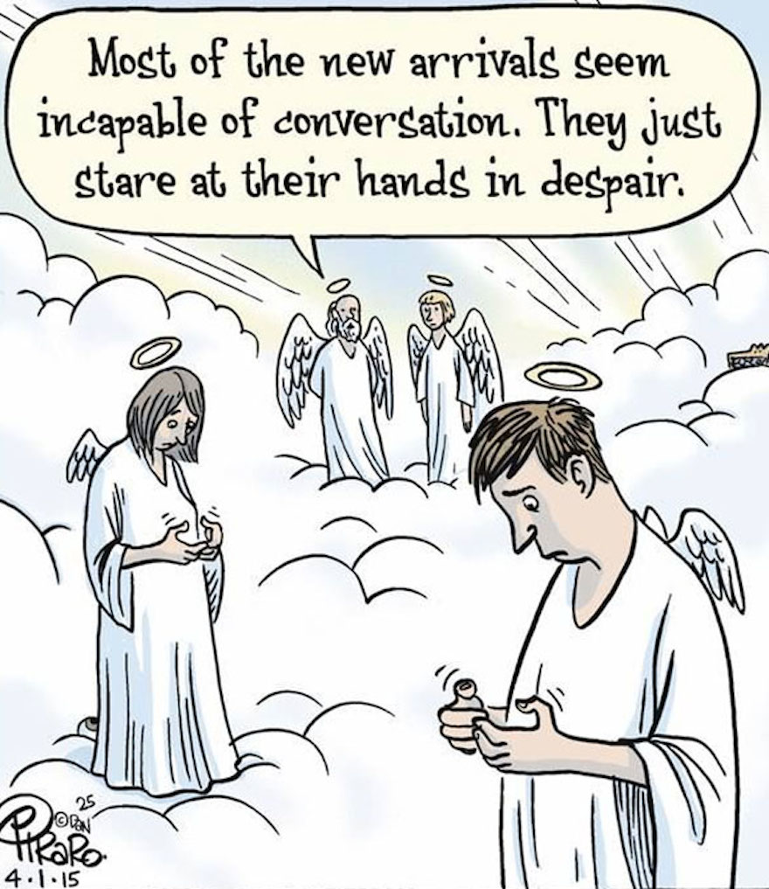
Holly Nguyen
Notes:
Introduce myself
Provide thirty seconds to look at comics/graphics
Ask (in order to gauge demographic in the classroom):
How many of you have smartphones?
How many of you use your smartphones as you are walking?
Picture #1 and #2 reference: http://www.earthporm.com/smartphones-are-taking-over/

Slide 18
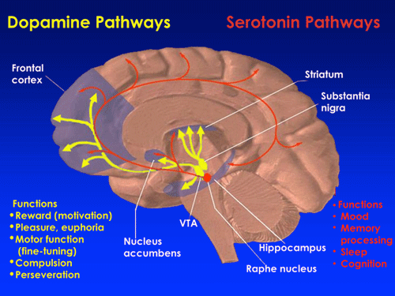
smartphone addiction exists
Holly Nguyen
Phones provide rewards [1]
Neurological effects [2]
10% of people using phones will become addicted [2]
Symptoms of addiction [3]
  Constant checking
  Phone withdrawal
Environmental triggers [1]
<Graphic>
Notes:
Smartphone addiction DOES exist
Computer technologies, the Internet, youtube videos, texts, emails → provide rewards [1]
Variable Ratio Reinforcement: uncertainty about whether you will get an email or text [2]
Result: continue to check, becomes a habit, can become addictive
Neurological effects – Dr. David Greenfield [2]
Receive text messages, social media, Internet access → release of dopamine
As seen in the IMAGE: dopamine pathways relate to reward, pleasure, compulsion
Can lead to addiction
10% of people actually become addicted
Other people (who are not the 10% and who aren’t actually addicted) find it difficult to resist (more common result)
“Symptoms” of addiction [3]
Constant checking
Withdrawal when not attached to your phone (feels like you are missing something)
Using it to boost self-esteem (dangerous to rely on)
Journal Personal and Ubiquitous Computing published a study in 2011 [1]
Emphasizes that the addiction is with “checking habits”
Boredom, awkward social situations are “environmental triggers” for this habit to develop → first instinct is to check phone
Conclusion: This fairly recent development in behavior is changing how our brains function
Reference for image: http://researchnews.osu.edu/archive/distractwalk.htm
References:
[1] http://www.webmd.com/balance/guide/addicted-your-smartphone-what-to-do?page=2
[2] https://www.thefix.com/content/digital-addictions-are-real-addictions
[3] http://www.publichealth.indiana.edu/features/cellphone.shtml

Slide 19
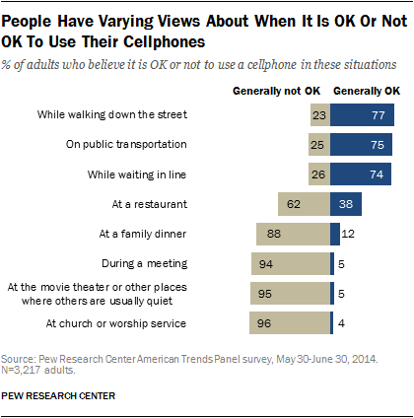
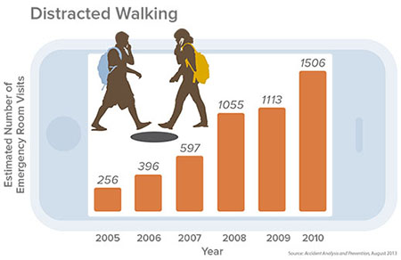
Cell Phone Use while walking is accepted but dangerous
Holly Nguyen
Survey done by Pew Research Center
  77% of adults say that using your phone while “walking
  down the street” is an accepted action [4]
Report in Accident Analysis and Prevention
  256 injured (2005) VS. 1500 injured (2010) [5]
Texting more dangerous than talking on the phone [6]
Notes:
Cell phone use while walking is accepted but dangerous
Phone use while walking (product of the addictive checking habits) is an accepted action in society (based on a survey done by Pew Research Center) [4]
Survey conducted in May 2014 with 3,217 U.S. adults (3,042 of which have cell phones)
Results as seen in the IMAGE
Actually can cause dangerous situations (from a report in Accident Analysis and Prevention and as seen in the graph titled “Distracted Walking”) (and seen in the IMAGE) [5]
2005 – 256 people injured in the US due to phone use while walking
2010 – 1500 people treated for injuries due to phone use while walking (more than 5x the number in 2005)
Clearly demonstrates a trend in increasing injures – from the standpoint of the 100 U.S. hospitals used in the study
Jack Nasar and other researchers hypothesize that the estimates of pedestrians injured are much lower than reality
Injuries caused due to the increased number of phones and the increased usage of phones, driven by this addiction/checking habit [5]
Younger people (ages 16-25) at higher risk
Study in 2011 by Stony Brook University [6]
With the rise of smartphones → texting, Internet, social media
Texting more dangerous than talking on phone (due to errors in navigation)
Reference for “OK or Not OK to Use Their Cellphones” image: http://www.pewinternet.org/2015/08/26/americans-views-on-mobile-etiquette/
Reference for “Distracted Walking”: http://researchnews.osu.edu/archive/distractwalk.htm
Other References:
[4] http://www.pewinternet.org/2015/08/26/americans-views-on-mobile-etiquette/
[5] http://www.medicalnewstoday.com/articles/262231.php
[6] http://www.governing.com/topics/transportation-infrastructure/too-many-pedestrians-injured-by-looking-at-their-phones.html

Slide 20
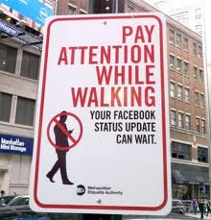
Solutions: laws, change street design, awareness
Holly Nguyen
Proposed legislation in New Jersey to fine people who cross streets and are texting [7]
State of Georgia: “Compared to speeding, red-light running, illegal turns, and distance between safe crossing facilities, distracted walking is just a minor contributor to risk of pedestrian deaths” [8]
Need awareness, warning signs, speed limit reduction
Notes:
Solutions: laws, change street design, reduce speed limits, more awareness
Proposed bill in New Jersey to make it illegal to cross streets and text [7]
$50 fine if caught doing so
(Counter point) Georgia: “Compared to speeding, red-light running, illegal turns, and distance between safe crossing facilities, distracted walking is just a minor contributor to risk of pedestrian deaths”
This may be true…
Government may be reticent to enact fines or laws about walking and phone use (could be seen as restriction of speech or expression, loss of freedom, very subjective)
BUT every pedestrian’s life should be of concern
Consider the increasing trend: “A Governor’s Highway Safety Association study released earlier this month estimates that pedestrian deaths would spike by 10 percent in 2015. So far, 32 pedestrians have been killed statewide in 2016, and a total of 170 pedestrians died in 2015, according to State Police Statistics.” [7]
Solutions:
If government isn’t willing to restrict “freedom of speech” (in the phone use) then steps must be taken to work around this behavior and make society safer
Design streets around this new behavior
Reduce speed limits (15mph can be the difference between death and injury) [7]
Add more warning signs (as seen in the IMAGE)
Advocate, spread awareness about the problem
Reference for image (possible awareness): http://www.wgelaw.com/blog/2015/12/15/texting-while-walking-or-driving-165915
Other References:
[7] http://www.nj.com/traffic/index.ssf/2016/03/safety_effort_tells_pedestrians_and_drivers_heads-.html#incart_2box_nj-homepage-featured
[8] http://www.governing.com/topics/transportation-infrastructure/too-many-pedestrians-injured-by-looking-at-their-phones.html

Slide 21
References
Holly Nguyen
[1] http://www.webmd.com/balance/guide/addicted-your-smartphone-what-to-do?page=2
[2] https://www.thefix.com/content/digital-addictions-are-real-addictions
[3] http://www.publichealth.indiana.edu/features/cellphone.shtml
[4] http://www.pewinternet.org/2015/08/26/americans-views-on-mobile-etiquette/
[5] http://www.medicalnewstoday.com/articles/262231.php
[6] http://www.governing.com/topics/transportation-infrastructure/too-many-pedestrians-injured-by-looking-at-their-phones.html
[7] http://www.nj.com/traffic/index.ssf/2016/03/safety_effort_tells_pedestrians_and_drivers_heads-.html#incart_2box_nj-homepage-featured
[8] http://www.governing.com/topics/transportation-infrastructure/too-many-pedestrians-injured-by-looking-at-their-phones.html

Slide 22
Class 4
The End
Keith A. Pray
Instructor
socialimps.keithpray.net
Notes:
Use remaining time to form groups, approve group topics, etc.
This is the end. Any slides beyond this point are for answering questions that may arise but not needed in the main talk. Some slides may also be unfinished and are not needed but kept just in case.

