Slide 1
Class 8
Crime
Keith A. Pray
Instructor
socialimps.keithpray.net
Notes:
Here’s the title slide. Is anyone not excited?
Paper Reminders:
5 High quality sources
Conclusion, Argument, Counter Point, Response
Try reading paper aloud
Paper 6.5

Slide 2
Overview
Review
Assignment
Students Present

Slide 3
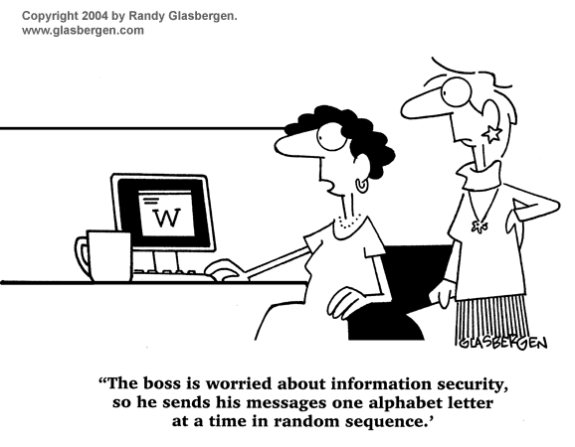
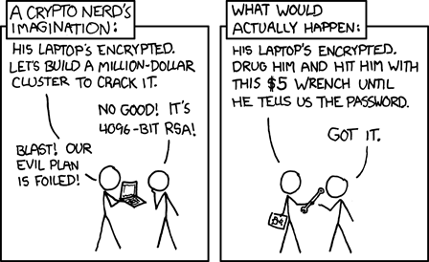
http://xkcd.com/538/ (2010-11-14)
Notes:
Are there any questions on the assigned reading?
Use the slides ahead to explain any of the attack methods from the text.
If there are no questions you can skip those slides.

Slide 4
Buffer Overrun
Run time stack
Local Variables
Return Address
Parameters
Variable Attack
buffer
Target Variable
Stack Attack
buffer
Return Address
code
Return Address
Notes:
When a function call is made, local variables, return address, parameters stored on run time stack. Local variables occupy lower memory addresses.
Variable attack – change variable value. Program expects user to input character and allocates a buffer for them. Attacker supplies too many characters and ends up over writing a variable.
Stack Attack – goal is to change value of return address so execution control goes to code which the attacker has provided in the input buffer.
Prevention – add checks against array bounds being exceeded, or modify operating system to not execute instructions stored on run time stack.

Slide 5
Run Example Code
Notes:
> imps
> assembly
> 123456789qwerty1

Slide 6
Buffer Overrun Code
#include <stdio.h>
#include <string.h>
int main ( void ) {
char buff [ 15 ]; int ace = 0;
printf ( "\n Enter best class ever : \n" );
gets ( buff );
if ( strcmp ( buff, "imps" ) ) {
printf ( "\n %s is wrong! You should FAIL! \n ace=%i\n", buff, ace ); }
else { printf ( "Correct! \n") ; ace = 1; }
if ( ace ) { printf ( "You get an A! \n" ); }
return 0; }
} The Naughty Line

Slide 7
TCP Three-way Handshake
SYN
SYN-ACK
ACK
Notes:
SYNchronize
SYNchronize ACKnowledgement (socket reserved awaiting ACK)
ACKnowledgement
TCP socket connection established

Slide 8
SYN Flood Attack
SYN
SYN-ACK
Notes:
Attacker spoofs the IP address so the SYN-ACK is sent to a different machine that cannot respond to the SYN-ACK.
This leaves the connection half open on the server machine decreasing the resources (sockets, memory, threads/processes) available to respond to legitimate clients.
The attacker send many such spoofed SYN messages.

Slide 9
Ping Attack
Target
Attacker
ping
ping
Notes:
Attacker finds routers that support broadcasting messages to all computers on their local area networks.
The attacker sends a spoofed ping message, which the routers echo to the spoofed address.

Slide 10
My Reading Notes
pp. 321 Might be interesting to compare password guidance over the years.
pp. 323 How does Firesheep always get a user photo?
pp. 328 Not current or virus unknown…
pp. 330 Goals include infect 3 machine per LAN and as many computers as possible? Never make last minute changes before release. Were they related to the defects?
pp. 332 Do people use the Internet as an experimental laboratory these days? Shutdown right after booting, “benign” doesn’t seem like the right word.
pp. 334 “send reports back to a host computer”?
pp. 335 Firewalls often not running on same machine as malware, routers?
pp. 337 Have 2003 fears of cyber terrorist attacks been realized?
pp. 345 How is online voting a moral issue?
pp. 346 Is Internet access due to financial restrictions still relevant? Could issue specific, unrelated code for each vote.
End of Chapter questions:

Slide 11
Group Quiz
A denial of service attack shuts down a bunch of retailer, stock brokerage, large corporate entertainment and information web sites. Possible guilty parties:
  Terrorist who aimed to cause billions of damage to U.S. economy.
  Protest organization opposing commercialization of the web and corporate manipulation of consumers.
  Script kiddie just having fun with tools he found on the web.
  Show off hacker in search of bragging rights.
State what penalties are appropriate for each.
Explain your answer to 1. using a single Ethical Theory for all.
Name the laws/acts under which these parties could be prosecuted.
Notes:
Note: short answer format expected.
Note: 2. only one argument needed, should include logic for all parties
Note: 3. same law(s) should be applicable to all parties

Slide 12
Assignment
Code Testing 1/2
Design tests for the code on the following slide.
Contains at least one major defect and several minor ones.
Write a paper (1-2 pages OK not counting source) including :
  Did you choose a good test strategy? (This is your conclusion.)
  The inputs and expected outputs
  What defects you found
  How you would fix the defects (you may include fixed source)
  Why would that fix the problems?
  What could happen if the defects are not found before the code is put into production?
Working example: http://socialimps.keithpray.net/assignments/index.jsp?content=Code_Test.jsp
Notes:
The online working example source code is best not viewed with IE though looking at the source for the page will reveal the implementation.
If guest presenter coming next class remind students to prepare questions for him.
Remember to work on groups projects.
Each group should have material on their sites for the topics we’ve covered so far.

Slide 13
Assignment
Code Testing 2/2
import java.text.NumberFormat;
public class SalesFun {
public static double calculateSalesTotal ( double amount, double discountRate, double taxRate ) {
double discount = amount * discountRate;
double total = amount - discount;
double tax = total * taxRate;
double taxedTotal = tax + total;
NumberFormat numberFormat = NumberFormat.getCurrencyInstance();
System.out.println ( "Subtotal : " + numberFormat.format ( amount ) );
System.out.println ( "Discount : " + numberFormat.format ( discount ) );
System.out.println ( "Total : " + numberFormat.format ( total ) );
System.out.println ( "Tax : " + numberFormat.format ( tax ) );
System.out.println ( "Tax+Total: " + numberFormat.format ( taxedTotal ) );
return taxedTotal;
}
}
} Lines of interest
Notes:
Bold lines are real focus.
Example input:
amount = 100.05;
discountRate = 0.10;
taxRate = 0.05;
OR
0.70, 0.0, 0.05
95.67, 0.20, 0.7

Slide 14
Overview
Survey
Review
Assignment
Students Present

Slide 15
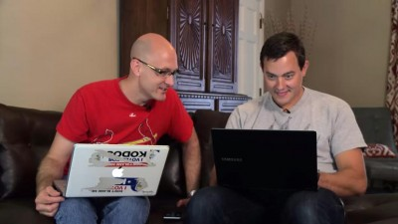
Security vs. Features – case study
Joshua Keller
Complicated issue
Security is often glossed over until it has to be dealt with [1]
Charlie Miller and Chris Valasek
http://techaeris.com/wp-content/uploads/2015/07/Charlie-Miller-Chris-Valasek-400x225.jpg
Notes:
- name, intro: Today I’m going to talk about security vs. features.
Complex topic, so focusing on an extreme case
Security not emphasized as often as it should be
I recognize there is another side to this – certainly features are what make money
But safety is important too
So we’re going to talk about a particular incident that shows this importance in a rather dramatic way…
Before I go on, does anyone know who these two people are and what they did?
Charlie Miller is a security researcher for Twitter and used to work for the NSA [1]
Chris Valasek is the director of vehicle security research at IOActive [1]

Slide 16
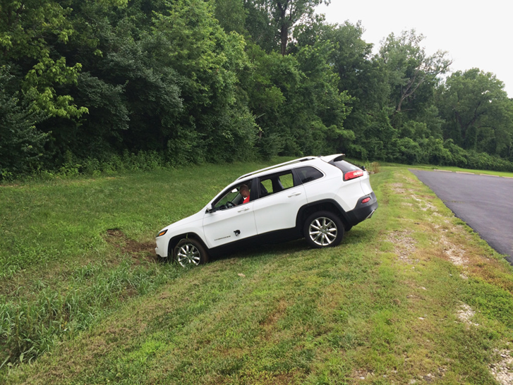
What Happened
Joshua Keller
2014 Jeep Cherokee was hacked
  wirelessly
Lots of vulnerabilities
  Air conditioning
  Radio
  Windshield wipers
  Digital display
  GPS
  Transmission (scary)
  Brakes (also scary)
  Even steering (but only in reverse)
<Graphic>
http://www.wired.com/wp-content/uploads/2015/07/IMG_0724-1024x768.jpg
Notes:
They are the ones behind the Jeep hacks from a few months ago.
So in July 2015, they managed to hack a Jeep remotely
Could do lots of scary stuff
(including tracking the car’s location through GPS)
They put an image of themselves on the car’s digital display
This was the culmination of several years of research.
They got an $80,000 DARPA grant to buy some cars and reverse-engineer them

Slide 17
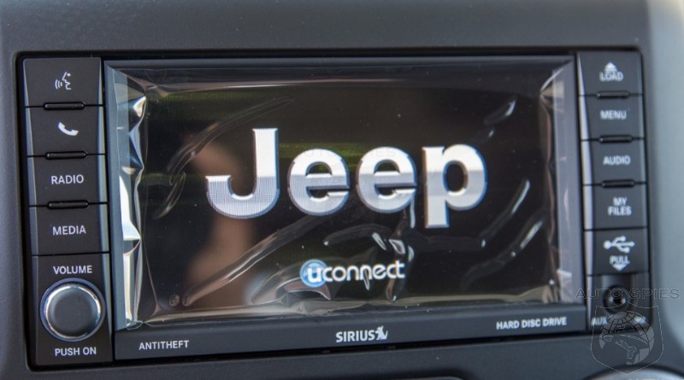
How they did it
Joshua Keller
Exploited a vulnerability in uconnect®
  Generated wifi password was easy to crack
  Connected to Sprint cell network even if user didn’t pay for wireless service
From there they accessed the CAN (Controller Area Network) bus
  Not sufficiently isolated from the entertainment system
An example of the uconnect® system.
http://www.autospies.com/images/users/Agent00R/main/jeep_wrangler_uconnect.jpg
Notes:
Uconnect is the internet-connected entertainment system of the car
Without getting into too many details, the wifi password was generated based on a random seed, but this seed wasn’t actually random.
It was based on the time of production, and varied only by a few seconds at most (Jan 1 2013) [6]
As a result there were very few distinct passwords to try, so they could crack it easily
All the head units are connected to the Sprint cell network [6]
“Easier to hack all the jeeps than one specific one”
But can narrow it down with GPS tracker (get all the Jeeps to send their location via GPS and then figure out which ones are where)
CAN (Controller Area Network) bus = car’s internal computer network [1]
Manufacturers claimed it *was* isolated from entertainment system
But wasn’t actually – there was a “middle guy” that could communicate with the entertainment system AND the CAN bus
Access to the CAN bus got them pretty much everything – since lots of a car’s functionality is now computerized

Slide 18
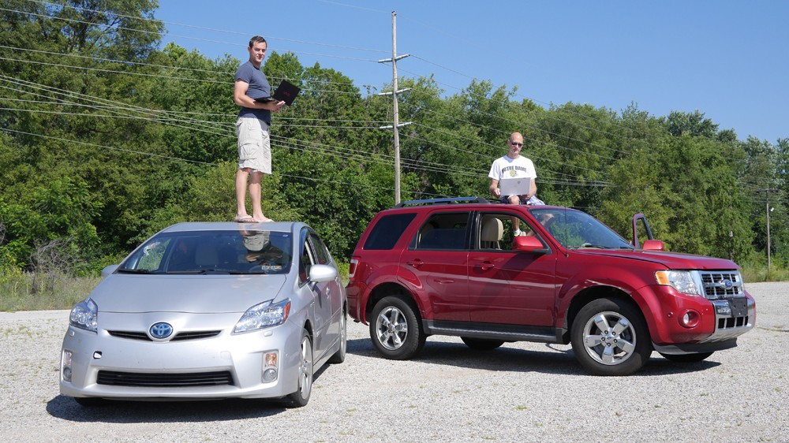
This happened before
Joshua Keller
Toyota Prius and Ford Escape were attacked in 2013
  Needed to be wired in though
Didn’t get the reaction they wanted
  Manufacturers insisted that their systems were “robust against wireless attacks”[1]
http://blogs-images.forbes.com/andygreenberg/files/2014/04/carhack-e1396974944366.jpg
Notes:
They had done this before with their DARPA grant, but they had to have physical access to the cars.
The manufacturers were not convinced by a wired in attack.
Understandable, but this is still dangerous.
The wireless attack convinced them more.

Slide 19
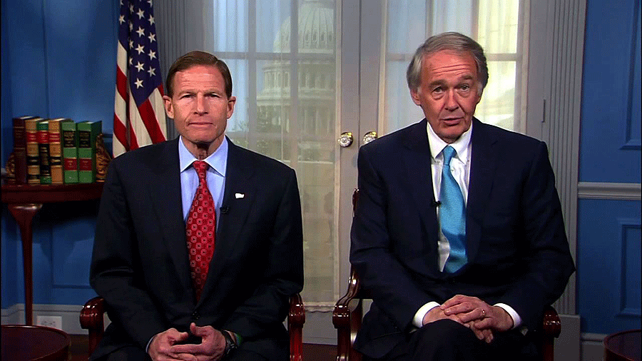
The reaction
Joshua Keller
Chrysler recalled 1.4 million vehicles
  After the hackers published the exploit
New Automotive Security legislation
  Senators Markey and Blumenthal introduced the Security and Privacy in Your Car act (SPY Car)[7]
Richard Blumenthal and Edward Markey
http://www.autonews.com/apps/pbcsi.dll/storyimage/CA/20150820/OEM02/150829989/V2/0/V2-150829989.jpg
Notes:
Fiat Chrysler Automobiles (FCA) did recall a lot of vehicles and released a patch for the others
Note: the hackers did not actually publish all of the exploit – the firmware needed to hack into the CAN bus was not there
(and is hard to develop) [1]
It has also prompted a movement towards new legislation.
Markey and Blumenthal introduced the SPY Car act
It’s still in process, but hopefully will become adopted soon.
The hope for this is that it will provide an incentive for companies to make security a priority
rather than only focusing on adding new features [1]
According to Josh Corman, cofounder of an organization devoted to protecting IoT (Internet of Things) devices,
“They’re getting worse faster than they’re getting better. If it takes a year to introduce a new hackable feature, then it takes them four to five years to protect it.”

Slide 20
References
Joshua Keller
[1] http://www.wired.com/2015/07/hackers-remotely-kill-jeep-highway/ (last accessed 21 Sept 2015)
[2] http://www.washingtonpost.com/news/morning-mix/wp/2015/07/22/car-hacking-just-got-real-hackers-disable-suv-on-busy-highway/ (last accessed 21 Sept 2015)
[3] http://www.autospies.com/images/users/Agent00R/main/jeep_wrangler_uconnect.jpg (last accessed 21 Sept 2015)
[4] http://techaeris.com/wp-content/uploads/2015/07/Charlie-Miller-Chris-Valasek-400x225.jpg (last accessed 21 Sept 2015)
[5] http://www.businessinsider.com/fiat-chrysler-recalls-14m-vehicles-after-wired-car-hacking-story-2015-7?op=1 (last accessed 21 Sept 2015)
[6] https://blog.kaspersky.com/blackhat-jeep-cherokee-hack-explained/9493/ (last accessed 21 Sept 2015)
[7] http://www.blumenthal.senate.gov/newsroom/press/release/blumenthal-markey-continue-investigation-of-automotive-cybersecurity-and-privacy-practices (last accessed 21 Sept 2015)
[8] http://www.autonews.com/apps/pbcsi.dll/storyimage/CA/20150820/OEM02/150829989/V2/0/V2-150829989.jpg (last accessed 21 Sept 2015)
[9] http://blogs-images.forbes.com/andygreenberg/files/2014/04/carhack-e1396974944366.jpg (last accessed 22 Sept 2015)
Notes:
Any Questions?

Slide 21
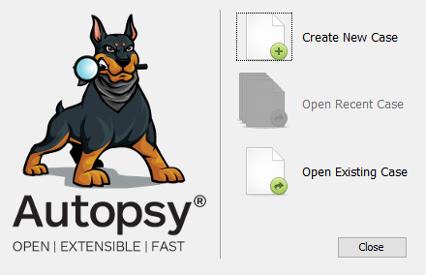
Cyberforensics
Thomas Sellie-Lund
Nowadays increasing amounts of data stored on computers
Many tools and techniques have been created to recover and quickly find data on hard disks.
Autopsy Login Screen: www.sleuthkit.org
Notes:
Overview, mention that unprotected data can be recovered, analyzed & large amounts of personal info can be found

Slide 22
Data recovery
Thomas Sellie-Lund
“Permanently Deleted” files are not truly deleted
  Save processing time
  Can be recovered
Protection can be provided thru “shredding” programs
  Linux built in “shred”
  Provided with some antivirus suites
  Can be defeated thru sophisticated hardware
Notes:
Cover simple principles of data recovery for 2-3 minutes
Deleted files are marked for overwrite by the system in order to save processing time, this is usually good behavior, but can have consequences with sensitive information.
Given a cyberforensics suite (or any number of open source programs) files can be recovered. [1]
Data can be protected thru functions such as unix built in “shred” [2], or thru your anti-virus suite
Magnetic force Microscopy can sometimes recover data after it has been overwritten on magnetic storage devices [3]

Slide 23
Data analysis
Thomas Sellie-Lund
Large Amount of Data Recovered
  Hand analysis could take too long
  Need for tools to automate data finding
Variety of tools exist
  Bulk Extractor
  Scalpel
Automatically create pattern-matched lists
Notes:
Cover data analysis techniques, scalpel foremost 3 minutes
Modern disks are large enough that manual inspection can be time consuming.
Several tools exist to attempt to automatically recover data, bulk extractor and scalpel are only two. Sophisticated pattern matching, automatic
Similar to grep & others.
Find things matching credit card numbers, ssn’s, phone numbers, gps records, URLs, anything and everything stored on your computer, catalogued, analyzed, and extracted.

Slide 24
summary
Thomas Sellie-Lund
Data, even on your own disk, is recoverable
Sophisticated tools exist to recover, analyze, and report data
Everything you store on your computer is findable reasonably quickly.
Notes:
Summarize main points again

Slide 25
References
Thomas Sellie-Lund
[1] http://www.sleuthkit.org/autopsy/v2/ Accessed 9/21/2015
[2] http://linux.die.net/man/1/shred Accessed 9/21/2015
[3] Data Recovery from Magnetic Media Using Magnetic Force Microscopy, Terry R Ferret, West Virginia University, http://csee.wvu.edu/~ferrett/thesis/Ferrett_Terry_thesis.pdf
[4] Bulk Extractor 1.4 Users Manual http://digitalcorpora.org/downloads/bulk_extractor/BEUsersManual.pdf Accessed 9/21/2015
[5] Scalpel Readme https://github.com/sleuthkit/scalpel/blob/master/README Accessed 9/21/2015

Slide 26
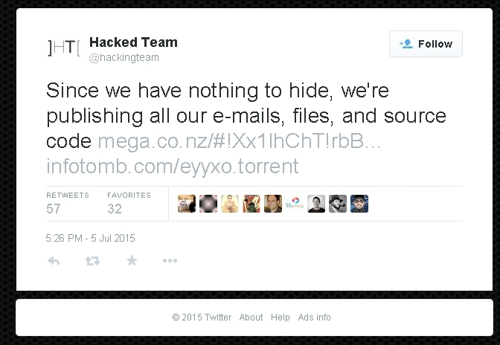
Hacking team hacked!
Ruofan Ding
Hacking Team
  Milan, Italy.
  Found in 2003
  Surveillance technology provider
Got hacked on July 5 2015
  415 GB data was compromised
  Including emails, customer files, and source code
  Advanced persist thread.
<http://www.csoonline.com/article/2943968/data-breach/hacking-team-hacked-attackers-claim-400gb-in-dumped-data.html>
Notes:
Hacking team is a company based on Milan, Italy, and was found in 2003. Specializing in surveillance technology, Hacking Team sells intrusion and surveillance tools to governments and law enforcement agencies.
On July 5th 2015, the hacking team got hacked and a huge amount of data (415 GB), including emails, files, source code, account usernames and password, was compromised. This was the tweet posted by the attackers after hacking team account on Twitter was compromised. No individual or group claims credit for hacking the hacking team.
Advanced persist thread.
The attackers are very likely to use advanced persist thread, which means they have intruded inside the company and been correcting data for a long period of time.

Slide 27
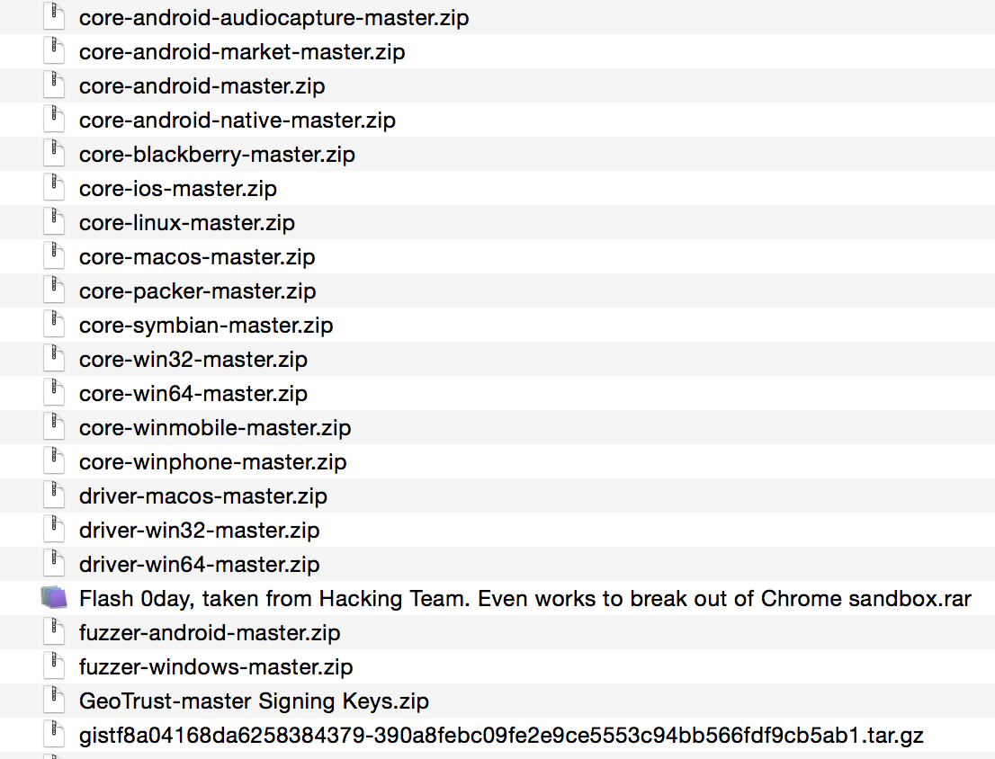
1.3 GB source code leaked
Ruofan Ding
Types
  Remote control system
  0 day exploit
  Rootkits
  Platforms:
  Windows, Linux, OSX, Android, IOS, Blackberry
https://ht.transparencytoolkit.org
Notes:
Let’s take a closer look at the compromised data. It contains more than 1.3 GB source code. (Huge amount).
The source codes contains different types of spywares.
RCS: Put on a person’s computers ormobile devices, and monitor what the person is doing with his or her devices.
0 day exploit: A zero day vulnerability refers to a security hole that is exploited by hackers before the vendor becomes aware and hurries to fix it—this exploit is called a zero day attack.
They have spyware tools target at most platforms.
The products of hacking team cover almost all mainstream platform
Before the leak of hacking team, the spyware industry was filled with a lot of unprofessional demos with few engineering things. A new age is opened, especially for the network underground industry chains.

Slide 28
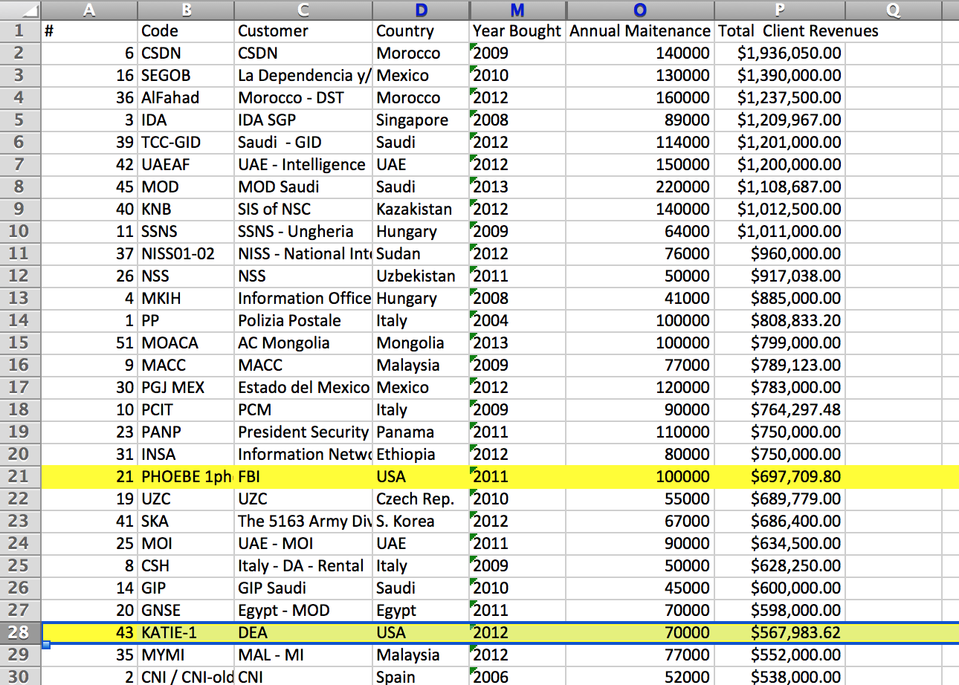
EMAIL AND CUSTOMER FILES
Ruofan Ding
Countries involved : 47
Total revenue: Euro 41,871,712
US government organizations and agencies: FBI, DEA, DOD
Hacking team client overview list 2015_06_03
https://docs.google.com/spreadsheets/d/1xBcnB8mPYrDh062XNtSjlPe_t7Agjdjpk_pnpz0sJgc/pub?output=xlsx
Notes:
The attacker published all compromised information. And I found a client_overview list for 2015 in the compromised data. I cannot guarantee this client overview is truthful. Maybe the attacker forged data and put it there on purpose. But through another evidence, such as emails between the company and its customers, I would say this client overview list is real.
I checked their client overview list for 2015.
FBI has spent 700,000 on hacking team product since 2011.
DEA has spent 600,000 on hacking team product since 2012.
Also, one US Action plan has been found in leaked data, which describes their plan to expand the market in united states.
I am not going to argue about whether government agency should use surveillance tool to monitor the people or not. I am just stating the fact.

Slide 29
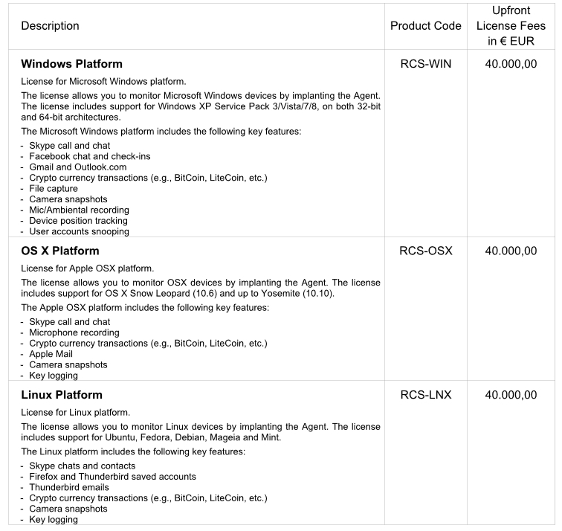
Spyware industry
Ruofan Ding
Business-driven
In fast growth industry with a big market
Profitable
http://core0.staticworld.net/images/article/2015/07/ht_rcs_04-100595147-orig.jpg
Notes:
According to gartner (American information technology research company), the security market grew 5.3% in 2014, touching $21.4 billion in revenue, (https://www.eset.sg/html/86/1324/)
What I am trying to argue is about the spyware industry.
This industry is very profitable.
It has a big market.
Comments from internet:
The exposure of Stuxnet made the public realize that : "this is really happening". Further more, Snowden issue told us: "there are more of such events" . what’s, HT leak told us : "This can even be a business.”

Slide 30
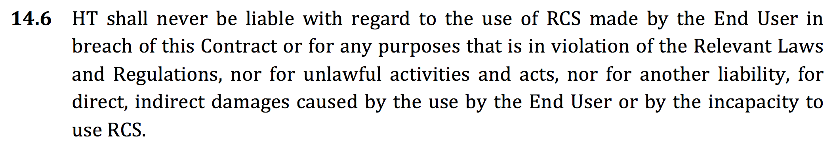
Conclusion
Ruofan Ding
In a grey area.
Legal issue.
Has the potential to be used by terrorist and criminals.
Hacking team remote control system
End user license agreement
Spyware industry needs more regulations and law enforcement.
https://ht.transparencytoolkit.org/Amministrazione/01%20-%20CLIENTI/HT_EULA_DIRECT_EndUserLicenseAgreement_052014_4%204.docx
Notes:
Even though they claim hacking team shall never be liable with the effect of remote control system made by the end user, they are actually breaking the law.
In the United States, lawmakers introduced a bill in 2005 entitled the Internet Spyware Prevention Act, which would imprison creators of spyware
Companies like hacking team that contract with governments are not likely to get involved in lawsuit due to creating spyware because their customers are governments. However, since these companies make commercial product, they may sell their products to criminals or terrorist in very high price.
Different from government agency, companies like hacking team lack of strict regulations.

Slide 31
References
Ruofan Ding
[1] http://www.csoonline.com/article/2943968/data-breach/hacking-team-hacked-attackers-claim-400gb-in-dumped-data.html
[2] https://ht.transparencytoolkit.org/
[3] https://docs.google.com/spreadsheets/d/1xBcnB8mPYrDh062XNtSjlPe_t7Agjdjpk_pnpz0sJgc/pub?output=xlsx
[4] https://ht.transparencytoolkit.org/Amministrazione/01%20-%20CLIENTI/HT_EULA_DIRECT_EndUserLicenseAgreement_052014_4%204.docx
[5]http://core0.staticworld.net/images/article/2015/07/ht_rcs_04-100595147-orig.jpg
[6]
https://www.eset.sg/html/86/1324/

Slide 32
Class 8
The End
Keith A. Pray
Instructor
socialimps.keithpray.net
Notes:
This is the end. Any slides beyond this point are for answering questions that may arise but not needed in the main talk. Some slides may also be unfinished and are not needed but kept just in case.

Slide 33
Crime How
Technical and Non-Technical
  Break into computer.
  Prevent access to computer.
What things make computer related crime easy?
Notes:
Exploit security holes, Break encryption, Spoofing
Social Engineering: Guess passwords, Find out passwords and procedures
Poor passwords, Insecure protocols, Program limitations (buffer overruns), Eavesdropping (Email, Interactive), Insecure files

Slide 34
Crime Bane
Trojan Horse
Virus
Worm
Bot Network
Buffer Overrun
(Distributed) Denial Of Service Attack
How do they work?
How harmful are they?

Slide 35
Crime Why
Why?
Notes:
Money: stolen credit cards, change records, stolen property.
Political, military, economic.
Challenge, Revenge, Mean
Why do at all? Have motivation, think about it, think it will help, think it’s acceptable.
Feel forced. Don’t agree. Don’t care.

Slide 36
Crime Time
What is different now compared to:
  10 years ago?
  20 years ago?
  30 years ago?
  40 years ago?
Notes:
More computers. Unsophisticated owners. More complex software. Greater connectivity. Easy access to cracking tools. Incentives. File-sharing
In ’60s and ’70s, access was mostly localized.
Modems. Wardialing.
Some Arpanet and Usenet.

Slide 37
Crime Doers
Hacker or Cracker
  Pre-1980 - Golden Age ☺ ?
  Eighties
  Nineties
  Naughts
Criminal Hacking == Cracking?
Notes:
Script kiddies
Phreakers
Security analysts
Packet monkey

Slide 38
Crime Gain
Justifications for Computing Crimes?
What can be done after access is gained?
  What resources are available?
  How valuable are they?
Notes:
Machines are unused. No harm done. Education. Exposes security holes. Exposes abuses.
Use computer and/or resources. Take data. Destroy data. Alter data. Lock out others. Attack other computers.
Equipment, Processor Time, Disk space, Printer time / paper, Bandwidth

Slide 39
Crime Pay
Computer Fraud and Abuse Act (1986)
  Bans :
    unauthorized access or use of computers, copying, modifying, or destroying data, disclosing of passwords.
    disrupting government and utilities.
  Covers government, financial, medical, and interstate systems.
USA Patriot Act (2001)
  Raised penalties.
  Permits freer surveillance and monitoring to detect illegal activity.
Electronic Communications Privacy Act
  Illegal to intercept telephone, email, other data transmissions, access stored email messages without authorization
Assign Cybercrime Treaty (2006), Wire Fraud Act, National Stolen Property Act, Identity Theft and Assumption Deterrence Act
Notes:
Are either of these laws still in effect? Have they been changed?
For additional legislation ask for presenting volunteers to brief recent incidents/cases.
Also ask for volunteers to find out laws from their home country/state.

Slide 40
Crime Stop
Technical
  Protect Data
  Protect Machine
  Protect Access
Non-technical?
  Social?
  Legal?
Notes:
Encryption, Authentication, Biometrics, Anti-virus, File integrity checking (E.g. Tripwire), Virtual private networks, Point-to-point networking (Twisted-pair Ethernet vs. Coax vs. wireless)
Security through obscurity, physical access required, not on network, behind locked doors.
Remove desire, remove incentives
Legalize, increase penalties, increase chance of getting caught.

