Slide 1
Class 7
Privacy and Government
Keith A. Pray
Instructor
socialimps.keithpray.net
Notes:
After this class we will be half done with the course… very sad I know.
Play Somebody’s Watching Me (1984) – Rockwell
The envy of all your classmates if you know the band or year.
Self Search paper – Progressive.com search is for address, not name.
Paper averages to date: 5.25 - 6.291666667 - 5.875

Slide 2
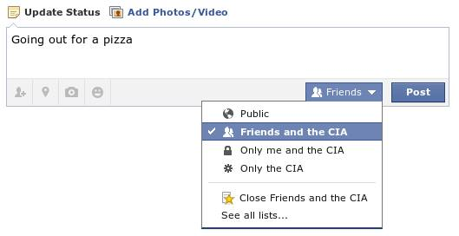
Notes:
Source?

Slide 3
Overview
Survey
Review
Assignment
Students Present

Slide 4

Notes:
Source?
Let’s see who said National ID yes and no. Let’s debate!

Slide 5
My Reading Notes
pp. 274 Arrests, altering and deleting records are violations of privacy?
pp. 275 Why not try to verify and correct records?
pp. 277 300 times = frames, locations, …?
pp. 289 “…don’t want anyone to know…” like seeking medical advice, etc.?
pp. 291 Just because it’s been happening for years doesn’t make it right.
pp. 297 Wouldn’t it be easy to make and show a fake SSN card?
pp. 298 Confusing false positive and negative explanations.
End of Chapter questions: 1, 31, 51

Slide 6
Group Quiz
List two problems with using biometrics for identification.
List two advantages of using biometrics for identification.
Describe two tools people can use to protect their privacy on the Web.
For each of the 4 categories of Daniel Solove’s privacy taxonomy give an example not listed in the book.

Slide 7
Overview
Survey
Review
Assignment
Students Present

Slide 8
Assignment – Group Project
Add analysis to group project website addressing all topics covered to date.

Slide 9
Overview
Survey
Review
Assignment
Students Present

Slide 10
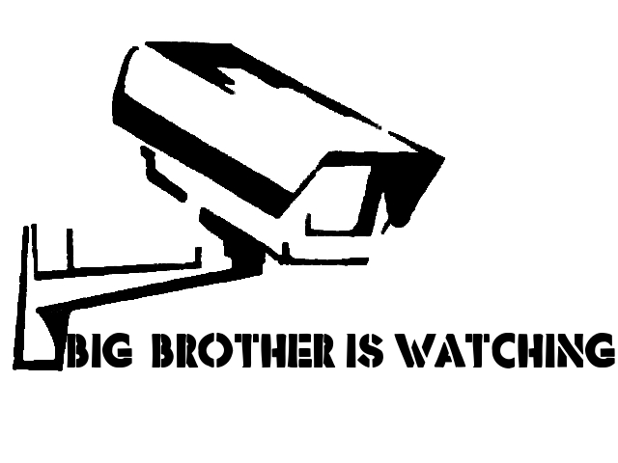
Big Brother
Anthony Dresser
Conclusion - The government has over extended it’s rights for surveillance
Obtained from http://orig02.deviantart.net/3163/f/2010/215/0/f/big_brother_is_watching_by_graffitiwatcher.jpg
Notes:
First going to talk about where the term came from
Then what is means to us
Then manifestations of Big Brother today

Slide 11
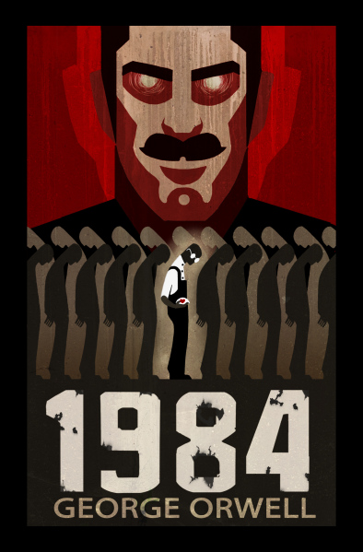
Where did you come from
Anthony Dresser
George Orwell’s 1984 (1949)
Single ruling Party
  Led by “Big Brother”
The party controls and sees everything
https://lightlit.wordpress.com/2014/07/06/1984-orwells-classic-becoming-more-relevant-by-the-day/
Notes:
The term originally came from George Orwell’s 1984
The premise of the book is that there is a single party that rules everything and keeps close watch on it’s citizens
Big Brother is the ruler of the party.

Slide 12
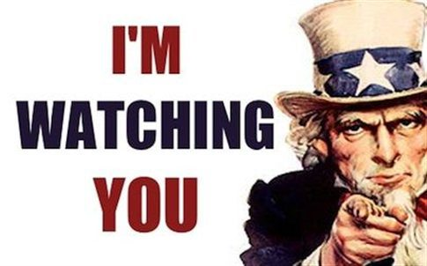
Relevance today
Anthony Dresser
Government Surveillance
  Direct Information Gathering
  Information Gathering through third parties
Patriot Act
http://www.nationofchange.org/does-uncle-sam-have-god-complex-1405693839
Notes:
This would manifest itself in our world with governments gathering as much information about it’s citizens as possible.
The most relevant for the United States is the Patriot Act

Slide 13
Patriot act
Anthony Dresser
Passed 45 days after 9/11 [2][3]
  Rushed through congress will no discussion, debate, or hearings
  Passed 7 times faster
Sneak And Peak
NSL
  No Limitation on time
Notes:
Patriot act was introduced 11 days after 9/11 and passed 34 days later with almost no discussion
The idea was to help government take more initiative in combatting terrorism
A few key points I wanted to expand on from the book, for sneak and peaks, they do not have to notify you they are searching until after the search is already done
The data collected by NSL’s are no expiration date, the government can keep that data forever.
Although the bill introduced NSL

Slide 14
USA Freedom Act - Enacted June 2, 2015
Anthony Dresser
What it removed
Removes “bulk” collection of “all” records and limits large-scale, indiscriminate collection
What is added
Allows “two-hops” of data collection on phone-data and internet meta-data
Extends Section 215, roving wiretaps, and lone wolf till December 2019
Greater transparency over FISA Court
Notes:
USA Freedom Act is an act meant to address the expiration of the Patriot act. It made a couple changes, a lot of which were sparked after the Snowden leaks. Some of the more notable ones are the removing of “bulk” collections of data and the limit of large-scale collections, For example NSL’s can no longer target entire zip codes.
However, it added “two-hops” collection. This means that NSA and FBI can request data from two connections from the source. So if it was targeting an organization, it can request information about people they are in contact with, and people those people are in contact with. It extended section 215, which dealt with collection of data, roving wiretaps, which the author talks about in the book, and lone wolf tracking, until December of 2019.
It also added greater transparency over the FISA court. So the proceeding of the court are still secret, however it is worded in the act that if the decision would make significant legal interpretations. It also designates a panel of advocates to represent the public’s interest in cases that involve novel or significant legal issues.
It also gives companies more opportunities to report to report publically information about orders. Still have to get court approval.

Slide 15
summary
Anthony Dresser
The government still has the ability to obtain a large amount of data without much judicial decision
Much of what the government obtains and does is still secret and illegal for the public to know
Reminiscent of what is seen in 1984
Notes:
In summary, today, even after the Snowden leaks and the outrage from a lot of the liberty advocacy groups, the government still has the ability to obtain large of amounts of data on US citizens without a whole lot of judicial process to ensure it is in the bounds of the intention of the law.
Additionally, a lot of what the government does and has is top secret, therefore is not allowed to be public knowledge, which means we don’t really get much of a say in what the government is doing.
Both of these realities are very reminiscent of what you see in 1984 from Big Brother, where the government is the eternal good and everyone trusts it and the government is watching, listening, and reading thoughts of its citizens.

Slide 16
References
Anthony Dresser
[1] Sparknotes. 1984. Accessed September 15, 2015. http://www.sparknotes.com/lit/1984/
[2] American Civil Liberties Union. Surveillance Under the Patriot Act. Accessed September 15, 2015. https://www.aclu.org/infographic/surveillance-under-patriot-act
[3] Electronic Privacy Information Center. USA Patriot Act. Accessed September 15, 2015. https://epic.org/privacy/terrorism/usapatriot/
[4] House of Representative. Final Vote Results for Roll Call 398. Accessed September 16, 2015. http://clerk.house.gov/evs/2001/roll398.xml
[5] United States Senate. U.S. Senate Roll Call Votes 107th Congressional – 1st Session. Accessed September 16, 2015. http://www.senate.gov/legislative/LIS/roll_call_lists/roll_call_vote_cfm.cfm?congress=107&session=1&vote=00313
[6] Lee, T. B. (2012, July 18). EFF says FBI gag orders violate service providers’ free speech rights. http://arstechnica.com/tech-policy/2012/07/eff-says-fbi-gag-orders-violate-service-providers-free-speech-rights/
[7] United States Judiciary Committee. (Accessed September 2015). http://judiciary.house.gov/index.cfm/usa-freedom-act
[8] The Washington Post. (2015, June 2). USA Freedom Act: What’s In, what’s out. http://www.washingtonpost.com/graphics/politics/usa-freedom-act/

Slide 17
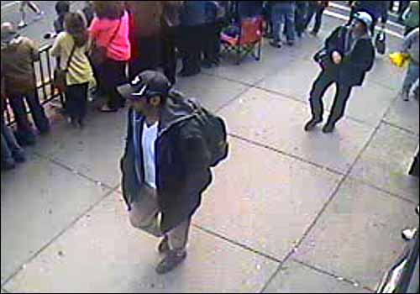
Closed-Circuit TV and Face Recognition
Sai Kiran Vadlamudi
Expectation of privacy in public?
Do not add new senses
  Simply enhance existing ones.
Expectation that your face will not be recognized?
Safety
<Graphic>
https://www.fbi.gov/news/updates-on-investigation-into-multiple-explosions-in-boston/photos
Notes:
I wanted to discuss and present the positive view of CCTV and Face recognition Technology or FRT and dispel some of the views of them being the scary Big Brother. When talking about CCTV and FRT in public it is important to discuss the expectation of privacy in a public environment. CCTVs do not add the ability to see through walls or any super human abilities that the public does not know about or understand. It is also good to note the general misconception that CCTV will begin the end of the fourth amendment and how its use actually aligns with the fourth amendment. Many also forget the primary goals of CCTV which are not to break peoples’ privacy but simply uphold safety in public environments which CCTV does so in a manner less invasive than typical security measures.

Slide 18
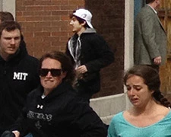
Privacy expectation
Sai Kiran Vadlamudi
“…an expectation that society is prepared to recognize as reasonable under the circumstances” [1]
When one has a risk of being observed by a stranger he/she forgoes any expectation of privacy. [2]
Private Investigator hired by state records cop on beach[2].
http://www.washingtonpost.com/wp-srv/special/national/boston-marathon-explosions-recap/
Notes:
It is important to understand the expectations of privacy that one can have and this is by no means a limiter of the fourth amendment but in fact is defined in the fourth amendment. For example a public beach where one can be observed by many leads to no expectation of privacy but a restroom or changing room or one’s house has an expectation of privacy. An example of a court case regarding a matter like this involves a Pennsylvania state police, who claimed he was injured while working to receive compensation but then was recorded sunbathing on a beach by a private investigator hired by the state. The court ruled that the state did not violate the fourth amendment due to no expectation of privacy on a public beach. Another example involves the photo on the right which shows one of the suspects of the Boston marathon bomber case and was taken by a runner who submitted it to the police and was just one of the hundreds of citizen submitted photos.

Slide 19
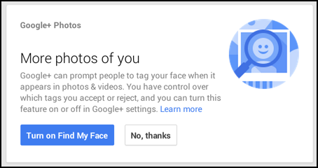
Expectation of Face recognition
Sai Kiran Vadlamudi
Can’t expect that your face will not be recognized in public [3].
Google, Facebook can auto tag pictures.
Possibility of strangers using such methods so government can.
Police uses software that recognizes your face?
http://www.askdavetaylor.com/wp-content/uploads/2015/01/google-plus-automatically-tag-photos-1.png
Notes:
Similar to how one has no expectation of privacy when there is a risk he/she can be observed by many, one also has no expectation that his/her face will remain anonymous. “No person can have a reasonable expectation that others will not know the sound of his voice, any more than he can reasonably expect that his face will be a mystery to the world”[7]. Since in a public environment it is possible for anyone to take a picture of you and use something like google photos or Facebook for suggestions about people to tag in the picture. The government can also be the one doing such recognition computations and “…as long as people know a technology could conceivably be used against them by strangers, the government’s use of the technology is not a constitutional issue”[2].

Slide 20
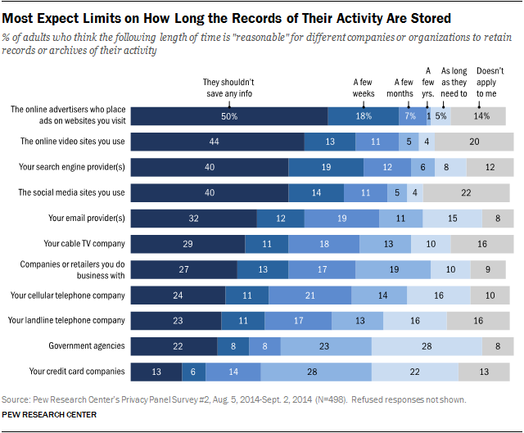
No novel senses
Sai Kiran Vadlamudi
Sensory enhancing tools are legal [2].
CCTV
  Enhances vision
  More officers observing area
Face Recognition Technology
  Faster way of looking through a mugshot book [4].
http://www.pewinternet.org/2015/05/20/americans-views-about-data-collection-and-security/
Notes:
The courts also agree that as long as a tool does not add a new sense or human ability it does not offend public expectation. For example binoculars or telescopes are okay but a tool that can see through walls is not legal as the public doesn’t expect someone can see through their walls. In regards to CCTV it enhances vision of officers and acts as if there are more officers. FRT simply speeds up looking through the videos similar to an officer watching the video and looking through mugshots. The picture on the right demonstrates how people are better understanding of the government keeping data than others. In the same study the vast majority – 81% of participants – agreed that surveillance cameras are hard to avoid; 36% say they “strongly agree” and 45% “agree.”

Slide 21
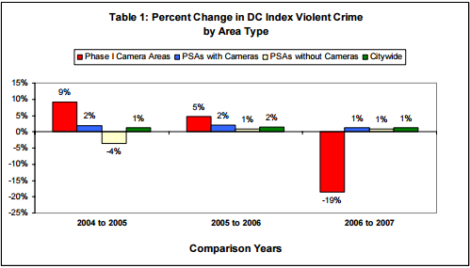
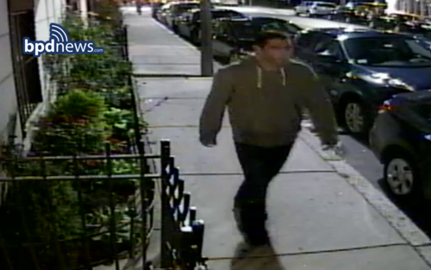
benefits
Sai Kiran Vadlamudi
Efficient
  Monitor public spaces without large number of officers on scene [5].
Safety
  Washington DC saw crime rate go down after installing CCTV [6]
  CCTV helped FBI track suspects of Boston bombing in 3 days [7]
  London bombers were tracked in five days with CCTV footage [8]
Less Invasive than others
  Pat downs, Metal detectors, Body Scanners
http://mpdc.dc.gov/sites/default/files/dc/sites/mpdc/publication/attachments/CCTV_annual_report_2007.pdf
Notes:
CCTV systems have their share of benefits that are often overlooked due to their relation to the fear of Big Brother. They lead to better efficiency for the police department and the officers as they allow a limited set of people to observe large areas therefore cutting down on the numbers of officers that need to be present in the area, this is especially important during large public events like presidential inaugurations, walks etc. This allows more officers to be available leading to faster responses to incidents. There is also an increase in safety, the red bars on the image on the right shows the decline of crime after the installation of CCTV in Washington DC. They also help identify suspects and catch criminals, CCTV footage allowed the FBI to have large amount of information leading to the suspects being finalized within 3 days. CCTVs are also less intrusive than stop and search methods such as pat downs, metal detectors and body scanners employed in many public places.

Slide 22
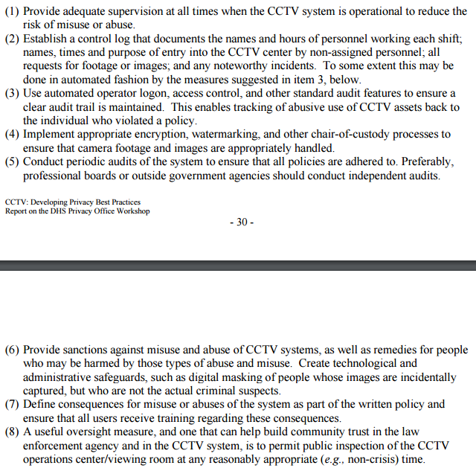
Harm
Sai Kiran Vadlamudi
Abuse
  Possibility of spying on innocent individuals or certain groups
Time-shifting
  Memory length of actions is increased
Limitations
  Impractical for rural areas
http://www.dhs.gov/sites/default/files/publications/privacy_rpt_cctv_2007.pdf
Notes:
Some of the dangers, limitations of implementing CCTV in public area include the following. It is always possible for there to be a malicious officer who spies on or monitors a certain group of people for personal reasons. Many cities and regions that have implemented CCTV surveillance also implemented a logging systems to log requests. The department of homeland security along with multiple states defines logging and audit instructions as seen on the image on the right. Another issue is the problem is the increased memory length of recorded actions, a person remembering another’s actions vs CCTV footage being stored. One major issue with video is storage intensive for example New York CCTV network only keeps recordings for 30 days before it is overwritten and London stores CCTV for 14 days and Washington DC CCTV stores for only 10 days so although it is recorded it is for a finite time. One limitation is also that implementing CCTV is expensive and it is improbable for all of united states to be covered with CCTV so it should be implemented in heavily populated urban areas.

Slide 23
Summary
Sai Kiran Vadlamudi
CCTV and FRT are less invasive than other safety measures.
CCTV and FRT should not simply be viewed as Big Brother.
CCTV and FRT provide efficiency and safety.
Important for highly populated public areas but impractical for rural areas
Notes:
To summarize CCTV and FRTs involve less hassle and are less invasive than other security measures employed in public spaces such as pat downs, body scanners and metal detectors. The view of Big Brother primarily comes to mind when talking about CCTV especially due to their idea of constant surveillance but even in the novel 1984 the main problem came from CCTVs being employed in private spaces which is not the case here. The use of CCTVs helps cut down number of officers needed for surveillance and helps them to be prepared for emergencies. The use of FRT cuts down in the time taken to inspect video footage for suspects and criminals.

Slide 24
References
Sai Kiran Vadlamudi
[1] Legal Information Institute, Fourth Amemdment, https://www.law.cornell.edu/wex/fourth_amendment (9/15/15)
[2] Fretty, Douglas A., Face-Recognition Surveillance: A Moment of Truth for Fourth Amendment Rights in Public Places, http://www.vjolt.net.ezproxy.wpi.edu/vol16/issue3/v16i3_430-Fretty.pdf (9/13/15)
[3] Supreme Court, United States V. Dionisio, 410 US 1 – Supreme Court 1973, https://scholar.google.com/scholar_case?case=16045488821293671430&hl=en&as_sdt=6&as_vis=1&oi=scholarr (9/15/15)
[4]Peterson, J.K., Understanding Surveillance Technologies: Spy Devices, Privacy, History & Applications (Aurbaech Publications 2007), 747
[5] MPD, Metropolitan Police Department Annual Report, http://mpdc.dc.gov/sites/default/files/dc/sites/mpdc/publication/attachments/MPD%20Annual%20Report%202014_lowres_0.pdf (9/14/15)
[6] MPD, Closed Circuit Television System 2007 Annual Report, http://mpdc.dc.gov/sites/default/files/dc/sites/mpdc/publication/attachments/CCTV_annual_report_2007.pdf (9/13/15)
[7] Kelly, Heather, After Boston: The pros and cons of surveillance cameras, http://www.cnn.com/2013/04/26/tech/innovation/security-cameras-boston-bombings/ (9/13/15)
[8]N/A, 7 July bombers spotted on CCTV after exhaustive hunt, http://www.bbc.com/news/uk-11534951 (9/17/15)

Slide 25

Prime Numbers, Encryption, and You
Tiffany Leung
Prime numbers effectively hide your information ^{[6]}
Credit card companies use primes numbers to encrypt your transactions^{[2]}
Case Study involving NSA and RSA^{[4][5][3]}
Conclusion
  Although your private information is encrypted, it is still possible for outside parties to decrypt it
Image courtesy of wired.co.uk
Notes:
Prime numbers are a very important aspect in protecting your privacy. It is used to in RSA encryption to secure online transactions and many other forms of communication such as when you use a credit card, phone calls, emails,. However, even though RSA encryption protects hundreds of millions of people[3], NSA is still finding ways to access that private information.

Slide 26
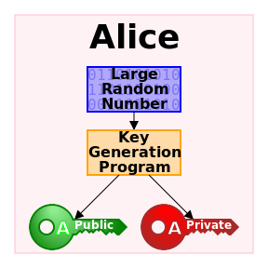
HOW DO PRIME NUMBERS ENCRYPT?
Tiffany Leung
RSA algorithm takes two distinct prime numbers p and q
Compute a large random number N =pq to be the modulus
  2⁵ = 32 = 2 modulus 5
  (p-1)(q-1) + 1
  Get r and s
Distribute the public key and safeguard the private key
Image courtesy of Wikimedia Commons
Notes:
^{[2]}First, you want to randomly select two very large prime numbers. The next step is to use the RSA algorithm developed by three MIT faculty in 1976 to generate your keys. The basic concept is that if you raise any number m to the Nth power modulo N, you get back the same number m. So you take the result (p-1)(q-1)+1, which typically is a non prime number and can be represented as a product of two numbers r and s. If (p-1)(q-1)+1 = 12, then r and s can be 4 and 3, respectively. Finally distribute N and r as public keys while keeping all other variables private. A key is variable value, or a piece of information. You can use the private key to encrypt as a signature. The public keys would still be public but if the owner uses the private key to encrypt then if the other person decrypts it with public key and it works then they know it was sent from the owner.

Slide 27
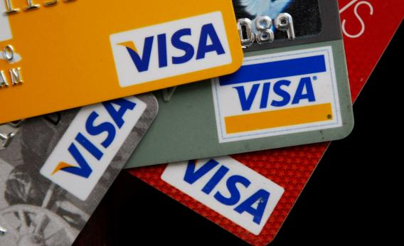
Credit card encryption
Tiffany Leung
What?
  Encrypt a credit card number and then decrypt it
How?
  A merchant picks two large prime numbers p and q
  Choose r and s from the product N
  Merchant makes r and N public while s, p, and q private
Why is this effective?
Image courtesy of Justin Sullivan/Getty Images
Notes:
^{[2]}What does prime numbers have to do with internet security? Well, you want to encrypt a credit card number and then decrypt it so that a customer can pass information to the merchant without someone else also accessing that information. How does one do this? By using the method I just explained. The merchant makes r and N public and s, p, and q private. The encryption consists of raising a credit card number to the r^{th} power modulo N. The decryption, on the other hand, consists of raising the resulting number to the s^{th} power modulo N. This gives back the original credit card number. This is very effective because the only way to decrypt the card without the private key is to do prime factorization to find p and q of the number n. The factorization could take months to find p and q and there has been no algorithm that can factor large integers in polynomial time on a classical computer, eg Mac or PC.^{[1]}

Slide 28
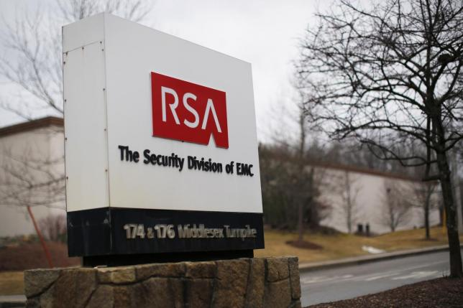
CASE STUDY: NSA infiltrated rsa security
Tiffany Leung
In December 2013, allegation of $10 million RSA/NSA deal^{[3]}
  Supplied NSA with a “back door” to RSA software
Several months later, a group of Johns Hopkins professors discovered a second NSA tool^{[5]}
NSA has influenced IT companies to weaken their encryption on their commercial products^{[4]}
Image courtesy of Reuters/Brian Snyder
Notes:
In December 2013, NSA allegedly paid RSA $10 million to make Dual Elliptic Curve system, a weakened random number generator, which would allow NSA to crack encryptions.^{[3]} This system was the default software used by a wide range of Internet and computer security programs.^{[3]} A group of professors at Johns Hopkins found that NSA had a tool that exploited RSA software’s vulnerability and helped crack a version of RSA’s Dual Elliptic Curve tens of thousands of times faster.^{[3]} NSA spends more than $250 million a year to influence domestic and foreign IT industries to leverage their commercial products’ designs to make them “exploitable”. Thus, allowing NSA to decrypt information received by these companies from their products.^{[4]}

Slide 29
conclusions
Tiffany Leung
Infinitely many prime numbers make it possible to generate very large random numbers
Prime numbers are used to encrypt and decrypt forms of communication such as emails, text messages, and ecommerce
However, through backdoors and exploitation of weaknesses in software, NSA can access private information of yours that you encrypt or decrypt
Notes:
[6]Since it was created almost 40 years ago, there are still no effective solutions to decrypting what was encrypted by the algorithm. The most sure way to get the keys is to do prime factorization. Prime numbers are based off the simple concept that it has no divisors other than 1 and itself. It is impossible to predict the next prime number because there is no pattern. There seems to be infinitely many primes, which makes very large random numbers easily calculable. However, NSA’s power and desire to decrypt private information has allowed NSA to crack encryption codes that guard global commerce and banking systems to codes that protect your emails, phone calls, and web searches.^{[4]}

Slide 30
References
Tiffany Leung
[1] Blanda, S. (2014, March 30). RSA Encryption – Keeping the Internet Secure. AMS Blog. Retrieved September 17, 2015.
[2] Frenkel, E. (2013, June 3). Prime Numbers and Pierre Fermat Keep Your Secrets Safe Online. Slate. Retrieved September 17, 2015.
[3] Glaser, A. (2014, January 30). After NSA Backdoors, Security Experts Leave RSA for a Conference They Can Trust. EFF. Retrieved September 17, 2015.
[4] Larson, J. (2013, September 5). Revealed: The NSA’s Secret Campaign to Crack, Undermine Internet Security. Propublica. Retrieved September 17, 2015.
[5] Menn, J. (2014, March 31). Exclusive: NSA infiltrated RSA security more deeply than thought. Reuters. Retrieved September 17, 2015.
[6] Robinson, S. (2003). Still Guarding Secrets after Years of Attacks, RSA Earns Accolades for its Founders. SIAM, 36(5).
[7] Weisstein, Eric W. "Modulus." From MathWorld--A Wolfram Web Resource. http://mathworld.wolfram.com/Modulus.html

Slide 31
Class 7
The End
Keith A. Pray
Instructor
socialimps.keithpray.net
Notes:
This is the end. Any slides beyond this point are for answering questions that may arise but not needed in the main talk. Some slides may also be unfinished and are not needed but kept just in case.

