Slide 1
Class 6
Privacy
Keith A. Pray
Instructor
socialimps.keithpray.net
Notes:
Here’s the title slide. Excited already, aren’t you?
Paper Ave ~6, full point higher!

Slide 2
Logistics
We need to schedule Groups present days.
Send your group web site URL and choice of day via email.
Address email to entire course staff for quickest response time
Presentations are due 24 hours before class
Use Presentation Guidelines on course web site
Notes:
Not needed this time:
Send presentations via email as attachment.
Do not change the format, footers, etc. in the template slides.
Paper writing process: Sources → Notes → Conclusion → Argument → Counter Point → Response

Slide 3
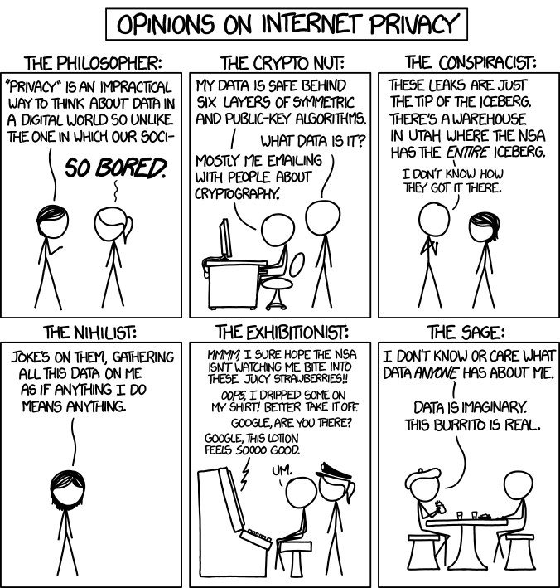
Overview
Review
Assignment
Students Present
http://xkcd.com/1269/
Notes:
1 – Accessed 2014-04-14
Personal Information Privacy

Slide 4
My Reading Notes
pp. 231 Moral capitol – 1984?
pp. 237 “…privacy…in their own homes…” != nanny to expect privacy “…when… insides Sullivans home.
pp. 245 Web Browsers put cookies on on your hard drive, not Web Servers.
pp. 249 why is assumption flawed?
pp. 251 Are call records really a “social network”?
pp. 255 Why does Apple not enforce policy of asking permission in the API?
pp. 256 5. 2003 is a while ago.
pp. 267 Does not answer first question.

Slide 5
Assignment
One Page Paper
Would a National ID System be a good thing?
  One acceptable approach is to show the argument in the book for the position opposite to your conclusion is a weak argument.
  Feel free to reference or build upon your self search work if it helps your argument.

Slide 6
Overview
Review
Assignment
Students Present

Slide 7
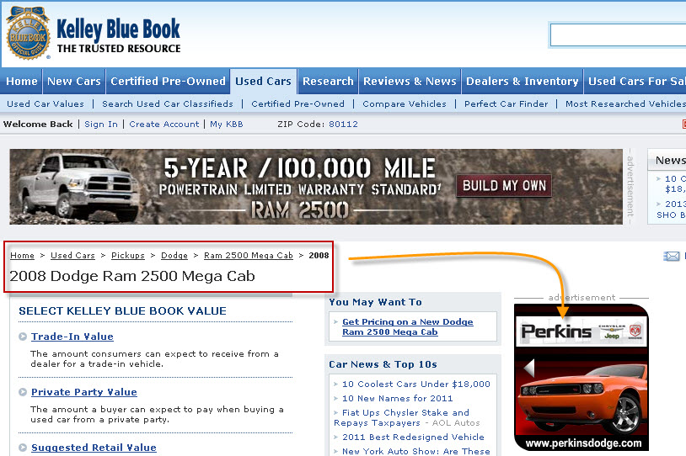
Targeted ads
Robyn Domanico
Targeted advertising displays ads based on a user’s interest
Ad networks partner with websites to collect information
Ads can be placed based on the content of a page
Some ad software can track users anywhere
Image courtesy of http://www.onlinemarketingdenver.net/endemic-targeting-display/
(Beales, 2010),(Deschene, 2008)
Notes:
-Targeted advertising uses data it collects to display ads that are more relevant to the customer that views them, in the hope that they are more likely to click the ads.
-Websites can partner with ad networks to sell or give information that can be used for ad placement. Ad networks are limited by the websites they partner with, and can only look at data from those websites.
-The context of the page also provides a context for ads. (e.g. Searching for power drills and then seeing an ad for a sale on drills at Home Depot) User demographics for a site can also be used to determine where ads are placed.
-For example, in the image the user is viewing an page about a 2008 Dodge Ram 2500 Mega Cab, and there are advertisements for other cars both to the right and top of the page.
-The introduction of software (such as NebuAd’s software) has raised additional privacy concerns due to its ability to track consumers wherever they go on the internet, not just websites that have partnered with an ad network. While data collected by these programs is anonymous, users can be continually tracked by their ISPs [7]

Slide 8
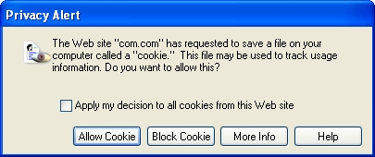
How ads use and gather data
Robyn Domanico
Some ads use the context of a page in addition to user data
  This includes keywords on the page, or how often words appear
Other sites use the data gathered from a user
  Ad networks use cookies and the user’s IP address
  Data can be used to make inferences on user preferences
Image courtesy of http://www.polyu.edu.hk/~ags/itsnews0608/security.html
(Google, n.d.),(Deschene, 2008)
Notes:
-Some websites like Google Adsense use the context of a webpage or previous user interactions in addition to user data to place ads. For example, google looks at “keyword analysis, word frequency, font size, and the overall link structure of the web”
-As a result, ads can be placed on a page based on a specific user’s interests, or the advertiser can place ads that users who are likely to be interested in the ad if they visited that page (e.g The ads for cars on a site about cars, from the first page)
-Defined demographics (such as sports enthusiasts) also provide a basis for placing ads, based off of other advertiser sites that users visit.
-Using the IP address, ad networks can link search/web data to a specific computer and base their advertisements off of it. Based on the information in a cookie, advertisers will look at data such as user preferences and search terms that have been used. Additionally, ad networks make inferences based off of the data they receive, such as someone who logs in from many global IP addresses, they can assume that that person travels a lot.
-Dynamic IP addresses can mislead or throw off advertisers, but data that is stored in an online account (e.g user preferences on a website) can be used regardless of IP, or giving the cookie on a computer a unique ID. [5]
-IP addresses can be misleading for advertisers some of the time: if multiple people use the same computer (such as a family computer).

Slide 9
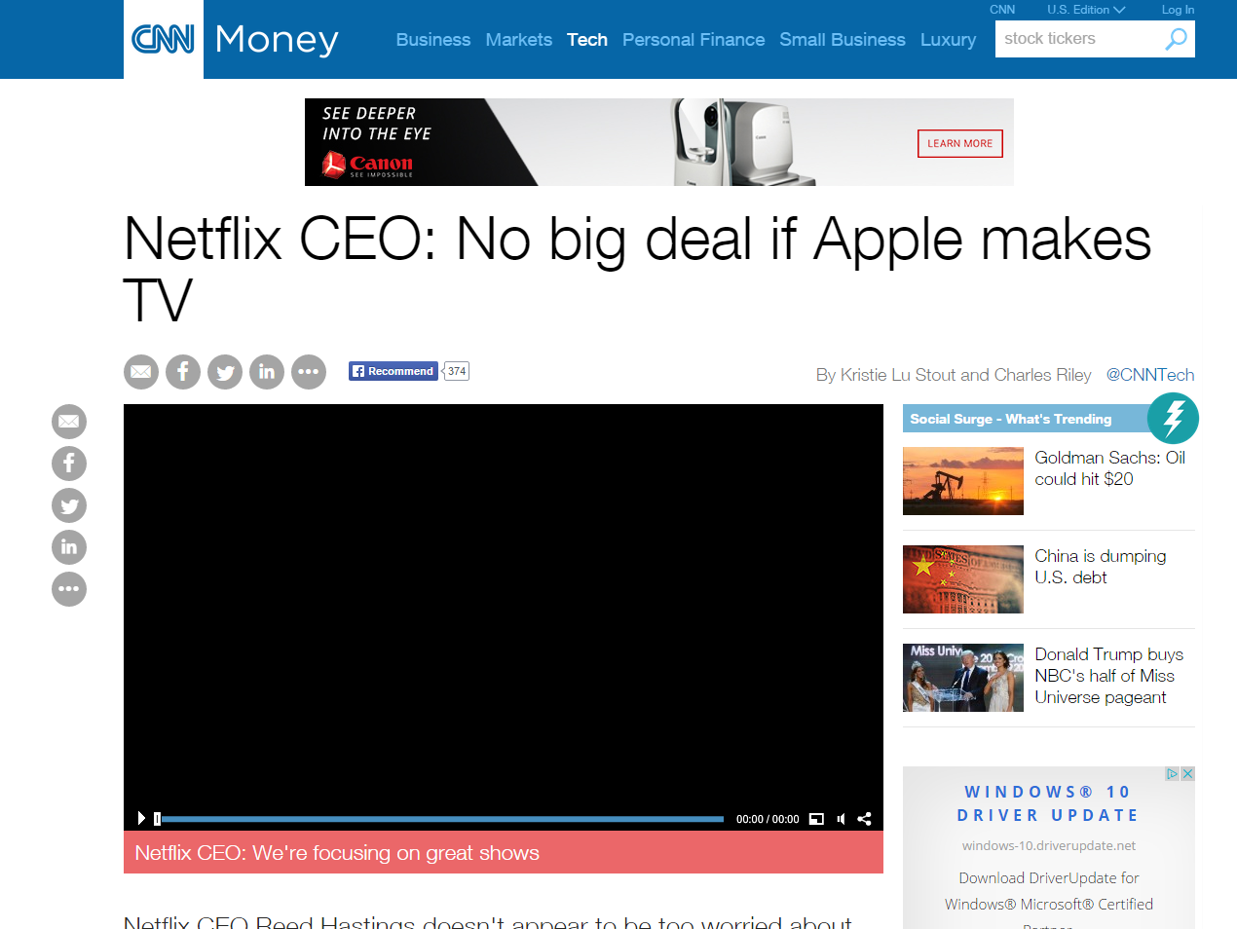
The Benefits for advertisers
Robyn Domanico
“Premium spots” for advertising are hard to get
Targeted ads are often more cost-effective
Users see ads that are tailored to them
(Deschene, 2008)
Screenshot of an article on CNN’s website, featuring a high-traffic ad location
Notes:
-Premium advertising spots (these are often spots on major media sites with a lot of traffic: for example, CNN.com got about 993 million page views in September 2014 [6]) are very competitive and usually very expensive, but not always effective at reaching the people advertisers want.
-Premium advertisements were previously the best way to reach the largest number of people with an ad, but targeted advertising reduces the need to pay for these spots
-Buying a sponsored link spot in search results is another common method, but is still limited by people searching for specific terms related to the advertisers business.
-Targeted ads allow advertisers to display ads to people who are more likely to be interested and click the ads, and can more effectively reach the people that they want. This also eliminates the need to find the ‘prime’ spots on the internet, and allows advertisers to place ads in more relevant locations, minimizing the cost of placing ads on a larger number of pages.
-The image shows an advertisement placed in what is likely a premium spot: it is at the top of an article on CNN, where the millions of users who read the article will see it, even though this image may not relate to the user specifically

Slide 10
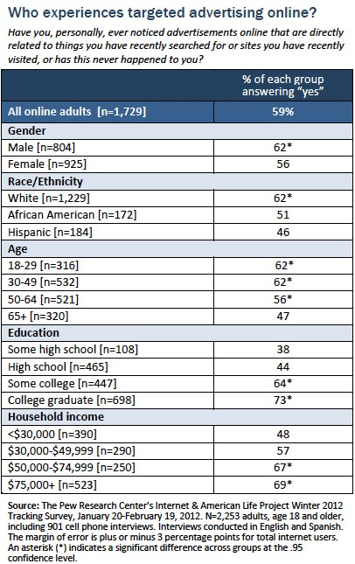
41% of users are not aware of targeted ads
Robyn Domanico
Image courtesy of http://www.pewinternet.org/2012/03/09/main-findings-11/
Networks claim that they are not collecting personal data
Consumers must be informed when their information is being collected
Users may not be aware that their data is being collected
(Deschene, 2008), (Purcell, Brenner, & Rainie, 2012)
Notes:
-Many users express privacy concerns over the data that is collected, though advertising networks look at data such as search terms that have been used or previous partnered sites that a user has visited, not addresses or usernames.
-The FTC has tried to address these privacy concerns by proposing guidelines for behavioural targeting, such as informing a consumer when their information is being collected. Many websites will bury the opt-out disclaimer, however. This results in many users being unaware that they can opt-out or know that their data is being collected in the first place
-Advertisements on a page that have been placed through targeted advertising are indistinguishable from advertisements that have not been placed this way, but the consumer has no way to distinguish a difference between the two aside from the topic of the advertisements.
-Overall, 59% of users said that they have noticed targeted advertising: This rate is higher among “men, white internet users, those under age 65, those who have been to college, and those living in higher income households. Three-quarters (73%) of college graduates have noticed online ads related to things they recently searched or sites they recently visited, significantly higher than online adults with lower educational attainment.” [4]

Slide 11
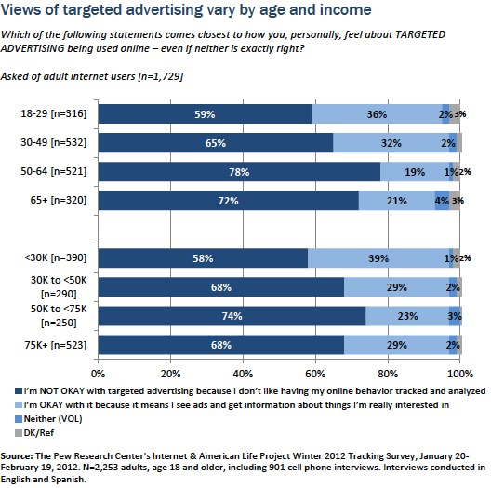
Majority of users not ok with targeted ads
Robyn
Domanico
Image courtesy of http://www.pewinternet.org/2012/03/09/main-findings-11/
Roughly two-thirds of users are not okay with targeted advertising
  About 28% of users were okay with targeted advertising
Younger users are more likely to have a favorable view of targeted ads
Overall, most users do not like having their behavior online tracked
(Purcell, Brenner, & Rainie, 2012)
Notes:
-According to a 2012 survey, approximately two-thirds of users do not like targeted advertising, as they are against being tracked and analyzed online.
-On the other hand, about 28% of users are okay with targeted ads, since it means they are more likely to see things they are actually interested in over traditional advertising.
-While all age groups surveyed mostly did not agree with the practice, younger users were more likely to be alright with the targeted ads.
-The survey may not take into account users who were ok with targeted ads and not with behavior tracking, as those surveyed could only choose whether they were ok with it, not ok with it, or neither. User awareness about targeted advertising may have influenced results, as users may not know the exact context of how behavioral tracking works.

Slide 12
Summary
Robyn Domanico
Targeted advertising is cheaper and more effective for advertising companies
Advertising networks collect data when users visit a site, or their previous preferences
Users mostly do not approve of having their data collected for targeted advertising, though a large percentage of users are not aware of it happening
Overall, targeted advertising benefits advertisers but may harm the privacy of their users
(Google, n.d.),(Deschene, 2008)
Notes:
-Targeted advertising helps advertisers save money by not needing to place ads in premium spots, and can only display ads to those who are deemed interested
-Data collection is done silently, and relies on the user data given when a user goes to a website
-About two thirds of users do not approve of targeted advertising, but approximately 40% of users are not even aware that their data is being collected
-Overall, targeted advertising allows advertisers to save money and better reach their intended audience, but can present a privacy risk to users by collecting data on their internet usage habits. People may be uncomfortable with the idea that their internet usage is tracked, and user trust is not helped by websites that bury opt-out notifications.

Slide 13
References
Robyn Domanico
[1] Beales, Howard. "The Value of Behavioral Targeting." The Value of Behavioral Targeting (n.d.): n. pag. Web. 6 Sept. 2015. <http://www.networkadvertising.org/pdfs/Beales_NAI_Study.pdf>.
[2] "How Ads Are Targeted to Your Site." AdSense Help. Google, n.d. Web. 6 Sept. 2015. <https://support.google.com/adsense/answer/9713?hl=en>.
[3] Deschene, Lori. "What Is Behavioral Targeting?" CBS News. CBS, 17 June 2008. Web. 6 Sept. 2015. <http://www.cbsnews.com/news/what-is-behavioral-targeting/>.
[4] Purcell, Kristen, Joanna Brenner, and Lee Rainie. "Search Engine Use 2012." Pew Research Center. N.p., 9 Mar. 2012. Web. 6 Sept. 2015. <http://www.pewinternet.org/2012/03/09/search-engine-use-2012/>.
[5] "Why Is It so Important Not to Store IP Address or User ID Cookie?" Start Page. N.p., 23 July 2015. Web. 14 Sept. 2015. <https://support.startpage.com/index.php?/Knowledgebase/Article/View/218/1/why-is-it-so-important-not-to-store-ip-address-or-user-id-cookie>.
[6] "CNN.com Takes #1 Video and Traffic Spots, Dominates Social and Mobile." CNN Press Room. CNN, 22 Oct. 2014. Web. 14 Sept. 2015. <cnnpressroom.blogs.cnn.com/2014/10/22/cnn-com-takes-1-video-and-traffic-spots-dominates-social-and-mobile/>.
[7] Steel, Emily, and Vishesh Kumar. "Targeted Ads Raise Privacy Concerns." Wall Street Journal. N.p., 8 July 2008. Web. 14 Sept. 2015. <http://www.wsj.com/articles/SB121548469430734901>.

Slide 14
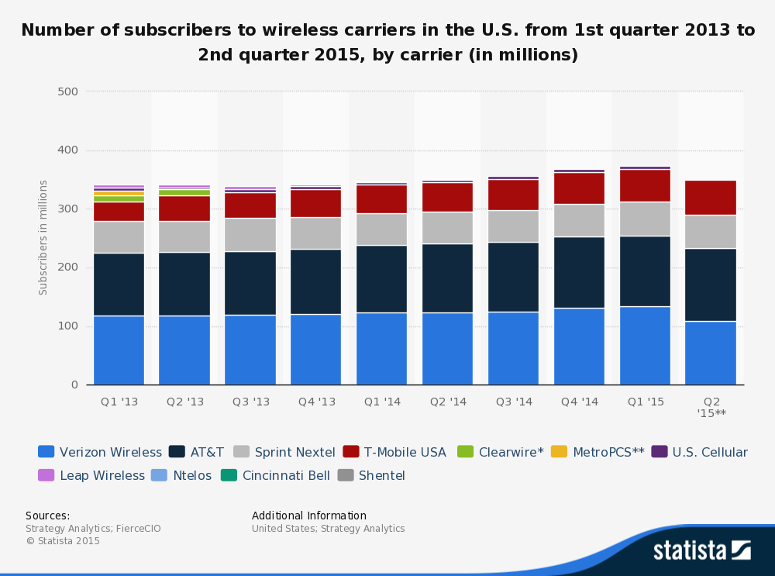
Cell Phone Tracking and advertisements
Nicholas Muesch
Carriers Track Users
Target advertisements
Ads Reduce Prices
http://www.statista.com/statistics/283507/subscribers-to-top-wireless-carriers-in-the-us/
Notes:
I did my research on how mobile device tracking done by Carriers. This is a relevant issue because, as you can see, as of this year there were over 350 million people with a cell phone subscription in the USA. Currently 64% of Americans have a smartphone vs 35% in 2011. As seen on the graphic, a majority of people with a cell phone subscription have Verizon and AT&T. Through this presentation, I will both describe some cases of mobile tracking and subsequent targeted advertising, and then show why such tracking is necessary to keep prices of services down through current real life examples. To this end, I conclude that tracking is a necessary evil to subsidize costs of services.

Slide 15

Tracking Case Studies
Nicholas Muesch
General HTTP header injection
Verizon and AT&T Supercookie
Carrier IQ
http://www.adweek.com/files/imagecache/node-detail/news_article/supercookie-2011.jpg
Notes:
These are a few examples of current ways that cell phone carriers are tracking their consumers. I will go into each in detail in the coming slides.
These methods are used to target advertising and for diagnostic purposes
-General HTTP Header Injection
-Verizon and AT&T Supercookie
- and lastly Carrier IQ

Slide 16
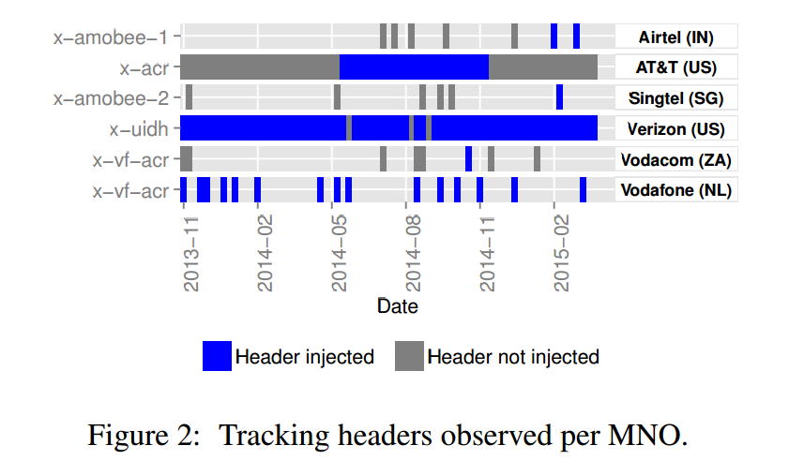
Carriers Track web history and personalize ads
Nicholas Muesch
Information is added into HTTP packets
Verizon and AT&T Supercookie
  Unique identifier
  Destination can keep track of user
  Used for personalized advertisements
  AT&T discontinued after outcry
  Verizon adopted opt-out policy
                http://sigcomm2015.org/pdf/papers/hotmiddlebox/p25.pdf
Notes:
HTTP Header Injection is the means by which a content is added into a packet sent out by a consumer’s device.
-This can mean adding anything between a timestamp and a Name in each packet.
-As seen in the graphic taken from a paper who used a Netalayzer troubleshooting service to inspect packets, quite a few mobile companies participate in this injection
-Verizon is clearly utilizing this injection methodology.
-The authors of the paper state that Verizon doesn’t inject anything into corporate or govt subscribers (explaining the time windows)
-The study spans 16 months and looks at 112 countries
Verizon and AT&T have been doing this injection with uniquely identifiable information.
-The ISP, Verizon and AT&T, inject a unique identifier into the packet before it reaches its destination
-The unique identifier is unknown to the user but can be seen by the destination of the packet
-The destination and AT&T/Verizon can use this to keep track of who you are and how you interact with the site, similar to a cookie
-This allows for personalized advertisements which a user is more likely to click/view than a normal ad.
-After the outcry from the public, AT&T said they ended this policy, and Verizon offers an opt-out solution.
-As of 2013, people found that they this injection was still happening
-This doesn’t mean that they won’t find another way to track their consumers.
These can be seen as an invasion of privacy
-Should a company have this much data about what a person is doing?

Slide 17
Carrier IQ
Nicholas Muesch
Software on over 140 million devices (2011)
Collects user data
  Keystrokes
  Recording telephone calls
  Storing text messages
  Tracking location
Data sent to carrier
  Diagnostic services
Notes:
Carrier IQ is a piece of software that was installed on over 140 million devices as of 2011
This app runs hidden in the background and is capable of capturing data such as
-logging keystrokes
-Recording telephone calls
-Storing text messages
-and tracking location
These were found by locating the process IQRD on an HTC phone and looking at the permissions
By plugging the phone in USB mode, Trevor Eckhart, a security researcher, found that received text message content was sent to the IQRD process as well as other keystrokes and web surfing habits.
This data can then be sent to the phone carrier to do with what they please.
-Carriers claim that they are not malicious and are used for the purpose of diagnostics
-What app is taking most battery
-Why calls drop and where to put up a new tower
Runs in the background, set to start up when phone starts
-Unable to force stop the process
-Doesn’t matter if phone is connected to network or not
-Only stops when phone is off
Couldn’t find any new information about this service. There is an app that will detect if Carrier IQ is on your phone
-My phone did not have traces of the software
-The company is still in business, but I believe its part of the diagnostics toggle on a users phone.
The privacy concern here is that no communication is private!!!

Slide 18
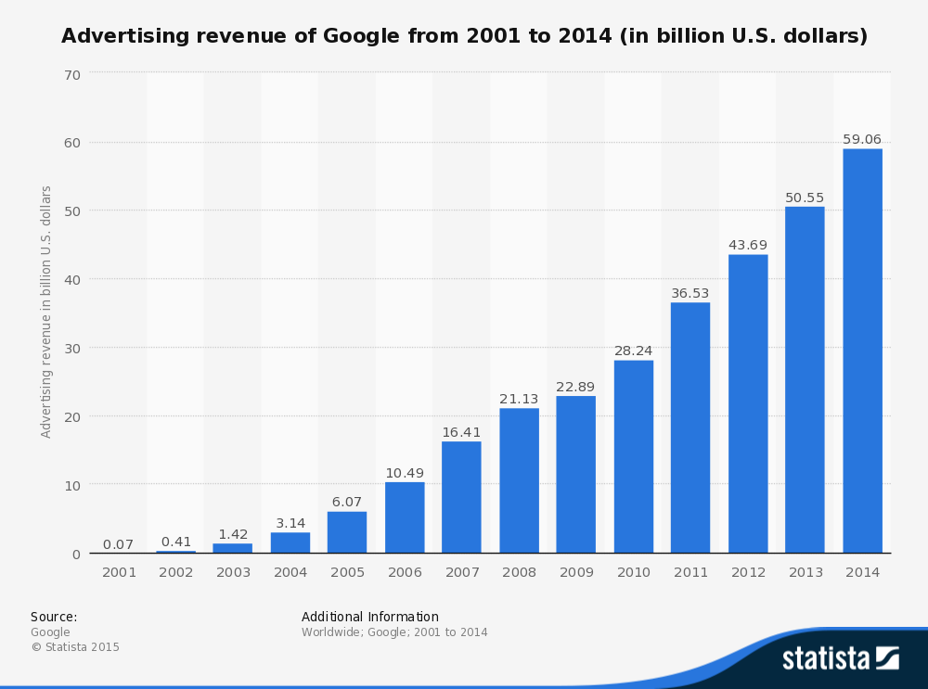
Making Money Requires Ads or higher prices
Nicholas Muesch
YouTube Subscription Service
Hulu Commercial Free Subscription
AT&T Internet Preferences Program
http://www.statista.com/statistics/266249/advertising-revenue-of-google/
Notes:
YouTube has plans to introduce a subscription based service
-It will lock certain content behind a paywall and will not have advertisements
Hulu recently came out with a commercial free plan for its consumers.
-For access to content with commercials, its $7.99/month
-For access to the same content without advertisements, its $11.99/month
-This allows for users willing to watch advertisements to receive a lower monthly price
-This works because Hulu is making up the money lost from ad revenue straight from its consumers
AT&T came out with its Gigapower fiber service which is supposed to compete with Google fiber.
-This is great because it offers insanely fast speeds
-AT&T introduced an “Internet Preferences Program” with this service
-For between $29.99 and $66 extra a month, (depending on the package) AT&T will not use a user’s web browsing information
-They do this by looking at the IP address assigned to the GigaPower account and checks whether you are opted in to the program
-If you are not participating, your traffic is not routed to the “Preferences web browsing and analytics platform”
These imply that a decent amount of money made by these services come through advertising.
-Therefore in order to keep prices low and maintain a service, there has to be some form of advertisement
-Google made 59.6 billion US dollars in ad revenue in 2014

Slide 19
Conclusion
Nicholas Muesch
Carriers use various methods to track users
Necessary evil to keep prices low
Will privacy turn into a premium service?
Notes:
Mobile Carriers have found a few ways to track their consumers. Even if public outcry forces a company to abandon a policy, there will no doubt be another to take its place
Also, despite user’s valid privacy concerns, this tracking enables personalized advertisements which allow companies to keep prices low by providing users with advertisements they are more likely to click on/view. This may be a necessary evil.
This begs the question:
-Will privacy turn into a paid service? Personally, I think the answer is that this is a policy we will continue to see more companies adopt.

Slide 20
References
Nicholas Muesch
[1] Rodriguez, Sundaresan, Kreibich, “Header Enrichment or ISP Enrichment? Emerging Privacy Threats in Mobile Networks”, http://sigcomm2015.org/pdf/papers/hotmiddlebox/p25.pdf
[2] Lutz, Zachary, “Carrier IQ: What it is, what it isn’t, and what you need to know”, http://www.engadget.com/2011/12/01/carrier-iq-what-it-is-what-it-isnt-and-what-you-need-to/ (9/12/15)
[3] Farooqui, Adnan, “Ad-Free YouTube Subscription Service Reportedly Coming Soon” http://www.ubergizmo.com/2015/08/ad-free-youtube-subscription-service-reportedly-coming-soon/ (9/11/15)
[4] Auerbach, David, “Privacy is becoming a Premium Service”, http://www.slate.com/articles/technology/bitwise/2015/03/at_t_gigapower_the_company_wants_you_to_pay_it_not_to_sell_your_data.html (9/13/15)
[5] http://www.hulu.com/nocommercials (9/14/15)
[6] Graziano, Dave, “How o opt out of Verizon’s ‘supercookie’ tracking program”, http://www.cnet.com/how-to/how-to-opt-out-of-verizon-supercookie-tracking-program/ (9/12/15)
[7] Brodkin, Jon, “AT&T’s plan to watch your Web browsing—and what you can do about it”, http://arstechnica.com/information-technology/2015/03/atts-plan-to-watch-your-web-browsing-and-what-you-can-do-about-it/ (9/12/15)
[8] Angwin, Julia and Larson, Jeff, “Somebody’s Already using verison’z ID to Track Users”,(http://www.propublica.org/article/somebodys-already-using-verizons-id-to-track-users 9/11/2015)
[9] Carrier IQ, “Understanding Carrier IQ Technology”, http://www.franken.senate.gov/files/letter/111212_CarrierIQ_Attachment.pdf (9/13/15)
[10] Smith, Aaron, “U.S. Smartphone Use in 2015”, http://www.pewinternet.org/2015/04/01/us-smartphone-use-in-2015/ (9/14/15)
Notes:
References
Any questions?

Slide 21
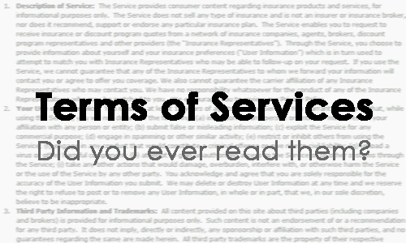
Terms of Service & Privacy Policies
Dennis Silva, Jr.
ToS and Privacy Policies are separate entities [1]
Virtually all websites have
some form of ToS [2]
  Clickwrap agreements
  Browsewrap agreements
Conclusion to Argue:
  ToS agreements are being abused
  by companies
Source: www.yingyingz.com [12]
[1] [2] [12]
Notes:
Introduce yourself and the general topic (Terms of Service & Privacy Policies).
Terms of Service (ToS) are the governing conditions that the user must abide by in order to use a website.
A Privacy Policy informs a website’s users how their personal information will be collected, stored, and whether it is shared or sold. Required for all businesses which collect personally identifiable information of a user.
Although separate, ToS and the Privacy Policy usually reference one another and both must be excepted before use of site. For rest of presentation, if I mention ToS I mean both documents.
Clickwrap agreements are agreements in which the user must click an “ok” or “I agree” button after “reading” the terms of service and privacy in order to use website/service (Ex: ITUNES, FACEBOOK, most account creation websites).
Browsewrap agreements are agreements that are posted on the website (typically hyperlinked at the bottom of a page) where by simply using the website, the user accepts the terms (Ex: GOOGLE and YOUTUBE without login).
CONCLUSION:
Companies abuse their ToS agreements to acquire additional rights and information about you and your intellectual property (IP).

Slide 22
Extent of the Terms of Service
Dennis Silva, Jr.
Legally Enforceable (mostly)
- Clickwraps > Browsewraps [3]
  Toysmart.com [4]
  GameStation [5]
Can be modified at
company’s discretion
  AOL Phone-numbers [6]
  Facebook privacy defaults [7]
“By placing an order via this Web site […] you agree to grant us a non-transferable option to claim, for now and for ever more, your immortal soul.”
- GameStation [5]
[3] [4] [5] [6] [7]
Notes:
LEGALLY ENFORCEABLE:
To be enforceable, the website has to give adequate notice, opportunity to read, and some action must be taken by the user. Clickwraps more enforceable than browsewraps.
Toysmart was an online toystore in the early 2000s. After going bankrupt, the company tried to sell all collected customer data to the highest bidder. Under their privacy agreement it said explicitly all information would be kept internally. Court ruled for legality of ToS.
Gamestation is an online videogame store. In 2010, for one day, they added a clause in ToS that by agreeing the company had a right to your immortal soul. 7,500 agreed to the terms. Obviously this would not be enforceable in court.
CAN BE MODIFIED AT COMPANY’S DISCRETION:
One of first big cases. AOL in 1997, without notice to its customers, changed their TOS to be able to provide telephone numbers to AOL’s business partners of all users on the site. Word got out early, and people were outraged. AOL would revoke the part in their terms.
Other companies today like YOUTUBE, AMAZON, FACEBOOK state that the ToS can change either with short or no notice. Difficult for the user to keep up with all changes for all websites they use.
In 2009 FACEBOOK, overnight, changed the privacy settings of all users to share publically a majority of a user’s Facebook content. Default privacy settings also changed throughout the years, by 2010 all content except your contact info and birthday were shared with the entire internet. Facebook defended itself it was for innovation and it (vaguely) stated in ToS.

Slide 23
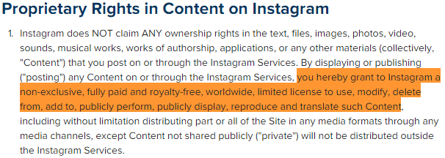
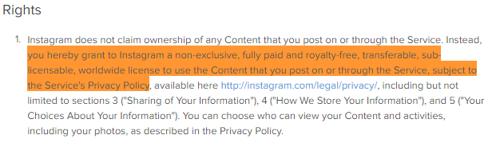
How is my information being USED?
Dennis Silva, Jr.
Intellectual Property [7] [8] [9]
  Broad copyright licensing
  Without warning removal
  Deleted does not mean deleted
Metadata [7] [10] [11]
  Track everything!
  True anonymity?
  3rd party sharing
Source: www.Instagram.com [8] [14]
[7] [8] [9] [10] [11] [14]
Notes:
Many sites claim that you still own your works, but not always the case. Websites have very broad copyright licensing that give them more rights than are needed to use the user’s IP on their website. EX FACEBOOK, YOUTUBE, LINKEDIN, INSTAGRAM
The figure shows two ToS of Instagram, the top before Jan. 19, 2013 and the bottom after. The above, in short, gives a “limited license” to share and modify content the user expects on the site. The second ToS is much broader.
Your IP can also be removed without warning on these websites. Makes sense for copyrighted material, obscenity, etc., but ToS are very vague. Can remove anything company deems to violate terms of service. EX YOUTUBE
Deleted information is just hidden from the public and you. YOUTUBE can retain, but not display, distribute or perform services of your content. FACEBOOK same. Some websites like SKYPE, you can’t delete your account.
Metadata is structured information that can describe, explain, or make it easier to retrieve or use some information.
GOOGLE happily shares that it collects data on the things you do (websites, ads, location, IP address), things that “make” you (email address + content, personal information), and things you create (contacts, photos, videos). For some may be too much.
Sites claim your data remains anonymous. GOOGLE has enough data to describe almost your entire life online and off, but says it does not share with other websites.
FACEBOOK automatically shares data directly with companies like BING, PANDORA, TRIPADVISOR, ROTTEN TOMATOES, etc. unless users opt-out.

Slide 24

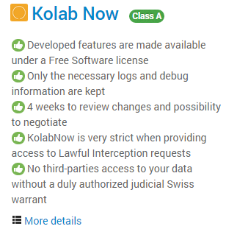
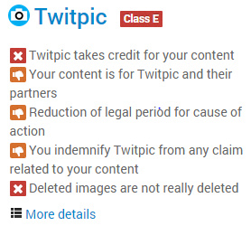
Conclusions
Dennis Silva, Jr.
Companies have the advantage
ToS agreements use vague wordings
Your data really isn’t yours
Utilize tosdr.org’s class rating system
Source: www.tosdr.org [15]
[15]
Notes:
Companies have the advantage when it comes to their ToS and Privacy Policies.
ToS are written in such a way that they are vague. This helps any future use of your data whether to better the service of the website or for financial gain.
People are granting these companies broad licenses to your own IP and data. You give up more rights than necessary to use the services of the site.
Overall awareness of the ToS and Privacy Policies need to increase.
Websites like tosdr.org help to give insight into how websites monitor, store, and use your personal information.
Class A: Best ToS, treat you fairly, respect your rights and won’t abuse your data KOLAB & DUCKDUCKGO
Class C: Alright ToS but issues exist that need your consideration GOOGLE
Class E: ToS raise serious concerns TWITPIC
No Class Yet: tosdr hasn’t sufficiently reviewed the terms yet FACEBOOK, AMAZON, TWITTER…
Questions, comments, or concerns?

Slide 25
References
Dennis Silva, Jr.
[1] Solove, Daniel J. & Hartzog, Woodrow. THE FTC AND THE NEW COMMON LAW OF PRIVACY. http://cyberlaw.stanford.edu/files/publication/files/SSRN-id2312913.pdf (9/12/15)
[2] Bayley, Ed. “The Clock That Bind: Ways Users ‘Agree’ to Online Terms of Service.” https://www.eff.org/wp/clicks-bind-ways-users-agree-online-terms-service (9/12/15)
[3] Organ, Shawn J. & Corcoran, Mathew C. “Your Web Site’s ‘Terms of Use’ Are They Enforceable?” http://www.jonesday.com/files/Publication/97a326a1-0077-4fc9-ac81-e82c265d0c82/Presentation/PublicationAttachment/a882327c-e026-49bf-91fb-ee3f9ca21ac0/Terms%20of%20Use.pdf (9/12/15)
[4] Federal Trade Commission: “FTC Announces Settlement With Bankrupt Website, Toysmart.com, Regarding Alleged Privacy Policy Violations.” https://www.ftc.gov/news-events/press-releases/2000/07/ftc-announces-settlement-bankrupt-website-toysmartcom-regarding (9/12/15)
[5] CNET: “Online game shoppers duped into selling souls.” http://www.cnet.com/news/online-game-shoppers-duped-into-selling-souls/ (9/12/15)
[6] CNET: “AOL dumps new member policy.” http://archive.is/GPPzv (9/12/15)
[7] Facebook: Statement of Rights and Responsibilities. https://www.facebook.com/legal/terms (9/12/15)
Notes:
[1] http://cyberlaw.stanford.edu/files/publication/files/SSRN-id2312913.pdf
[2] https://www.eff.org/wp/clicks-bind-ways-users-agree-online-terms-service
[3] http://www.jonesday.com/files/Publication/97a326a1-0077-4fc9-ac81-e82c265d0c82/Presentation/PublicationAttachment/a882327c-e026-49bf-91fb-ee3f9ca21ac0/Terms%20of%20Use.pdf
[4] https://www.ftc.gov/news-events/press-releases/2000/07/ftc-announces-settlement-bankrupt-website-toysmartcom-regarding
[5] http://www.cnet.com/news/online-game-shoppers-duped-into-selling-souls/
[6] http://archive.is/GPPzv
[7] https://www.facebook.com/legal/terms
[8] https://instagram.com/about/legal/terms/
[9] https://www.youtube.com/static?template=terms
[10] http://www.google.com/intl/en/policies/terms/
[11]http://www.amazon.com/gp/help/customer/display.html/ref=footer_cou?ie=UTF8&nodeId=508088
[12] http://www.yingyingz.com/wp-content/uploads/2011/09/Terms-of-Services.jpg
[13] http://mattmckeon.com/facebook-privacy/
[14] https://instagram.com/about/legal/terms/before-january-19-2013/
[15] https://tosdr.org/

Slide 26
References
Dennis Silva, Jr.
[8] Instagram: Terms of Use. https://instagram.com/about/legal/terms/ (9/12/15)
[9] YouTube: Terms of Service. https://www.youtube.com/static?template=terms (9/12/15)
[10] Google: Google Terms of Service. http://www.google.com/intl/en/policies/terms/ (9/12/15)
[11] Amazon: Conditions of Use. http://www.amazon.com/gp/help/customer/display.html?ie=UTF8&nodeId=508088 (9/12/15)
[12] yingying: Terms-of-Service. Image. http://www.yingyingz.com/wp-content/uploads/2011/09/Terms-of-Services.jpg (9/13/15)
[13] McKeon, Matt. “The Evolution of Privacy on Facebook.” May 2010. http://mattmckeon.com/facebook-privacy/ (9/13/15)
[14] Instagram: Terms of Use (Prior to January 19, 2013). https://instagram.com/about/legal/terms/before-january-19-2013/ (9/12/15)
[15] Terms of Service Didn’t Read. https://tosdr.org/ (9/12/15)
Notes:
[1] http://cyberlaw.stanford.edu/files/publication/files/SSRN-id2312913.pdf
[2] https://www.eff.org/wp/clicks-bind-ways-users-agree-online-terms-service
[3] http://www.jonesday.com/files/Publication/97a326a1-0077-4fc9-ac81-e82c265d0c82/Presentation/PublicationAttachment/a882327c-e026-49bf-91fb-ee3f9ca21ac0/Terms%20of%20Use.pdf
[4] https://www.ftc.gov/news-events/press-releases/2000/07/ftc-announces-settlement-bankrupt-website-toysmartcom-regarding
[5] http://www.cnet.com/news/online-game-shoppers-duped-into-selling-souls/
[6] http://archive.is/GPPzv
[7] https://www.facebook.com/legal/terms
[8] https://instagram.com/about/legal/terms/
[9] https://www.youtube.com/static?template=terms
[10] http://www.google.com/intl/en/policies/terms/
[11]http://www.amazon.com/gp/help/customer/display.html/ref=footer_cou?ie=UTF8&nodeId=508088
[12] http://www.yingyingz.com/wp-content/uploads/2011/09/Terms-of-Services.jpg
[13] http://mattmckeon.com/facebook-privacy/
[14] https://instagram.com/about/legal/terms/before-january-19-2013/
[15] https://tosdr.org/

Slide 27
Class 6
The End
Keith A. Pray
Instructor
socialimps.keithpray.net
Notes:
This is the end. Any slides beyond this point are for answering questions that may arise but not needed in the main talk. Some slides may also be unfinished and are not needed but kept just in case.

