Slide 1
Class 11
Work
Keith A. Pray
Instructor
socialimps.keithpray.net
Notes:
Here’s the title slide. Excited already, aren’t you?
Last paper average: Game: ?
Total points not counting extra credit so far: 16 - 33 - 52

Slide 2
Overview
Review
Assignment
Students Present

Slide 3
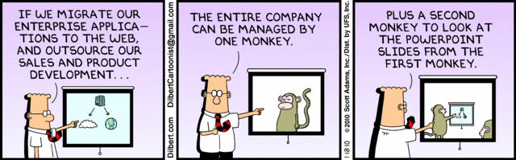
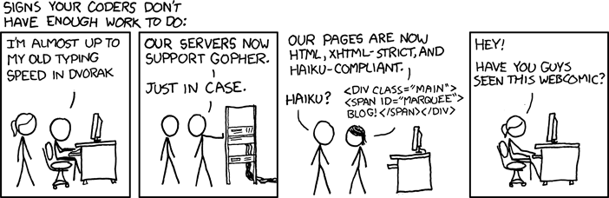
http://xkcd.com/554/

Slide 4
Group Quiz
List 2 ways IT can lead to organizational change.
List 4 ways a Video Game Producer may protect its IP and what specific IP each protects.
List a computing technology that can be used to protect an individual’s privacy.
List a computing technology that can be used to intrude upon an individual’s privacy.
Notes:
Could split into groups of 4-5 for this.
Fill time with Work Discussion on Course Web Site
Maybe watch video:
CGP Grey
Humans Need Not Apply – 2014-08-13
http://www.youtube.com/watch?v=7Pq-S557XQU
Last access 2015-04-23

Slide 5
Overview
Review
Assignment
Students Present
Notes:
Review Group Assignment Details.

Slide 6
Overview
Review
Assignment
Students Present

Slide 7
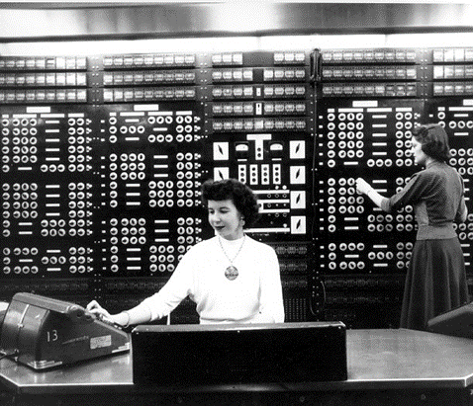
History and Current Status of Women in Computing
Breanne Happell
How the PC lead to the decline of Women in Computer Science
Howard Aiken “History of Computers and Computing, Birth of the Modern Computer, Relays Computer” http://history-computer.com/ModernComputer/Relays/Aiken.html (4-22-15)
Notes:
Thesis: Rise of Personal Computers lead to techie culture which eventually drove females from computer science.
Women with the Mark II computer [5]

Slide 8
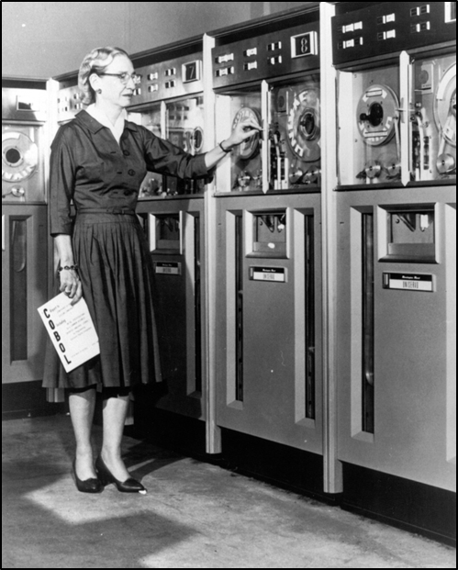
History of Women in Computing
Breanne Happell
Ada Lovelace
  First Computer Programmer
  First Algorithm for the Analytical Engine
Edith Clark
  First Women to get an MS in EE from MIT
Grace Hopper
  Helped create the first compiler
  Compiler was a precursor to COBOL
http://www.npr.org/blogs/alltechconsidered/2015/03/07/390247203/grace-hopper
Notes:
Ada Lovelace: First computer programmer, wrote the first algorithm ever tailored for a computer, for the analytical engine [2]
Edith Clark: First women to obtain an MS from MIT in EE, invented a calculator that could solve hyperbolic functions ten times faster than its predecessor [2]
Grace Hopper: Masters in Mathematics was assigned to the Computation Project at Harvard University
- Worked with Mark I and Mark II when a moth shorted out the Mark II and the term computer bug was developed
- helped create the first compiler for computer languages
- the compiler was a precursor to COBOL (Common Business Oriented Language) [4]

Slide 9

The Rise of the PC
Breanne Happell
1975 – MITS Altair 8800
1975 - IMSAI 8080
1981 – IBM 5150
1982 – Commodore 64
1984 – Macintosh 128K
Dan Knight "Personal Computer History: The First 25 Years." http://lowendmac.com/2014/personal-computer-history-the-first-25-years/ (4-17-15)
Notes:
MITS Altair 8800 and IMSAI 8080 clone of the Altair, both came as kits and used Intel 8080 CPU -Kit computers mainly sold to hobbyists and technicians [1]
- IBM 5150 - became primary pc for professional users [5]
- Commodore 64 – highest selling computer of all time
- Macintosh 128K - first pc with GUI and mouse
Describe the basics of the PC boom and how it all built up to 1984 (when women stopped computing)

Slide 10

Emerging TECHIE Culture
Breanne Happell
PCs marketed to boys as toys
Familiarized with computers at a younger age
Weird Science (1985)
Revenge of the Nerds (1984)
War Games (1983)
http://hoorayformovies.com/2014/08/27/forgotten-films-1984-blogathon-review-revenge-of-the-nerds-1984-unsurprisingly/
Notes:
Movies like Weird Science, Revenge of the Nerds and War Games all came out in the 80s [6]
Picture from Revenge of the Nerds – Nerdy Boy coding to win the girl
I’ve talked to many women here who came to WPI interested in CS and after the first day of systems where they had no experience with either putty or emacs and they were not explained changed majors
1985 study – “55% of adult women reported not using the computer at all in a typical week, compared to 27% of men.” [7]

Slide 11
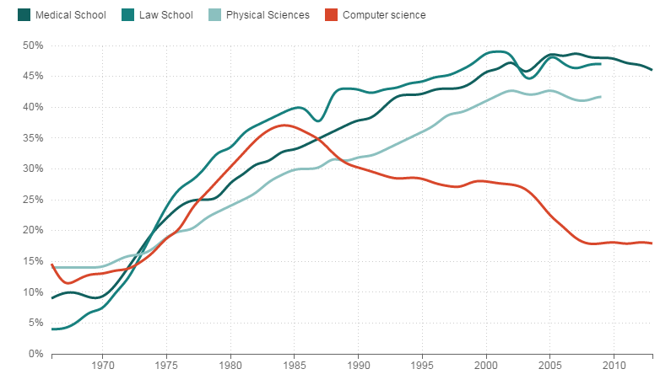
Decline of Women in Computing
Breanne Happell
1984 – Percent of women in Computer Science plummets
Prior to 1984 the percent of women in CS was increasing
In 1984, 37.1% of CS degrees were awarded to women
Steve Henn “When Women Stopped Coding”
http://www.npr.org/blogs/money/2014/10/21/357629765/when-women-stopped-coding (4-12-15)
Notes:
Percent of Women’s Majors, by field
For decades before 1984 the number of women studying computer science was growing faster than the number of men in computer science [6]
Dip due to rise in PCs
“Computer science is the only field in science, engineering and mathematics in which the number of women receiving bachelors degrees has decreased since 2002” [6]
Less than 12% of Computer Science bachelor's degrees were awarded to women in the US in 2010-11. [7]

Slide 12
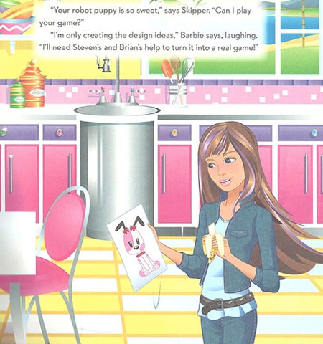
The End
Breanne Happell
Recent efforts to get women into CS
  Some more successful than others
  How to get more women into Computer Science?
http://www.dailydot.com/geek/barbie-engineer-book-girls-game-developers/
Notes:
Restate thesis
Mention current measures being taken to reverse this trend
Discuss how having a diverse team benefits a company
Today women receive less than 18.2% of all Bachelor Degrees [7]

Slide 13
References
Breanne Happell
[1] Dan Knight "Personal Computer History: The First 25 Years." Low End Mac., 17 Apr. 2014. Web. 18 Apr. 2015. http://lowendmac.com/2014/personal-computer-history-the-first-25-years/ (4-17-15)
[2] "Ada Byron King (aka Ada Lovelace)." The Ada Project. Web. 18 Apr. 2015. https://www.women.cs.cmu.edu/ada/Resources/Women/ (4-17-15)
[3] "Statistics." Statistics. Web. 22 Apr. 2015 http://www.ngcproject.org/statistics (4-22-15)
[4] Bio.com. A&E Networks Television, Web. 22 Apr. 2015. http://www.biography.com/people/grace-hopper-21406809#world-war-ii- (4-22-15)
[5] "History of Computers and Computing, Birth of the Modern Computer, Relays Computer, Howard Aiken." History of Computers and Computing, Birth of the Modern Computer, Relays Computer, Howard Aiken. N.p., n.d. Web. 22 Apr. 2015. http://history-computer.com/ModernComputer/Relays/Aiken.html (4-22-15)
[6] Steve Henn "When Women Stopped Coding." NPR. NPR, Web. 12 Apr. 2015. http://www.npr.org/blogs/money/2014/10/21/357629765/when-women-stopped-coding (4-12-15)
[7] Larson, Selena. "Women in Computer Science, Why so Few?" ReadWrite. N.p., n.d. Web. 24 Apr. 2015. http://readwrite.com/2014/09/02/women-in-computer-science-why-so-few (4-22-15)
[8] Breene, L. Anne. "Women and Computer Science." Initiatives 55.2 (1992): 39-44.
[9] Kick Jr, Russell C., and F. Stuart Wells. "Women in computer science." ACM SIGCSE Bulletin 25.1 (1993): 203-207.
[10] Fisher, Allan, Jane Margolis, and Faye Miller. "Undergraduate women in computer science: experience, motivation and culture." ACM SIGCSE Bulletin. Vol. 29. No. 1. ACM, 1997.
[11] Quinn, Michael J. Ethics: For the Information Age. Boston, MA: Pearson Education, 2015. Print.
Notes:
Thank you, any questions?

Slide 14
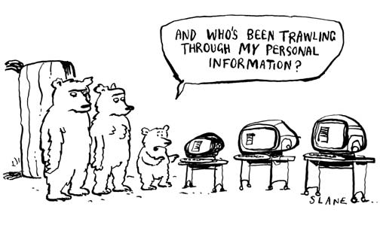
ETHICAL NETWORK MONITORING
IN BUSINESSES and institutions
Etienne Scraire
What is appropriate?
http://blog.securitymonks.com/images/3bears-01.jpg
Notes:
- Current laws are vague and provide very few guidelines for monitoring employees.
- Monitoring techniques:
- Keyloggers
- Website and file usage
- Desktop screenshots
- Internet packet data
- Can aggregate the data and present all activities as easy to read graphical reports.

Slide 15

NETWORK MONITORING IN SCHOOLS
Etienne Scraire
Children's Internet Protection Act (CIPA)
Acceptable Use Policy (AUP)
http://www.net-orbit.com/images/solutions/school-network-monitoring.jpg
Notes:
- Schools and public libraries must ensure filtering and comply with CIPA if they want federal funding.
- Universities receive RIAA complaints regularly and are responsible for the illegal actions of their users.
- Institutions must implement an Acceptable Use Policy.

Slide 16

CYBERLOAFING
Etienne Scraire
Electronic Communications Privacy Act (ECPA)
  Doesn't apply to service providers
Monitoring is used to measure employee productivity.
Or to catch employees violating company policy.
http://www.scu.edu/ethics/publications/iie/v9n2/resources/littlebro.jpg
Notes:
- Cyberloafing is the act of using an organization's Internet resources for personal purposes during work hours.
- Companies monitor their network and have been known to fire employees for:
- Excessive personal use
- Violation of company policy
- Inappropriate language
- Breach of confidentiality agreement
- Employees are warned of the monitoring but many let their guards down.
- Some companies also engage in telephone and video monitoring.

Slide 17
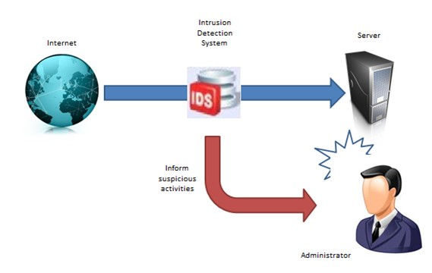
INTRUSION DETECTION
Etienne Scraire
Intrusion Detection System (IDS)
What if a system is compromised?
http://www.pkfavantedge.com/wp-content/uploads/2012/12/IDS.jpg
Notes:
- Intrusion Detection Mechanism intercept traffic to detect security intrusion.
- An IDS detects breaches by defining a pattern of packets associated with a potential exploit. When a packet signature is matched, the IDS will trigger an alarm.
- Some IDS have been extended to detect packet patterns associated with Skype, Steam or the Blizzard Launcher to detect company policy violations.

Slide 18
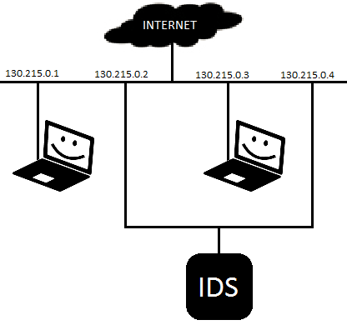
CASE STUDY: NETWORK TELESCOPE
Etienne Scraire
Monitoring unallocated address space
If the address does not correspond to a machine it can be assumed that the traffic is malicious.
The privacy of the users is respected.
Notes:
- Institutions own an ip prefix but usually does not allocate all ip addresses to users in the network.
- Portscanners, DDoS or backscatter attacks tend to attack an entire address space rather than a single host.
- It can be assumed that traffic sent to ip addresses that were not allocated is either malicious or due to misconfiguration.
All the information captured that way is relevant and this monitoring technique respects the privacy of users.
Need to cite image

Slide 19
References
Etienne Scraire
[1] http://www.iiakm.org/ojakm/articles/2013/volume1_2/OJAKM_Volume1_2pp44-55.pdf
[2] http://www.huizenga.nova.edu/Jame/articles/employee-monitoring.cfm
[3] http://www.ijarcce.com/upload/2015/march-15/IJARCCE%20113.pdf
[4] http://www.pcworld.com/article/189806/Ethics_of_Monitoring_PC_Activity.html
[5] http://www.caida.org/publications/papers/2004/tr-2004-04/tr-2004-04.pdf

Slide 20

THE ULTIMATE AUTOMATED WORKER
Josh Audibert
Outline
  Related history
Possible future?
What needs to be considered?
Should we be concerned?
http://cdn.thefiscaltimes.com/cdn/farfuture/IALeR66vTKjsK9siQI_wUjkEZLiJdQsIAeEx-CaRjYA/mtime:1378417280/sites/default/files/styles/article_hero/public/articles/04042011_robot_worker_article.jpg?itok=nxkl_hUV (2015-4-22)
Notes:
Introduce self
Introduce topics to cover

Slide 21
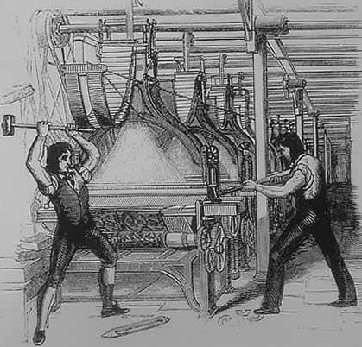
RELATED HISTORY
Josh Audibert
Industrial Revolution
  Luddites [1]
Now-obsolete jobs
  Pinsetters, human alarm clocks, lamplighters, etc.
http://upload.wikimedia.org/wikipedia/commons/6/6e/FrameBreaking-1812.jpg (2015-4-24)
Notes:
Industrial Revolution displaced many workers’ jobs
Luddites: Ned Ludd allegedly smashed two stocking frames and began revolts
early 1800s
don’t like technology/automation
Obsolete Jobs: Bowling pinsetters, human alarm clocks, and lamplighters
technological advances make lives easier, but make some jobs obsolete
is this a good thing?

Slide 22
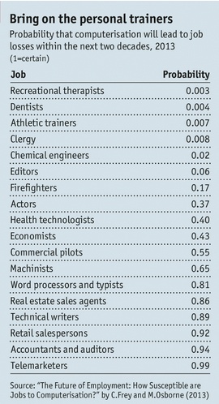
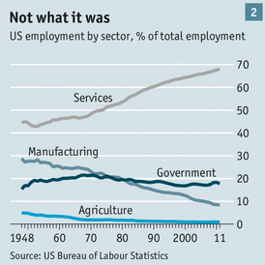
POSSIBLE FUTURE
Josh Audibert
Job losses in service sector
Unexpected automated jobs
  Technical writers
  Health Technologists
  Paralegals
http://www.economist.com/news/briefing/21594264-previous-technological-innovation-has-always-delivered-more-long-run-employment-not-less (2015-4-22)
for both images
Notes:
Unexpected automated jobs:
Technical writers (Sportswriters)
Health Technologists (Watson from Jeopardy is “clinical decision support system”)
Paralegals (computers can analyze data faster)
Lead into things to consider with:
Andrew McAfee (author of Race Against the Machine: How the Digital Revolution is Accelerating Innovation, Driving Productivity, and Irreversibly Transforming Employment and the Economy): "Would I rather protect the jobs of today's doctors or would I rather improve the health of all people tomorrow?” [2]

Slide 23
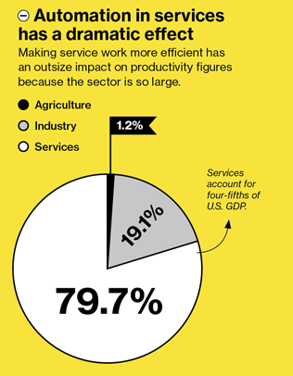
THINGS TO CONSIDER
Josh Audibert
Low-skill service jobs are being replaced
New programs for youth
  camps, competitions, etc.
Limiting the work-week [3]
  35 hrs/week in France
http://www.technologyreview.com/sites/default/files/images/destroying.jobs_.chart1x910_0.jpg (2015-4-22)
Notes:
According to many charts/graphs, service jobs are in peril
Want the right proportion of students going into each field to fit the future job market
France limited to 35 hrs/week
spread workload more evenly → decreased unemployment
government incentives to work less [3]

Slide 24
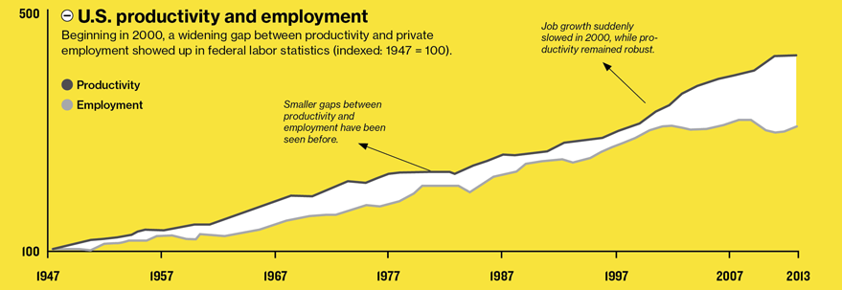
THINGS TO CONSIDER
Josh Audibert
http://www.technologyreview.com/sites/default/files/images/destroying.jobs_.chart1x910_0.jpg (2015-4-22)
Notes:
Increasing productivity but stagnant employment → limit work-week hours and spread the jobs around
“[Brynjolfsson and McAfee] believe that rapid technological change has been destroying jobs faster than it is creating them” [4]

Slide 25
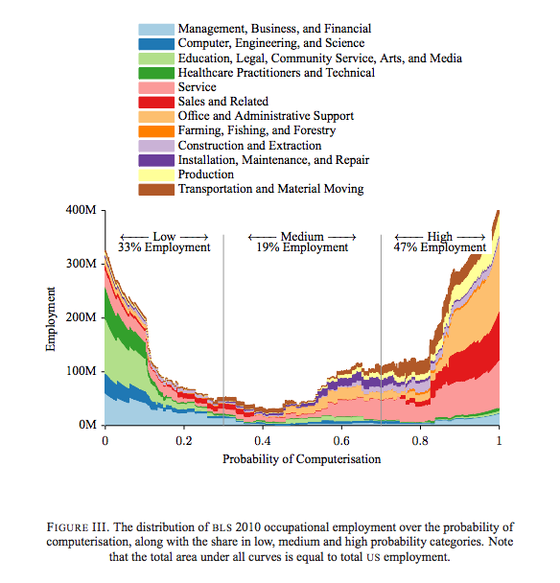
THINGS TO CONSIDER
Josh Audibert
Service, Sales, and Support jobs are being computerized
Need to aim students toward jobs that will be available
http://tinyurl.com/nuwgrfv (2015-4-22)
Notes:
Both charts convey similar ideas:
we need more people getting college educations in order to do the jobs that will be available
jobs that require little to no college education are being computerized

Slide 26
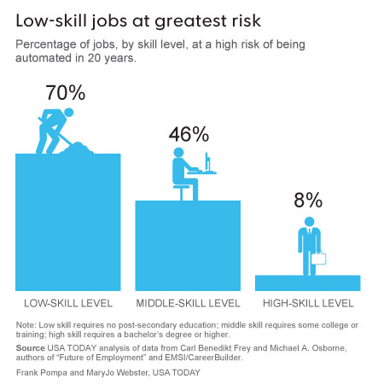
THINGS TO CONSIDER
Josh Audibert
Low-skill jobs at risk of being automated
Need more people to get college educations
http://www.usatoday.com/story/news/nation/2014/10/28/low-skill-workers-face-mechanization-challenge/16392981/ (2015-4-22)
Notes:
Both charts convey similar ideas:
we need more people getting college educations in order to do the jobs that will be available
jobs that require little to no college education are being computerized

Slide 27
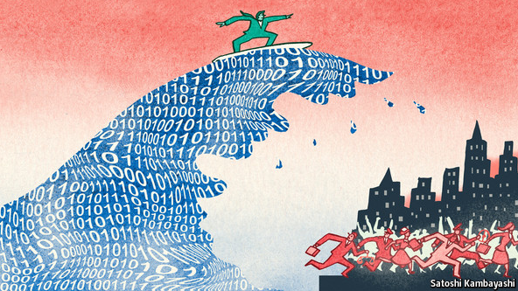
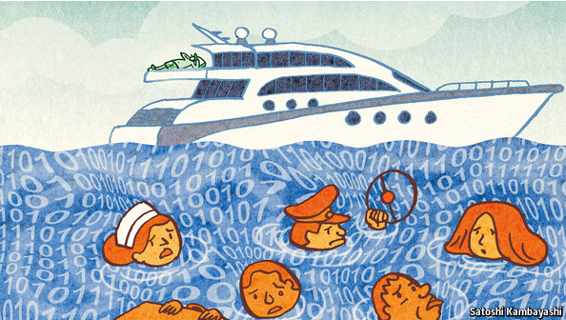
CONCLUSIONS
Josh Audibert
Should we be worried?
  A little…
  Needs to be talked about
    options for displaced workers
    matching future job market
  Some industries don’t need to worry
    routine + non-routine
http://www.economist.com/news/briefing/21594264-previous-technological-innovation-has-always-delivered-more-long-run-employment-not-less (2015-4-22)
for both images
Notes:
Since jobs in the service sector have a high risk of being displaced…
we need alternative options for displaced workers
we need to discuss methods of matching incoming workers to new job market needs
Many jobs require routine and nonroutine tasks to be done, allowing for automation to aid humans by performing the routine tasks [5]
Still half a million bank tellers after ATM was invented [5]

Slide 28
REFERENCES
Josh Audibert
[1] "Luddite." Wikipedia. Wikimedia Foundation, 8 Apr. 2015. Web. 23 Apr. 2015.
[2] Upton, Jodi. "Could a Robot Do Your Job?" USA Today. Gannett, 28 Oct. 2014. Web. 21 Apr. 2015.
[3] Rifkin, Jeremy. "The End of Work." Spiegel Online (2005): n. pag. 3 Aug. 2005. Web. 21 Apr. 2015.
[4] Rotman, David. "How Technology Is Destroying Jobs." MIT Technology Review (2013): n. pag. Web. 21 Apr. 2015.
[5] Atkinson, Robert. "Robots aren't taking your job." Issues in Science and Technology 30.4 (2014): 9+. Academic OneFile. Web. 21 Apr. 2015.
[6] Frey, Carl Benedikt, and Michael A. Osborne. THE FUTURE OF EMPLOYMENT: HOW SUSCEPTIBLE ARE JOBS TO COMPUTERISATION? (2013): n. pag. 13 Sept. 2013. Web. 21 Apr. 2015.
[7] “The Onrushing Wave." The Economist. The Economist Newspaper, 18 Jan. 2014. Web. 21 Apr. 2015.

Slide 29
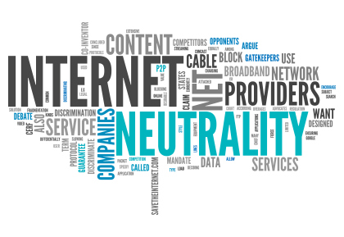
Loss of Net Neutrality and the Death of Businesses
Lucas R. Lebrao
Limited access
How would businesses suffer?
How does it affect you as a consumer?
https://legalmatterblog.files.wordpress.com/2015/03/shutterstock_186658136.jpg?w=420&h=289
Accessed April 22nd, 2015
Notes:
Body:
Net Neutrality was a hot topic among media, most recently sparked by the recent FCC voting on Net Neutrality rules in February[1].
These are good news, as the new regulations prevents ISPs from limiting consumer access to the internet (or at least for now).
However, what is the potential danger of ISPs acting as the Gatekeepers of the Internet?
Which raises the question, how would it affect business?
And subsequently, how would it affect customers?
Would this matter at all to you (as an user)?
[next]

Slide 30

net neutrality is important for businesses
Lucas R. Lebrao
Small businesses are able to prosper through internet[2][3]
Without, impossible to compete
  Smaller companies might be unable to purchase the right of fast access[4]
  Bigger companies might be capable of purchasing “Sponsorship” rights of access from an ISP
Loss of jobs[8]
http://collectivelifestyle.com/wp-content/uploads/2014/05/Net-neutrality-sign-Closed-Internet-ahead-640x350.jpg
Accessed April 22nd, 2015
Notes:
Shortnotes:
Importance of Net Neutrality to Online Businesses
It’s the most viable model -> Provide own content, service, advertising with capability of being seen by anybody
“80% of traffic to a website begins with search query” / “88% of consumers who search for a type of local business on a mobile device, call or go to that business within 24 hours.”[
Without, impossible to compete -> No Net Neutrality means ISPs being capable of setting tariffs to use their “fast lane”.
It has already happened before outside law, Comcast limited Netflix streaming until they settled a deal.
Possibility #1-> Very little precedence on this sort of tariffs, ISPs would be able to charge whatever they would like, something that smaller businesses wouldn’t be able to afford.
Possibility #2 -> Sponsor-like deals, where ISPs promote a particular service/brand. Alike, sponsored products in events, restaurants where there is only one choice of beverage.
Certain Result -> Businesses are forced out of business, which means high unemployment rates. [next]
Body:
Now, lets look into the importance of net neutrality to online businesses.
First and foremost, it is important to note that Small Businesses are mostly viable through the internet, as they are to provide their own content, service and advertising, where anyone is able to access their content unrestricted. For example, “80% of traffic to a website begins with search query” [3], which Search Engines is one of the best means of a smaller business being found without having a larger fund pool. For context, “88% of consumers who search for a type of local business on a mobile device, call or go to that business within 24 hours.”[3].
Which leads to the issue described in the title; not having net neutrality makes competition near impossible.
ISPs would then be capable of imposing tariffs to companies so they are able to provide their content in the “fast lane” of the internet[5].
Considering how big internet businesses like Google or Netflix are making unspeakable amounts of money from the internet, a tariff wouldn’t mean much to them, right?
Well, since there is no precedence to anything similar to this scenario, ISPs would be able to charge whatever they would like, meaning any significant sum would be unpayable by smaller businesses. Therefore, small businesses would slowly die[6].
Another alternative to this scenario would be a “Sponsor”-like deal made between the ISP and the service in question, where it would mirror a scenario of an establishment providing an exclusive beverage brand to its customers, only that the customer base of an ISP is much more significant. In the US, almost 90% of businesses are composed by less than 20 workers out of 5.68 million US firms[7]. Which means, leaving that huge amount of workers out of business means a notable rise in unemployment rate. [8]

Slide 31

The user loses internet freedom
Lucas R. Lebrao
Lack of choice
  No consumer choice, only the ISP’s
  Alike the ISP diversity in the US
  Censorship
Nickle-and-dime consumer’s browsing[9]
  Pay for access
  Pay for content
http://www.wordstream.com/images/what-is-net-neutrality-video-blocked.jpg
Accessed April 22nd, 2015
Notes:
Shortnotes:
Loss of business -> Loss of customer
Biggest loss -> Lack of choice (less variety, less access)
Variety -> Dissolution of smaller businesses means less choices for the customer make
Access -> ISPs can simply block alternatives that do not fit their ideals
Comcast owns NBCUniversal, hence it would most likely block out its competitors or simply making access to its content faster / “Censorship”
Access control -> Possible nickle-and-dime approach
Instead of paying for your internet speed, user would pay for access speed to websites and content.
This could go on in two different ways: [next]
Body:
As a subsequent loss of smaller businesses, YOU, as a customer, would suffer as well.
One of the biggest losses would be lack of choice over what type and kind of services you would have access to.
The dissolution of smaller business would decrease the variety of services and products the internet offers, reducing choice. Choice could also be reduced through the ISP’s direct influence. A good example of that would be Comcast promoting its own content through NBCUniversal (which is owned by them) by severely restricting user’s access to competitors and simply making direct to NBCUniversal’s content faster. Another problem would potentially be censorship, as the “Gatekeepers” of the internet would have the power of cutting access from any website that they desire, unrestricted by anyone.
Another great loss to the consumer would potentially be the nickle-and-dime approach to internet browsing, where the consumer would have to pay based off the access speed they would have while browsing non-promoted websites or pay based off the sort of content they browse.
The possible need for paying to having good access speeds is one of the greatest concerns of the Net Neutrality debate, where there has been previous occurrences of ISPs limiting data transfer of different websites, an example being Comcast limiting Netflix streaming rate last year. Lacking actual Net Neutrality means that ISPs wouldn’t have any more regulations preventing them from selling a “fast lane” access to their customers so they are able to browse at “better-than-average” speeds [10]. Lastly, there is also another possibility of how ISPs can tax users on what sort of content they browse, such as providing data plans for “standard user access” and additional plans to extend the access of different types of content the user would like to have (such as news, search tools, international websites, etc…), in a manner similar to buying TV plans and/or channels [8][9].

Slide 32

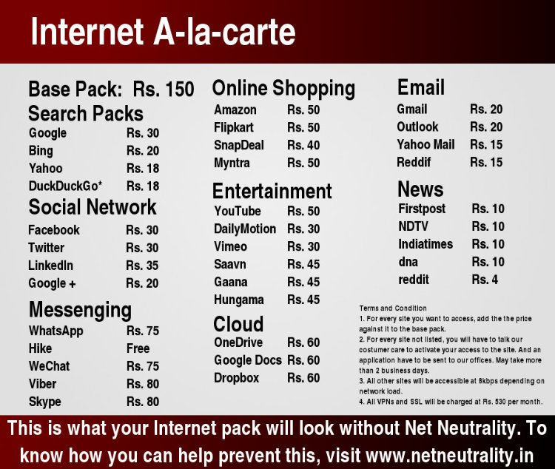
The user loses internet freedom
Lucas R. Lebrao
http://ak-hdl.buzzfed.com/static/2014-01/enhanced/webdr02/14/13/enhanced-buzz-31562-1389724100-28.jpg (left)
https://media.licdn.com/mpr/mpr/shrinknp_750_750/AAEAAQAAAAAAAAMDAAAAJDM2ODk0ZDVlLTZlYjctNDhmZS1hYThiLTVjMzdkZDI0MTJmNA.jpg (right)
Accessed April 22nd, 2015
Notes:
ShortNotes:
Left: A pro-net-neutrality graphic from 2009 [9]
Depics:
-> Base deal: users playing a flat rate for general access to internet, with limited access to non-peering websites at full speed.
-> Deal addons: users would pay extra money for full speed on other websites, which is mostly limited to the ones the ISPs select.
Right: An Indian nickle-and-dime tentative estimate of what sort of costs consumers would have to cover based off their access [8]
-> Slightly different from previous, no base deal
-> Instead of choosing packs, choose particular websites you desire to use that you will pay on top off your base pack.
[next]
Body (copied from previous):
The possible need for paying to having good access speeds is one of the greatest concerns of the Net Neutrality debate, where there has been previous occurrences of ISPs limiting data transfer of different websites, an example being Comcast limiting Netflix streaming rate last year. Lacking actual Net Neutrality means that ISPs wouldn’t have any more regulations preventing them from selling a “fast lane” access to their customers so they are able to browse at “better-than-average” speeds [10]. Lastly, there is also another possibility of how ISPs can tax users on what sort of content they browse, such as providing data plans for “standard user access” and additional plans to extend the access of different types of content the user would like to have (such as news, search tools, international websites, etc…) [8][9].

Slide 33

Conclusion
Lucas R. Lebrao
Questions?
Near-impossible growth of businesses
Major unemployment
ISP-tailored internet experience
Difficult to predict cost changes
https://www.battleforthenet.com/images/change_avatar/avatar-cat.gif
Accessed April 22nd, 2015
Notes:
Short Notes:
Near-impossible growth of business -> Very difficult for smaller companies to sustain profits in an ISP-controlled internet, either due tariffs or advantages bigger businesses could purchase from ISPs. Subsequently, it means that startups of the “new Facebook” are very likely to fail due the very high bar to the cost of entry in the internet market.
Major Unemployment -> With a large amount of companies running out of businesses, a large chunk of jobs will leave the market.
ISP’s Internet “Experience” -> Users will be stuck with whatever websites are left from businesses that managed to survive, which could be reduced even further by the “plans” the consumer would need to purchase to have actual access to different websites.
Cost changes? -> Too many variables to account for
US is already known for having an awful internet speeds (30th in the world) and still pay more for much less (Hong Kong with way better internet speeds pay 40% less in average) [11]
Likely to get worse, due to:
businesses having to pay more stay alive, either raising the number of ads or costs for their own services
ISPs most likely changing their business model of what speeds users will get
High Unemployment is a big variable that could shift prices either way
All of these results combined would make quite an impact on the internet “ecology”, where the only certainty is that the only certainty is that average browsing experience would be significantly different from the pre-End of Net Neutrality, for the better or for the almost certain-worse.
[next]
Questions?
<time for questions>
Body:
So, in summary, the end of Net Neutrality could impact both producers and consumers of content heavily.
Most notably, the smaller businesses would have difficulties surviving an ISP-controlled internet access, due to the tariffs that could possibly be imposed by the ISPs or the possible advantages that bigger businesses could purchase to provide better access to their content. This would result in a very notable percentage of companies running out of business (up to 90%), which would lead to many people losing their current jobs. This also means that other startups are very likely to fail or at least set a very high bar to the cost of entry in the market due to tariffs.
Not only businesses, but users would be affected as well. There would be changes in the costs of their internet browsing experience, leading to potentially new plans that would determine what sort of things the user could see, leaving a big ‘IF’ to what would be allowed or not by the ISPs.
As a result, it is quite difficult to predict the cost changes of internet usage. Would users pay more, less or nothing? It all depends on the ISP’s decision of how it would tax companies and users alike, but if there is a resulting major increase in unemployment rates, it is impossible to determine where the costs of internet usage would go.
All of these results combined would make quite an impact on the internet “ecology”, where the only certainty is that the only certainty is that average browsing experience would be significantly different from the pre-End of Net Neutrality, for the better or for the almost certain-worse.

Slide 34
References
Lucas R. Lebrao
[1] Bill Chappel, “FCC Aproves Net Neutrality Rules For ‘Open Internet’”, http://www.npr.org/blogs/thetwo-way/2015/02/26/389259382/net-neutrality-up-for-vote-today-by-fcc-board
[2] Jim Strom & Simpson Poon, “Small business’ Use of the Internet: Some Realities”, https://www.isoc.org/inet97/proceedings/C2/C2_1.HTM
[3] Local Vox, “Small Business Marketing Statistics”, http://localvox.com/resources/small-business-marketing-statistics/
[4] Diane Weklar, “Will Killing Net Neutrality Death Knell for Small Businesses?”, http://www.weklarbusinessinstitute.com/will-killing-net-neutrality-death-knell-small-business/
[5] Premier VEBA, “The Death of Net Neutrality: One More Nail in the Coffin of Small Businesses”, https://www.premierveba.com/the-death-of-net-neutrality-one-more-nail-in-the-coffin-of-small-business/
[7] SBE Council, “Small Business Facts and Data”, http://www.sbecouncil.org/about-us/facts-and-data/
[8] Chandresh Dedhia, “Net Neutrality in India: Pay Rs.250 pm to access Whatsapp/Facebook”, https://www.linkedin.com/pulse/net-neutrality-india-pay-rs250-pm-access-chandresh-dedhia
[9] John Herrman, “Welcome to Net Neutrality Nightmare Scenario”, http://www.buzzfeed.com/jwherrman/welcome-to-the-net-neutrality-nightmare-scenario#.uvvrkwbEb
[10] Elijah Zolfagharifard, “How will net neutrality impact YOU? As the FCC passes ‘open internet’ rules, here’s what you need to know”, http://www.dailymail.co.uk/sciencetech/article-2970596/How-net-neutrality-impact-FCC-votes-open-internet-rules-s-need-know.html
[11] Micah Singleton, “Here’s how terrible US broadband service really is”, http://www.dailydot.com/politics/us-broadband-speed-cost-infographic/

Slide 35
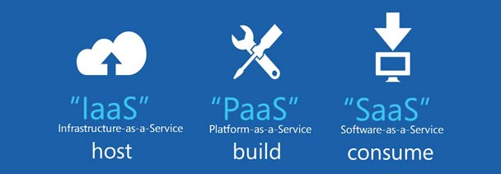
Programming as a service
Chris Knapp
Focuses on a software's use, rather than ownership¹
  “free-to-play”
  Freemium
  Crowd-funding
  Open Source
  “Gift culture”
  Subscriptions
http://dabushar.com/article/software-service
Notes:
This is fundamentally at odds with programming as a product. Product focuses on ownership and possession of the finished program, whereas service focuses on the consumption and usage of the program, typically focused on granting access and allowing consumption.
35

Slide 36

Video games for “free”
Chris Knapp
No cost, at least initially
Micro-transactions
Often coupled with paid DLC or extra content
Clash of Clans made $892 million in 2013²
  Currently estimates $1,772,479 every day³
http://clashofclansandroid.info/clash-of-clans-strategy/
Notes:
Notorious “free-to-play” phenomena that has risen. Can be harmless, as many free games are, or an honest attempt at a business model. Examples include League of Legends, DotA 2, old Runescape. Can also be abused, such as with Clash of Clans, a free game that has become the top grossing game on the Android’s Play Market, notorious for the money spent buy children on the game unbeknownst to their parents.
36

Slide 37

Freemium
Chris Knapp
Distribute free version of software
Allows for substantial user growth
Charge for premium content and services later when users are acquired
http://www.kpcb.com/news/zynga-takes-on-social-gaming
Notes:
Almost a subsection of “free-to-play”, but not isolated to video games. As far as games are concerned, these tend to be the ones with more abusive free-to-play business models, where one must “pay-to-win”, or are otherwise gated ridiculously from game content in the free version. Zynga is a prime example of freemium games.
37

Slide 38

Crowd-funding
Chris Knapp
Allows for easier free releases
The most supportive pay for the content ahead of time
Risky, but can be incredibly profitable before the project is even made
  Star Citizen raised $2,134,375⁴
https://www.kickstarter.com/help/brand_assets
Notes:
Not exclusive to software as a service, but at times a means used to fund such software. IndieGoGo, GoFundMe, Kickstarter. Shadowrun Online, now Shadowrun Chronicles made it through Kickstarter, and is shifting towards a free model.
38

Slide 39

Open Source
Chris Knapp
Most quintessential example of programming as a service
Typically free
Largely intrinsic motivations
Goes against marketing principles of selling products
http://imgkid.com/red-hat-linux-logo.shtml
Notes:
An extreme look at programming as a service. Very difficult to create something as Open Source and market it as a traditional product, as the source code is open for all to view, study, and emulate in copy-cat products, thus lowering the market share of the original product. Can still be done, but many prominent examples of Open Source opt for free services, such as RedHat’s Linux OS, Fedora OS, or Eclipse.
39

Slide 40

Gift Culture
Chris Knapp
Adopted by many Open Source programmers
Like a Marxist utopia, but programming
Everyone shares everything, everyone has everything
http://rt.com/politics/lenin-body-revolution-communists-540/
Notes:
Closely related to Open Source programming, oriented towards sharing. Letting others access your software for little more than the act of programming and sharing it. Promotes others to follow suit. In Communist programming, program sells YOU. Great way to get your name known, not typically a sustainable approach or reliable means of business model.
40

Slide 41


Subscriptions
Chris Knapp
Paid services
Many MMORPGs
Very profitable
  World of Warcraft reported $1.041 billion in 2013⁵
http://us.battle.net/wow/en/blog/15910697/release-the-names-character-name-reclamation-coming-9-15-2014
http://www.delucchiplus.com/spotify/
Notes:
Spotify (also freemium), Xbox Live, Playstation Network, World of Warcraft, Runescape. World of Warcraft is an interesting example in terms of software as a service, as it employs a product based model, where one must pay to own the game and any additional expansions desired, but then must also pay a subscription in order to be granted access, then is also presented with in-game micro-transactions with the newly added cash shop. If anyone doubts the viability of this model, and has ever played World of Warcraft with an active, paid account, follow these steps: calculate the amount of money spent on the game in your life, now be depressed at how much money that is.
41

Slide 42

Conclusion
Chris Knapp
Software as a service on the rise
Huge potential for growth and profit
Overall benefits both consumers and programmers
https://dribbble.com/shots/723015-Happy-iOS-Dev
Notes:
Incredibly successful in most cases. I’d argue that such service-oriented models will begin overtaking product-oriented ones in software markets. Already easily visible in mobile markets. Starting to become more prominent in console and PC software. Must be cautious of abusive models, gating core content behind a pay wall, or pay-to-win games, or the like. Overall very promising with benefits to both parties. Users get to pay for the time they want to use the software, and can stop paying when they no longer wish to use it. Often users even get free options to use the software, with extras added on for those willing to pay. Programmers on the other hand, turn a very large profit, as history has so far shown.
42

Slide 43
References
Chris Knapp
[1] Turner, Mark, David Budgen, and Pearl Brereton. "Turning software into a service." Computer. 36.10 (2003): 38-44.
[2] http://www.forbes.com/sites/ewanspence/2014/02/12/clash-of-clans-developer-reports-829-million-in-revenue-and-a-desire-to-support-the-finnish-community/ (4/23/2015)
[3] https://thinkgaming.com/app-sales-data/1/clash-of-clans/ (4/23/2015)
[4] https://www.kickstarter.com/projects/cig/star-citizen (4/23/2015)
[5] http://www.forbes.com/sites/insertcoin/2014/07/19/world-of-warcraft-still-a-1b-powerhouse-even-as-subscription-mmos-decline/ (4/23/2015)

Slide 44
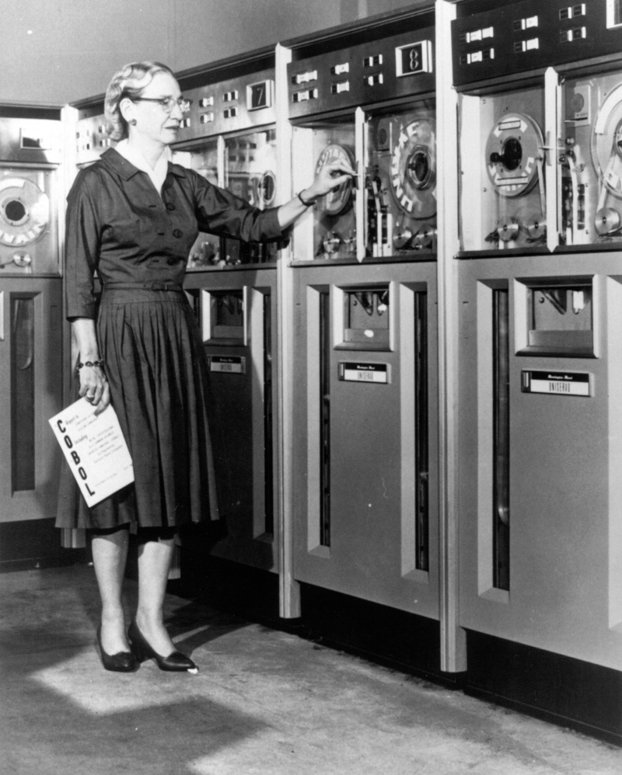

Why are there so few female computer scientists?
Lindsay O’Donnell
There are many factors that lead to women choosing not to major in CS:
  stereotypes about typical programmers
  lack of experience with computers
  concerns about work-life balance
  attitudes of professor and colleagues
https://xkcd.com/385/
http://www.computerhistory.org/timeline/images/1952_hopper-grace_large.jpg
Notes:
<speaker notes>

Slide 45
The Data^{[1]}
1970
2,388 degrees
1985
42,337 degrees
2010
43,072 degrees
13.6% female
35.7% female
17.6% female
Notes:
Ask class what percentage they think 2010 will have, after explaining the other numbers.

Slide 46
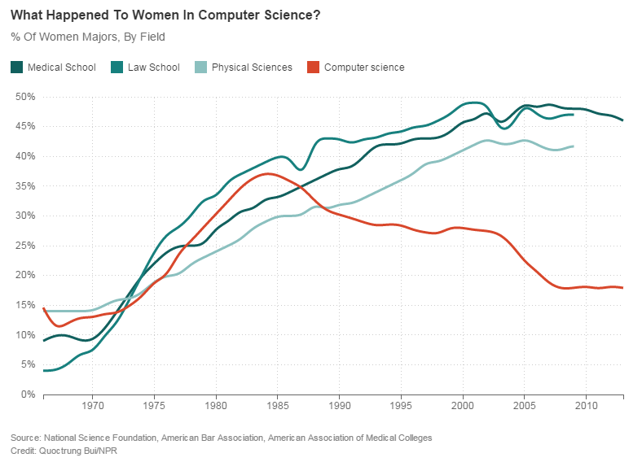
Possible reasons for the decline
Lack of experience using computers prior to college
Few female role models
Style of teaching/lecturing turns away female students
Concerns about balancing career with family and other interests
Women believe computer science does not involve much interaction with other people^{[2]}
Notes:
Many “tech” toys are marketed to boys (legos, robots)
Especially in high school classes
CS Lectures are often uninteractive
Many companies offer more flexible benefits and the ability to work from home, but this isn’t true for every company

Slide 47
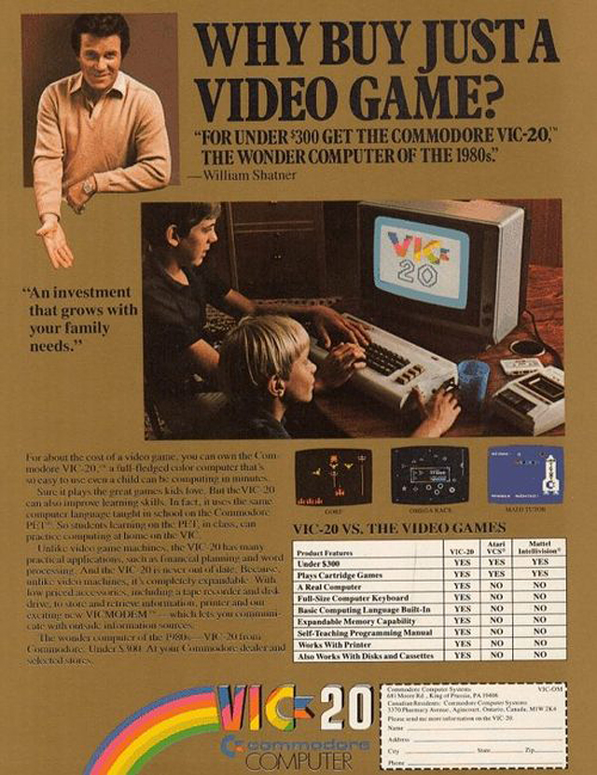
“Geek” culture
Decline of women in CS began in the 1980’s
Personal computers were starting to become common at home
Many computer related movies and the first video game systems were being released during this time
Advertisements for video games and home computer kits almost always targeted boys^{[4]}
Notes:
Before the 80s, women’s representation was climbing, just as it was in many other advanced fields of study.
This lead to many women ending up behind the men in CS classes where they were expected to know how to use a computer already.

Slide 48

Solutions
Identify female role models in the field
Introduce mentoring systems
Use programs and classes that include all children equally to start teaching programming
Companies can offer more flexible work hours
http://www.examiner.com/article/workshop-to-teach-girls-of-color-programming-skills
Notes:
Many women drop CS classes because they find them too hard, and feel that asking for help would make them look bad.
Unfortunately, the nature of raising a child does mean that many women leave the workforce for some amount of time at some point in their career.
However, companies who don’t hire as many women because of this are missing out on some great minds.

Slide 49
References
Lindsay O’Donnell
[1] National Center for Education Statistics http://nces.ed.gov/programs/digest/d12/tables/dt12_349.asp
[2] Beyer, Sylvia. “Why are women underrepresented in Computer Science? Gender differences in stereotypes, self-efficacy, values, and interests and predictors of future CS course-taking and grades”. Computer Science Education. (2014)
[3] Henn, Steve. “When Women Stopped Coding” http://www.npr.org/blogs/money/2014/10/21/357629765/when-women-stopped-coding. NPR. October 2014.
[4] Fessenden, Marissa. “What Happened to All the Women in Computer Science?” http://www.smithsonianmag.com/smart-news/what-happened-all-women-computer-science-1-180953111/?no-ist October 2014.

Slide 50
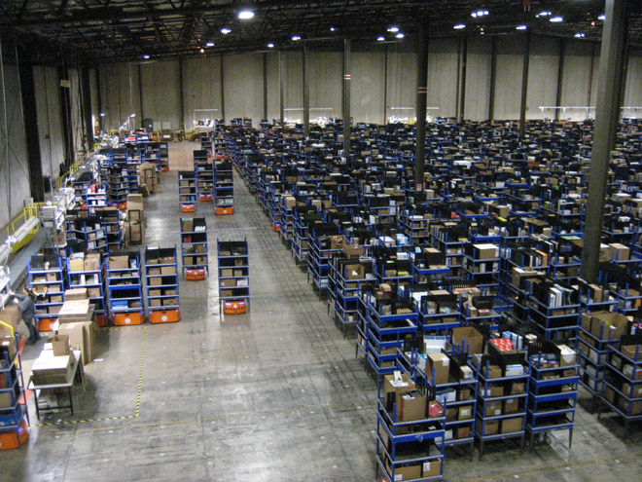
Displacement or Replacement:
Robots in Industry
Yael Rosenblum
Expansion of automation poses risk to employment
New approach to warehouse management
New “ordinary” worker
http://www.wired.com/images_blogs/photos/uncategorized/2009/01/28/big_warehousesmall.jpg
Notes:
As an engineering student, and especially within the field of robotics, I always get the SKYNET remark and the worry of robots taking our jobs.
This, of course, has some merit to the expansion of robotics in new fields and industries and their more common widespread through automation.
I will go over the use of robotics systems within warehouse management which is the most consumer and volume-heavy industry.

Slide 51
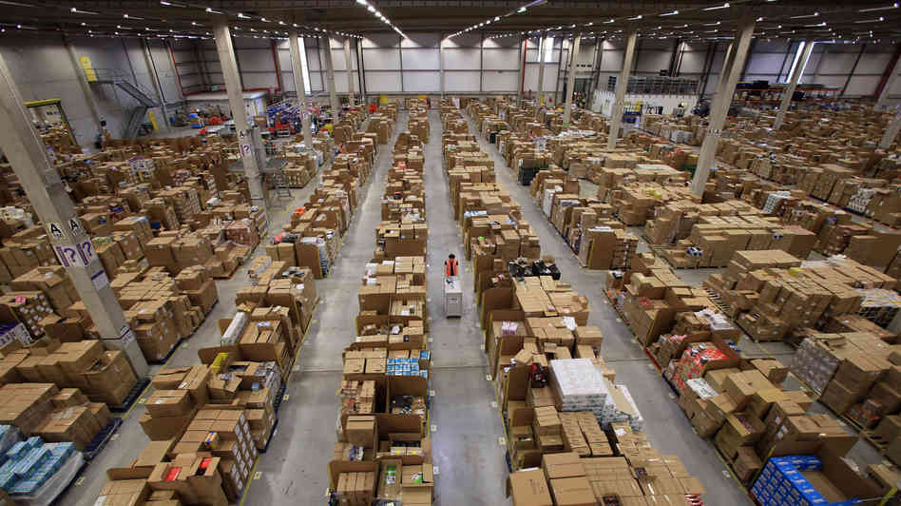
Traditional Warehouses
Yael Rosenblum
Warehouse architecture
  Size
  Storage capacity
Inefficient
  Time-consuming
  Taxing to workers_{[1]}
More prone to human-error
  Different systems of package collection and delivery protocols
http://s32.iamwire.com.s3.amazonaws.com/wp-content/uploads/2014/09/ama.jpg
Notes:
The typical set-up of warehouses for different industries are all run in a variety of ways. The size and storage capacity of a warehouse determines the day-to-day operations for its workers and managers. For these reasons, it has become very inefficient for warehouses to be run the traditional ways nowadays due to rising consumer demands.
Specifically, it is time-consuming for traditional warehouse workers, known as “pickers”, to walk around millions of square-ft large warehouses to grab items for shipments. This would create problems and health concerns for the pickers as they would be required to be on their feet all day and walk anywhere from 8-10 miles daily. Not only that, but this allows packages to be more prone to human-error.
For this reason, automation has become a tailor-fit solution to many warehouse locations.

Slide 52
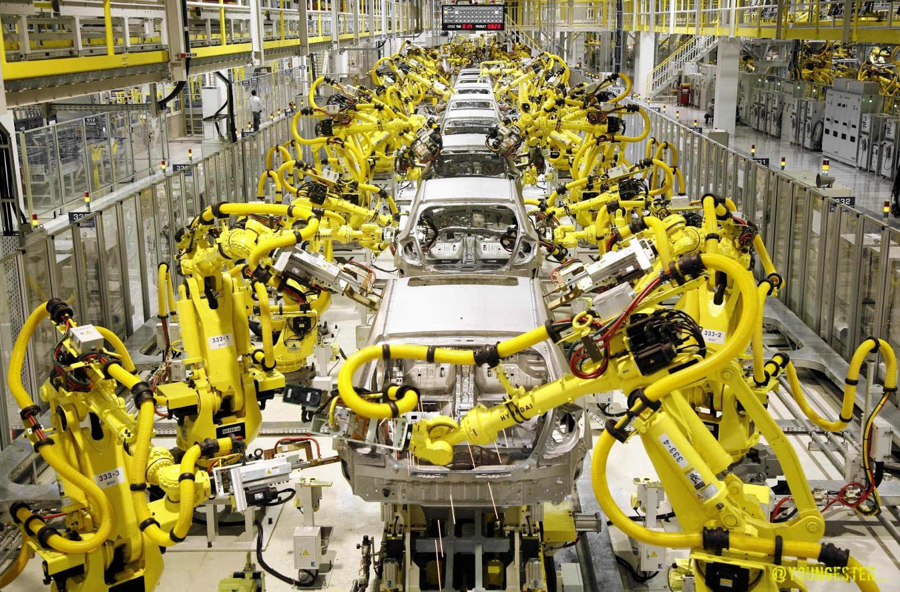
Expansion of AUTOMATION
Yael Rosenblum
Top Robotic Warehouses_{[1]}:
  Coca-Cola, Amazon.com, Nike, IKEA, Diapers.com, Zappos.com
Most common automation include:
  Conveyor System
  Kiva System
  RFID Tags _{[2]}
  Automated Storage Retrieval System
http://www.robots.com/images/Robot%20Integration.jpg
Notes:
Currently, the market has expanded in every industry with automation, with popular companies like Coca-Cola, Amazon.com. and Nike. Most notorious automation companies are automobile, having machines build machines.
The most common automations that are implemented in these types of industries include either just one or a combination of these systems. There are conveyor belt systems where are typically for incoming supply and outgoing packaging throughout the storage facilities.
There is also Automated Storage Retrieval System, which is the general concept for database software management for warehouses to better catalogue their inventory, and is specifically tailored to the companies they are supplying.
Next are RFID tagging systems which can be implemented at any level (pallet, case, unit) to keep account of inventory and location of products. This has it own benefits of increased theft-deterrents and tracking supply.
Finally, there is also a combine systems, like Kiva Systems. Which is a contracting company for different warehouses that was recently acquired by Amazon to supply both software and hardware assistance in warehouse management.

Slide 53
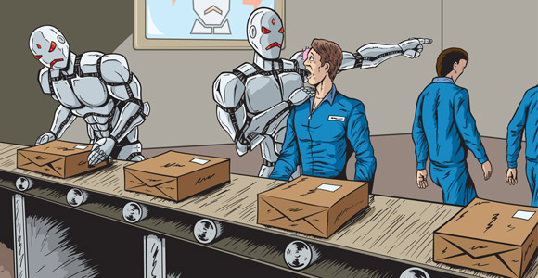
Decline in Employment
Yael Rosenblum
For 200,000 picks a day_{[3]}:
  Standard warehouse operations: 75 persons for 8-hour shifts
  Automation technology: 25 workers per shift
http://www.leafmagazine.ca/wp-content/uploads/2015/02/robots-and-jobs.jpg
Notes:
This type of expansion in automation has led to an increase in output from automated factories. This begs to ask the question about job loss. In conveyor-based operations picks 200-400 items per hour, while robotic present items to workers every 6 seconds, resulting in a base rate of 600 items per hour.

Slide 54
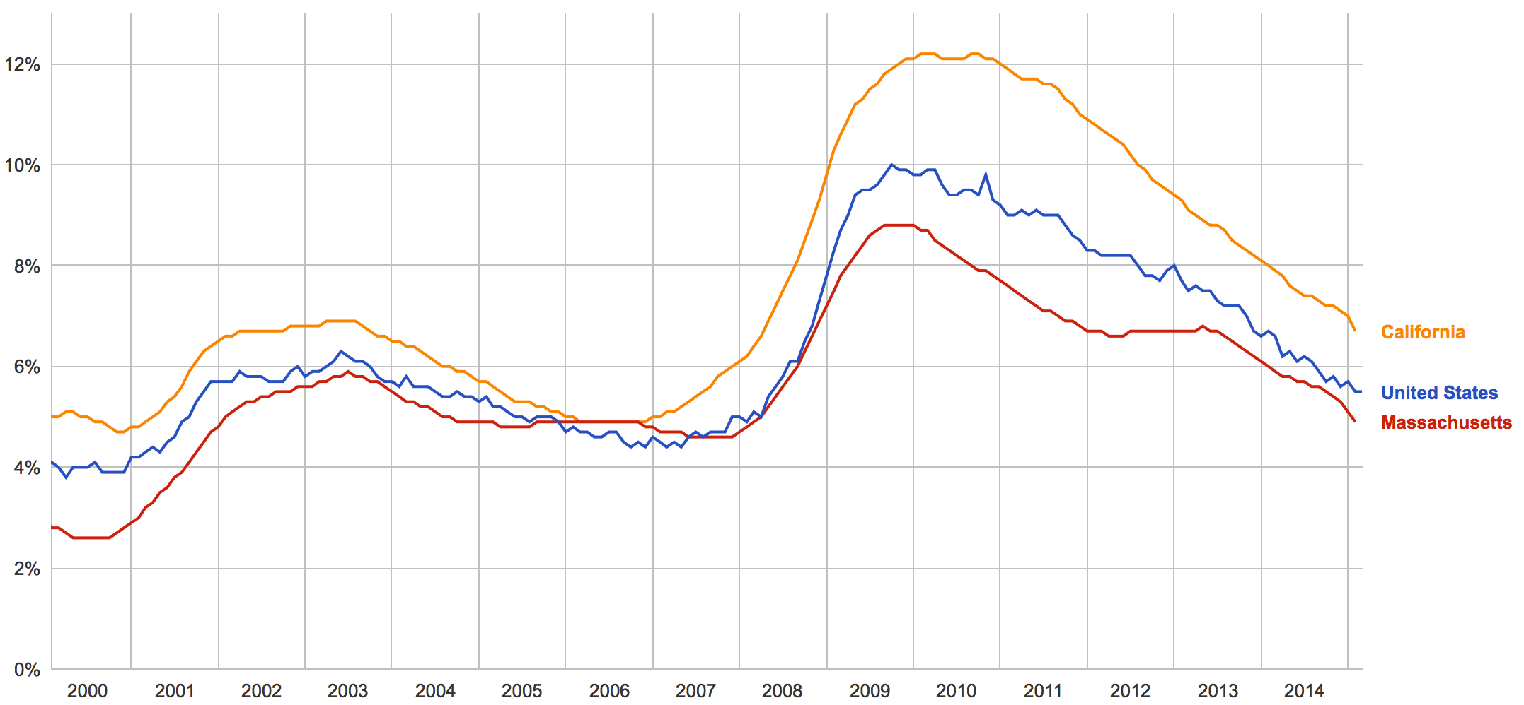
Current Unemployment
Yael Rosenblum
[4]
Notes:
However, in terms of numbers, unemployment rates are decreasing. In this graph from the Census Bureau, there were 6-8 million unemployed in early 2000’s, which rose to 15 million in 2010’s. Since then it has drastically declined to 8.5 million to just last year. This just quantifies the amount of jobs being created within the last half-decade and provides better metrics to see that change.
For automation, while the number declines in workers per shift, an increase in new positions are becoming available and more in-demand. Similarly, these industries are becoming more prevalent and require more new-build of warehouses to fill consumer demand.
With automation jobs, many companies are now starting to offer different seasonal schedules. For really shopping intensive months of November and December for the major holiday season and August and September for back to school. This is showing the importance of more workers adding to the demand in-hand with automation.

Slide 55
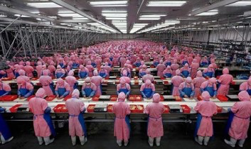
The new “ordinary” Worker
Yael Rosenblum
Projections:
  Current job markets will be automated more assertively
  New job market created in-turn
Redefinition of the “ordinary” worker_{[5]}
  Less repetitive
  More creative
http://www.ourhenhouse.org/wp-content/uploads/2013/06/manufacturing-assembly-line-in-china-353x210.jpg
Notes:
This shows the new idea of sought-out work for the upcoming decades with further expansion of robotics and automated fields. The idea of “ordinary” workers is projected to change from repetitive work to more creative and contrastive.

Slide 56
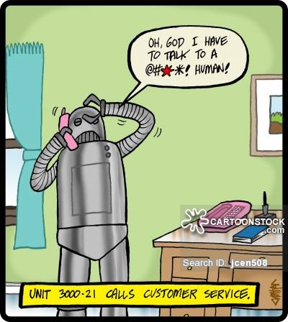
Questions?
Yael Rosenblum
http://lowres.cartoonstock.com/computers-robot-robotics-artificial_intelligence-call_centres-call_centers-jcen508_low.jpg

Slide 57
References
Yael Rosenblum
[1] Kroft, Steven. Robots on the Rise in the Workplace. CBS News.http://www.cbsnews.com/news/robots-on-the-rise-in-the-workplace/ (4/20/15)
[2] Malone, Robert. Inside the Automated Warehouse. http://www.inboundlogistics.com/cms/article/inside-the-automated-warehouse/ (4/22/15)
[3] Guizzo, Erico. Three Engineers, Hundreds of Robots, One Warehouse.http://spectrum.ieee.org/robotics/robotics-software/three-engineers-hundreds-of-robots-one-warehouse (4/23/15)
[4] US Bureau of Labor Statistics. https://www.google.com/publicdata/explore?ds=z1ebjpgk2654c1_&met_y=unemployment_rate&idim=country:US&fdim_y=seasonality:S&hl=en&dl=en#!ctype=l&strail=false&bcs=d&nselm=h&met_y=unemployment_rate&fdim_y=seasonality:S&scale_y=lin&ind_y=false&rdim=country&idim=country:US&idim=state:ST2500000000000:ST0600000000000&ifdim=country&tstart=951282000000&tend=1427083200000&hl=en_US&dl=en&ind=false (4/23/15)
[5] Boyd, Stowe. When Robots Take Over Most Jobs, What Will Be the Purpose of Most Humans? http://www.huffingtonpost.com/stowe-boyd/robots-jobs-purpose-humans_b_5689813.html (4/20/15)

Slide 58
Class 11
The End
Keith A. Pray
Instructor
socialimps.keithpray.net
Notes:
This is the end. Any slides beyond this point are for answering questions that may arise but not needed in the main talk. Some slides may also be unfinished and are not needed but kept just in case.

