Slide 1
Class 8 Crime
Keith A. Pray
Instructor
socialimps.keithpray.net
Notes:
Here’s the title slide. Is anyone not excited?
Paper Reminders:
5 High quality sources
Conclusion, Argument, Counter Point, Response
Try reading paper aloud

Slide 2
Overview
Review
Assignment
Students Present

Slide 3
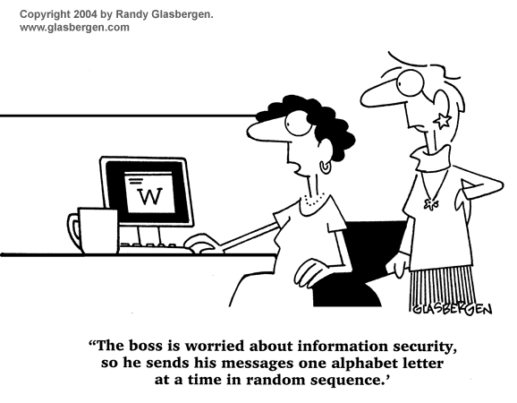
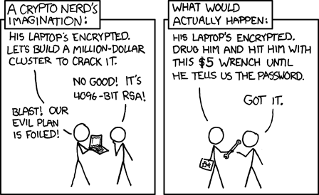
http://xkcd.com/538/ (2010-11-14)
Notes:
Are there any questions on the assigned reading?
Use the slides ahead to explain any of the attack methods from the text.
If there are no questions you can skip those slides.

Slide 4
Buffer Overrun
Run time stack
Local Variables
Return Address
Parameters
Variable Attack
buffer
Target Variable
Stack Attack
buffer
Return Address
code
Return Address
Notes:
When a function call is made, local variables, return address, parameters stored on run time stack. Local variables occupy lower memory addresses.
Variable attack – change variable value. Program expects user to input character and allocates a buffer for them. Attacker supplies too many characters and ends up over writing a variable.
Stack Attack – goal is to change value of return address so execution control goes to code which the attacker has provided in the input buffer.
Prevention: add checks against array bounds being exceeded, or modify operating system to not execute instructions stored on run time stack.

Slide 5
Run Example Code

Slide 6
Buffer Overrun Code
#include <stdio.h>
#include <string.h>
int main ( void ) {
char buff [ 15 ]; int ace = 0;
printf ( "\n Enter best class ever : \n" );
gets ( buff );
if ( strcmp ( buff, "imps" ) ) {
printf ( "\n %s is wrong! You should FAIL! \n ace=%i\n", buff, ace ); }
else { printf ( "Correct! \n") ; ace = 1; }
if ( ace ) { printf ( "You get an A! \n" ); }
return 0; }
} The Naughty Line

Slide 7
TCP Three-way Handshake
SYN
SYN-ACK
ACK
Notes:
SYNchronize
SYNchronize ACKnowledgement (socket reserved awaiting ACK)
ACKnowledgement
TCP socket connection established

Slide 8
SYN Flood Attack
SYN
SYN-ACK
Notes:
Attacker spoofs the IP address so the SYN-ACK is sent to a different machine that cannot respond to the SYN-ACK.
This leaves the connection half open on the server machine decreasing the resources (sockets, memory, threads/processes) available to respond to legitimate clients.
The attacker send many such spoofed SYN messages.

Slide 9
Ping Attack
Target
Attacker
ping
ping
Notes:
Attacker finds routers that support broadcasting messages to all computers on their local area networks.
The attacker sends a spoofed ping message, which the routers echo to the spoofed address.

Slide 10
My Reading Notes
pp. 321 Might be interesting to compare password guidance over the years.
pp. 323 How does Firesheep always get a user photo?
pp. 328 Not current or virus unknown…
pp. 330 Goals include infect 3 machine per LAN and as many computers as possible? Never make last minute changes before release. Were they related to the defects?
pp. 332 Do people use the Internet as an experimental laboratory these days? Shutdown right after booting, “benign” doesn’t seem like the right word.
pp. 334 “send reports back to a host computer”?
pp. 335 Firewalls often not running on same machine as malware, routers?
pp. 337 Have 2003 fears of cyber terrorist attacks been realized?
pp. 345 How is online voting a moral issue?
pp. 346 Is Internet access due to financial restrictions still relevant? Could issue specific, unrelated code for each vote.
End of Chapter questions:

Slide 11
Group Quiz
A denial of service attack shuts down a bunch of retailer, stock brokerage, large corporate entertainment and information web sites. Possible guilty parties:
Terrorist who aimed to cause billions of damage to U.S. economy.
Protest organization opposing commercialization of the web and corporate manipulation of consumers.
Script kiddie just having fun with tools he found on the web.
Show off hacker in search of bragging rights.
State what penalties are appropriate for each.
Explain your answer to 1. using a single Ethical Theory for all.
Name the laws/acts under which these parties could be prosecuted.
Notes:
Note: short answer format expected.
Note: 2. only one argument needed, should include logic for all parties
Note: 3. same law(s) should be applicable to all parties

Slide 12
Assignment Code Testing 1/2
Design tests for the code on the following slide.
Contains at least one major defect and several minor ones.
Write a paper (1-2 pages OK not counting source) including :
Did you choose a good test strategy? (This is your conclusion.)
The inputs and expected outputs
What defects you found
How you would fix the defects (you may include fixed source)
Why would that fix the problems?
What could happen if the defects are not found before the code is put into production?
Working example: http://socialimps.keithpray.net/assignments/index.jsp?content=Code_Test.jsp
Notes:
The online working example source code is best not viewed with IE though looking at the source for the page will reveal the implementation.
If guest presenter coming next class remind students to prepare questions for him.
Remember to work on groups projects.
Each group should have material on their sites for the topics we’ve covered so far.

Slide 13
Assignment Code Testing 2/2
import java.text.NumberFormat;
public class SalesFun {
public static double calculateSalesTotal ( double amount, double discountRate, double taxRate ) {
double discount = amount * discountRate;
double total = amount - discount;
double tax = total * taxRate;
double taxedTotal = tax + total;
NumberFormat numberFormat = NumberFormat.getCurrencyInstance();
System.out.println ( "Subtotal : " + numberFormat.format ( amount ) );
System.out.println ( "Discount : " + numberFormat.format ( discount ) );
System.out.println ( "Total : " + numberFormat.format ( total ) );
System.out.println ( "Tax : " + numberFormat.format ( tax ) );
System.out.println ( "Tax+Total: " + numberFormat.format ( taxedTotal ) );
return taxedTotal;
}
}
} Lines of interest
Notes:
Bold lines are real focus.
Example input:
amount = 100.05;
discountRate = 0.10;
taxRate = 0.05;
OR
0.70, 0.0, 0.05
95.67, 0.20, 0.7

Slide 14
Overview
Survey
Review
Assignment
Students Present

Slide 15
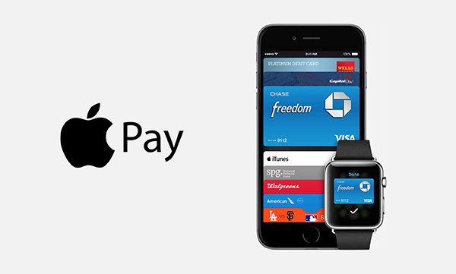
Apple pay
Hai Nguyen
The need for more secure payment method
Credit card payment systems : compromised
Better method : digital wallet using NFC
Apple Pay features
Payments happen in a single touch
No card information shared with merchant
No need to type addresses
Using Near Field Communication (NFC)
http://appadvice.com/appnn/2014/12/my-apple-pay-experience-at-bloomingdales-left-me-feeling-ugg
Notes:
First talk about the need for more secure payment method since the traditional credit card systems can be compromised. A better method, digital wallet, is growing. Digital wallet is more convenient and secure than physical credit card. Apple Pay appeared in Oct 2014 to be the most secure one . Then, a brief introduction to Apple Pay
Is a recent digital wallet service
Payments happen in a single touch : to pay just hold your iPhone near the contactless reader with your finger on Touch ID.
No card information shared with merchant
No need to type addresses like with physical credit card
Has a dedicated Near Field Communication (NFC) chip for secure purpose

Slide 16
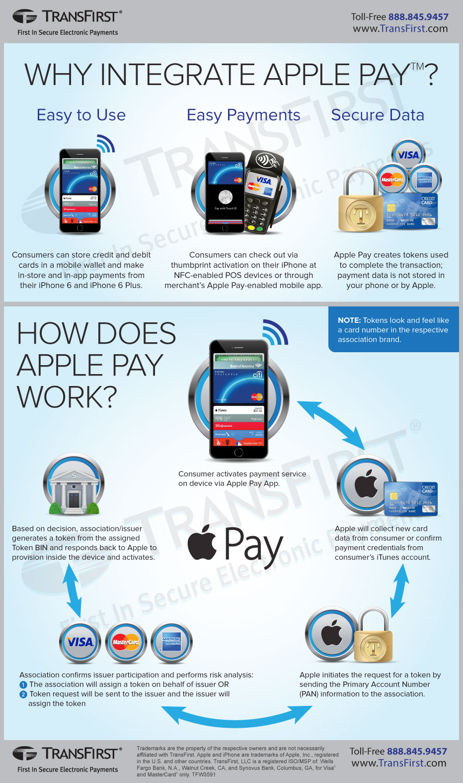
Hai Nguyen
http://www.transfirst.com/resources/infographics/why-integrate-apple-pay
Notes:
Describe how Apple pay works:
Step one: Pay is opened on the smartphone.
Step two: The NFC tap connection is made between the NFC POS terminal and the smartphone.
Step three: The NFC POS terminal connects to Pay on the iPhone and selects the card information designated by the buyer.
Step four: The Secure Element chip (part of the phone's NFC hardware) validates the transaction, and the user's authorization is transmitted to the NFC POS terminal.
Step five: Next, the purchase information moves through the merchant's system, and forwarded to the acquiring bank.
Step six: The acquiring bank verifies the merchant and places the transaction data on the payment-processing network.
Step seven: The payment processor (Visa, MasterCard, etc.) matches the transaction data (purchase information and Device Account Number) to the buyer's credit card account.
Step eight: The purchase is processed, and a verification transmitted back through the system to the POS device.

Slide 17
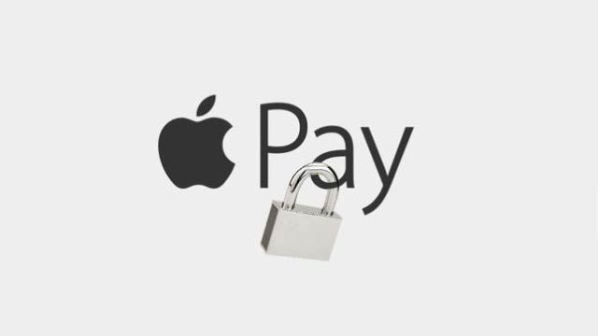
Is apple pay secure?
Hai Nguyen
Built-in Security :
Use Touch ID to authorize a purchase
Store device account number on a Secure Element not Apple servers
Generate random account number: “tokenization”
Protect accounts even if lost or stolen
Doesn’t save transaction information
Notes:
One big social concern is the security and safety of it. Is that possible for hackers to steal credit card information form Apple Pay?
And then, talk about security aspects of Apple Pay:
Support Touch ID to authorize a purchase. That means to make a transaction, need to scan fingerprints to verify
Each card has a device-specific Device account number and is stored in a secure element . It’s is isolated from iOS and never stored on servers or backed up to iClound.
When you add a credit card to Apple Pay, the system generates a random account number that associates with your iPhone, but not your credit card number, so whenever you go to pay for something at a store using Apple Pay, that random account number is sent through the store’s system rather than your actual credit card number
Can disable to make payment by using Find My Iphone
Doesn’t save personal transaction information (also protect the privacy of customers)

Slide 18
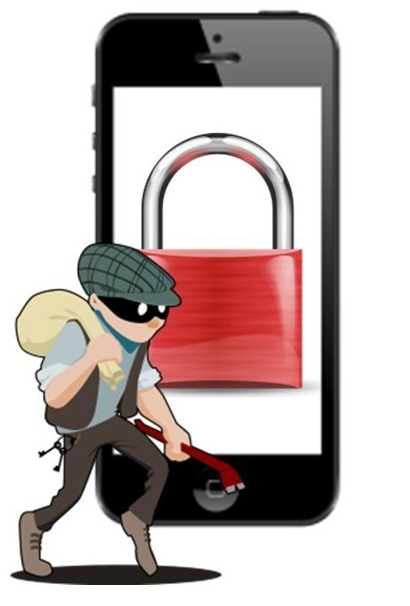
Is apple pay secure? (Cont’d)
Hai Nguyen
Potential Security Issues
Break Apple Touch ID : 2 day for Chaos Computer Club to bypass Touch ID used on IPhone 5
Create fraudulent Apple Pay accounts
NFC risks :
Data tampering
Data interception
Mobile malware
http://www.mobilecommercepress.com/mobile-security-incidents-experience-by-most-companies-in-2012/857058/
Notes:
Talk about potential security problems
Hackers can break apple touch ID although it’s is hard in general. For example, Chaos Computer Club took 2 days to bypass it used on IPhone 5.
To create Apple Pay account, banks just ask customers some basic personal information that cyber thieves may already access to it. So cyber thieves could easily create accounts with stolen credit cards.
Problems from NFC : It might seem like it would be impossible for a malicious third-party to interfere with close-ranged interaction in NFC, but actually it still possible to do some attacks like data tampering, data interception, mobile malware.
Knowing these problems may help users protect themselves from attackers or at least makes more difficult to attack their own accounts.

Slide 19
Conclusion
Hai Nguyen
With a lot of new features, Apple Pay is more convenient, safe, and secure than physical credit card.
However, it has some potential security issues that attackers can exploit them soon.

Slide 20
References
Hai Nguyen
Craig Lloyd, Is Apple Pay Safe and Secure?, 04/08/2015, http://www.gottabemobile.com/2014/10/21/ipad-air-2-vs-surface-2-which-to-buy/
Micah Singleton, Does Apple Pay really have a fraud problem?, 04/08/2015, http://www.theverge.com/2015/3/4/8149663/apple-pay-credit-card-fraud-banks
Michael Kassener, Apple Pay: More secure or just different?, 04/08/2015, http://www.techrepublic.com/article/apple-pay-more-secure-or-just-different/
Joel Lee, Using NFC? 3 Security Risks To Be Aware Of, 04/08/2015, http://www.makeuseof.com/tag/using-nfc-3-security-risks-to-be-aware-of/
Apple Pay security and privacy overview, 04/09/2015, https://support.apple.com/en-us/HT203027

Slide 21
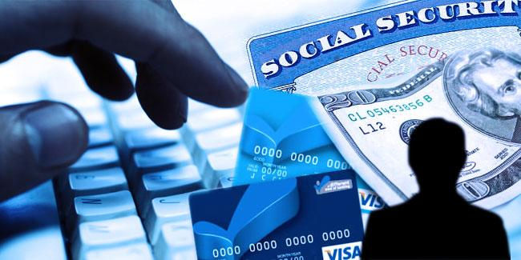
Identity Fraud Timeline
Yuan (Will) Wen
Ways of Stealing Identities
Selling/Forging an Identity
Police & Bank Policies
Ways to Prevent
Self > Legislation.
http://johndruckenmiller.com/wp-content/uploads/2014/10/Identity-theft.jpg
Notes:
Main point:
With the current laws, the best way to prevent identity fraud from happening is preparation and awareness.
Catching an identity thief is hard and legislation rewards prompt awareness.
Self: taking precautions , being aware of how they fish you.
Legislation: hard for police to ever catch them. Legislation also rewards you for fast action.
This slide is a basic outline of what to talk about. Point out the “flow” of an identity theft. First they get the info, then they sell/use it, then you panic and see what laws and policies protect you. Then you look up ways to prevent it from happening again.

Slide 22
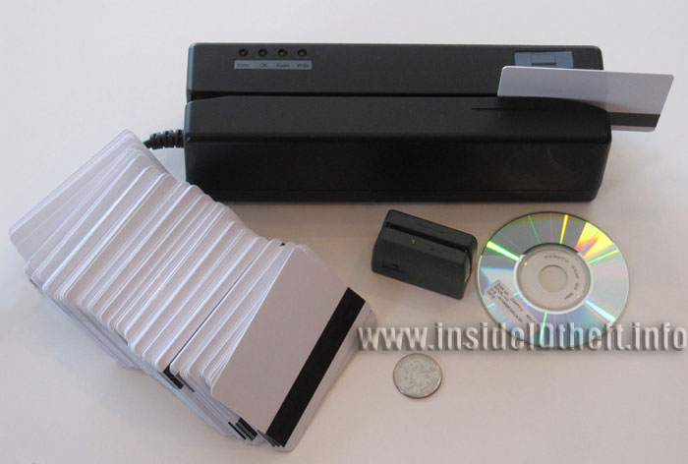
Ways of Obtaining Identities
Will Wen
Wallets, letters -> online
Dumpster Diving
Eavesdropping
Phishing
Large Scale Hacking/Exploits [5]
Card Readers (Skimmers) [10]
http://www.identitytheft.info/images/Debit-Card-Skimmer.jpg
Notes:
Skimmers: be aware of what other skimmers look like. Avoid using pin as much as possible.
Large Scale Hacking:Aug 2011- Feb 2014 , Mircea Ispasoiu, in Romania, hacked into US computer systems. 10,000 credit and debit card numbers . Extradited to the US
Skimmers: can be at restaurants, gas stations , because they are unmaned. Credit Card Skimmer Found at Lakeland Gas station. Says it was INSTALLED IN THE MACHINE. Only noticed when an alarm went off so the clerk went to check pump’s receipt paper.

Slide 23
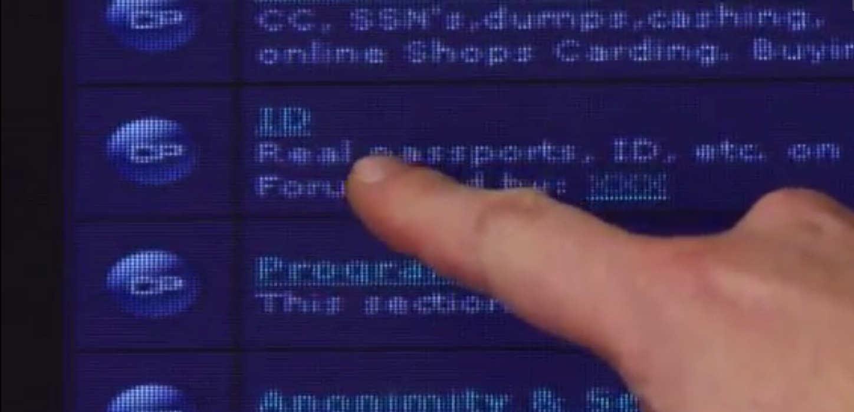
Selling/Forging an Identity
Will Wen
Sell on Illegal Forums
Carder’s Forums
Dark Market
The Vouched
Open up Credit Card
Cashers/Mules [1,6]
American Greed Documentary – Cyber Crime
Notes:
Example: Max Butler ~2000s serious hacker, partnered up, made a forum called carder’s market, took down all the other sites. Had a struggle with FBI.

Slide 24
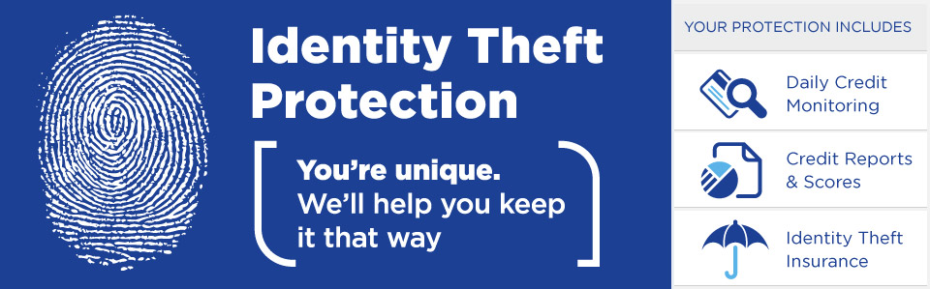
Laws & Bank Assistance
Will Wen
Identity Theft and Assumption Act of 1998
Fair and Accurate Credit Transaction Act [3]
Zero-Liability Policy (Credit Cards) [4]
AmEx, Discover > Visa, Mastercard
Federal Law: $50 if within 60 Days
Exceptions [8]
FBI sting operations [7]
“two-year undercover operation”
https://www.53.com/resources/skins/ftb/img/product/idtheft/lp-header.jpg
Notes:
FACT Act – amendment to the Fair credit report act, Allows consumers to request and obtain a free credit report once every twelve months from each of the three nationwide consumer credit reporting companies . (Equifax, Experian, transunion) + must put a fraud alert for 90 days
Visa: $0 for 120 days and in fine print, negotiable, basically at their discretion. (wait too long, you already had bad standing, must file police report, not in US
A credit report : you live, how you pay your bills, sued or have filed for bankruptcy. sell the information in your report to creditors, insurers, employers, and other businesses that use it to evaluate
FBI is going for busts as a whole, long drawn out operations. Even if you report, they will hold information to bring down a big group

Slide 25
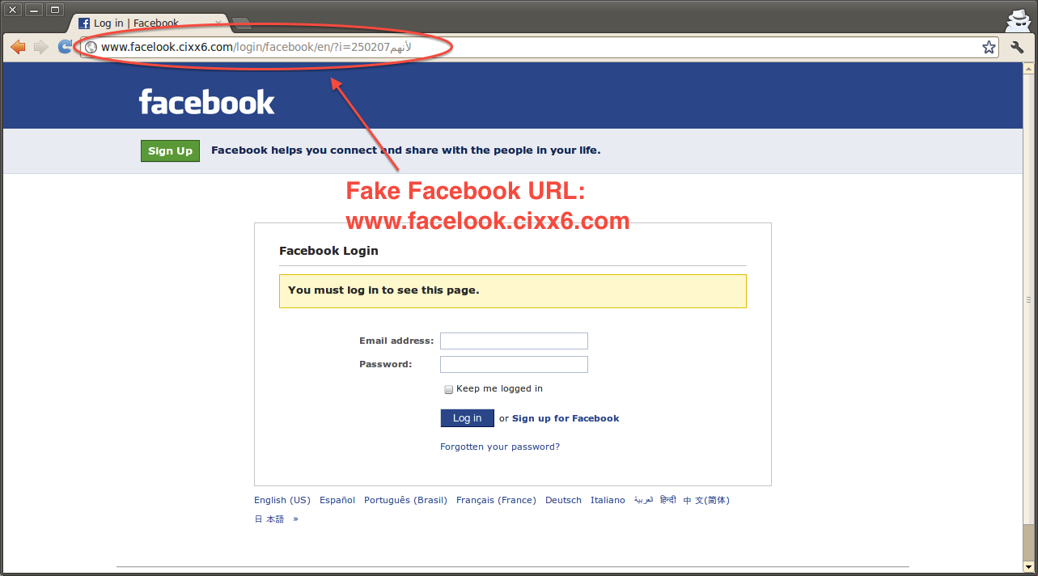
Ways to prevent
Will Wen
Check credit scores
Shred all sensitive papers
Opt out of subscriptions
Credit Alerts & Freeze [2]
Don’t get Baited.
Think: Did you Initiate?
Look around environment
Other card scanners
https://www.eff.org/files/images_insert/april_11_copy.png
Notes:
Paying attention to credit scores allows monitoring.
Also credit alerts are available. The agency will tell you when they see some weird things
Online guides advise these things.
Credit freeze prevents access to your credit report. Then new accounts cannot be opened.
KEEP INFORMATION WELL MONITORED AND WHEN ASKED FOR THEM, BE CAUTIOUS.

Slide 26
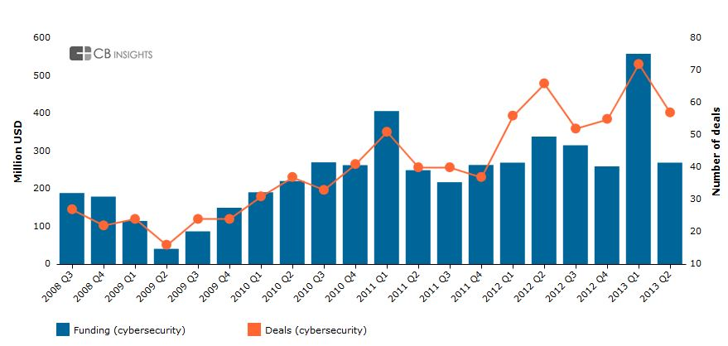
Conclusion
Will Wen
Legislation -> Self Responsibility
Virtual Stealing >= Physical Stealing
Constant one-up man ship in cyber security
FBI and corporations vs Hackers
Increase in market! [11]
https://www.cbinsights.com/blog/wp-content/uploads/2013/08/security3.jpg
Notes:
The way the world works, the way the laws are, all points back to self responsibility.
credit cards, email, all electronic stealing. You would never realize it is physically gone.
Laws make it easier for you to check with credit reports, alerts, and bank statements.
“ the demand for cyber security experts increased 73% from 2007 to 2014.” – Burning Glass International ,
in comparison, the demand for all computer jobs only increased 20%, still a great growth rate, and the demand for all jobs grew just 6%.
“The industry has seen 29% funding growth and 19% deal growth on a year-over-year basis.” -https://www.cbinsights.com/blog/cybesecurity-venture-capital/
-published sep 4 2013

Slide 27
References
Will Wen
[1] American Greed – Cyber Crime Documentary CNBC
[2] "Consumer Information." Credit Freeze FAQs. Federal Trade Commission, Mar. 2014. Web. 08 Apr. 2015. <http://www.consumer.ftc.gov/articles/0497-credit-freeze-faqs>.
[3] "Consumer Information." Free Credit Reports. Federal Trade Commission, Mar. 2013. Web. 08 Apr. 2015. <http://www.consumer.ftc.gov/articles/0155-free-credit-reports>.
[4] Kiernan, John. "2015 Fraud Liability Study: Which Cards Protect You Best?" CardHub RSS. CardHub, n.d. Web. 08 Apr. 2015. <http://www.cardhub.com/edu/fraud-liability-study/>.
[5] Milo, Paul. "Alleged Hacker Brought to N.J. on Charges of Large-scale Identity Theft." True Jersey. NJ Advance Media, 23 Mar. 2015. Web. 08 Apr. 2015. http://www.nj.com/news/index.ssf/2015/03/alleged_hacker_brought_to_nj_on_charges_of_large-s.html.
[6] Poulsen, Kevin. "One Hacker's Audacious Plan to Rule the Black Market in Stolen Credit Cards." WIRED. WIRED, 22 Dec. 2008. Web. 08 Apr. 2015. <http://archive.wired.com/techbiz/people/magazine/17-01/ff_max_butler?currentPage=all>.
[7] Schwartz, Nelson D. "F.B.I. Says 24 Are Arrested in Credit Card Theft Plan." The New York Times. The New York Times, 26 June 2012. Web. 08 Apr. 2015. <http://www.nytimes.com/2012/06/27/business/fbi-says-24-people-are-arrested-in-credit-card-theft.html?_r=0>.
[8] Bertagnoli, Lisa. "7 Exceptions to 'zero Liability' Policies." CreditCardscom News. N.p., 19 Feb. 2015. Web. 08 Apr. 2015. <http://www.creditcards.com/credit-card-news/zero-liability-fraudulent-charges-1282.php>.
[9] Barnes, F. William. Identity Theft Documentary: An Educational Documentary https://www.youtube.com/watch?v=ziHI8htZV5g
[10] WFLA.com Web Staff. "Credit Card Skimmer Found at Lakeland Gas Station."WFLA News Channel 8. N.p., 06 Apr. 2015. Web. 09 Apr. 2015. <http://www.wfla.com/story/28731531/credit-card-skimmer-found-at-lakeland-gas-station>.
[11] Smith, Deker. "Cyber Jobs in High Demand-What's in Your Future? - National Cybersecurity Institute." National Cybersecurity Institute. Cyber Experts Blog, 15 Jan. 2015. Web. 09 Apr. 2015. <http://www.nationalcybersecurityinstitute.org/cyber-jobs-in-high-demand-whats-in-your-future/>.

Slide 28

Air-gap hacking
Jun Liang
What does “Air-Gap” mean?
What is Air-Gap Hacking?
How does it work?
http://www.wired.com/2014/12/hacker-lexicon-air-gap/
Notes:
- What does “Air-Gap” mean?
- What is Air-Gap Hacking?
- How does it work?

Slide 29
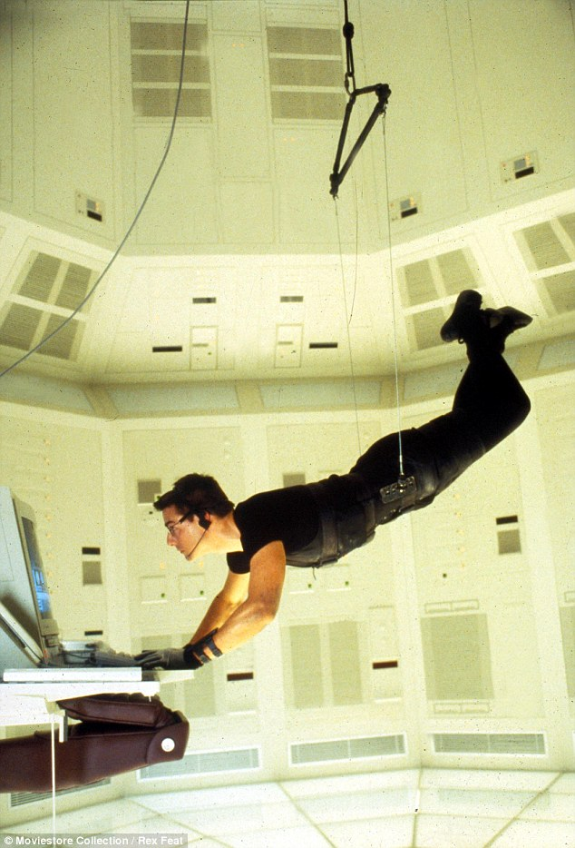
What Is an Air-Gap?
Jun Liang
The computer is physically isolated from the Internet.
Data can only pass to it via a removable media.
http://i.dailymail.co.uk/i/pix/2013/05/07/article-2320579-19A78BC8000005DC-582_634x934.jpg
Notes:
- Ask a question about this picture (Mission Impossible 1)
- A true air gap means the machine or network is physically isolated from the internet
- Data can only pass to it via a USB flash drive, other removable media, or a firewire connecting two computers directly.

Slide 30
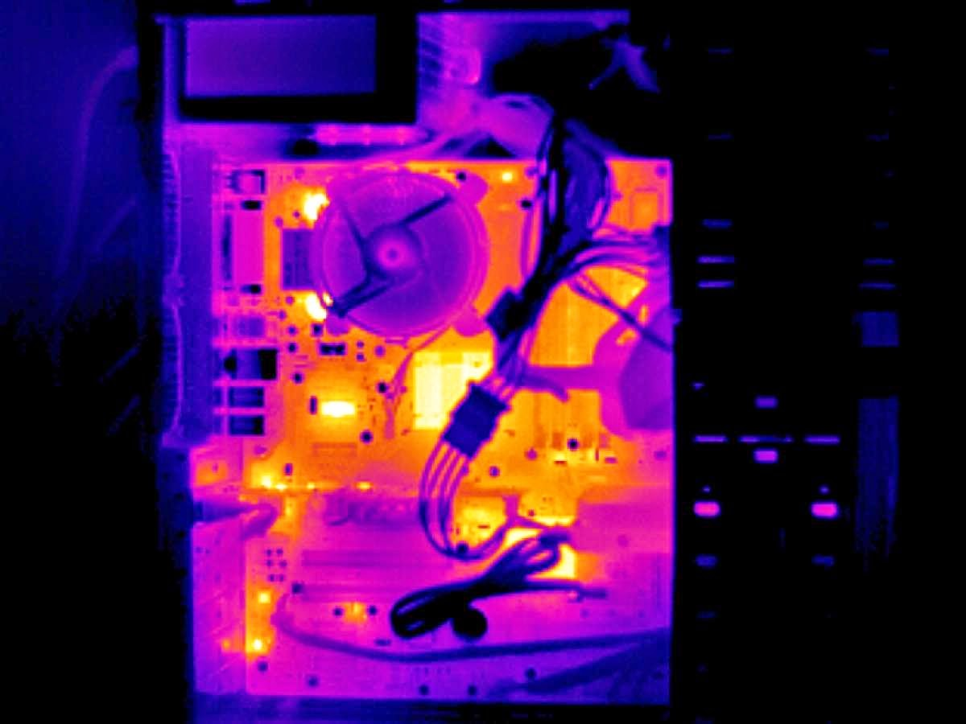
Air-gap hacking
Jun Liang
BitWhisper
Created by Ben Gurion University in Israel
Based on the heat emissions and built-in thermal sensors.
It can send small chunks of data.
It does not require modified hardware.
http://www.extremetech.com/computing/201870-bitwhisper-stealing-data-from-non-networked-computers-using-heat
Notes:
Israeli Researchers have defined a new exfiltration technique dubbed BitWhisper
1. that is based on the heat emissions and built-in thermal sensors.
2. It was developed and tested in a standard office environment with two systems sitting side-by-side on a desk.
3. One computer was connected to the Internet, while the other had no connectivity.
4. This setup is common in office environments where employees are required to carry out sensitive tasks on the air-gapped computer while using the connected one for online activities.

Slide 31
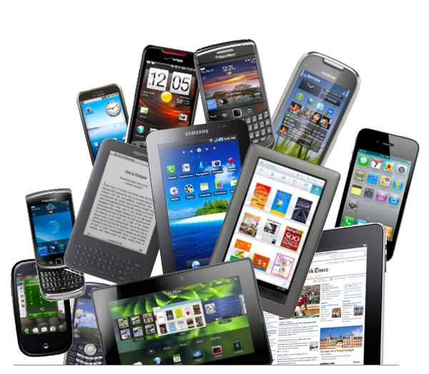
Problems
Jun Liang
Less protection for physical layer security
No computer use special case to against heat transfer yet
Most of computer cases are made of normal metals/ synthesis of carbon
Cellphone and wearable device are safe since most of them don’t have thermal sensors
http://matters.madisoncollege.edu/sites/default/files/field/image/mobile-device.png
Notes:
- Since Air-gap hacking is a new technology/direction, computer companies usually ignore this part when designing a product. However, they probably start to pay attention on this.
- Most of people do care about design or portable, not too many people would think about physical layer security.
- Mobile devices are lucky at this point since they don’t have thermal sensors (most of them).

Slide 32
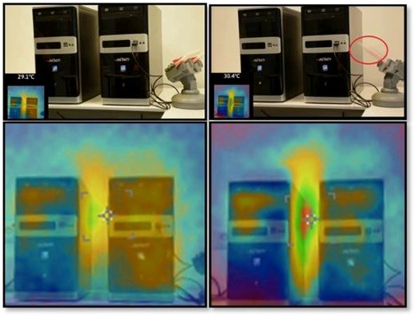
How it works
Jun Liang
Binary data is modulated into thermal signals.
Thermal sensors to measure the environmental changes.
These changes are then sampled, processed, and demodulated into binary data.
http://securityaffairs.co/wordpress/35298/hacking/bitwhisper-air-gapped-pcs.html
Notes:
- By detecting the heat from one computer to an adjacent computer, is possible to establish a channel that can claiming can facilitate the spread of keys, malicious code and more in general any kind of data.
By regulating the heating patterns, binary data is modulated into thermal signals.
In turn, the adjacent PC uses its built-in thermal sensors to measure the environmental changes.
These changes are then sampled, processed, and demodulated into binary data

Slide 33
How it works
Jun Liang
Transmitting system using controlled increases of heat to communicate with thermal sensors.
Thermal sensors detect the temperature changes –> translate them into a binary “1” or “0”.
http://securityaffairs.co/wordpress/35298/hacking/bitwhisper-air-gapped-pcs.html
Notes:
- By detecting the heat from one computer to an adjacent computer, is possible to establish a channel that can claiming can facilitate the spread of keys, malicious code and more in general any kind of data.
By regulating the heating patterns, binary data is modulated into thermal signals.
In turn, the adjacent PC uses its built-in thermal sensors to measure the environmental changes.
These changes are then sampled, processed, and demodulated into binary data

Slide 34
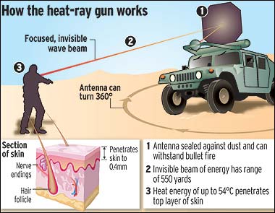
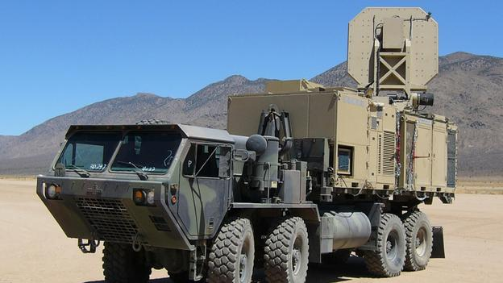
Assumption: heat ray gun + BitWhisper
Jun Liang
http://www.extremetech.com/computing/201870-bitwhisper-stealing-data-from-non-networked-computers-using-heat
Notes:
Heat ray gun + BitWhisper almost can hack every computer.
Devices can be hacked:
- Laptop
- Cellphone/iPad
- Wearable device

Slide 35

Solutions
Jun Liang
Disturb the temperature around the computer
Frozen Smoke (Silica Aerogel)
A solid with low density and low thermal conductivity.
http://www.optics.rochester.edu/workgroups/cml/opt307/spr08/matt/
Notes:
One solution is, disturb the temperature around the computer, because they mentioned (on the paper) the emission would be not accurate if the air temperature (around the thermal sensor) is not stable.
Aerogel is a synthetic porous ultralight material derived from a gel, in which the liquid component of the gel has been replaced with a gas. The result is a solid with extremely low density and low thermal conductivity.

Slide 36
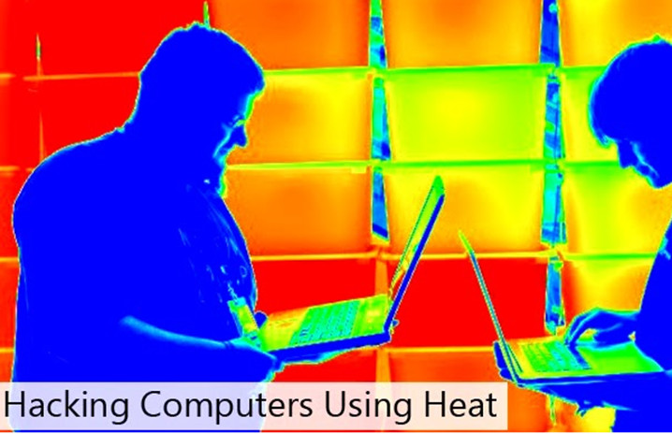
conclusion
Jun Liang
Isolated computers are still vulnerable to outside attacks
It’s possible to send data by using heat
We should be aware of security issues from physical layer
Video: https://www.youtube.com/watch?v=EWRk51oB-1Y
http://securityaffairs.co/wordpress/35298/hacking/bitwhisper-air-gapped-pcs.html
Notes:
Show a video: https://www.youtube.com/watch?v=EWRk51oB-1Y

Slide 37
References
Jun Liang
[1] Hacker Lexicon: What Is an Air Gap? - http://www.wired.com/2014/12/hacker-lexicon-air-gap/
[2] BitWhisper: Stealing data from non-networked computers using heat – http://www.extremetech.com/computing/201870-bitwhisper-stealing-data-from-non-networked-computers-using-heat
[3] Hacking Air Gapped Computer - http://thehackernews.com/2015/03/hacking-air-gapped-computer.html
[4] BitWhisper – hacking Air-Gapped PCs through heat emissions - http://securityaffairs.co/wordpress/35298/hacking/bitwhisper-air-gapped-pcs.html
[5] BitWhisper: Covert Signaling Channel between Air-Gapped Computers using Thermal Manipulations - http://arxiv.org/ftp/arxiv/papers/1503/1503.07919.pdf
Notes:
- QA
- Share ideas

Slide 38
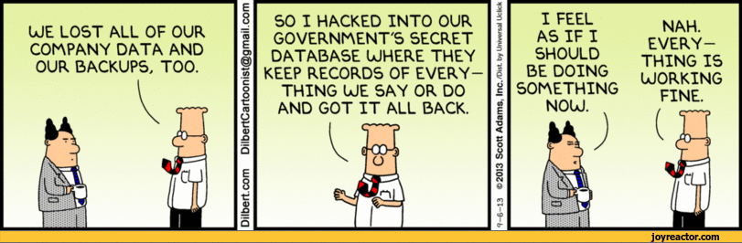
security
Anthony Romeo
How can we stop hacking?
Password Strength
Added Authentication
http://joyreactor.com/post/961232
Notes:
Conclusion: Passwords are not safe enough and honeywords further protects the users.
Hacking is an issue that is very prevalent in todays society. There are various reasons people hack between money, information, or power.
One typical way to prevent people from hacking is to increase password strength. Adding various characters increases the strength https://howsecureismypassword.net/. Adding length also increases the strength.
Another way to increase strength is increasing the length of the password. The longer and more diverse characters that the password is comprised of
The harder it is for the password to be cracked.
Not using words and having a random array of characters is also beneficial.
These both add strain to the user however as he is burdened with the challenging password to remember.
Another way to increase strength is to either add a second password or some sort of authentication such as a security question too.
While all of these methods do protect you more SQL injection disregards all of these and can retrieve your password if successfully done.

Slide 39
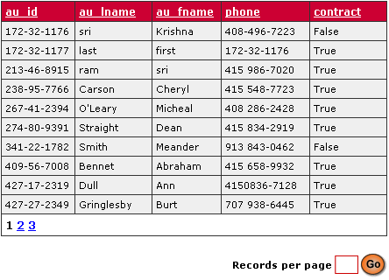
SQL Injection
Anthony Romeo
Obtains Information Stored in Database
Disregards Password Strength
SELECT UserId, Name, Password FROM Users WHERE UserId = 105 or 1=1^{[2]}
http://www.hsoftcon.com/csharptemplates.htm
Notes:
SQL injection is a method of obtaining information stored in a database. The information can contain UserID names, passwords, credit card numbers etc.
Sony Hack and Albert of Gonzales are examples of sensitive information being stolen and Albert Gonzales is confirmed using SQL injection.
When you retrieve a password from the table it disregards password strength and retrieves the string that represents the password. It doesn’t matter.

Slide 40
Honeywords
Anthony Romeo
Sweetwords
Honeywords
Sugarword
Further SQL Injection Prevention
Honeychecker
Notes:
Honewords is the concept of having false passwords hackers log into.
Sweetwords is a compilation of honewords and sugarwords. Sugarword is the actual password that you have.
Honeywords are stored into a value of a database in an array along with the sugarword. Logging into one of the honeywords can either instantly block the user, send a message to the server recording the false log in or even log them into a false account. Logging them into the false account could record them and see what they do.
Honeywords would ideally be something similar to the password. For example tacking letters or words onto the end of the password or having false words and having false words with letters and numbers one them.
This prevents people who obtain information from SQL injection from actually knowing the password and having an array of words they can try.
The user would also have to find the honeychecker function and figure out the hash to get the proper element in the array to know the password.

Slide 41
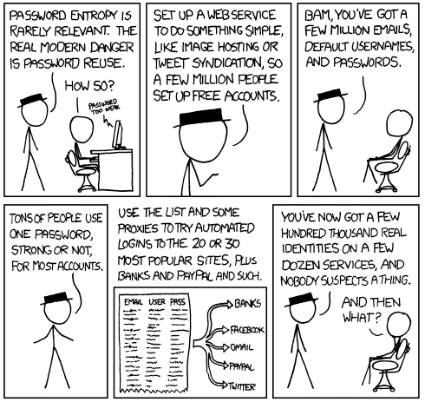
Conclusion
Anthony Romeo
Password Strength is Important
SQL Injection is Equally Important
http://www.kilala.nl/index.php?id=1736
Notes:
While it is definitely smart to increase password security its tough for the user and they are not entirely safe.
Passwords are not safe enough and honeywords further protects the users.

Slide 42
References
Anthony Romeo
[1] Jules, Ari, and Ronald Rivest. Honeywords: Making Password-Cracking Detectable. New York (NY): A.C.M., 2013. Web. 7 Apr. 2015.
[2] "SQL Injection." SQL Injection. N.p., n.d. Web. 8 Apr. 2015.
[3] Morris, R., & Thompson, K. (1979). Password security: A case history ACM. doi:10.1145/359168.359172. Web. 8 Apr. 2015.
[4] Anonymous. (2007). Password security. Sutton: TechTarget. Web. 8 Apr. 2015.
[5] "The Sony Hack: How It Happened, Who Is Responsible, and What We've Learned." Vox. N.p., 17 Dec. 2014. Web. 8 Apr. 2015.

Slide 43

The Heartbleed Fallout
Connor Porell
Reported April 7, 2014
Google researcher Neel Mehta
What is it?
What did it do?
Why do we care?
<nuget.org>
Notes:
Hello, everyone. Today I’m going to talk about the Heartbleed bug, the fallout its reveal caused, and the implications it has on computing today.
Many of you have probably heard of the bug. It was a security flaw in over 17% of websites that allowed an attacker to gain access to parts of a server’s memory, allowing the attacker access to usernames and passwords. Among the services afflicted by the bug were Steam, Twitter, GitHub, and Dropbox.
The bug was first reported by a Google researcher on April 7, 2014, but the commit containing the bug was made on December 31, 2011! Heartbleed attacks could have been made for over 2 years and we may not have known.
So, what is the Heartbleed bug? In short, it exploits a weakness in OpenSSL, a network cryptography and security system. OpenSSL uses a feature called “heartbeats” that keep connections open between an active user and a server, avoiding the expensive process of continually re-opening connections. The bug allowed a buffer overflow attack to provide hackers with usernames, passwords, and other vital data from a website implementing certain versions of OpenSSL.
Why do we care? – Obviously, the ability for a skilled hacker to steal potentially anyone’s usernames and passwords does not bode well for users of that website. I’m sure many of you have an account on Steam, Twitter, Dropbox, GitHub, or any combination of those. How would you feel if these websites were still vulnerable to your information being stolen without anyone knowing?

Slide 44
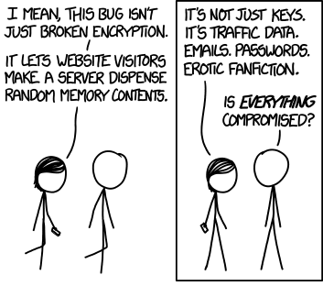
What went wrong, exactly?
Connor Porell
Exploited with SSL Heartbeats
A one-line malloc in OpenSSL
Reveals usernames, passwords, transactions
Attacks are undetectable!
Fixed on April 17, 2014
Current fix limits heartbeat size to 16 bytes.
But some companies have yet to adopt the change. [2]
Graphic adapted from: <https://xkcd.com/1353/>
Notes:
So what went wrong and what caused the Heartbleed panic exactly? To explain that, we need to know what SLL Heartbeats are.
Heartbeats are found in an extension of OpenSSL, as a relatively cheap way to see if connected users are still present or not. An SSL heartbeat is described as a “keep-alive” system. A heartbeat keeps a context with an active user open (or “alive,” if you will), eliminating the overhead of constantly re-initiating connection. When the heartbeat detects that the user is inactive or has dropped off, then it terminates the context.
Attacks were made using an exploit that was invoked via a buffer overflow. Attackers could make a heartbeat much larger than a server expected, causing the server to send a random 64kb of data to the user from the server’s memory. This 64kb often contained usernames, passwords, and financial information. If that wasn’t bad enough, attacks could be automated while never leaving a trace. Theoretically, an attacker could had a server report the username and password of every registered user in the system through automated attacks.
Fortunately, on April 17, 2014, the exploit was fixed by a line of code that limits the size of a heartbeat to 16 bytes; the code also validates the size of the heartbeat just before it is sent. Unfortunately, some vulnerable websites still have yet to adopt this change, because the process behind updating certificates is both slow and expensive.

Slide 45



Direct Effects of Heartbleed
Connor Porell
Over half a million websites vulnerable to attack [3]
Attackers could gain usernames, passwords, financial data, business transactions
Steam, Facebook, Twitter, Instagram, Github all affected
Minecraft shuts down its servers [4]
Game went offline starting April 9
All users encouraged to change passwords
<twitter.com>, <github.com>, <deviantart.com>
Notes:
Now that we know what the Heartbleed bug is, we can see just how bad it was and its effect on the services that use SSL Heartbeat. As I mentioned earlier, 17% of web services use the version of OpenSSL that included the Heartbleed vulnerability. That’s over half a million websites that have been vulnerable to having all their users’ personal information stolen since the bug was first introduced.
Attackers who exploited the Heartbleed bug could access virtually anything in the server’s working memory, including usernames, passwords, financial data, and business transactions. Among the affected services were Steam, Twitter, GitHub, Facebook, Dropbox, Tumblr, DuckDuckGo, and Minecraft. Any account on these services could have had information on their users stolen without anyone knowing.
One of the most famous effects of fallout as a result of the bug was with the game Minecraft. On April 9, 2014, Mojang, the developers of Minecraft, issued a statement saying that they were shutting down all of its online services until the issue was resolved. This prevented players from being able to join servers with their friends, update their player skin, or even play a single-player world while connected to the Mojang network. Players had to resort to playing in offline single-player worlds until the issue was patched. Mojang strongly suggested all players change their passwords after the issue was fixed a few days later. The fact that this bug temporarily shut down one of the world’s most popular online games shows the extent of the damage it could do.

Slide 46

How did this happen?
Connor Porell
Where was the community involvement?
Community can fix the issue vs. will fix the issue
Project is ~60MB, 10,000 commits, 21 contributors
What happened in the meantime?
Potential mass theft
Attacks are undetectable
Could this happen again?
Updating security certificates is “slow and expensive” [5]
74% of Global 2000 businesses still vulnerable
<thelastbastille.wordpress.com>
Notes:
How did a security issue this big enough even get published and go unnoticed for so long? The issue lies in the nature of OpenSSL. OpenSSL is an open-source project, so its upkeep is primarily based upon the community. This brings up the problem with open-source software: the community can fix the issue, but that doesn’t mean that the community will fix the issue. On GitHub, the OpenSSL project has over 10,000 commits made by 21 contributors across 25 branches. It’s possible that the bug just went undetected in the source code until April 2014, but what if it didn’t?
There is always the frightening potential that the bug wasn’t first discovered in April last year. For all we know, some people may have already exploited this bug to extract data on users on some of the world’s biggest websites. Part of the chaos that ensued as a result of the Heartbleed bug was that attacks left no trace, meaning that attackers could break into a system and steal user information on any number of users without ever leaving evidence of what they did.
Even though the Heartbleed bug has been fixed, protecting a vulnerable server isn’t as simple as pulling down the latest version. Websites have to update their security credentials as well, a process that is both time-consuming and expensive. Without properly updated credentials, websites that had the old version of OpenSSL are still vulnerable to the Heartbleed exploit until the security keys and certificates update as well. Attackers can use the old keys and certificates to set up fake websites that appear real, but will steal data from unsuspecting users. Because the remediation process is so slow, some businesses today are still vulnerable. In an article published earlier this week, CNBC reported that 74% of companies in the Global 2000 are still vulnerable to being attacked though the Heartbleed exploit. To put this into perspective, some of the higher-ranking companies of the Global 2000 are Apple, Bank of America, General Electric, AT&T, Samsung, and WalMart.

Slide 47

What are the Takeaways?
Connor Porell
Emphasizes importance of network security
Importance of community involvement in open-source
Risk to users of web services
Users should plan for the worst
<thebostoncalendar.com>
Notes:
So, what are the takeaways from the case of the Heartbleed bug?
The incident certainly emphasizes the importance of network security. While similar proprietary web services (such as those put out by Microsoft) were unaffected, the popularity of open-source solutions was undoubtedly a factor in the widespread use of OpenSSL. For a cryptography and security service used by 17% of the world’s web servers, a bug like Heartbleed is enough to cripple entire userbases at the hands of cyber criminals.
Additionally, the fact that the bug went undetected for over 2 years shows how much open-source projects rely on their community for upkeep. While OpenSSL is by no means a small program, the unfixed state of the Heartbleed bug shows how open-source projects often rely on their communities to constantly improve them.
The bug also reminds us how cautious we should be online. While many of us probably use similar usernames and passwords across multiple sites to make remembering our accounts easy, the ease with which an attacker could have found out that information thanks to the Heartbleed bug is a grim reminder that we shouldn’t take chances online, and that we should always prepare for the worst. We don’t know who’s out there trying to steal our information.
The Heartbleed bug is a critical event in the history of network security. We can hope that software developers will learn from this to prevent systems as widely used as OpenSSL from being exploited in a similar manner.

Slide 48
References
Connor Porell
[1] Hunt, Troy. Everything you need to know about the Heartbleed SSL bug. www.troyhunt.com/2014/04/everything-you-need-to-know-about.html. (7 Apr. 2015)
[2] Schlesinger, Jennifer. Global business may still be vulernable to Heartbleed. http://www.cnbc.com/id/102564014. (8 Apr. 2015)
[3] Mutton, Paul. Half a million trusted websites vulnerable to Heartbleed bug. http://news.netcraft.com/archives/2014/04/08/half-a-million-widely-trusted-websites-vulnerable-to-heartbleed-bug.html. (7 Apr. 2015)
[4] Fahmy, Albaraa. Minecraft affected by Heartbleed bug. http://www.digitalspy.com/gaming/news/a563926/minecraft-affected-by-heartbleed-bug.html#~p9dI8eGV4mJEQP. (7 Apr. 2015)
[5] Forget Creepers: ‘Heartbleed’ security flaw is the greatest threat to millions of Minecraft players. http://venturebeat.com/2014/04/09/forget-creepers-heartbleed-security-flaw-is-the-greatest-threat-to-millions-of-minecraft-players/. (8 Apr. 2015)
Notes:
Do you have any questions?

Slide 49
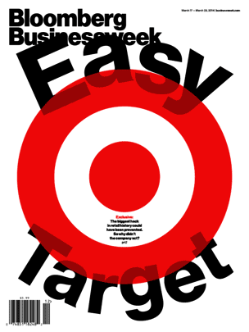
Businesses being hacked
Thomas Grimshaw
Target (2013) [1]
40 million credit card numbers
Cost the company over $148 million
Spent $1.6 million on a security software
Security staff of 300
JPMorgan Chase (2014) [2] [3]
76 million clients’ data stolen
Plans to spend $250 million/year on security in the future
Security staff of 1,000
http://images.bwbx.io/cms/2014-03-12/bbw_cover_easy_target_304x405.gif
Notes:
There have been many companies that have been hacked in the past few years. One example is Target, that had 40 million credit card numbers stolen in 2013. The breach cost the company over $148 million. This breach was accomplished despite the fact that the company had spent $1.6 million on a security software called FireEye and had a security staff of 300.
Another company that was hacked recently was JPMorgan Chase. Last year they had addresses, names, emails, and phone numbers of 76 million clients stolen. After this attack JPMorgan has said that they plan to spend $250 million per year on security and increase their security staff to 1,000 people.

Slide 50
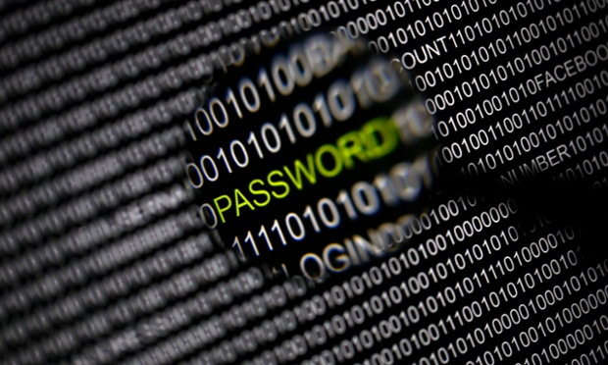
Why small businesses
Thomas Grimshaw
Smaller security teams
Smaller budget
Conducting business in the cloud
Still hold sensitive data
“Too small to hack” mentality [4]
Lack of security culture
http://i.guim.co.uk/static/w-620/h--/q-95/sys-images/Guardian/Pix/pictures/2014/8/21/1408633475780/8b3b28cd-a427-4f9b-b96a-6ae744a6fa17-620x372.jpeg
Notes:
But what happens to the companies that don’t have a security staff of hundreds to thousands and have no where near the budget of larger companies? Small business are target for exactly these reasons.
They tend to conduct a lot of business in the cloud as they don’t have the infrastructure to do it themselves, and there is a high chance that they are conducting their cloud interactions insecurely.
Even though the businesses are small, they still hold sensitive and lucrative information like credit card numbers.
One thing that leaves small businesses particularly vulnerable is the “Too small to hack” mentality. Small business owners think that they have nothing of value and are too small a target to be worth a hacker’s time.
This mentality leads to a company with no security culture encouraging good security behavior.

Slide 51
Impact of a hack
Thomas Grimshaw
Costs companies an average of $188,000
Can have data held for ransom
Loss of customers
60% go out of business within 6 months [5]
Notes:
The impact of a hack on a small business can be devastating. The average cost of an attack on a small company is $188,000.
In addition to stealing data, hackers can hold the business’s information hostage, threatening to delete it if they are not paid.
When a small business is hacked they lose the trust of their customers.
60% of small businesses that are hacked go out of business within 6 months.

Slide 52
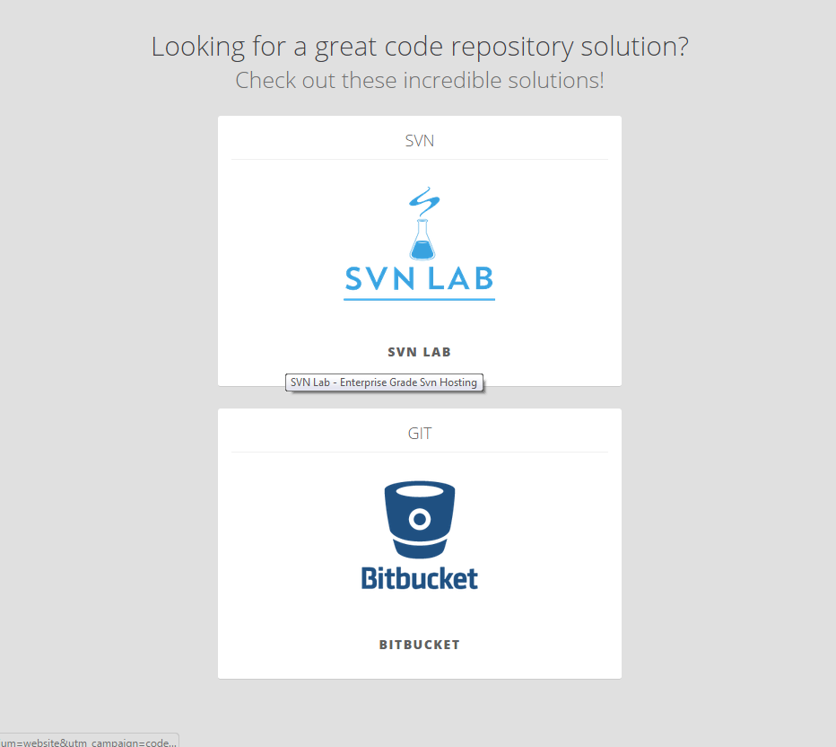
Code Spaces
Thomas Grimshaw
Was a code hosting and software collaboration company
Hacker gained control of their Amazon Web Services account
Demanded ransom for its return
Owners attempted to retake control, but hacker started deleting their customer’s data
“Within 12 hours, Code Spaces went from a viable business to devastation” [6]
http://www.codespaces.com/
Notes:
Even small companies that are technologically savvy and should know better are susceptible to being hacked. Code Spaces was a code hosting and software collaboration company.
The company relied on AWS to host all of their customer’s data, and in 2014 a hacker managed to gain access to their AWS console.
The hacker demanded payment from the company in exchange for their data back.
The company attempted to find out how the hacker gained access and attempted to take back control of their AWS account. However when the hacker saw that they were trying to recover their account he started deleting the customer’s data.
“Within 12 hours, Code Spaces went from a viable business to devastation.” The hack left all of Code Spaces’s customers without their data. Code Spaces shut down after the hack and their website now points you to other code hosting companies as seen I this picture.

Slide 53

Solutions?
Thomas Grimshaw
Train employees
Install security software on endpoints
Hire a security consultant
Get insurance that covers cyber-attacks [7]
http://www.esecure.com.au/sites/default/files/head_keys.jpg
Notes:
So what can a small business do to protect itself without the resources of large firms? One of the biggest things companies can do is to train its employees better. Developing a security culture in the company can help prevent an attack before it happens. If employees use best practices like strong passwords, 2-factor authentication, and not clicking links in emails, then a company can avoid the majority of attacks.
On top of that the companies can install endpoint security on their systems. Security companies like Symantec offer small business cloud based security systems.
Companies can hire a security consultant to help implement the security measures.
Finally companies can make sure they have insurance that covers cyber-attacks.

Slide 54
Conclusion
Thomas Grimshaw
A hack on a small business can easily cause it to go out of business
There needs to be a culture shift when it comes to security
Small business are an easy target due to lack of staff and funds
Notes:
In conclusion, small business are especially vulnerable to hacks. They can easily put the company out of business.
There needs to be a culture shift when it comes to security, people need to have it in mind when making any business decision.
In their present condition small business are ill equipped to handle attacks because of their lack of funds and staff. These vulnerabilities make them easy targets for hackers.

Slide 55
References
Thomas Grimshaw
[1] Riley, M. (2014, March 13). Target Missed Warnings in Epic Hack of Credit Card Data. Retrieved April 9, 2015, from http://www.bloomberg.com/bw/articles/2014-03-13/target-missed-alarms-in-epic-hack-of-credit-card-data#p
[2] Robertson, J. (2014, August 29). JPMorgan Hack Said to Span Months Via Multiple Flaws. Retrieved April 9, 2015, from http://www.bloomberg.com/news/articles/2014-08-29/jpmorgan-hack-said-to-span-months-via-multiple-flaws
[3] Silver-Greenberg, J. (2014, October 2). JPMorgan Chase Hacking Affects 76 Million Households. Retrieved April 9, 2015, from http://dealbook.nytimes.com/2014/10/02/jpmorgan-discovers-further-cyber-security-issues/?_php=true&_type=blogs&_r=1
[4] Anonymous. (2011). No business is too small to hack. Bank Teller's Report, 43(8), 3.
[5] Tynan, D. (n.d.). Warning: Your small business may have already been hacked. Retrieved April 9, 2015, from https://smallbusiness.yahoo.com/advisor/warning--your-small-business-may-have-already-been-hacked-183345805.html
[6] Mimoso, M. (2014, June 18). Hacker Puts Hosting Service Code Spaces Out of Business. Retrieved April 9, 2015, from https://threatpost.com/hacker-puts-hosting-service-code-spaces-out-of-business/106761
[7] Viuker, S. (2015, January 24). Cybercrime and Hacking Are Even Bigger Worries for Small Business Owners. The Guardian. Retrieved April 9, 2015, from http://www.theguardian.com/business/2015/jan/21/cybersecurity-small-business-thwarting-hackers-obama-cameron

Slide 56
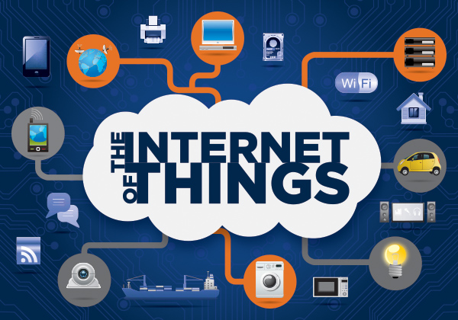
Internet of Things (iot) Security
Matt Beardsley
Context: Home
Potential utility
Data storage security
Network security
http://www.luxcapital.com/blog/wp-content/uploads/2014/02/the-internet-of-things.jpg, (April 8 2015)
Notes:
The internet of things is the concept of connecting any device to the internet in order to send and receive data between these devices [7]. These devices include already widely used internet-connected devices such as mobile phones and personal computers. It also expands to include widely used personal devices which will have internet communication capabilities added in future iterations of the product, such as a washing machine, microwave, door, or light source. This could also include some brand-new technologies with internet connection capabilities, like the self-driving car. The internet of things would essentially gather information about its environment and surroundings, and process that data in order to execute some plan of how to use that data. For example, the lights in the home could turn off if everyone in the home is asleep.
The IoT has potential utility both in and out of the home environment, but the IoT also comes with its own selection of data security and network security issues, as the IoT is a collection of internet-connected devices. For this presentation, I’ll have a focus on the usage of the IoT within the home.

Slide 57
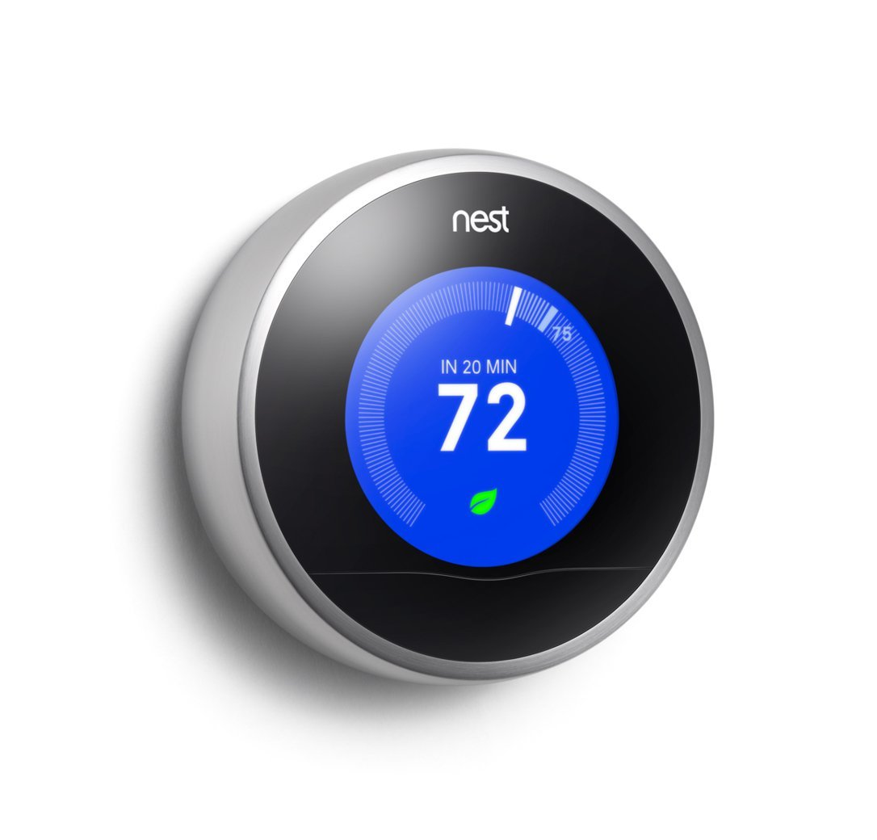
Utility of Iot
Matt Beardsley
Early example: Nest [2]
Save time and money
Autonomously track system status
Automate home
Simplify daily life
http://theultimatesmarthome.com/wp-content/uploads/2014/04/Nest.jpg, (April 08 2015)
Notes:
Nest is a pretty good embodiment of IOT on a small scale. Nest uses the user’s daily schedule and preferences to cut 20% off of heating and cooling bill by setting the thermostat values differently depending on who’s in the home during the day. Nest also has an awareness of other energy systems implemented in the home to optimize based on that parameter as well. Nest also sets reminders to change system filters, acting as a tracking and reminder system, offloading a few things from the user’s thoughts.
The IoT also potentially has the utility of further automating the home environment – .for example, the system could have all of the lights in the home dim or turn off altogether when no one is home in order to save time and money for the user. For a more complex example, it could compile a weekly grocery list depending on eating habits and remaining quantities of various consumables in the home and have it all shipped from a central provider before the user actually needs it, saving the user time and thought.
The automated home concept would certainly simplify daily life for the user under normal operating conditions for the IoT system – the use of something as simple as the lightswitch would no longer need to be operated manually. Instead, the IoT would sense a person entering an unlit room, and would then light up that room for the user, darkening it once the user engages in a low-light activity (e.g. sleeping) in that room, or when the user exits the room.

Slide 58

Iot: Data security considerations
Matt Beardsley
IoT data is private and safe as long as no one else sees your data
May require central servers to process large amounts of data [3]
Major servers are breached all the time [1]
Affinity Gaming: Dec ‘13 – Apr ‘14
Michaels: May ‘13 – Jan ’14: 2.6 million credit/debit card users affected
Target: Nov ‘13 – Dec ’14: 40 million credit/debit card users affected
http://www.midshire.co.uk/wp-content/uploads/2014/02/data-security.jpg, (April 08, 2015)
Notes:
The IoT inevitably collects large amounts of data to make your daily life simpler, which imposes privacy and security risks to the user. With a local central server that’s disconnects from the internet, these problems are largely reduced, as long as the user remains only in the area of their own system, and no one else’s. If they move within the realm of another person’s system, some data about them is now stored on the other person’s server, diminishing privacy.
If a global central server is used, IoT must be internet-connected, imposing a real security and privacy threat to the user. This server would log sensitive user information like whether or not the user is at home, an analysis of their usual daily habits to predict when they might get home, information which the user certainly doesn’t want accessible to anyone. If the home is to be truly automated, the IoT will need to make purchases for the user to maintain a supply of basic household consumables. This will require storage of some of the user’s financial information, which strongly heightens the severity of a potential data security breach.
This central IoT server could be breached, similar to how over 20 major businesses had their servers breached in 2014, including Target, Stables, and JP Morgan and Chase. Then, all of the user’s personal day-to-day home data would be accessible to other people, who could use that data malevolently.

Slide 59
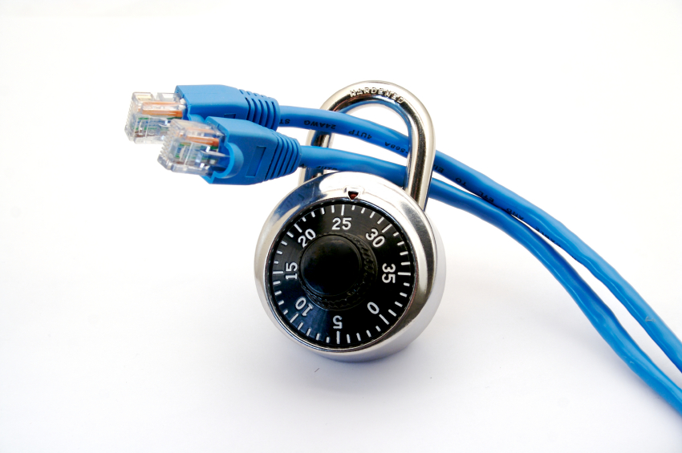
Iot: Network security considerations
Matt Beardsley
Susceptible to DDoS
Daily life interrupted if IoT down
Dangers – Example: Connected car [8]
IoT turned botnet [4]
Accessing internal data feeds – privacy [5]
GhostNet webcam hacking: 2009: 1295 webcams in 103 countries
http://cdn2.hubspot.net/hub/213677/file-299181344-jpg/images/network-security-image.jpg, (08 April 2015)
Notes:
With the IoT necessarily being connected to a network, network security issues come hand-in-hand with it. First of all, the IoT is susceptible to DDoS. If someone’s daily life depends too heavily on the IoT, this could seriously hinder that person for as long as their system is not behaving as expected. This could cause not only disruptions to the system user, but potentially life-threatening hazards. The connected car is an example of this – critical functionality can be attacked, including the steering and braking systems.
Next, if the IoT network is broken into, someone else now has access to all of these small computing devices, allowing that person to create a botnet without the user’s permission. This could cause the IoT network to require some serious fixes in prevent that from happening in the future.
Also, internet-connected sensor devices have a history of having their governance taken over by an external party. Webcams have a history of being attacked in such events. A group of hackers known as GhostNet has cracked over 1295 webcams in 103 countries, making the video capturing available to the hackers whenever they want. Each of the devices on the internet of things could have its control taken by an external third party as well, which would spell doom for the IoT’s user’s privacy and daily workload.

Slide 60
We aren’t ready for full-blown Iot
Matt Beardsley
Databases not secure enough
Networks not secure enough
In consumer’s hands to verify automation accomplishes intended purpose
Notes:
Overall, existing databases/servers are not secure enough to trust the placement of mass amount of personal home information. Additionally, the current network architecture is not nearly secure enough for this amount of data collection – in the current, relatively insecure network configuration, a third party user with access to the server would be able to effectively view an ongoing stream how many people are in the house, and who they are, which presents a very real security and privacy issue for the user. Last, despite the potential long-term utility of the IoT, the user is still responsible for ensuring that they IoT is doing actions that they’d like to be done. This means that the user must essentially supervise the system that is meant to automate their daily life, which basically defeats the purpose of having an automation system or IoT overall.
IoT won’t be ready for a full-scale implementation until serious work has gone into improving network and server security in order to preserve the users’ privacy and security.

Slide 61
References
Matt Beardsley
[1] Bill Hardekopf, http://www.forbes.com/sites/moneybuilder/2015/01/13/the-big-data-breaches-of-2014/, (April 2, 2015)
[2] Nest, https://nest.com/thermostat/saving-energy/, (08 April 2015)
[3] Mark Jaffe, IOT Won’t Work Without Artificial Intelligence, http://www.wired.com/2014/11/iot-wont-work-without-artificial-intelligence/, (08 April 2015)
[4] Waylon Grange, The Botnet of the Internet of Things, https://www.bluecoat.com/security-blog/2015-01-09/botnet-internet-things, (08 April 2015)
[5] Kim Boatman, Are Hackers Using Your Webcam to Watch You?, http://us.norton.com/yoursecurityresource/detail.jsp?aid=webcam_hacking, (08 April 2015)

Slide 62
References
Matt Beardsley
[6] Galen Gruman, Home automation is a solution in search of a problem, http://www.infoworld.com/article/2853026/internet-of-things/home-automation-is-still-mostly-a-solution-in-search-of-a-problem.html, (April 08 2015)
[7] Jacob Morgan, A Simple Explanation of ‘The Internet of Things,’ http://www.forbes.com/sites/jacobmorgan/2014/05/13/simple-explanation-internet-things-that-anyone-can-understand/, (April 08, 2015)
[8] Eugene Kaspersky, Five Reasons Connected Cars are a Security Issue, http://www.forbes.com/sites/eugenekaspersky/2015/02/11/five-reasons-connected-cars-are-a-security-issue/, (April 09, 2015)

Slide 63
Class 8 The End
Keith A. Pray
Instructor
socialimps.keithpray.net
Notes:
This is the end. Any slides beyond this point are for answering questions that may arise but not needed in the main talk. Some slides may also be unfinished and are not needed but kept just in case.

Slide 64
Crime How
Technical and Non-Technical
Break into computer.
Prevent access to computer.
What things make computer related crime easy?
Notes:
Exploit security holes, Break encryption, Spoofing
Social Engineering: Guess passwords, Find out passwords and procedures
Poor passwords, Insecure protocols, Program limitations (buffer overruns), Eavesdropping (Email, Interactive), Insecure files

Slide 65
Crime Bane
Trojan Horse
Virus
Worm
Bot Network
Buffer Overrun
(Distributed) Denial Of Service Attack
How do they work?
How harmful are they?

Slide 66
Crime Why
Why?
Notes:
Money: stolen credit cards, change records, stolen property.
Political, military, economic.
Challenge, Revenge, Mean
Why do at all? Have motivation, think about it, think it will help, think it’s acceptable.
Feel forced. Don’t agree. Don’t care.

Slide 67
Crime Time
What is different now compared to:
10 years ago?
20 years ago?
30 years ago?
40 years ago?
Notes:
More computers. Unsophisticated owners. More complex software. Greater connectivity. Easy access to cracking tools. Incentives. File-sharing
In ’60s and ’70s, access was mostly localized.
Modems. Wardialing.
Some Arpanet and Usenet.

Slide 68
Crime Doers
Hacker or Cracker
Pre-1980 - Golden Age ☺ ?
Eighties
Nineties
Naughts
Criminal Hacking == Cracking?
Notes:
Script kiddies
Phreakers
Security analysts
Packet monkey

Slide 69
Crime Gain
Justifications for Computing Crimes?
What can be done after access is gained?
What resources are available?
How valuable are they?
Notes:
Machines are unused. No harm done. Education. Exposes security holes. Exposes abuses.
Use computer and/or resources. Take data. Destroy data. Alter data. Lock out others. Attack other computers.
Equipment, Processor Time, Disk space, Printer time / paper, Bandwidth

Slide 70
Crime Pay
Computer Fraud and Abuse Act (1986)
Bans :
unauthorized access or use of computers, copying, modifying, or destroying data, disclosing of passwords.
disrupting government and utilities.
Covers government, financial, medical, and interstate systems.
USA Patriot Act (2001)
Raised penalties.
Permits freer surveillance and monitoring to detect illegal activity.
Electronic Communications Privacy Act
Illegal to intercept telephone, email, other data transmissions, access stored email messages without authorization
Assign Cybercrime Treaty (2006), Wire Fraud Act, National Stolen Property Act, Identity Theft and Assumption Deterrence Act
Notes:
Are either of these laws still in effect? Have they been changed?
For additional legislation ask for presenting volunteers to brief recent incidents/cases.
Also ask for volunteers to find out laws from their home country/state.

Slide 71
Crime Stop
Technical
Protect Data
Protect Machine
Protect Access
Non-technical?
Social?
Legal?
Notes:
Encryption, Authentication, Biometrics, Anti-virus, File integrity checking (E.g. Tripwire), Virtual private networks, Point-to-point networking (Twisted-pair Ethernet vs. Coax vs. wireless)
Security through obscurity, physical access required, not on network, behind locked doors.
Remove desire, remove incentives
Legalize, increase penalties, increase chance of getting caught.

