Slide 1
Class 6
Privacy
Keith A. Pray
Instructor
socialimps.keithpray.net
Notes:
Here’s the title slide. Excited already, aren’t you?

Slide 2
Logistics
We need Groups to volunteer to present Friday
2015-04-28. The first 3 to send the course staff email win.
Send me group web site location
Address email to entire course staff for quickest response time
Presentations are due 24 hours before class
Use Presentation Guidelines on course web site
Notes:
Not needed this time:
Send presentations via email as attachment.
Do not change the format, footers, etc. in the template slides.
Paper writing process: Sources → Notes → Conclusion → Argument → Counter Point → Response

Slide 3
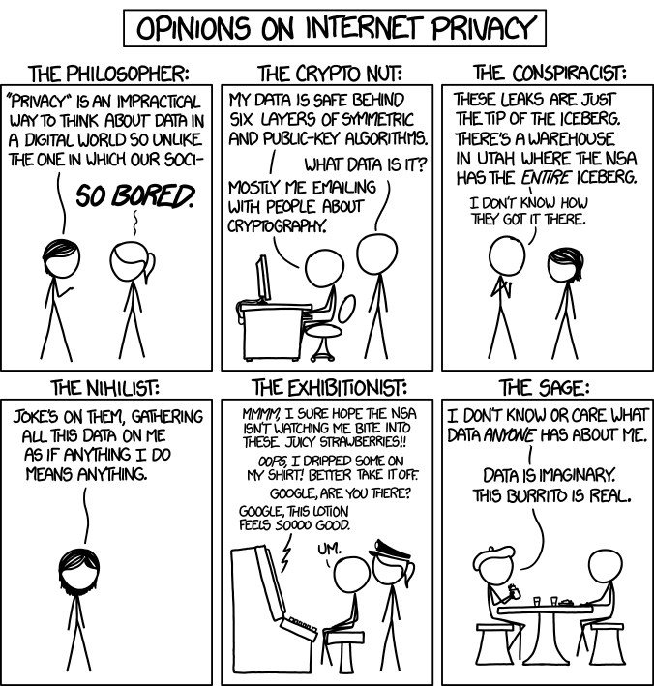
Overview
Review
Assignment
Students Present
http://xkcd.com/1269/
Notes:
1 – Accessed 2014-04-14
Personal Information Privacy

Slide 4
My Reading Notes
pp. 231 Moral capitol – 1984?
pp. 237 “…privacy…in their own homes…” != nanny to expect privacy “…when… insides Sullivans home.
pp. 245 Web Browsers put cookies on on your hard drive, not Web Servers.
pp. 249 why is assumption flawed?
pp. 251 Are call records really a “social network”?
pp. 255 Why does Apple not enforce policy of asking permission in the API?
pp. 256 5. 2003 is a while ago.
pp. 267 Does not answer first question.

Slide 5
Assignment
One Page Paper
Would a National ID System be a good thing?
  One acceptable approach is to show the argument in the book for the position opposite to your conclusion is a weak argument.
  Feel free to reference or build upon your self search work if it helps your argument.

Slide 6
Overview
Review
Assignment
Students Present

Slide 7

Cookies and privacy
Robert Edwards
HTTP Cookies
  Session/Transient cookies
  Persistent cookies
Flash Cookies
  Not controlled by browser
http://www8.pcmag.com/media/images/237640-flash-cookie-cop.jpg
Notes:
Cookies and Privacy
Two major cookies that will be covered: HTTP and Flash Cookies (Both touched on in the book so not too much detail)

Slide 8
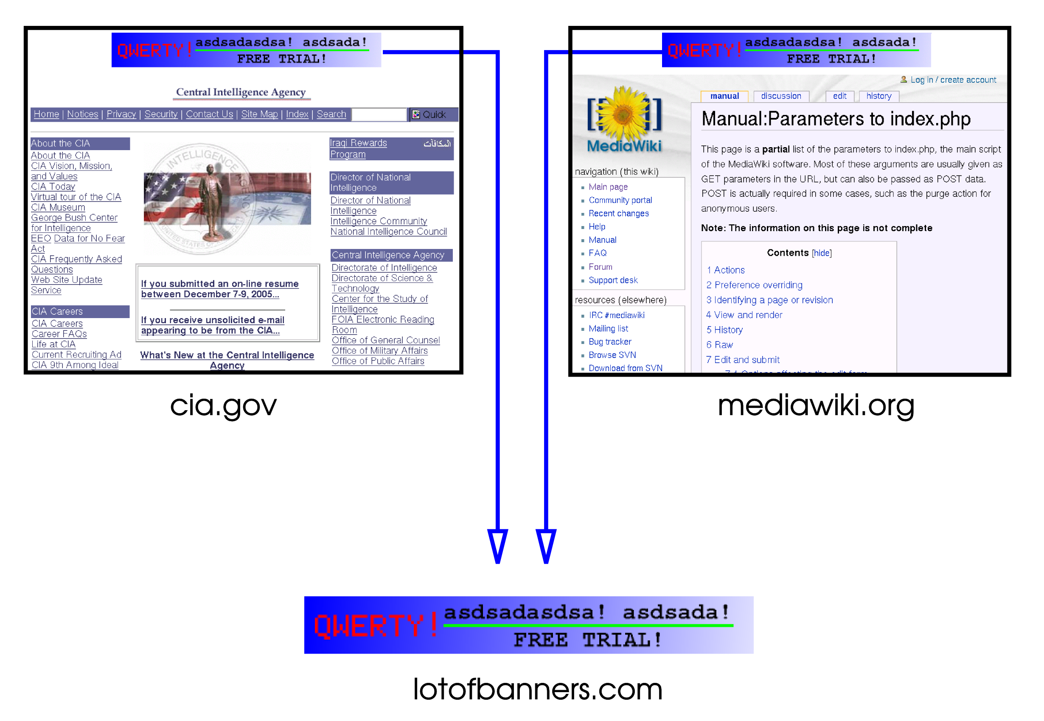
Whose Cookies?
Robert Edwards
First Party cookies
  Generated by the website
  Track across multiple pages
Third Party cookies
  Generated by a party other than the website
  Can get information across multiple sites
http://upload.wikimedia.org/wikipedia/commons/0/0b/Third_party_cookie.png
Notes:
First Party
Generated by the website that you are visited, the domains in the cookie will match the domain of the website. These are generally left unblocked by all browsers, as website interaction will be very dependent on these cookies; first party cookies provide the website information as to who the user accessing the site is, and will allow the user to keep using the website with the same privileges across multiple web pages of the same domain. Websites with any sort of login or shopping cart, information that persists across multiple links, will need these cookies or else the experience is greatly hindered and functionality is lost.
Third Party
Generated by parties and domains other than the website being visited. These cookies are used by third party companies to track user site visits. These cookies will hold information that persists across multiple websites that will employ a cookie from the same party, creating an aggregate profile of the user. These can generally be disabled without removing and website functionality.

Slide 9
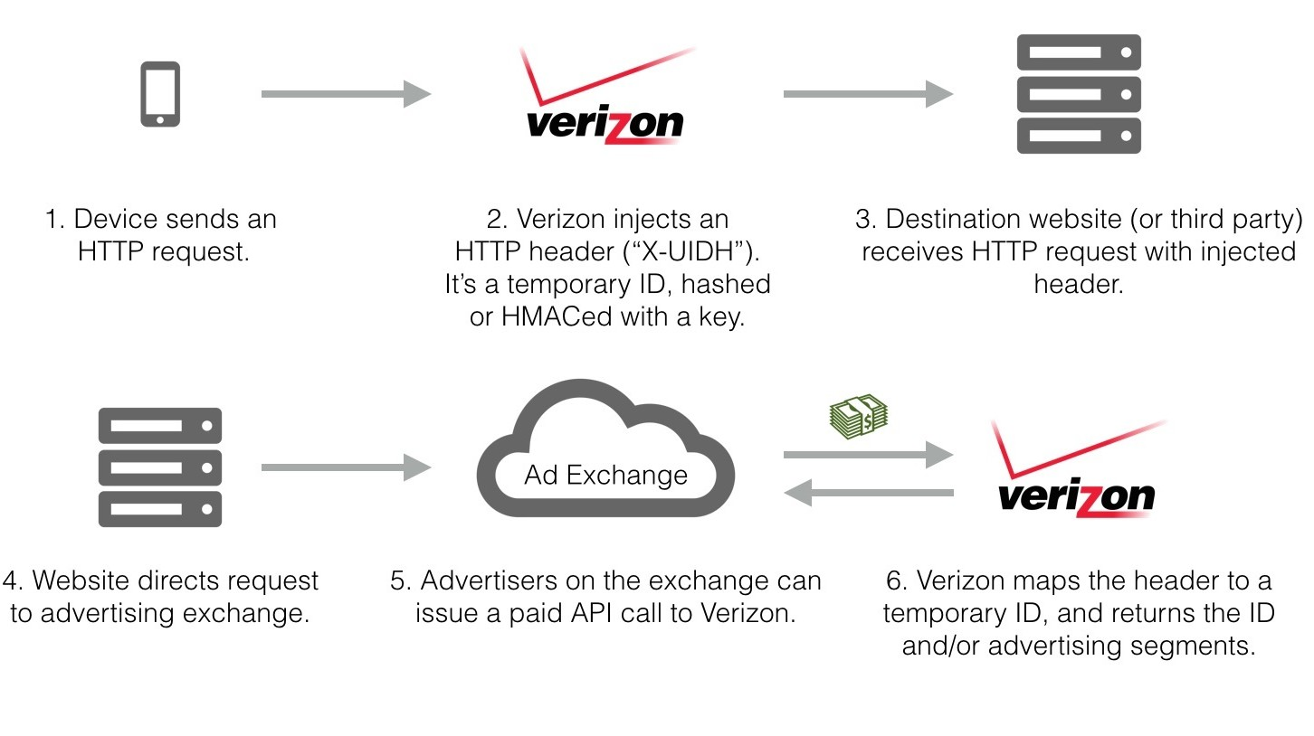
Privacy Concerns
Robert Edwards
Cookie Respawning with Flash
  Committed without consent from the user
  Makes tracking resistant to user
“Permanent cookie”
  Verizon phones use X-UIDH tied to plans
  Opt-out very recently implemented
http://blogs-images.forbes.com/kashmirhill/files/2014/10/How-Verizon-is-tracking-users-web-browsing-e1414523624890.jpg
Notes:
Cookie respawning is an action performed by some flash cookies, where the cookie will regenrate an HTTP browser cookie that may have been cleared or deleted by the user. One of the core complaints against this practice is that automatically generating that cookie is being done without the consent of the user, questioning the validity of the practice and the ethics of doing so. This also makes deleting the cookies themselves much more difficult, as it is compounded by the lack of knowledge of these flash cookies amongst the general userbase of the computer technology, increasing the average length of time that the cookie remains effective in transmitting data.

Slide 10


P3P Policy and EU Regulation
Robert Edwards
P3P designed to facilitate information usage
  Enforced on IE browsers
Not strictly enforced
  ~37% websites faulty policies
  No legal obligation
EU Privacy Policy
  “Cookie Law”
  Not especially effective
http://upload.wikimedia.org/wikipedia/commons/thumb/e/ed/W3C%C2%AE_Icon.svg/2000px-W3C%C2%AE_Icon.svg.png
http://www.bellenews.com/wp-content/uploads/2012/05/Thousands-of-websites-in-Europe-are-expected-to-be-in-breach-of-a-law-that-dictates-what-they-can-log-about-visitors.jpg
Notes:
The P3P is a system for facilitating information usage, meant to streamline the cookie policy process and make it easier for the users to know what their cookies were capable of sending. However, due to the lack of enforcement of the standard as well as the lack of legal obligation, a large number of the P3P policy files for many websites were riddled with syntax errors and incomplete policies. However, due to the way IE handled evaluating these files, many of the cookies from these policies still went through. Along side being difficult to read the exact policies for the average user, P3P was largely disregarded.
In the EU , due to growing concern, a “cookie law” is mandated, requiring companies to display notices to website visitors about their cookie use. However, though in good faith, the idea falls short. Cookie usage is really ubiquitous with websites, and the non-specificity of cookies that require such a notice leads to annoyances rather than reassurances.

Slide 11
Conclusion
Robert Edwards
Very easy for companies to not disclose potential privacy concerns
  Cookies are opt-out rather than opt-in
Efforts to educate average users about these concerns need to be made
  Current efforts merely state “the obvious”
Enforcement is necessary
Notes:
To conclude:
Companies do not have to put in a large amount of effort in disclosing their cookie practices and policies. Like with the UIDH headers that were unknown to Verizon customers and the flash cookie respawning, it’s either hidden in the background or not easily accessible by the average computer user. Many of the practices are opt-out rather than opt-in, making it easier for companies to not provide the full scope.
Users, as a result, are not largely aware of many of these potentially harmful practices. A suggestion is to revise current laws or policies to make it more apparent to users what the cookies can do and how they work. There needs to be a middle ground between briefly mentioning the cookies with no useful information, as with the EU cookie law, and providing a too low-level set of information that most users won’t be able to interpret, as with P3P.
Enforcement of some sort is required. As with the policies mentioned previously, there’s no forcing these companies to comply in any meaningful way. This would mean a reform of some of the current policies and interactions between website and user, which may take some time to implement.

Slide 12
References
Robert Edwards
Ayenson, Mika D., Dietrich J. Wambach, Ashkan Soltani, Nathaniel Good, and Chris J. Hoofnagle. "Flash Cookies and Privacy II: Now with HTML5 and ETag Respawning." Social Science Research Network. N.p., 29 July 2011. Web. 01 Apr. 2015.
Charlton, Graham. "The EU 'cookie Law': What Has It Done for Us?" Econsultancy. N.p., 27 Aug. 2014. Web. 01 Apr. 2015.
Fiscer, Dennis. "Verizon Allows Opt Out of UIDH Mobile Supercookie." Threatpost. N.p., 01 Apr. 2015. Web. 02 Apr. 2015.
Hoffman-Andrews, Jacob. "Verizon Injecting Perma-Cookies to Track Mobile Customers, Bypassing Privacy Controls." Electronic Frontier Foundation. 03 Nov. 2014. Web. 1 Apr. 2015.
Leon, Pedro G., Lorrie F. Cranor, Allecia M. McDonald, and Robert McGuire. "Token Attempt: The Misrepresentation of Website Privacy Policies through the Misuse of P3P Compact Policy Tokens." (2010): 5-6. 06 Jan. 2015. Web. 31 Mar. 2015.

Slide 13

My book, or your book?
Michael Andrews
Should we use Facebook?
Useful tools
Cost of privacy
Questions going forward
Facebook Logo[6]
13
Notes:
Hello everyone, I'm Mike Andrews, and I'd like to present on Facebook. Specifically, on how facebook works, what it gives us, what we give it, and whether we should be using it at all. My argument is that, in the modern age, facebook is a reasonable compromise between utility and privacy.
13

Slide 14

What Facebook gives us
Michael Andrews
Communication
  Instant messages
  Groups
  WWW integration
Social search
  Communities
  Search bar[1]
Like Icon[7]
14
Notes:
Facebook is a social media platform. This means that it provides instant messages, social connections, groups, that it integrates with all of your websites, and that it provides services like social search and image hosting. These things let you find your friends, coordinate groups, keep in touch, and even automatically tag people in albums. You can click a single button on most websites to share media, and you can even log into services with your facebook account. All of these things are expected of a modern social media platform, and you see the same sort of tools in twitter, google+, and others. These tools help us communicate, share, coordinate, and organize ourselves. They are expected of a modern social platform, something that should put our computers and phones to their best possible use for us. All of these tools make facebook invaluable to the techsavy college student.
14

Slide 15

What we give Facebook
Michael Andrews
Who, What, When, Where
  Long-living records
  Potential abuse[2]
Personal data
  Revenue from targeted ads[3]
Locked Like Symbol[8]
15
Notes:
There is a downside to using a service like facebook. By digitalizing our social activities, we build pools of potentially private data that can both be used and abused. Even with an intelligent data privacy policy, data can be leaked, policies can change, and governments can intervene. One of the most troublesome features of personal data is that it can stick around for years or decades, the immediate risk isn't so apparent. Avoiding having this data over our heads is a convincing argument to avoid social networks all together, and there have even been problems in the past about keeping data private. One particular example is when we found out facebook searched our private messages for URLs, and automatically scanned them for "security". These sorts of things may seem minor, but they demonstrate just how not-private our private data is. Facebook's revenue comes from advertisements, both targeted and general. The more targeted an ad becomes, the better they fair, and there is tremendous pressure to datamine our posts, photos, and even messages, searching for relevant information.
While all of these things are scary, they have been happening for over a decade. Ad companies like google have already built robust analytics infrastructures that record most of our online activity and search it for patterns. Half of the ads I see on a daily basis are for WPI or some processor I searched on amazon a few months ago. These privacy concerns are one of the costs of digitization, and given the global trend towards socially-integrated technologies, I believe facebook represents a reasonable utility-to-privacy compromise.
15

Slide 16
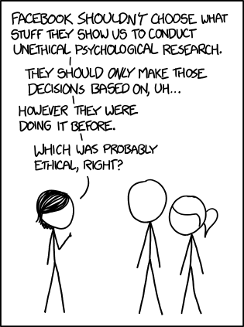
How Facebook affects us
Michael Andrews
Massive adoption[4]
  Network effect
  Unification
Social organization
  Ease of use
  Dependence
Example
  Newsfeeds hurt lives[5]
XKCD “Research Ethics”[9]
16
Notes:
Facebook has a weird impact on our real lives. Because everyones' dog, cat, and grandma have an account, you can search for and message nearly any loose associate, the person three seats to your left or right, or that person you saw talking with your friend that one time two months ago. Because most people use this service, we're close to getting an answer to how to contact someone, gtalk, aim, skype, text, irc, what? By building on a unified architecture, we waste less time fighting with computers and more time doing what we meant to. Beyond mass adoption, facebook has other advantages. Nowadays, it's trivial to make a facebook group, invite your relevant friends, and set up an event from your computer. No email tag, no waiting in IRC, just group communication (and maybe a when-to-meet on the side.) Groups, from your local D&D club to massive companies, use facebook to organize, announce, and keep members up to date on what's happening. As we integrate with facebook's services, we gain its benefits, while becoming more dependent. There are other effects to social media that few ever predicted; facebook recently ran a study that, with slight tweaks to their newsfeed algorithm, they could observe negative posts spreading like a virus. That we are so reliant on a technology that minor tweaks can affect so many so severely is concerning, and it belongs in a long list of ways the internet can make or break each person.
16

Slide 17
In Conclusion
Michael Andrews
Utility outweighs cost
Reasonable privacy compromise for 21st century
Technical dependence inevitable
Any questions?
17
Notes:
In conclusion, technology is scary. We're somewhere nobody has ever been before, and we're only going farther faster. Facebook provides amazing services and acts as an irreplaceable social glue. Like most services today, these create privacy concerns, they affect us in weird ways, and we're still not sure what this means going forward. Facebook is an excellent realization of what technology can do for us, and despite these concerns, I think facebook is more useful than harmful, and that we couldn't stop technology if we tried.
Do I think we should use Facebook? Absolutely. Do I have any idea what future it will bring? I certainly hope not.
Any questions?
17

Slide 18
References
Michael Andrews
[1] Drew Olanoff, “Facebook announces its third pirral 'Graph Search' that gives you answers, not links like google.”, http://techcrunch.com/2013/01/15/facebook-announces-its-third-pillar-graph-search/ (May 28, 2015)
[2] Alexis Kleinman, “Facebook accused of reading private messages, selling data”, http://www.huffingtonpost.com/2014/01/03/facebook-lawsuit-private-messages_n_4536154.html (May 29, 2015)
[3] Nicholas Carlson, “How does Facebook make money?”, http://www.businessinsider.com/how-does-facebook-make-money-2010-5?op=1 (May 30, 2015)
[4] World Geographic Regions, “Facebook users in the world”, http://www.internetworldstats.com/facebook.htm (May 29, 2015)
[5] Chenda Ngak, “Emotions spread through Facebook are contagious, study says”, http://www.cbsnews.com/news/emotions-spread-through-facebook-are-contagious-study-says/ (May 29, 2015)
18

Slide 19
References
Michael Andrews
[6] http://2.bp.blogspot.com/-tvmgENfHanM/U-kriCleTNI/AAAAAAAABvs/Yb5VeHaIgPU/s1600/facebook+logo+vector.png (May 30, 2015)
[7] https://commons.wikimedia.org/wiki/File:Facebook_like_thumb.png (May 30, 2015)
[8] http://www.2dayblog.com/images/2011/november/550x-facebook-privacy-like.jpg (May 30, 2015)
[9] https://imgs.xkcd.com/comics/research_ethics.png (May 30, 2015)
19

Slide 20

Monetizing your personal data
Will Spurgeon
Reward the content creators
Raise awareness of privacy issues
http://www.psfk.com/2014/02/datacoup-sell-personal-data.html (4/2/15)
Notes:
I’m going to discuss how content creators can monetize their personal data, to the benefit of themselves, web services, and advertisers. By empowering people to monetize their own data, people’s awareness of how they are sharing their data should also increase, allowing them to make more meaningful choices about how to share.

Slide 21
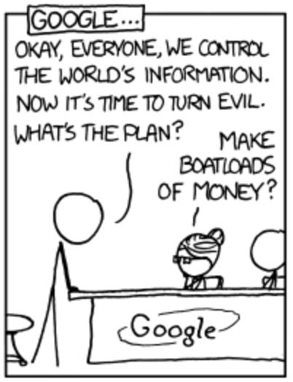
Ways for a firm to make money online
Will Spurgeon
E-commerce – provide a product
Sell ad space [1]
Sell user information to advertising companies
A study by JPMorgan Chase found that each unique user is worth approximately $4 to Facebook and $24 to Google.[2]
http://xkcd.com/792/ (4/3/15)
Notes:
Traditionally, a company can make money online by either selling a product, or by selling advertising space. Large companies like Facebook and Google, sell personal information to advertisers. The first two methods are not particularly profitable for the average user. The third method could be profitable for the user, but currently isn’t. Is this fair to the user?

Slide 22

An unfair system
Will Spurgeon
Companies like Facebook and YouTube profit from its user’s information
Users add value to a social media site, but are not compensated
https://www.facebook.com/advertising/solutions (4/2/15)
Notes:
Personal data is a precious commodity that companies pay handsomely for. Simply, sites turn a profit off of the content that its users provide. Some sites, like Youtube, provide additional services to users that post the best content (i.e. add the most value to the site), but it is extremely hard for the average user to profit from these initiatives.

Slide 23
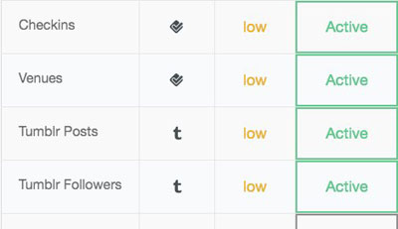
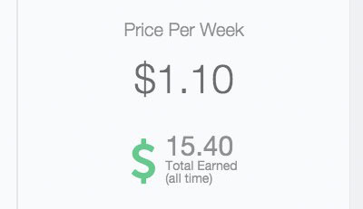
Balancing the scales
Will Spurgeon
Users should receive a portion of advertising profits [3]
Users should be able to choose what information they sell and to whom they sell it
https://datacoup.com/docs#faq (4/2/15)
Notes:
Because the success of advertising is directly tied to the amount of information users provide, they should receive a share of advertising profits. Alternatively, users could sell individual pieces of personal information to specific firms. Advertisers already pay companies like Facebook for user information, why not remove the middle man and buy directly from the source? More money for more information, more money for degree of privacy loss.

Slide 24
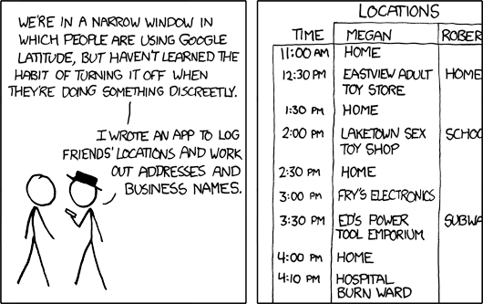
Benefits
Will Spurgeon
Users become more aware of how their personal information is shared
Users may share more of their information
Users may come to expect compensation for their data
http://xkcd.com/596/ (4/3/15)
Notes:
If compensation systems are developed, users may become more aware of how what types of information they are sharing/willing to share. As the comic illustrates, people are not always good at hiding the data they want to hide. They will have to manage their information, and who they sell it to, as opposed to today where they have very little say. Users may also share more data because of the financial incentive. This is great for websites and advertisers. Once a tipping point is reached, users may start to expect meaningful compensation for their data. This would result in a serious paradigm shift for social media sites and users.

Slide 25
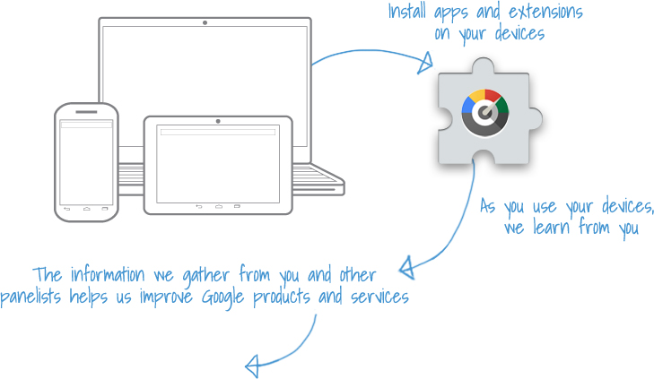
Examples
Will Spurgeon
The Respect Network [4]
Google’s Screenwise Trends Panel [5]
Datacoup [6]
https://www.screenwisetrends.com (4/2/15)
Notes:
Currently, most examples are small or not well-known. Examples of platforms that let users monetize their data include The Respect Network. The Respect Network is a peer-to-peer system that allows users to share information directly with businesses. Users receive a portion of the fees paid by the businesses. Google’s Screenwise Trends Panel asks users to install a plugin that records browser history in exchange for $6 plus $3 a week. (In gift cards, not cash). Datacoup connects with your existing accounts and allows you to sell information to a global market. Currently, only Datacoup is buying information.

Slide 26
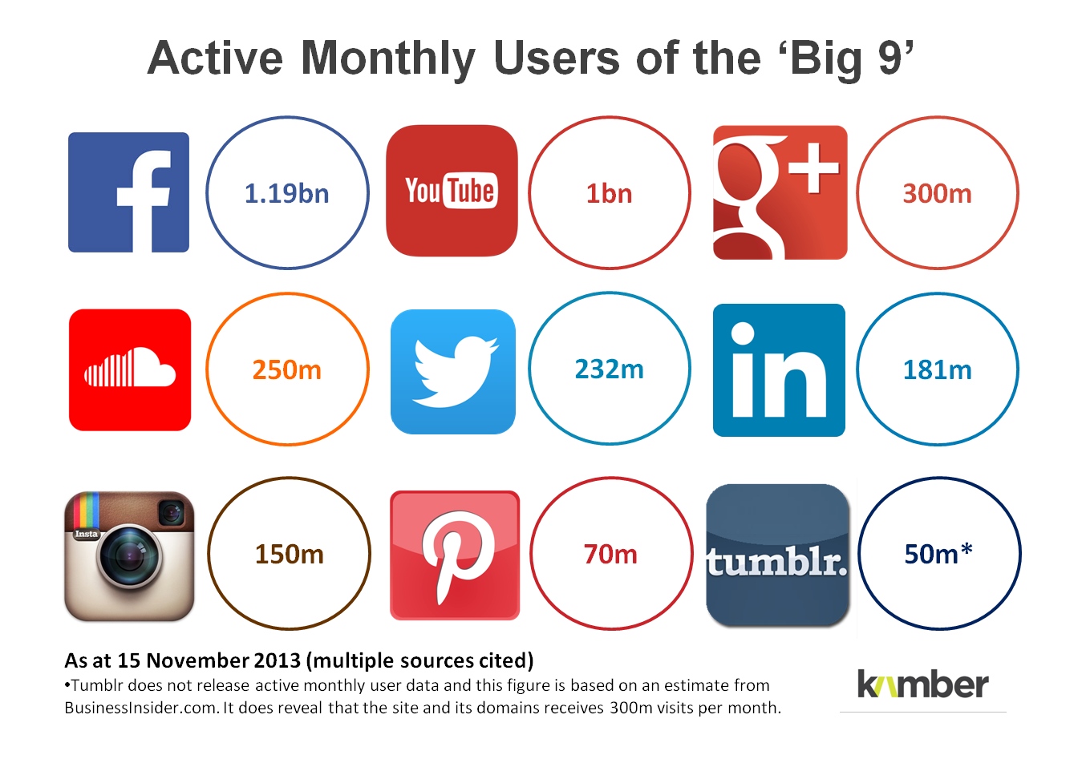
The future
Will Spurgeon
A paradigm shift must occur
None of these solutions can shift the paradigm without a critical mass of users
This is a option worth exploring
https://www.screenwisetrends.com (4/2/15)
Notes:
Moving forward, it is important to be aware that companies are not going to pay their users for information they had traditionally gotten for free unless the users demand it. Right now, Facebook get free information from over a billion people. It’s not going to give that up unless enough users want them to Users must change how we value our personal information. We must stop giving it up for free.

Slide 27
References
Will Spurgeon
[1] Anya Kamenetz, Yes, You Can Monetize Your Own Social Data—Here's How. (http://www.fastcolabs.com/3015091/yes-you-can-monetize-your-own-social-data-heres-how, 4/2/15)
[2] Chao Li, Daniel Yang Li, Gerome Miklau, Dan Suciu. A Theory of Pricing Private Data. (http://cloud-data-pricing.cs.washington.edu/p33-li.pdf, 4/2/15)
[3] Lanier, Jaron. Who Owns the Future? Simon & Schuster Trade Paperback ed. Print.
[4] Respect Network. (https://www.respectnetwork.com/business-model/, 4/2/15)
[5] Google Inc. (https://www.screenwisetrends.com , 4/2/15)
[6] Datacoup, (https://datacoup.com/docs#how-it-works, 4/2/15)

Slide 28
Facebook Privacy - My conclusions
Joshua Morse
By using Facebook, you are agreeing to give up your privacy online
Facebook knows a lot about you
Notes:
Greet everyone
Introduce self
Introduce presentation
Before we begin, how many of you use Facebook?
Now how many of you have read the terms and conditions?
Well no worries I did the research for you
Through my research into Facebook privacy, I’ve come to two conclusions
The Facebook terms and conditions take away your online privacy
And Facebook probably knows a lot more about you than you realize

Slide 29
Terms & Conditions
Joshua Morse
Special Provisions Applicable to Advertisers
If you use our self-service advertising creation interfaces for creation, submission and/or delivery of any advertising or other commercial or sponsored activity or content (collectively, the “Self-Serve Ad Interfaces”), you agree to our Self-Serve Ad Terms. In addition, your advertising or other commercial or sponsored activity or content placed on Facebook or our publisher network will comply with our Advertising Guidelines.
Special Provisions Applicable to Pages
If you create or administer a Page on Facebook, or run a promotion or an offer from your Page, you agree to our Pages Terms.
Special Provisions Applicable to Software
  If you download or use our software, such as a stand-alone software product, an app, or a browser plugin, you agree that from time to time, the software may download and install upgrades, updates and additional features from us in order to improve, enhance, and further develop the software.
  You will not modify, create derivative works of, decompile, or otherwise attempt to extract source code from us, unless you are expressly permitted to do so under an open source license, or we give you express written permission.
Amendments
  We’ll notify you before we make changes to these terms and give you the opportunity to review and comment on the revised terms before continuing to use our Services.
  If we make changes to policies, guidelines or other terms referenced in or incorporated by this Statement, we may provide notice on the Site Governance Page.
  Your continued use of the Facebook Services, following notice of the changes to our terms, policies or guidelines, constitutes your acceptance of our amended terms, policies or guidelines.
Termination
If you violate the letter or spirit of this Statement, or otherwise create risk or possible legal exposure for us, we can stop providing all or part of Facebook to you. We will notify you by email or at the next time you attempt to access your account. You may also delete your account or disable your application at any time. In all such cases, this Statement shall terminate, but the following provisions will still apply: 2.2, 2.4, 3-5, 9.3, and 14-18.
Disputes
  You will resolve any claim, cause of action or dispute (claim) you have with us arising out of or relating to this Statement or Facebook exclusively in the U.S. District Court for the Northern District of California or a state court located in San Mateo County, and you agree to submit to the personal jurisdiction of such courts for the purpose of litigating all such claims. The laws of the State of California will govern this Statement, as well as any claim that might arise between you and us, without regard to conflict of law provisions.
  If anyone brings a claim against us related to your actions, content or information on Facebook, you will indemnify and hold us harmless from and against all damages, losses, and expenses of any kind (including reasonable legal fees and costs) related to such claim. Although we provide rules for user conduct, we do not control or direct users' actions on Facebook and are not responsible for the content or information users transmit or share on Facebook. We are not responsible for any offensive, inappropriate, obscene, unlawful or otherwise objectionable content or information you may encounter on Facebook. We are not responsible for the conduct, whether online or offline, of any user of Facebook.
  WE TRY TO KEEP FACEBOOK UP, BUG-FREE, AND SAFE, BUT YOU USE IT AT YOUR OWN RISK. WE ARE PROVIDING FACEBOOK AS IS WITHOUT ANY EXPRESS OR IMPLIED WARRANTIES INCLUDING, BUT NOT LIMITED TO, IMPLIED WARRANTIES OF MERCHANTABILITY, FITNESS FOR A PARTICULAR PURPOSE, AND NON-INFRINGEMENT. WE DO NOT GUARANTEE THAT FACEBOOK WILL ALWAYS BE SAFE, SECURE OR ERROR-FREE OR THAT FACEBOOK WILL ALWAYS FUNCTION WITHOUT DISRUPTIONS, DELAYS OR IMPERFECTIONS. FACEBOOK IS NOT RESPONSIBLE FOR THE ACTIONS, CONTENT, INFORMATION, OR DATA OF THIRD PARTIES, AND YOU RELEASE US, OUR DIRECTORS, OFFICERS, EMPLOYEES, AND AGENTS FROM ANY CLAIMS AND DAMAGES, KNOWN AND UNKNOWN, ARISING OUT OF OR IN ANY WAY CONNECTED WITH ANY CLAIM YOU HAVE AGAINST ANY SUCH THIRD PARTIES. IF YOU ARE A CALIFORNIA RESIDENT, YOU WAIVE CALIFORNIA CIVIL CODE §1542, WHICH SAYS: A GENERAL RELEASE DOES NOT EXTEND TO CLAIMS WHICH THE CREDITOR DOES NOT KNOW OR SUSPECT TO EXIST IN HIS OR HER FAVOR AT THE TIME OF EXECUTING THE RELEASE, WHICH IF KNOWN BY HIM OR HER MUST HAVE MATERIALLY AFFECTED HIS OR HER SETTLEMENT WITH THE DEBTOR. WE WILL NOT BE LIABLE TO YOU FOR ANY LOST PROFITS OR OTHER CONSEQUENTIAL, SPECIAL, INDIRECT, OR INCIDENTAL DAMAGES ARISING OUT OF OR IN CONNECTION WITH THIS STATEMENT OR FACEBOOK, EVEN IF WE HAVE BEEN ADVISED OF THE POSSIBILITY OF SUCH DAMAGES. OUR AGGREGATE LIABILITY ARISING OUT OF THIS STATEMENT OR FACEBOOK WILL NOT EXCEED THE GREATER OF ONE HUNDRED DOLLARS ($100) OR THE AMOUNT YOU HAVE PAID US IN THE PAST TWELVE MONTHS. APPLICABLE LAW MAY NOT ALLOW THE LIMITATION OR EXCLUSION OF LIABILITY OR INCIDENTAL OR CONSEQUENTIAL DAMAGES, SO THE ABOVE LIMITATION OR EXCLUSION MAY NOT APPLY TO YOU. IN SUCH CASES, FACEBOOK'S LIABILITY WILL BE LIMITED TO THE FULLEST EXTENT PERMITTED BY APPLICABLE LAW
Special Provisions Applicable to Users Outside the United States
We strive to create a global community with consistent standards for everyone, but we also strive to respect local laws. The following provisions apply to users and non-users who interact with Facebook outside the United States:
  You consent to having your personal data transferred to and processed in the United States.
  If you are located in a country embargoed by the United States, or are on the U.S. Treasury Department's list of Specially Designated Nationals you will not engage in commercial activities on Facebook (such as advertising or payments) or operate a Platform application or website. You will not use Facebook if you are prohibited from receiving products, services, or software originating from the United States.
  Certain specific terms that apply only for German users are available here.
Definitions
  By "Facebook" or” Facebook Services” we mean the features and services we make available, including through (a) our website at www.facebook.com and any other Facebook branded or co-branded websites (including sub-domains, international versions, widgets, and mobile versions); (b) our Platform; (c) social plugins such as the Like button, the Share button and other similar offerings; and (d) other media, brands, products, services, software (such as a toolbar), devices, or networks now existing or later developed. Facebook reserves the right to designate, in its sole discretion, that certain of our brands, products, or services are governed by separate terms and not this SRR.
  By "Platform" we mean a set of APIs and services (such as content) that enable others, including application developers and website operators, to retrieve data from Facebook or provide data to us.
  By "information" we mean facts and other information about you, including actions taken by users and non-users who interact with Facebook.
  By "content" we mean anything you or other users post, provide or share using Facebook Services.
  By "data" or "user data" or "user's data" we mean any data, including a user's content or information that you or third parties can retrieve from Facebook or provide to Facebook through Platform.
  By "post" we mean post on Facebook or otherwise make available by using Facebook.
  By "use" we mean use, run, copy, publicly perform or display, distribute, modify, translate, and create derivative works of.
  By "application" we mean any application or website that uses or accesses Platform, as well as anything else that receives or has received data from us. If you no longer access Platform but have not deleted all data from us, the term application will apply until you delete the data.
  By “Trademarks” we mean the list of trademarks provided here.
Other
  If you are a resident of or have your principal place of business in the US or Canada, this Statement is an agreement between you and Facebook, Inc. Otherwise, this Statement is an agreement between you and Facebook Ireland Limited. References to “us,” “we,” and “our” mean either Facebook, Inc. or Facebook Ireland Limited, as appropriate.
  This Statement makes up the entire agreement between the parties regarding Facebook, and supersedes any prior agreements.
  If any portion of this Statement is found to be unenforceable, the remaining portion will remain in full force and effect.
  If we fail to enforce any of this Statement, it will not be considered a waiver.
  Any amendment to or waiver of this Statement must be made in writing and signed by us.
  You will not transfer any of your rights or obligations under this Statement to anyone else without our consent.
  All of our rights and obligations under this Statement are freely assignable by us in connection with a merger, acquisition, or sale of assets, or by operation of law or otherwise.
  Nothing in this Statement shall prevent us from complying with the law.
  This Statement does not confer any third party beneficiary rights.
  We reserve all rights not expressly granted to you.
  You will comply with all applicable laws when using or accessing Facebook.
By using or accessing Facebook Services, you agree that we can collect and use such content and information in accordance with the Data Policy as amended from time to time. You may also want to review the following documents, which provide additional information about your use of Facebook:
Payment Terms: These additional terms apply to all payments made on or through Facebook, unless it is stated that other terms apply.
Platform Page: This page helps you better understand what happens when you add a third-party application or use Facebook Connect, including how they may access and use your data.
Facebook Platform Policies: These guidelines outline the policies that apply to applications, including Connect sites.
Advertising Guidelines: These guidelines outline the policies that apply to advertisements placed on Facebook.
Self-Serve Ad Terms: These terms apply when you use the Self-Serve Ad Interfaces to create, submit, or deliver any advertising or other commercial or sponsored activity or content.
Promotions Guidelines: These guidelines outline the policies that apply if you offer contests, sweepstakes, and other types of promotions on Facebook.
Facebook Brand Resources: These guidelines outline the policies that apply to use of Facebook trademarks, logos and screenshots.
How to Report Claims of Intellectual Property Infringement
Pages Terms: These guidelines apply to your use of Facebook Pages.
Community Standards: These guidelines outline our expectations regarding the content you post to Facebook and your activity on Facebook.
To access the Statement of Rights and Responsibilities in several different languages, change the language setting for your Facebook session by clicking on the language link in the left corner of most pages. If the Statement is not available in the language you select, we will default to the English version.
This agreement was written in English (US). To the extent any translated version of this agreement conflicts with the English version, the English version controls. Please note that Section 16 contains certain changes to the general terms for users outside the United States.
Date of Last Revision: January 30, 2015
Statement of Rights and Responsibilities
This Statement of Rights and Responsibilities ("Statement," "Terms," or "SRR") derives from the Facebook Principles, and is our terms of service that governs our relationship with users and others who interact with Facebook, as well as Facebook brands, products and services, which we call the “Facebook Services” or “Services”. By using or accessing the Facebook Services, you agree to this Statement, as updated from time to time in accordance with Section 13 below. Additionally, you will find resources at the end of this document that help you understand how Facebook works.
Because Facebook provides a wide range of Services, we may ask you to review and accept supplemental terms that apply to your interaction with a specific app, product, or service. To the extent those supplemental terms conflict with this SRR, the supplemental terms associated with the app, product, or service govern with respect to your use of such app, product or service to the extent of the conflict.
Privacy
Your privacy is very important to us. We designed our Data Policy to make important disclosures about how you can use Facebook to share with others and how we collect and can use your content and information. We encourage you to read the Data Policy, and to use it to help you make informed decisions.
Sharing Your Content and Information
You own all of the content and information you post on Facebook, and you can control how it is shared through your privacy and application settings. In addition:
  For content that is covered by intellectual property rights, like photos and videos (IP content), you specifically give us the following permission, subject to your privacy and application settings: you grant us a non-exclusive, transferable, sub-licensable, royalty-free, worldwide license to use any IP content that you post on or in connection with Facebook (IP License). This IP License ends when you delete your IP content or your account unless your content has been shared with others, and they have not deleted it.
  When you delete IP content, it is deleted in a manner similar to emptying the recycle bin on a computer. However, you understand that removed content may persist in backup copies for a reasonable period of time (but will not be available to others).
  When you use an application, the application may ask for your permission to access your content and information as well as content and information that others have shared with you. We require applications to respect your privacy, and your agreement with that application will control how the application can use, store, and transfer that content and information. (To learn more about Platform, including how you can control what information other people may share with applications, read our Data Policy and Platform Page.)
  When you publish content or information using the Public setting, it means that you are allowing everyone, including people off of Facebook, to access and use that information, and to associate it with you (i.e., your name and profile picture).
  We always appreciate your feedback or other suggestions about Facebook, but you understand that we may use your feedback or suggestions without any obligation to compensate you for them (just as you have no obligation to offer them).
Safety
We do our best to keep Facebook safe, but we cannot guarantee it. We need your help to keep Facebook safe, which includes the following commitments by you:
  You will not post unauthorized commercial communications (such as spam) on Facebook.
  You will not collect users' content or information, or otherwise access Facebook, using automated means (such as harvesting bots, robots, spiders, or scrapers) without our prior permission.
  You will not engage in unlawful multi-level marketing, such as a pyramid scheme, on Facebook.
  You will not upload viruses or other malicious code.
  You will not solicit login information or access an account belonging to someone else.
  You will not bully, intimidate, or harass any user.
  You will not post content that: is hate speech, threatening, or pornographic; incites violence; or contains nudity or graphic or gratuitous violence.
  You will not develop or operate a third-party application containing alcohol-related, dating or other mature content (including advertisements) without appropriate age-based restrictions.
  You will not use Facebook to do anything unlawful, misleading, malicious, or discriminatory.
  You will not do anything that could disable, overburden, or impair the proper working or appearance of Facebook, such as a denial of service attack or interference with page rendering or other Facebook functionality.
  You will not facilitate or encourage any violations of this Statement or our policies.
Registration and Account Security
Facebook users provide their real names and information, and we need your help to keep it that way. Here are some commitments you make to us relating to registering and maintaining the security of your account:
  You will not provide any false personal information on Facebook, or create an account for anyone other than yourself without permission.
  You will not create more than one personal account.
  If we disable your account, you will not create another one without our permission.
  You will not use your personal timeline primarily for your own commercial gain, and will use a Facebook Page for such purposes.
  You will not use Facebook if you are under 13.
  You will not use Facebook if you are a convicted sex offender.
  You will keep your contact information accurate and up-to-date.
  You will not share your password (or in the case of developers, your secret key), let anyone else access your account, or do anything else that might jeopardize the security of your account.
  You will not transfer your account (including any Page or application you administer) to anyone without first getting our written permission.
  If you select a username or similar identifier for your account or Page, we reserve the right to remove or reclaim it if we believe it is appropriate (such as when a trademark owner complains about a username that does not closely relate to a user's actual name).
Protecting Other People's Rights
We respect other people's rights, and expect you to do the same.
  You will not post content or take any action on Facebook that infringes or violates someone else's rights or otherwise violates the law.
  We can remove any content or information you post on Facebook if we believe that it violates this Statement or our policies.
  We provide you with tools to help you protect your intellectual property rights. To learn more, visit our How to Report Claims of Intellectual Property Infringement page.
  If we remove your content for infringing someone else's copyright, and you believe we removed it by mistake, we will provide you with an opportunity to appeal.
  If you repeatedly infringe other people's intellectual property rights, we will disable your account when appropriate.
  You will not use our copyrights or Trademarks or any confusingly similar marks, except as expressly permitted by our Brand Usage Guidelines or with our prior written permission.
  If you collect information from users, you will: obtain their consent, make it clear you (and not Facebook) are the one collecting their information, and post a privacy policy explaining what information you collect and how you will use it.
  You will not post anyone's identification documents or sensitive financial information on Facebook.
  You will not tag users or send email invitations to non-users without their consent. Facebook offers social reporting tools to enable users to provide feedback about tagging.
Mobile and Other Devices
  We currently provide our mobile services for free, but please be aware that your carrier's normal rates and fees, such as text messaging and data charges, will still apply.
  In the event you change or deactivate your mobile telephone number, you will update your account information on Facebook within 48 hours to ensure that your messages are not sent to the person who acquires your old number.
  You provide consent and all rights necessary to enable users to sync (including through an application) their devices with any information that is visible to them on Facebook.
Payments
If you make a payment on Facebook, you agree to our Payments Terms unless it is stated that other terms apply.
Special Provisions Applicable to Developers/Operators of Applications and Websites
If you are a developer or operator of a Platform application or website or if you use Social Plugins, you must comply with the Facebook Platform Policy.
About Advertisements and Other Commercial Content Served or Enhanced by Facebook
Our goal is to deliver advertising and other commercial or sponsored content that is valuable to our users and advertisers. In order to help us do that, you agree to the following: You give us permission to use your name, profile picture, content, and information in connection with commercial, sponsored, or related content (such as a brand you like) served or enhanced by us. This means, for example, that you permit a business or other entity to pay us to display your name and/or profile picture with your content or information, without any compensation to you. If you have selected a specific audience for your content or information, we will respect your choice when we use it.
We do not give your content or information to advertisers without your consent.
You understand that we may not always identify paid services and communications as such.
Notes:
Here is Facebook’s terms and conditions, presented in a completely readable 3 point font
Don’t worry, I’m not going to recite it to you
The only part that I’m going to focus on today is the part in green

Slide 30
Terms & Conditions
Joshua Morse
Privacy
“Your privacy is very important to us. We designed our Data Policy to make important disclosures about how you can use Facebook to share with others and how we collect and can use your content and information. We encourage you to read the Data Policy, and to use it to help you make informed decisions.”
Notes:
This is the part of the Terms and Conditions that was highlighted in the previous slide.
As you can see, it doesn’t really say much about you privacy, but instead redirects you to a different policy.
I hope you see where this is going.

Slide 31
Data Policy
Joshua Morse
What kinds of information do we collect?
Depending on which Services you use, we collect different kinds of information from or about you.
Things you do and information you provide.
We collect the content and other information you provide when you use our Services, including when you sign up for an account, create or share, and message or communicate with others. This can include information in or about the content you provide, such as the location of a photo or the date a file was created. We also collect information about how you use our Services, such as the types of content you view or engage with or the frequency and duration of your activities.
Things others do and information they provide.
We also collect content and information that other people provide when they use our Services, including information about you, such as when they share a photo of you, send a message to you, or upload, sync or import your contact information.
Your networks and connections.
We collect information about the people and groups you are connected to and how you interact with them, such as the people you communicate with the most or the groups you like to share with. We also collect contact information you provide if you upload, sync or import this information (such as an address book) from a device.
Information about payments.
If you use our Services for purchases or financial transactions (like when you buy something on Facebook, make a purchase in a game, or make a donation), we collect information about the purchase or transaction. This includes your payment information, such as your credit or debit card number and other card information, and other account and authentication information, as well as billing, shipping and contact details.
Device information.
We collect information from or about the computers, phones, or other devices where you install or access our Services, depending on the permissions you’ve granted. We may associate the information we collect from your different devices, which helps us provide consistent Services across your devices. Here are some examples of the device information we collect:
Attributes such as the operating system, hardware version, device settings, file and software names and types, battery and signal strength, and device identifiers.
Device locations, including specific geographic locations, such as through GPS, Bluetooth, or WiFi signals.
Connection information such as the name of your mobile operator or ISP, browser type, language and time zone, mobile phone number and IP address.
Information from websites and apps that use our Services.
We collect information when you visit or use third-party websites and apps that use our Services (like when they offer our Like button or Facebook Log In or use our measurement and advertising services). This includes information about the websites and apps you visit, your use of our Services on those websites and apps, as well as information the developer or publisher of the app or website provides to you or us.
Information from third-party partners.
We receive information about you and your activities on and off Facebook from third-party partners, such as information from a partner when we jointly offer services or from an advertiser about your experiences or interactions with them.
Facebook companies.
We receive information about you from companies that are owned or operated by Facebook, in accordance with their terms and policies. Learn more about these companies and their privacy policies.
Return to top
How do we use this information?
We are passionate about creating engaging and customized experiences for people. We use all of the information we have to help us provide and support our Services. Here’s how:
Provide, improve and develop Services.
We are able to deliver our Services, personalize content, and make suggestions for you by using this information to understand how you use and interact with our Services and the people or things you’re connected to and interested in on and off our Services.
We also use information we have to provide shortcuts and suggestions to you. For example, we are able to suggest that your friend tag you in a picture by comparing your friend's pictures to information we've put together from your profile pictures and the other photos in which you've been tagged. If this feature is enabled for you, you can control whether we suggest that another user tag you in a photo using the “Timeline and Tagging” settings.
When we have location information, we use it to tailor our Services for you and others, like helping you to check-in and find local events or offers in your area or tell your friends that you are nearby.
We conduct surveys and research, test features in development, and analyze the information we have to evaluate and improve products and services, develop new products or features, and conduct audits and troubleshooting activities.
Communicate with you.
We use your information to send you marketing communications, communicate with you about our Services and let you know about our policies and terms. We also use your information to respond to you when you contact us.
Show and measure ads and services.
We use the information we have to improve our advertising and measurement systems so we can show you relevant ads on and off our Services and measure the effectiveness and reach of ads and services. Learn more about advertising on our Services and how you can control how information about you is used to personalize the ads you see.
Promote safety and security.
We use the information we have to help verify accounts and activity, and to promote safety and security on and off of our Services, such as by investigating suspicious activity or violations of our terms or policies. We work hard to protect your account using teams of engineers, automated systems, and advanced technology such as encryption and machine learning. We also offer easy-to-use security tools that add an extra layer of security to your account. For more information about promoting safety on Facebook, visit the Facebook Security Help Center.
We use cookies and similar technologies to provide and support our Services and each of the uses outlined and described in this section of our policy. Read our Cookie Policy to learn more.
Return to top
How is this information shared?
Sharing On Our Services
People use our Services to connect and share with others. We make this possible by sharing your information in the following ways:
People you share and communicate with.
When you share and communicate using our Services, you choose the audience who can see what you share. For example, when you post on Facebook, you select the audience for the post, such as a customized group of individuals, all of your Friends, or members of a Group. Likewise, when you use Messenger, you also choose the people you send photos to or message.
Public information is any information you share with a public audience, as well as information in your Public Profile, or content you share on a Facebook Page or another public forum. Public information is available to anyone on or off our Services and can be seen or accessed through online search engines, APIs, and offline media, such as on TV.
In some cases, people you share and communicate with may download or re-share this content with others on and off our Services. When you comment on another person’s post or like their content on Facebook, that person decides the audience who can see your comment or like. If their audience is public, your comment will also be public.
People that see content others share about you.
Other people may use our Services to share content about you with the audience they choose. For example, people may share a photo of you, mention or tag you at a location in a post, or share information about you that you shared with them. If you have concerns with someone’s post, social reporting is a way for people to quickly and easily ask for help from someone they trust. Learn More.
Apps, websites and third-party integrations on or using our Services.
When you use third-party apps, websites or other services that use, or are integrated with, our Services, they may receive information about what you post or share. For example, when you play a game with your Facebook friends or use the Facebook Comment or Share button on a website, the game developer or website may get information about your activities in the game or receive a comment or link that you share from their website on Facebook. In addition, when you download or use such third-party services, they can access your Public Profile, which includes your username or user ID, your age range and country/language, your list of friends, as well as any information that you share with them. Information collected by these apps, websites or integrated services is subject to their own terms and policies.
Learn more about how you can control the information about you that you or others share with these apps and websites.
Sharing within Facebook companies.
We share information we have about you within the family of companies that are part of Facebook. Learn more about our companies.
New owner.
If the ownership or control of all or part of our Services or their assets changes, we may transfer your information to the new owner.
Sharing With Third-Party Partners and Customers
We work with third party companies who help us provide and improve our Services or who use advertising or related products, which makes it possible to operate our companies and provide free services to people around the world.
Here are the types of third parties we can share information with about you:
Advertising, Measurement and Analytics Services (Non-Personally Identifiable Information Only).
We want our advertising to be as relevant and interesting as the other information you find on our Services. With this in mind, we use all of the information we have about you to show you relevant ads. We do not share information that personally identifies you (personally identifiable information is information like name or email address that can by itself be used to contact you or identifies who you are) with advertising, measurement or analytics partners unless you give us permission. We may provide these partners with information about the reach and effectiveness of their advertising without providing information that personally identifies you, or if we have aggregated the information so that it does not personally identify you. For example, we may tell an advertiser how its ads performed, or how many people viewed their ads or installed an app after seeing an ad, or provide non-personally identifying demographic information (such as 25 year old female, in Madrid, who likes software engineering) to these partners to help them understand their audience or customers, but only after the advertiser has agreed to abide by our advertiser guidelines.
Please review your advertising preferences to understand why you’re seeing a particular ad on Facebook. You can adjust your ad preferences if you want to control and manage your ad experience on Facebook.
Vendors, service providers and other partners.
We transfer information to vendors, service providers, and other partners who globally support our business, such as providing technical infrastructure services, analyzing how our Services are used, measuring the effectiveness of ads and services, providing customer service, facilitating payments, or conducting academic research and surveys. These partners must adhere to strict confidentiality obligations in a way that is consistent with this Data Policy and the agreements we enter into with them.
Return to top
How can I manage or delete information about me?
You can manage the content and information you share when you use Facebook through the Activity Log tool. You can also download information associated with your Facebook account through our Download Your Information tool.
We store data for as long as it is necessary to provide products and services to you and others, including those described above. Information associated with your account will be kept until your account is deleted, unless we no longer need the data to provide products and services.
You can delete your account any time. When you delete your account, we delete things you have posted, such as your photos and status updates. If you do not want to delete your account, but want to temporarily stop using Facebook, you may deactivate your account instead. To learn more about deactivating or deleting your account, click here. Keep in mind that information that others have shared about you is not part of your account and will not be deleted when you delete your account.
Return to top
How do we respond to legal requests or prevent harm?
We may access, preserve and share your information in response to a legal request (like a search warrant, court order or subpoena) if we have a good faith belief that the law requires us to do so. This may include responding to legal requests from jurisdictions outside of the United States where we have a good faith belief that the response is required by law in that jurisdiction, affects users in that jurisdiction, and is consistent with internationally recognized standards. We may also access, preserve and share information when we have a good faith belief it is necessary to: detect, prevent and address fraud and other illegal activity; to protect ourselves, you and others, including as part of investigations; or to prevent death or imminent bodily harm. For example, we may provide information to third-party partners about the reliability of your account to prevent fraud and abuse on and off of our Services. Information we receive about you, including financial transaction data related to purchases made with Facebook, may be accessed, processed and retained for an extended period of time when it is the subject of a legal request or obligation, governmental investigation, or investigations concerning possible violations of our terms or policies, or otherwise to prevent harm. We also may retain information from accounts disabled for violations of our terms for at least a year to prevent repeat abuse or other violations of our terms.
Return to top
How our global services operate
Facebook, Inc. complies with the US-EU and US-Swiss Safe Harbor framework for the collection, use and retention of information from the European Union and Switzerland, as set out by the Department of Commerce. To view our certification, visit the Safe Harbor website.
As part of our participation in the Safe Harbor program, we will resolve disputes you have with us in connection with our policies and practices through TRUSTe. You can contact TRUSTe through their website.
Facebook may share information internally within our family of companies or with third parties for purposes described in this policy. Information collected within the European Economic Area (“EEA”) may, for example, be transferred to countries outside of the EEA for the purposes as described in this policy.
Return to top
How will we notify you of changes to this policy?
We’ll notify you before we make changes to this policy and give you the opportunity to review and comment on the revised policy before continuing to use our Services.
Return to top
How to contact Facebook with questions
To learn more about how privacy works on Facebook, please check out Privacy Basics. If you have questions about this policy, here’s how you can reach us:
Notes:
Another wall of text! This entire document is actually relevant to what I want to say today.
I’ll briefly summarize the things that are contained in this document for you.

Slide 32
What data Facebook collects
Joshua Morse
Account details
Liked pages
Things you post
Pages you view
Pages your friends like/view
Frequency or duration of use
Messages you send
Contact information
What you look like
How often you interact with your friends
Info about your computer/devices
Location and ISP
Information about your activity off of Facebook
Notes:
Found in the data policy are all these different types of things that Facebook collects
They collect a few other things not listed here but I tried to get the important ones
The big ones that I want to point out are the ones colored in yellow
Facebook has face recognition software that can tell who you are in pictures.
Also Facebook can track your activity OUTSIDE of Facebook, namely on other sites, even if you don’t have Facebook open. I’ll tell you how.

Slide 33
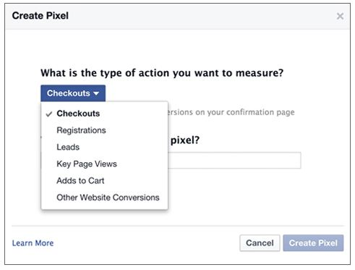
Tracking Pixels
Joshua Morse
Embedded 1x1 gif image
Sends information to Facebook about your visit on third party websites
New as of 2014
Source: https://www.facebook.com/help/435189689870514/
Notes:
Tracking pixels!
Websites that want to advertise to you on Facebook use these things.
These pixels are html additions to websites that are invisible to the user but allow Facebook to see what you are doing on other websites.
They work by sending a get request to a Facebook server with whatever information they feel necessary to include for the action you did.
They link it to your account by linking it with the tracking cookie that Facebook places in your cookies.
They send information like what the website is, what page you are on, and what you are looking at.
Facebook of course keeps a log of all of these activities.
This is a relatively new thing that Facebook has implemented.

Slide 34

What does Facebook do with the data
Joshua Morse
Provide, improve, and develop services
Communicate with you
Promote safety and security
Show and measure ads and services
Source: https://www.facebook.com/
Notes:
So now that Facebook has all this data, what do they do with it?
Well they do a lot of things. Thankfully one of them is not giving it freely to third parties.
Since Facebook is a business, their biggest motivator is advertising. Whatever makes them the most money.
They are able to use all this information that they track to focus their advertising to net the highest profit for the people they are advertising for
As a result, Facebook gets a bigger slice of change for it.

Slide 35
What you can do
Joshua Morse
Here are your options
Quit Facebook
Complain loudly, but do nothing
Go to the Digital Advertising Alliance website and apply a no-tracking cookie to your browser
Notes:
What can you do to not be followed around the web?
Really the only option you are given is to go to a third party website and “opt-out” of being tracked.

Slide 36
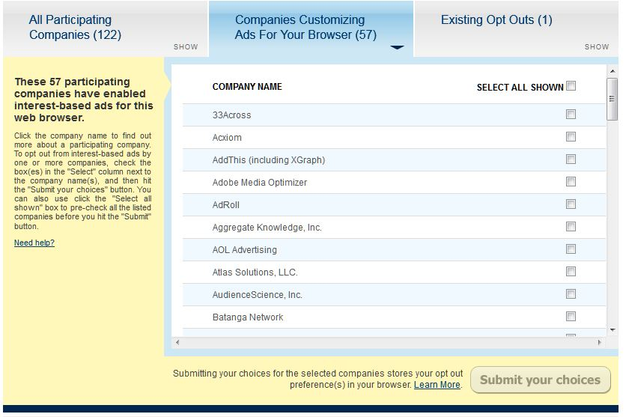
Digital Advertising Alliance
Source: www.aboutads.info/choices/
Notes:
Here at the Digital Advertising Alliance page, you can opt-out of select companies being able to track you.
This makes it easy to opt-out of not only Facebook tracking you, but a whole lot more.
You must do this for every web browser and device you use, as it is saved as a cookie.
If you delete your cookies, you delete the opt-out.
There are plugins you can download that can reapply this cookie automatically whenever you delete your cookies so you don’t have to worry about it.

Slide 37
Summary
Facebook is tracking you
You signed up for it
It may be creepy, but it is legal
Notes:
In summary of all I just presented to you, Facebook knows a lot about you, about me, and about your friends.
Facebook is using this to target advertisements to make money.

Slide 38
References
Joshua Morse
[1] https://www.facebook.com/business/a/online-sales/conversion-tracking
[2] http://adage.com/article/digital/facebook-web-browsing-history-ad-targeting/293656/
[3] http://www.aboutads.info/choices/
[4] https://www.facebook.com/settings?tab=ads
[5] http://www.propublica.org/article/its-complicated-facebooks-history-of-tracking-you
[6] http://www.wsj.com/articles/what-you-can-do-about-facebook-tracking-1407263246
[7] http://venturebeat.com/2014/10/06/the-cookie-is-dead-heres-how-facebook-google-and-apple-are-tracking-you-now/
[8] https://www.abine.com/blog/2014/facebook-tracking-browsing/
[9] https://www.facebook.com/policy.php
[10] http://support.hasoffers.com/hc/en-us/articles/202266873-Pixel-Tracking
All references were accessed on April 1st
Notes:
-references-

Slide 39
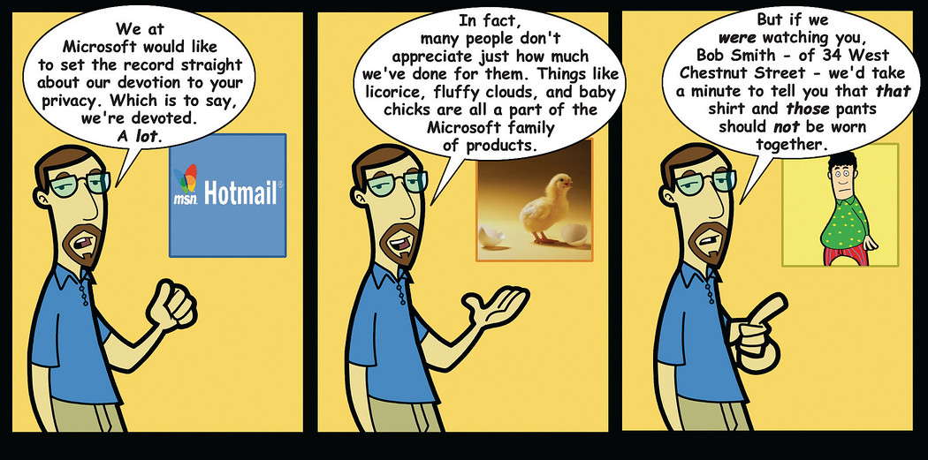
Gaming privacy
Chris Hanna
Penny Arcade [0]
Notes:
Introduce yourself! I’ll be giving a quick talk on what your privacy looks like when it comes to video games. I’ll mostly be focusing on PC gaming, and leaving the world of mobile computing out of the picture. Obviously mobile gaming is a huge topic in privacy, but I found that PC gaming was already big enough for one talk. I’m going to be talking about different examples of gamers losing their private data. There have been many breaches of privacy that you may not of heard of.
As we’ve been discussing, the Right to Privacy is important, including your digital privacy. Nefarious people can gleam a lot about you from your digital footprint
Give people a moment to read the comic

Slide 40
Who and What is at risk?
Chris Hanna
60% of Americans are Gamers [1]
Their privacy is at risk!
  Physical location
  Personal Information
    Name
    Address
    Email
    Credit Card
    Passwords
    Data
?
Notes:
So, when it comes to gaming privacy, who and what am I talking about?
It happens that just over 60% of Americans play video games. The average age of a game consumer is about 31. So, a lot of people who play video games have a lot of personal information.
And that is all at risk!
When you game online, or even offline, you wouldn’t want your geographical location, your name, your home address, your email, your credit card, your passwords, your user names, your whatever, to spill out over the internet.
But as it happens, people do lose this information. Its happening more and more.
Obviously, this is a huge privacy issue.

Slide 41



Who is preying upon us gamers?
Chris Hanna
Hacker Groups
Game Producers
Other Gamers
Notes:
Who is responsible?!
A couple of major groups are the primary drivers. First and foremost, there are various hacker groups, like Anonymous or Lulzsacs, that are out to rob corporate America. They have it in for the MAN and by releasing all your data to the world, they can make the MAN look bad. To them, the MAN is usually a big corporation, like Microsoft or Sony.
The next group is the MAN himself. Game *developers* don’t seem to be responsible for this, but game *publishers* have a somewhat distressing trackrecord of being sleezy with their customer’s information. They may just sell your information to the highest bidder.
Finally, there are angry people out there on the internet, bent on ruining your day.
I’ll talk about three of these groups throughout my talk.

Slide 42
Has anything serious happened?
Chris Hanna
  Sadly, yes. Quite a lot of things.
Massive hacks from Anon and Lulzsec
Alarming software bugs
Sinister ELUA and suspicious software
Rage filled acts of aggression
!!!
Notes:
There have already been more than a few cases of some major incidents in personal data leakage through video games.
Those hacker groups have been trying to swarm large companies like Sony and Microsoft.
There are some pretty astonishing software bugs in huge programs like EA’s Origin and Steam that leave you open to attacks.
Like I said before, some of the big name companies seem to have some slimey wordings in their privacy policies and EULA that leave the door open for them to swing your information about.
And again, like I said in the last slide, there have been some cases were people on the internet of done horrible things to one another due to video game mishaps.

Slide 43
Hackers leak data
Chris Hanna
2011
Lulzsec brings down PSN for over 3 weeks [2]
  Affects around 77 million users
2012
Hackers break into Blizzard, stealing personal data [3]
2014
Anonymous releases login credentials and credit card info for a variety of services, including several video games [4]
  Over 13,000 credentials shared
Notes:
Games have been getting hacked for years.
Probably since 1999 when CounterStrike first came out, people have been messing with each other over the internet and breaking the rules of the game. While that’s annoying and frustrating, the first video game hacks weren’t so much privacy invasions, and more just a nuisance.
However, as of recently, some major hacker groups have begun bombarding big software companies, video game companies included. In 2011, Lulzsec broke into Sony’s PlayStation Network and gained access to an estimated 77 million user accounts.
Inside a user account, were names, emails, passwords, security questions, and possible financial info. That was huge. You probably remember hearing about it. Sony took the PSN offline for about 3 weeks, until they were sure that they had nabbed the security flaw.
In 2012, some hackers broke into Blizzard’s servers and grabbed some more personal data. Online badguys have been stealing Blizzard’s customer info for years. For as long as World of Warcraft has been out, people have had their accounts looted and stolen from them. Blizzard is always cooking up new protection methods, but accounts can still be broken into.
In 2014, Anon managed to gather the logon credentials for a whole bunch of websites and video games services. Along with each login credential, came an associated credit card. Anon released 13,000 of these.

Slide 44

Software bugs
Chris Hanna
Bugs are what leave software vulnerable to hackers
Origin is unintentionally spying on you [8]
URI Handlers can be twisted to launch malicious code on an unsuspecting users [5]
  Steam:// or origin:// addresses
  Crash your computer, run a random DLL, collect your data
ReVuln [5]
Notes:
The way that people are able to take advantage of software, and steal personal information, is usually due to a software bug, or an undiscovered security flaw.
It comes down to software, and sometimes it can have some pretty remarkable bugs.
For example, in 2014, EA’s Origin service was silently monitoring your web browsing. When asked about it, the lead guy in charge had no idea it was happening. Weather it was the strangest bug in the world, or an inside job, who knows.
In another case, back in 2012, a research group called ReVuln found new sinister ways to use Steam and Origin. Both products register with your OS as URI Handlers, which means if you get some link that starts with steam:// or origin://, your browser will simply redirect it steam or origin. Usually this is used if you are trying to launch a game from a browser. ReVoln found a way to create a bad link that could lodge a .bat file in your startup folder, and then the sky is the limit for what horrible nasty terrible thing it could do you, or what information it could steal. If you’re interested, check it out. They have a video demonstration of it working, where in the end, that squirrel tells you got pwned.

Slide 45

Software “Features”
Chris Hanna
Blizzard Real ID [6]
  Lets Starcraft2 players import their FaceBook friends straight into Battle.NET
XBOX Kinect ‘Always On’ [7]
  Allows users to issue voice commands all the time
Blizzard Warden [9]
  Monitors your RAM whilst you play games
2001 A Space Odyssey
Notes:
So, besides software BUGS, some software has… FEATURES.
A few years back, Blizzard tried to start a program called real ID. It was right as Starcraft 2 was coming out. Blizzard wanted their users to be able to import their friends from facebook into the game’s own contact system, called battle.NET. The way they were going to implement this was by having their fans have real ID’s, or, their real names instead of their silly usernames. This caused a huge outcry from all their fans. They got rid of it pretty quick.
Then, recently, when Microsoft announced the XboxONE, it said that there would also be an ‘always on’ Kinect. The goal of the ‘always on’ bit was so that the Xbox could process voice commands, even when it was supposed to be off. It’s a cool idea, but the possibility of privacy invansion was too much for the public to bare. Everyone went bezerk, and Microsoft changed its policy on the matter.
Lastly, back to Blizzard. To prevent cheating in all of their online games, like Starcraft, Diablo, and World of Warcraft, they have a piece of software called Warden, that launches in the background, and sends messages to Blizzard HQ, telling them about whats in your RAM. Again, this is a cool idea, but the possibility of things going horribly wrong is enormous. Blizzard is still using Warden, even though it could definitely be considered spyware.

Slide 46
Sinister Companies
Chris Hanna
“WHEN RUNNING, THE GAME MAY MONITOR YOUR COMPUTER'S RANDOM ACCESS MEMORY (RAM) AND/OR CPU PROCESSES” – Blizzard [9]
“Valve may share anonymous data, aggregated or not, with third parties.” – Steam [10]
“EA may collect, use, store and transmit technical and related information that identifies your computer, operating system, Application usage (including but not limited to successful installation and/or removal), software, software usage and peripheral hardware.” – EA Origin [11]
Notes:
The Blizzard privacy agreement actually says exactly what it will do, so its not LYING to you, its just being creepy.
Some other companies also have some unsettling messages in their privacy agreements.
Steam says that it won’t send your personal data to third parties, but that it doesn’t have a problem selling anonymous data. Its anonymous, but thanks to things like data mining, there is a good chance it could be linked back to an individual.
EA’s Origin has a wonderful line too. It’s just saying that they can do whatever they want with data they get while you play their games.

Slide 47

Crazy people from the internet
Chris Hanna
IP Address Tracking
  130.215.24.224 = RTR-CORE-FULLER.INF.WPI.EDU
Julien Barreaux [12]
  Tracked and stabbed a man who bested him in CounterStrike
Paul Horner [13]
  First person convicted of swatting.
  25 years in prison
  15 years old
South Park
Notes:
Okay, so finally, the last group of people out to get you, are crazy people from the internet.
When you’re playing a game online, chances are that your IP is visible to other players.
The IP address can be used to track your current location, to a fair amount of precision. For example, I was in Fuller yesterday, when to my.ip, got an address, then punched it into a reverse lookup site, and got FULLER.INF.WPI.EDU. It wouldn’t be enough to put me in a particular room, but its still pretty good.
There are people who have used IP tracking for terrible things. One guy named Julien Barreaux was playing Counter Strike one day, and lost. Some other guy on the internet beat him. So in retalization, Julien looked up his IP, found his home address, marched on over, rang the door bell, and stabbed him in the chest. It took Julien 6 months to do, but he still did it.
In another, slightly stranger case, people can use IP tracking to swat people. It’s a dumb term, but basically it means to prank call 911 and tell them there is a hostage situation at some one elses address. People do it to gamers who are streaming over twitch, you can go watch videos of people being ‘swatted’. Its definitely scary, to have an armed, ready to go, swat team bust into your living room and hand cuff you.
One kid, named Paul Horner just got himself 25 years in prison for swatting. He is only 15 years old.

Slide 48

Conclusion –
Brace yourselves, winter is coming
Chris Hanna
The video game industry is worth over 111 Billion dollars [14]
Players are a huge part of that
Personal data leakage has been increasing over the years
Its only going to get worse.
Game of Thrones
Notes:
To conclude, you are not safe while you game.
The video game industry is worth a ton of money, and that attracts all kinds of evil doers and nutcases.
Video game players make up a vital part of the video game money pie, and are therefor subject to all this nonsense I’ve been telling you about.
People have lost their privacy in more ways than one through video game related acts.
In my personal opinion, not to be a negative Nancy, but its probably going to get worse as time goes on. So make sure you change your password often, have different account info for different sites, and be as careful as can be.
Thanks!
Any questions?

Slide 49
References
Chris Hanna
[0] http://art.penny-arcade.com/photos/215109257_DUbv4/0/1050x10000/215109257_DUbv4-1050x10000.jpg
[1] http://www.theesa.com/wp-content/uploads/2014/10/ESA_EF_2014.pdf
[2] http://www.extremetech.com/gaming/84218-how-the-playstation-network-was-hacked
[3] https://blog.spideroak.com/20131205164417-security-concerns-with-online-gaming
[4] http://www.dailydot.com/politics/anonymous-lulzxmas-passwords-credit-cards/
[5] http://www.revuln.com/files/ReVuln_EA_Origin_Insecurity.pdf
[6] http://www.economist.com/blogs/babbage/2010/07/online_gaming
[7] http://www.xbox.com/en-US/kinect/privacyandonlinesafety
[8] http://www.eteknix.com/investigation-started-after-ea-caught-spying-via-origin-client/
[9] http://us.blizzard.com/en-us/company/legal/wow_tou.html
[10] http://store.steampowered.com/privacy_agreement/
[11] http://www.rockpapershotgun.com/2011/08/24/eas-origin-eula-proves-even-more-sinister/
[12] http://www.telegraph.co.uk/news/worldnews/europe/france/7771505/Video-game-fanatic-hunts-down-and-stabs-rival-player-who-killed-character-online.html
[13] http://nationalreport.net/15-year-old-swatted-domestic-terrorism/
[14] http://www.gartner.com/newsroom/id/2614915
All sites accessed between March 30th - April 2nd, 2015

Slide 50

Right to privacy as it relates to Search Engines
Sam Mailand
http://setuserv.com/wp-content/uploads/2014/05/google-logo.png
Notes:
I don’t need to explain how Google and other search engines works to you guys, we even did a paper on exactly what might come up if you were to search yourself.
What I think is an interesting point to look into is what right do we have to tell companies like Google that we don’t want information about ourselves to show up when our name is entered. This is slightly different from dealing with a person’s right to privacy, but I believe that it falls closely enough under the same category to be talked about in the same context..

Slide 51
Right to privacy as it relates to Search Engines
Sam Mailand
“You, the individual, have some control over what the world can know about you.”
http://setuserv.com/wp-content/uploads/2014/05/google-logo.png
[2]
Notes:
So within the European Union they have been dealing with this type of an issue for a while. Search Engines like Google have been told to take down search results for topics related to copyright and other property issues for years. It has been the general viewpoint of the EU that a person has the right to have some control over what people know about them online. They compare it to having a life raft in the sea of the Internet (you should at least have a fighting chance).

Slide 52

Right to privacy as it relates to Search Engines
Sam Mailand
2010 – A Spain citizen had a negative (but technically truthful) article written about him
Google linked to the article when his name was searched
http://upload.wikimedia.org/wikipedia/commons/thumb/a/a6/Flag_map_of_Spain.svg/749px-Flag_map_of_Spain.svg.png
[1]
Notes:
So then we move on to 2010, when a newspaper website wrote about an article about a Spanish Citizen and a debt that he had once had. He noticed that when he Googled his name, the article appeared. This is something that he did not want, as it portrayed him more negatively than he would have liked. He had had the debt paid off for years and he did not believe that it was relevant anymore, especially considering that he

Slide 53
Right to privacy as it relates to Search Engines
Sam Mailand
2010 – A Spain citizen had a negative (but technically truthful) article written about him
Google linked to the article when his name was searched
Journalistic work already had protection under the EU’s Data Protection Act
http://upload.wikimedia.org/wikipedia/commons/thumb/a/a6/Flag_map_of_Spain.svg/749px-Flag_map_of_Spain.svg.png
[1, 3]
Notes:
So why exactly could he not just ask the Newspaper to take the article down from the website? Well he thought the same thing, but it turns out that since the article was technically true, it legally didn’t have to be taken down by a journalistic agency, which had protection under the EU’s Data protection act. Which then meant that Google and other search engines were targeted to simply not link to the site, as Google is not classified as a journalist site.
So that you all are aware, the Data protection act was essentially just laws that were intended to secure potentially damaging and private information about individuals. But as I said, journalistic sources have protection under them.

Slide 54
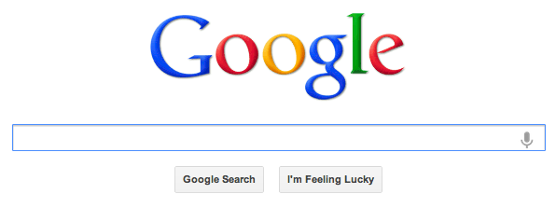
“Right to be forgotten”
Sam Mailand
“Individuals have the right, under certain conditions, to ask search engines to remove links with personal data.”
“Inaccurate, inadequate, irrelevant, or excessive”
[1, 4]
Notes:
So the verdict of that case was made back in last May, where it was decided that individuals had “the right to be forgotten” online. The wording, however, was fairly vague as far as what constituted information as being inaccurate, inadequate, irrelevant, or excessive, and left the companies like Google to decide on a case-by-case basis.

Slide 55
“Right to be forgotten”
Sam Mailand
“Individuals have the right, under certain conditions, to ask search engines to remove links with personal data.”
“Inaccurate, inadequate, irrelevant, or excessive”
[5]
Notes:
This acceptance of all requests can be seen as essentially censoring the Internet. While this was not the original intention of the law, the effect is still clear. Some people who have lots to lose (such as politicians or businessmen) have even tried to cheat the system by requesting that negative information be removed, claiming it’s irrelevant and not accurate to present day. Since, in most cases, Google has no way to clearly tell whether this is the truth or not, it simply removes it anyway.

Slide 56
Conclusion
Sam Mailand
Not reasonable or feasible within the context of the Internet
More direct and strict language must be used
Target the websites, not Google
http://setuserv.com/wp-content/uploads/2014/05/google-logo.png
[5]
Notes:
While I completely understand that everybody has a right to privacy, I do not think that essentially censoring Google and other search engines is feasible or reasonable to expect. If a law like this were to be drafted again (although fitting all cases would be incredibly difficult, if not impossible), I would make sure that it has more direct language and deals more with the actual sites that have the information, and not Google, as the company is essentially just a way to find the information and has no actual connection to what is said.

Slide 57
References
Sam Mailand
[1] http://ec.europa.eu/justice/data-protection/files/factsheets/factsheet_data_protection_en.pdf -- April 1, 2014
[2] http://go.galegroup.com.ezproxy.wpi.edu/ps/i.do?id=GALE%7CA390996753&v=2.1&u=mlin_c_worpoly&it=r&p=ITOF&sw=w&authCount=1 -- April 1, 2014
[3] http://www.theguardian.com/technology/2014/may/14/explainer-right-to-be-forgotten-the-newest-cultural-shibboleth -- April 1, 2014
[4] http://curia.europa.eu/jcms/upload/docs/application/pdf/2014-05/cp140070en.pdf -- April 1, 2014
[5] http://fortune.com/2014/10/21/company-directors-deep-sixing-google-links/ -- April 1, 2014

Slide 58
Class 6
The End
Keith A. Pray
Instructor
socialimps.keithpray.net
Notes:
This is the end. Any slides beyond this point are for answering questions that may arise but not needed in the main talk. Some slides may also be unfinished and are not needed but kept just in case.

