Slide 1
Class 8
Crime
Keith A. Pray
Instructor
socialimps.keithpray.net
Notes:
Here’s the title slide. Is anyone not excited?
Paper Reminders:
5 High quality sources
Conclusion, Argument, Counter Point, Response
Try reading paper aloud

Slide 2
Survey Results 1/2
Likes
Improve
Feedback on essays (2)
Professor is engaged (1)
Discussions are guided (2)
Jokes (1)
Paper writing drives understanding (1)
Extra credit opportunities (1)
Peer Discussion (10)
Presentations encourage depth of understanding (1)
Papers are good research practice (1)
Max-length Papers good writing practice (2)
Presentations provide different viewpoints (1)
Some assignments to be more explained (2)
I would like less guided discussions (2)
Paper topics aren’t flexible enough (2)
Some topics hard to pick side and argue for (1)
Like to know expected reading takeaways (1)
Advertise Interesting Article board (1)
Please Talk Louder (2)
Your handwriting is hard to read (1)
Please add images to slides (1)
More guest speakers (1)
Not enough time on essays (2)
Less Essays (2)
More presentations (1)

Slide 3
Survey Results 2/2
Self-Improve:
  Go to extra credit opportunities (2)
  Bring reading notes to class (1)
  Reading before writing the paper (1)
  Reading more in depth (2)
  Engaging in discussion more (2)
  Work more efficiently (3)
  Starting Earlier (7)
  Reviewing before class (1)

Slide 4
Overview
Review
Assignment
Students Present

Slide 5
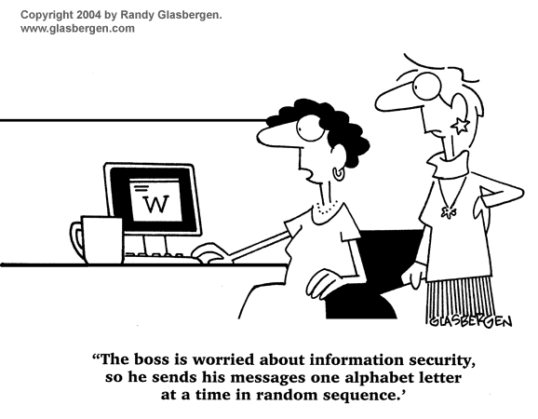
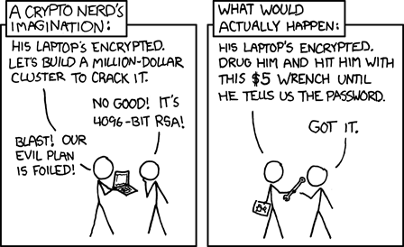
http://xkcd.com/538/ (2010-11-14)
Notes:
Are there any questions on the assigned reading?
Use the slides ahead to explain any of the attack methods from the text.
If there are no questions you can skip those slides.

Slide 6
Buffer Overrun
Run time stack
Local Variables
Return Address
Parameters
Variable Attack
buffer
Target Variable
Stack Attack
buffer
Return Address
code
Return Address
Notes:
When a function call is made, local variables, return address, parameters stored on run time stack. Local variables occupy lower memory addresses.
Variable attack – change variable value. Program expects user to input character and allocates a buffer for them. Attacker supplies too many characters and ends up over writing a variable.
Stack Attack – goal is to change value of return address so execution control goes to code which the attacker has provided in the input buffer.
Prevention: add checks against array bounds being exceeded, or modify operating system to not execute instructions stored on run time stack.

Slide 7
TCP Three-way Handshake
SYN
SYN-ACK
ACK
Notes:
SYNchronize
SYNchronize ACKnowledgement (socket reserved awaiting ACK)
ACKnowledgement
TCP socket connection established

Slide 8
SYN Flood Attack
SYN
SYN-ACK
Notes:
Attacker spoofs the IP address so the SYN-ACK is sent to a different machine that cannot respond to the SYN-ACK.
This leaves the connection half open on the server machine decreasing the resources (sockets, memory, threads/processes) available to respond to legitimate clients.
The attacker send many such spoofed SYN messages.

Slide 9
Ping Attack
Target
Attacker
ping
ping
Notes:
Attacker finds routers that support broadcasting messages to all computers on their local area networks.
The attacker sends a spoofed ping message, which the routers echo to the spoofed address.

Slide 10
My Reading Notes
pp. 321 Might be interesting to compare password guidance over the years.
pp. 323 How does Firesheep always get a user photo?
pp. 328 Not current or virus unknown…
pp. 330 Goals include infect 3 machine per LAN and as many computers as possible? Never make last minute changes before release. Were they related to the defects?
pp. 332 Do people use the Internet as an experimental laboratory these days? Shutdown right after booting, “benign” doesn’t seem like the right word.
pp. 334 “send reports back to a host computer”?
pp. 335 Firewalls often not running on same machine as malware, routers?
pp. 337 Have 2003 fears of cyber terrorist attacks been realized?
pp. 345 How is online voting a moral issue?
pp. 346 Is Internet access due to financial restrictions still relevant? Could issue specific, unrelated code for each vote.
End of Chapter questions:

Slide 11
Group Quiz
A denial of service attack shuts down a bunch of retailer, stock brokerage, large corporate entertainment and information web sites. Possible guilty parties:
  Terrorist who aimed to cause billions of damage to U.S. economy.
  Protest organization opposing commercialization of the web and corporate manipulation of consumers.
  Script kiddie just having fun with tools he found on the web.
  Show off hacker in search of bragging rights.
State what penalties are appropriate for each.
Explain your answer to 1. using a single Ethical Theory for all.
Name the laws/acts under which these parties could be prosecuted.
Notes:
Note: short answer format expected.
Note: 2. only one argument needed, should include logic for all parties
Note: 3. same law(s) should be applicable to all parties

Slide 12
Assignment
Code Testing 1/2
Design tests for the code on the following slide.
Contains at least one major defect and several minor ones.
Write a paper (1-2 pages OK not counting source) including :
  Did you choose a good test strategy? (This is your conclusion.)
  The inputs and expected outputs
  What defects you found
  How you would fix the defects (you may include fixed source)
  Why would that fix the problems?
  What could happen if the defects are not found before the code is put into production?
Working example: http://socialimps.keithpray.net/assignments/index.jsp?content=Code_Test.jsp
Notes:
The online working example source code is best not viewed with IE though looking at the source for the page will reveal the implementation.
If guest presenter coming next class remind students to prepare questions for him.
Remember to work on groups projects.
Each group should have material on their sites for the topics we’ve covered so far.

Slide 13
Assignment
Code Testing 2/2
import java.text.NumberFormat;
public class SalesFun {
public static double calculateSalesTotal ( double amount, double discountRate, double taxRate ) {
double discount = amount * discountRate;
double total = amount - discount;
double tax = total * taxRate;
double taxedTotal = tax + total;
NumberFormat numberFormat = NumberFormat.getCurrencyInstance();
System.out.println ( "Subtotal : " + numberFormat.format ( amount ) );
System.out.println ( "Discount : " + numberFormat.format ( discount ) );
System.out.println ( "Total : " + numberFormat.format ( total ) );
System.out.println ( "Tax : " + numberFormat.format ( tax ) );
System.out.println ( "Tax+Total: " + numberFormat.format ( taxedTotal ) );
return taxedTotal;
}
}
} Lines of interest
Notes:
Bold lines are real focus.
Example input:
amount = 100.05;
discountRate = 0.10;
taxRate = 0.05;
OR
0.70, 0.0, 0.05
95.67, 0.20, 0.7

Slide 14
Overview
Survey
Review
Assignment
Students Present

Slide 15

DoS/DDoS And Its Uses.
Long Nguyen Duc Hoang
DoS/Ddos is a powerful tool to take down a server
Controlled DoS/Ddos can be used to test the performance of the server
Image: http://mmoatk.com/mmo-news/ddosing-in-the-name-of-autism
Notes:
- Quick view at DoS/DDoS uses

Slide 16
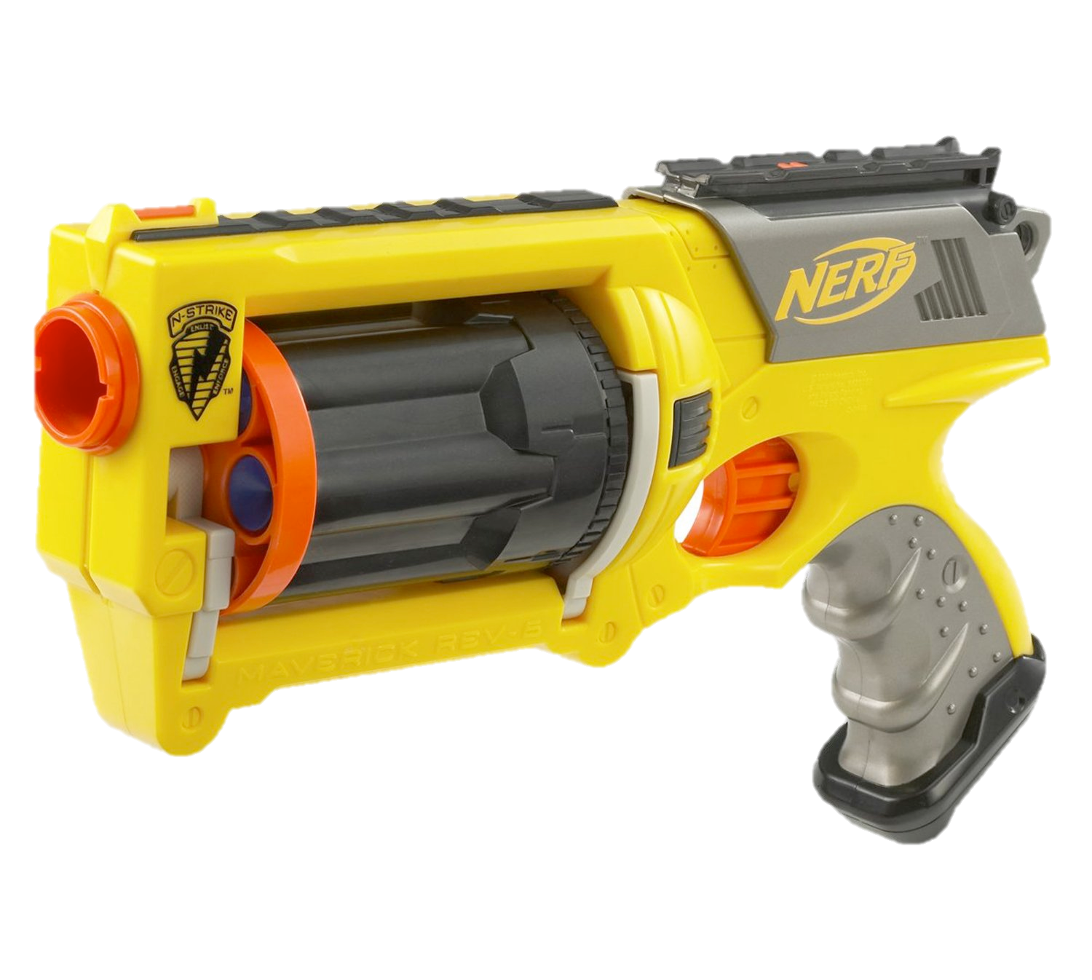
Normal request
Long Nguyen Duc Hoang
Image: http://www.amazon.com/Nerf-284182050-N-Strike-Maverick/dp/B00DW1JU7S
Notes:
A normal request is very easy to handle and doesn’t hurt for a server just like a nerf gun.

Slide 17
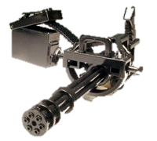
DoS Attack
Long Nguyen Duc Hoang
Image: http://www.guns.com/2012/03/15/family-victim-settle-gatling-gun-death-suit-gun-dealerkurty/
Notes:
Now, with ammo (invalid packets) and fast firerate (multiple requests). A server can be taken down.

Slide 18
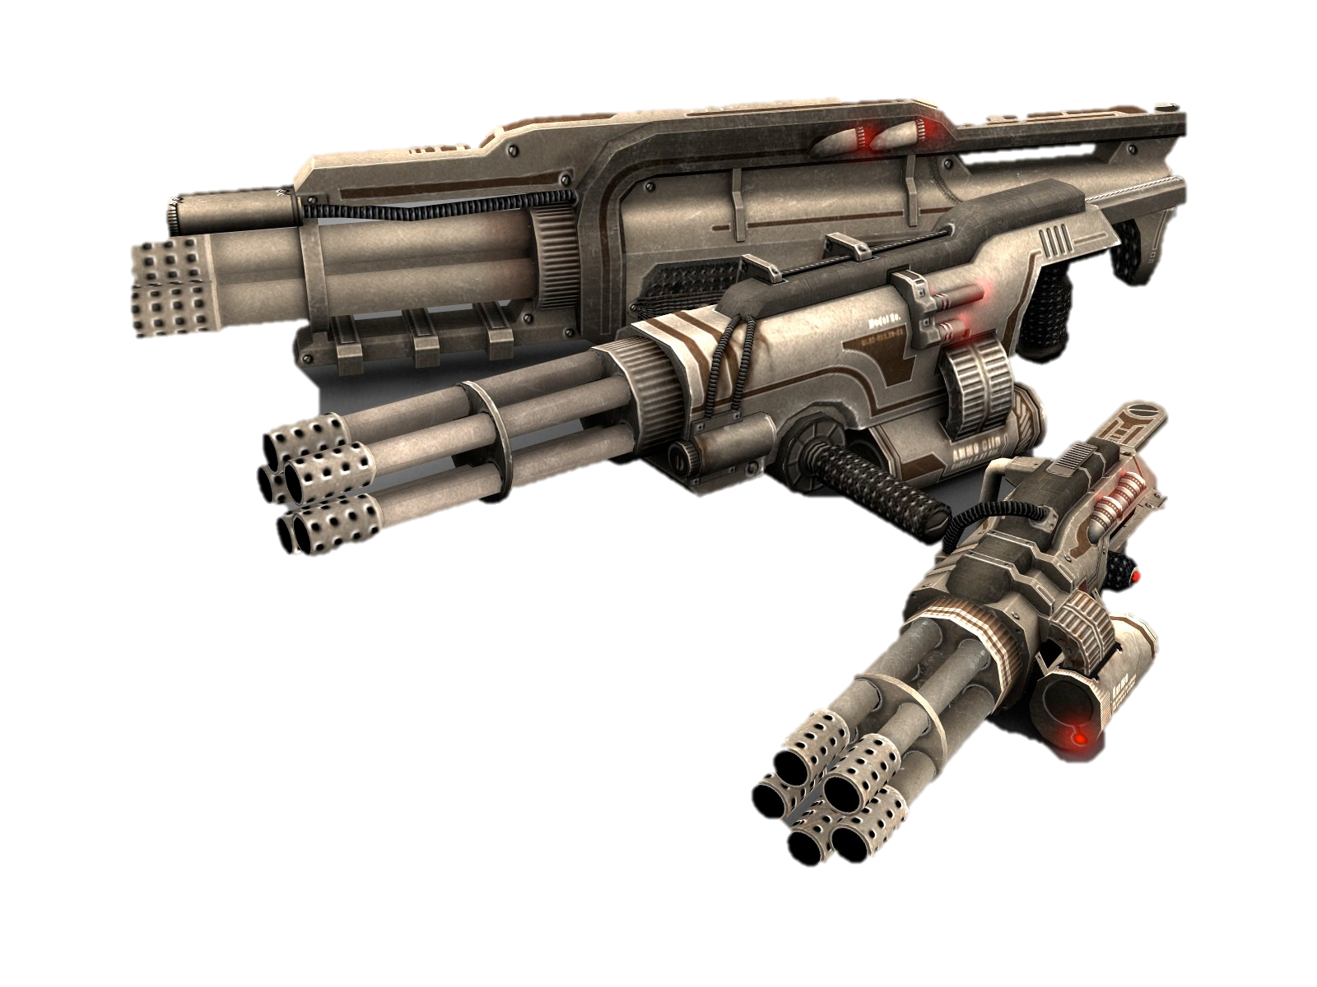
DDoS Attack
Long Nguyen Duc Hoang
Image: http://www.mpogd.com/news/?ID=1776
Notes:
DDoS is an organized system of computers to attack the server. DDoS is like multiple DoS attacks.

Slide 19
Common reasons for DDoS [1]
Long Nguyen Duc Hoang
Take down a server. Disrupt communication.
Revenge
Blackmail.
Gain advantage in economic. [2]
Distract for another attack.
Internet Protests. [3]
Average 28 attacks/hour. [4]
Image: http://mmoatk.com/mmo-news/ddosing-in-the-name-of-autism
Notes:
Server overflow => Disrupt communication
Someone hates their competitor in online games => DDoS
Blackmail: Request money to stop massive DDoS attack.
Gain advantage in economic: what if Dunkin Donuts want to take down Starbucks website and computer system so they can get more money for coffee orders!
Distract for another attack: Defenders will focus on DDoS while the attacker will have another door to access server data
Internet Protests: Anonymous attacks, protests government for internet censoring.

Slide 20
DDoS attacks in reality
Long Nguyen Duc Hoang
Average 28 attacks/hour. [4]
One of the largest DDoS attacks happened recently on Hong Kong democracy voting website PopVote. 300 Gbps. [5]
Image: http://mmoatk.com/mmo-news/ddosing-in-the-name-of-autism
Notes:
Average 28 attacks hour => Next map will display the data
One of the biggest DDoS is reported by CloudFare, Inc for Hong Kong democracy movement. China proposed candidates to Hong Kong with advantages over Hong Kong citizen. The movement was to oppose this. The attack was around 300 Gbps

Slide 21
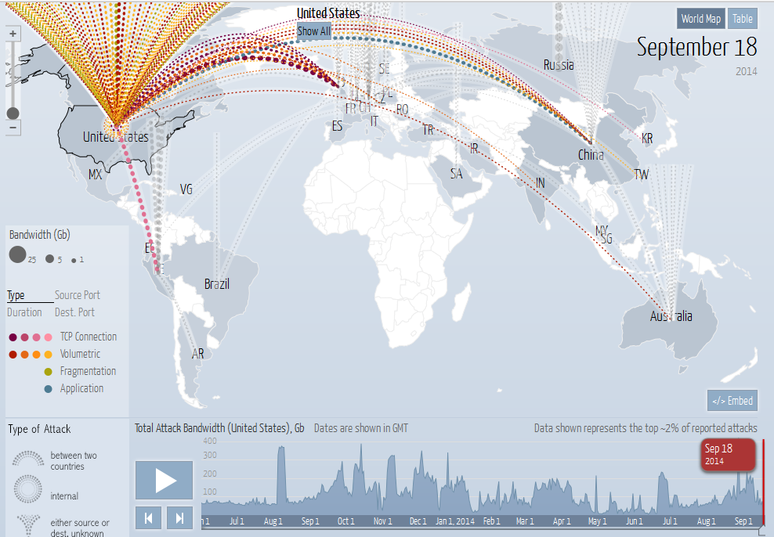
Long Nguyen Duc Hoang
Image: http://www.digitalattackmap.com/#anim=1&color=0&country=US&time=16331&view=map
Notes:
The United States is the destination for hacking traffic. Most came from China and Europe.

Slide 22
DDoS as a tool for researching
Long Nguyen Duc Hoang
Research network flows.
Measure server’s performance and protection against DDoS. (internal testing)
Notes:
The researchers will create many traffic flows to test their server capabilities to handle the attacks. Thus, they can create more method to prevent DoS/DDoS

Slide 23
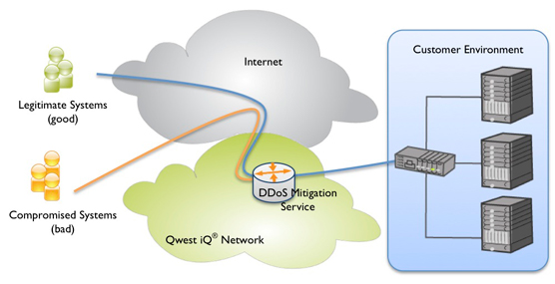
Protection against DDoS
Long Nguyen Duc Hoang
Software firewall [6]
Hardware firewall [7]
ISP blocking [8]
Cloud-based services [9]
Image: http://www.centurylink.com/business/security/ddos-mitigation-service.html
Notes:
Software firewall: Bad-traffic filtering
Hardware firewall: Resistance over pressurized traffic flow.
ISP Blocking: ISP with firewall will help block the DDoS Traffic
Cloud-based service: An intelligent firewall that blocks and filters “on the cloud”

Slide 24

Conclusion
Long Nguyen Duc Hoang
DoS/DDoS can be good or bad depends on the user
DDoS is mostly harmful, but also encourages technological development.
As an ethical computer scientist, one should never use DoS/DDoS to bring down a server that is not for security research purposes.
Image: http://seo-hacker.com/seo-and-the-white-hat-approach/
Notes:
- White hat hacking is the ethical and right way of hacking
- DDoS is a powerful tool, can be good or bad depends on the users.

Slide 25
References
Long Nguyen Duc Hoang
[1] Chan, Justin. “The Motivation and Goals Behind DDoS.” DOS Arrest. Accessed online 2014-09-18.
[2] "The Philosophy of Anonymous". Radicalphilosophy.com. 2010-12-17. Accessed online2014-09-18.
[3] Joseph Cox (June 19, 2014). "The fight to make DDoS attacks a legitimate form of protest". The Daily Dot.
[4] Arbor Cloud. Web. Accessed online 2014-09-18.
[5] Paganini, Pierluigi. Largest DDoS attack hit PopVote, Hong Kong Democracy voting site. Web. Accessed online 2014-09-23.

Slide 26
References
Long Nguyen Duc Hoang
[6] IEEE Transactions on Parallel and Distributed Systems, ISSN 1045-9219, 2014, Volume 25, Issue 9, pp. 2245 - 2254
[7] Arbor APS. Web. Accessed online 09/22/2014.
[8] Denise Pappalardo Network World, ISSN 0887-7661, 11/17/2003, Volume 20, Issue 46, p. 27
[9] Thapngam, Theerasak; Yu, Shui; Zhou, Wanlei; Makki, S Kami. Peer-to-Peer Networking and Applications, ISSN 1936-6442, 12/2014, Volume 7, Issue 4, pp. 346 – 358

Slide 27
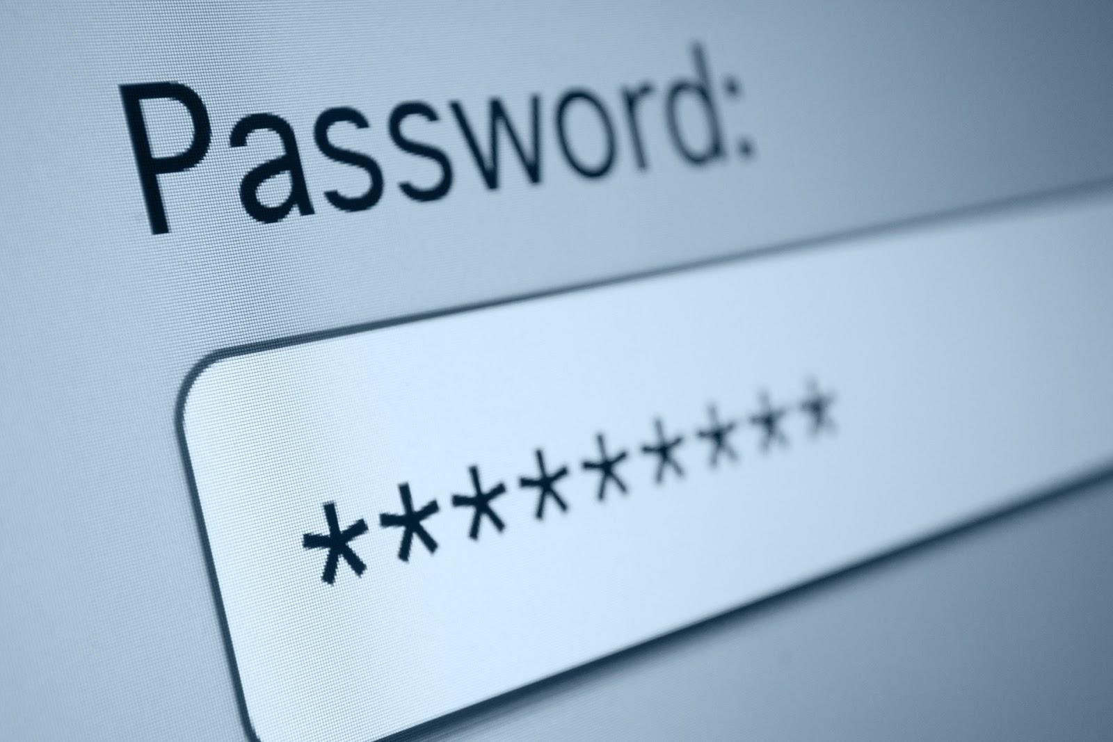
Password Security - Are we doing well yet?
Joseph Blackman
How good are your passwords?
How secure do you want to be?
How unique are your passwords?
<Graphic>
https://blog.lookout.com/wp-content/uploads/2013/11/password.jpg
27
Notes:
How secure are you? Numbers in detail later, but key points are:
Who uses alpha/num?
Who uses <8?
Who uses non-random?

Slide 28
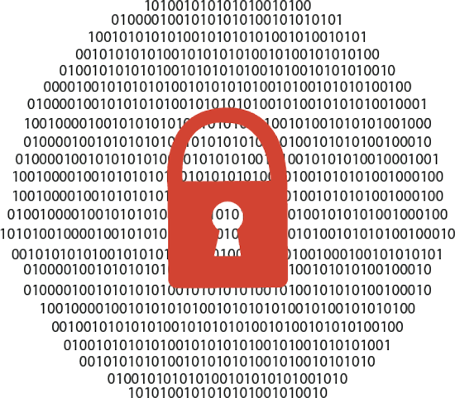
Basics of password security
Joseph Blackman
The black box
Brute force
  Rainbow tables
<Citation>
28
Notes:
Basic encryption theory: Plaintext → black box → ciphertext
Simplest solution is try all plaintexts (brute force)
If you’re smart, write them down! (rainbow table)

Slide 29

Advanced password security
Joseph Blackman
Salting
Dictionary attack
Again, brute force
http://www.nationaldefensemagazine.org/blog/Lists/Photos/cyber-security-05152013.gif
29
Notes:
Salting is a preventative measure for rainbow tables, how can you precompute when the input changes?
Dictionary attack/known plaintext, is a similar idea to password sharing.
Brute force numbers:
6-char alpha = 10^8 (At microsecond, 6 hours)
8-char alpha/num = 10^14 (At nanosecond, 1 day)
12-char Full ASCII = 10^23 (At picosecond, 3 millenia)

Slide 30
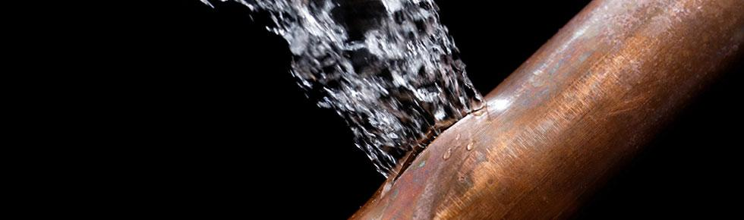
Major leaks
Joseph Blackman
2012 - eHarmony (1.2 M)¹
2013 - Adobe (135 M)²
2014 - Google (5 M)³
http://www.pipelt.com/wp-content/uploads/2012/02/Leak-Detection.jpg
30
Notes:
Large leaks (1M+) seem to be about yearly. Frequency is decreasing (more like twice yearly during early 2000s)
“I have some explicit information about the eHarmony leak, let’s see how it scales up to the classes’ security standards”
Alpha: 38.6% Alpha/num: 59.7% Num: 1.6%
Remaining .1% is high-security (nonstandard characters)
70% ≤ 8 char

Slide 31
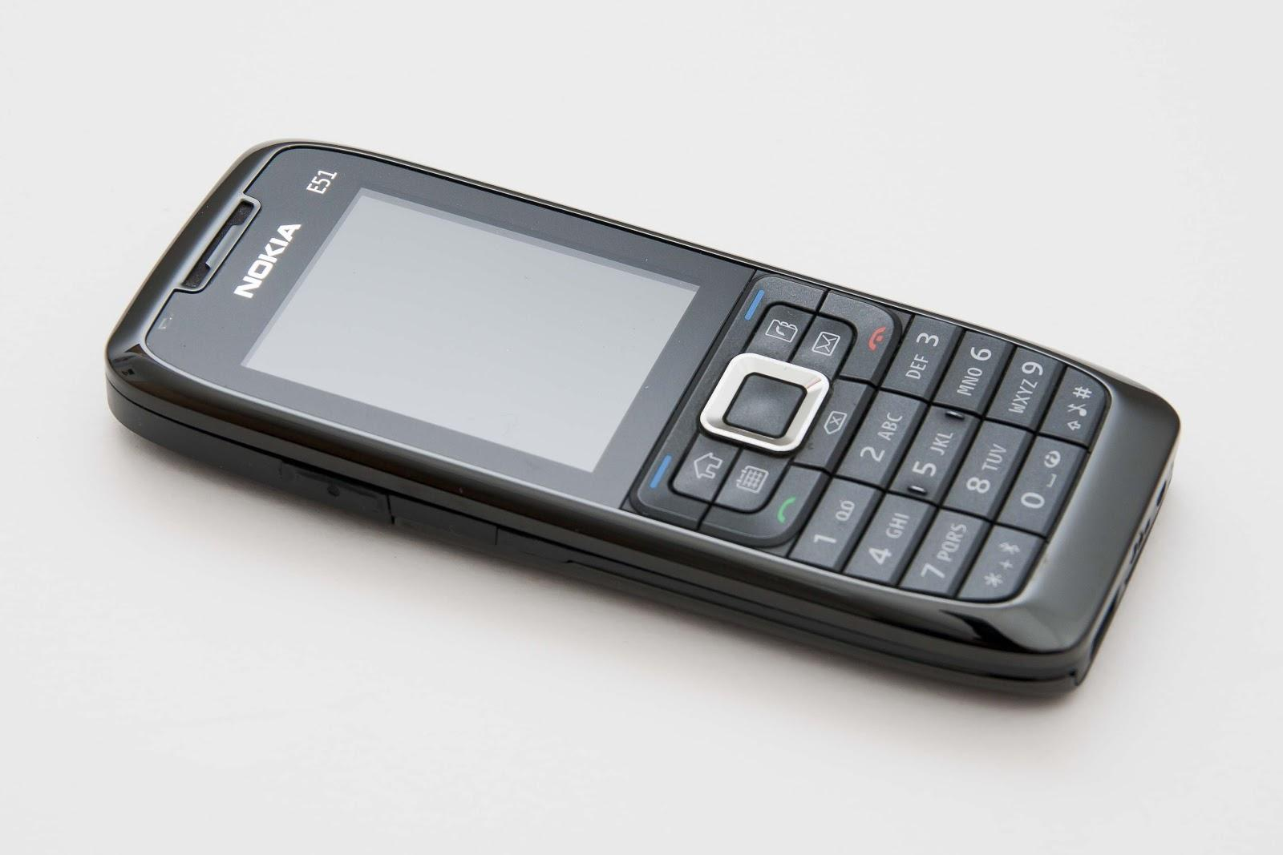
Looking forward
Joseph Blackman
Two-phase authentication
Slower algorithms⁴
Better passwords
http://upload.wikimedia.org/wikipedia/commons/d/db/Nokia_E51_Phone_Black_Nero_Schwarz_2.jpg
31
Notes:
Two-phase is the current theory, since it requires basically no new technology and no new effort
Slowdown is important. Bad algorithms (MD5, SHA-1) are not just bad for collisions--they are too fast to run.

Slide 32
REFERENCES
Joseph Blackman
[1] Accessed 9/21/2014 http://wayback.archive.org/web/20131114161909/http://www.hydraze.org/2012/06/not-so-quick-analysis-of-the-eharmony-password-leak/
[2] Accessed 9/21/2014 http://wayback.archive.org/web/20131104064133/http://www.hydraze.org/2013/10/some-information-on-adobe-135m-users-leak
[3] Accessed 9/22/2014 http://thenextweb.com/google/2014/09/10/4-93-million-gmail-usernames-passwords-published-google-says-evidence-systems-compromised/
[4] Accessed 9/23/2014 http://security.blogoverflow.com/2013/09/about-secure-password-hashing/
32
Notes:
REFER TO THIS.

Slide 33

quantum Encryption Today
Oscar Perez
<Graphic>
Quantum Encryption Methods
  Quantum Key Distribution
How much is quantum encryption being used today?
  Not much, because it has a limited range of about 60 miles[1].
  Battelle claims that they will be able to implement quantum encryption by 2015! [2][3]
http://esolutech.com/portfolio/battelle/
Notes:
-The fundamental concept of quantum physics is that any form of measurement done on a quantum system disturbs the system.
-Quantum Key Distributions allows two parties to create a key that is guaranteed to be safe. This is because when two people try to establish a key using quantum states, if an eavesdropper ever observes the key, the people who use the key will immediately take notice. Then, they can abort communication and try to use a different key.
-Since this property is provided by the laws of physics no amount of genius or computational power can over come this.
-Quantum Key Distribution being studied
-Today, It is not really used because of the limited range of fiber optics (Only can go about 60 miles/100 kilos)
-However, great progress is being made on this.
-Batelle Memorial Institute combines quantum encryption and classical encryption to extend the range
-They claim that they will have a 400 mile link connecting Columbus Ohio and Washington D.C.

Slide 34
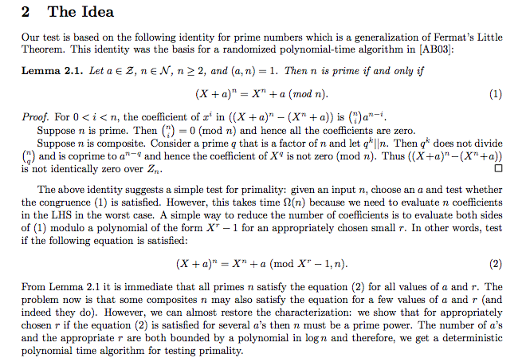
Is it Necessary?
Oscar Perez
Current encryptions are in danger.
  A lot of classical key’s can simply be beaten by brute force[4]
    A student at Notre Dame was able to crack a 109 bit key with 10,000 computers and 549 days
  There are advances in mathematics which make decrypting easier[5]
    Manindra Agrawal discovers easy way to determine primes. (Proof on Right)
  Quantum algorithms may be used to crack keys much faster[1].
    Shor’s algorithm can factor large primes in polynomial time.[7]
Quantum encryptions do not have to worry about these things.
<Graphic>
http://www.cse.iitk.ac.in/users/manindra/algebra/primality_v6.pdf
Notes:
- Today’s Key encryptions are only safe if they are long. However, they can be beaten simply by time and computing power.
- A student at Notre Dame was able to crack a 109 key bit with 10,000 computers and 549 days.
Manindra Agrawal a computer scientist at the Indian institute of technology developed a way to tell if a number is prime without factoring it. Runs in polynomial time
This is important because, clever methods of decrypting key’s may be able to cut the time and computational requirements to crack key’s
Quantum algorithms also make cracking keys easier
The great thing about quantum encryption is that even if the key is discovered the information is still safe! The people communicating will be immediately notified and they can simply abort communication.

Slide 35
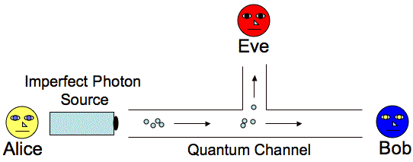
Is it invincible?
Oscar Perez
Theoretically, Quantum Encryption is still vulnerable[6].
Practically, Quantum Key distributions could also fail due to interference from the environment[1]
<Graphic>
http://www.cse.wustl.edu/~jain/cse571-07/ftp/quantum/
Notes:
-If a quantum version of the man-in-the-middle attack was implemented, then it is possible for an eavesdropper to get information.
-Basic Idea (I mean really basic Idea) is that when Alice sends Bob the key, Eve intercepts a piece of it and sends Bob her own piece. Then Bob gets the other pieces. Eve can look ate her piece with out disturbing Bobs pieces (since they are now different Quantum systems), then Eve can guess the basis (way of interpreting quantum data) to interpret the piece of information. This method is not certain however, since Eve can guess wrong but even if she does Alice and Bob will not know.
-Interference from the environment can cause enough error to the data to mess it up. Unfortunately it is impossible to differentiate between “interference error” and “eavesdropper” error. So, an eavesdropper may try to access information, and after the information is changed, the people who originally sent the information may believe that it was simply interference. (Or the other way around)

Slide 36
conclusion
Oscar Perez
While Quantum Encryption is limited, steps are being made to improve it, and it is realistically possible that one day it will be heavily used for many practical purposes.
Quantum Encryption is better than classical encryption especially since classical encryption can be beaten by genius and power.
Quantum Encryption may not be the solution to stopping hackers, but it is a good next step to make hacking much more difficult.
Notes:
-Conclusion: While Quantum Encryption is not perfect, it is a very good step to take in the fight against hackers.
-Since Quantum Encryptions have that quantum layer to fall back on, they are harder to break than their Classical counterparts, they are superior forms of security.
-Since Quantum computing has both theoretical and practical flaws, it will not be able to act as an absolutely secure system. But it will still be better than before!

Slide 37
References
Oscar Perez
[1]”Quantum Encryption – A Means to a Perfect Security? http://www.sans.org/reading-room/whitepapers/vpns/quantum-encryption-means-perfect-security-986, September 22, 2014
[2] http://spectrum.ieee.org/computing/networks/longdistance-quantum-cryptography, September 22, 2014
[3] http://gcn.com/articles/2013/10/28/quantum-cryptography.aspx, September 22, 2014
[4] http://www.zdnet.com/news/notre-dame-math-whiz-cracks-code/126169, September 22, 2014
[5] “PRIMES in P”, Manindra Agrawal, Neeraj Kayal, Nitin Saxena, http://www.cse.iitk.ac.in/users/manindra/algebra/primality_v6.pdf, September 22, 2014
[6]”Vulnerabilities in Quantum Key Distribution Protocols”, D. Richard Kuhn http://arxiv.org/pdf/quant-ph/0305076.pdf, September 22, 2014
[7] “Shor’s Quantum Factoring Algorithm”, Samuel J. Lomonaco, Jr., http://www.csee.umbc.edu/~lomonaco/ams/lecturenotes/SamShor.pdf, September 23, 2014

Slide 38
Class 8
The End
Keith A. Pray
Instructor
socialimps.keithpray.net
Notes:
This is the end. Any slides beyond this point are for answering questions that may arise but not needed in the main talk. Some slides may also be unfinished and are not needed but kept just in case.

Slide 39
Crime How
Technical and Non-Technical
  Break into computer.
  Prevent access to computer.
What things make computer related crime easy?
Notes:
Exploit security holes, Break encryption, Spoofing
Social Engineering: Guess passwords, Find out passwords and procedures
Poor passwords, Insecure protocols, Program limitations (buffer overruns), Eavesdropping (Email, Interactive), Insecure files

Slide 40
Crime Bane
Trojan Horse
Virus
Worm
Bot Network
Buffer Overrun
(Distributed) Denial Of Service Attack
How do they work?
How harmful are they?

Slide 41
Crime Why
Why?
Notes:
Money: stolen credit cards, change records, stolen property.
Political, military, economic.
Challenge, Revenge, Mean
Why do at all? Have motivation, think about it, think it will help, think it’s acceptable.
Feel forced. Don’t agree. Don’t care.

Slide 42
Crime Time
What is different now compared to:
  10 years ago?
  20 years ago?
  30 years ago?
  40 years ago?
Notes:
More computers. Unsophisticated owners. More complex software. Greater connectivity. Easy access to cracking tools. Incentives. File-sharing
In ’60s and ’70s, access was mostly localized.
Modems. Wardialing.
Some Arpanet and Usenet.

Slide 43
Crime Doers
Hacker or Cracker
  Pre-1980 - Golden Age ☺ ?
  Eighties
  Nineties
  Naughts
Criminal Hacking == Cracking?
Notes:
Script kiddies
Phreakers
Security analysts
Packet monkey

Slide 44
Crime Gain
Justifications for Computing Crimes?
What can be done after access is gained?
  What resources are available?
  How valuable are they?
Notes:
Machines are unused. No harm done. Education. Exposes security holes. Exposes abuses.
Use computer and/or resources. Take data. Destroy data. Alter data. Lock out others. Attack other computers.
Equipment, Processor Time, Disk space, Printer time / paper, Bandwidth

Slide 45
Crime Pay
Computer Fraud and Abuse Act (1986)
  Bans :
    unauthorized access or use of computers, copying, modifying, or destroying data, disclosing of passwords.
    disrupting government and utilities.
  Covers government, financial, medical, and interstate systems.
USA Patriot Act (2001)
  Raised penalties.
  Permits freer surveillance and monitoring to detect illegal activity.
Electronic Communications Privacy Act
  Illegal to intercept telephone, email, other data transmissions, access stored email messages without authorization
Assign Cybercrime Treaty (2006), Wire Fraud Act, National Stolen Property Act, Identity Theft and Assumption Deterrence Act
Notes:
Are either of these laws still in effect? Have they been changed?
For additional legislation ask for presenting volunteers to brief recent incidents/cases.
Also ask for volunteers to find out laws from their home country/state.

Slide 46
Crime Stop
Technical
  Protect Data
  Protect Machine
  Protect Access
Non-technical?
  Social?
  Legal?
Notes:
Encryption, Authentication, Biometrics, Anti-virus, File integrity checking (E.g. Tripwire), Virtual private networks, Point-to-point networking (Twisted-pair Ethernet vs. Coax vs. wireless)
Security through obscurity, physical access required, not on network, behind locked doors.
Remove desire, remove incentives
Legalize, increase penalties, increase chance of getting caught.

