Slide 1
Class 6
Privacy
Keith A. Pray
Instructor
socialimps.keithpray.net
Notes:
Here’s the title slide. Excited already, aren’t you?
Reminders:
Do not change the format, footers, etc. in the template slides.
Paper writing process: Sources → Notes → Conclusion → Argument → Counter Point → Response

Slide 2
Logistics
We need Groups to volunteer to present Tuesday
2014-10-07. The first 3 to send the TA and me email win.
Send me group web site location
Please send email to both me and the TA for quickest response time
Presentations are due 24 hours before class
Use Presentation Guidelines on course web site
Notes:
Not needed this time:
- We will now be using the myWPI Safe Assign feature to pass in papers in addition to hard copies due at the beginning of class. TA will send out detailed directions.
- High quality reference sources, writing, responses

Slide 3
Overview
Review
Assignment
Students Present

Slide 4
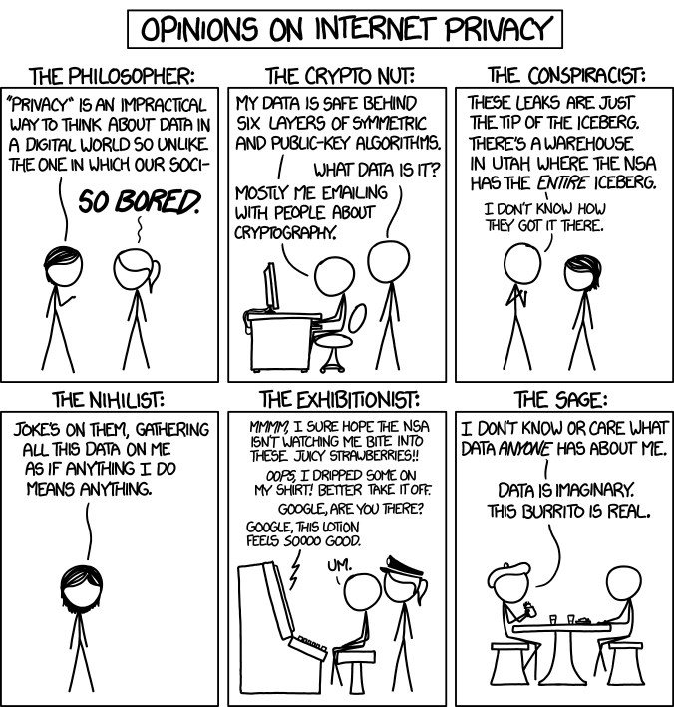
http://xkcd.com/1269/
Notes:
1 – Accessed 2014-04-14
Personal Information Privacy

Slide 5
My Reading Notes
pp. 231 Moral capitol – 1984?
pp. 237 “…privacy…in their own homes…” != nanny to expect privacy “…when… insides Sullivans home.
pp. 245 Web Browsers put cookies on on your hard drive, not Web Servers.
pp. 249 why is assumption flawed?
pp. 251 Are call records really a “social network”?
pp. 255 Why does Apple not enforce policy of asking permission in the API?
pp. 256 5. 2003 is a while ago.
pp. 267 Does not answer first question.

Slide 6
Assignment
One Page Paper
Would a National ID System be a good thing?
  One acceptable approach is to show the argument in the book for the position opposite to your conclusion is a weak argument.
  Feel free to reference or build upon your self search work if it helps your argument.

Slide 7
Overview
Review
Assignment
Students Present

Slide 8
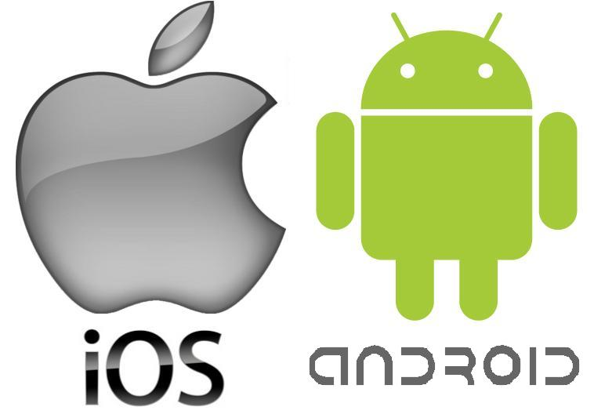
DOES THE SOFTWARE YOU USE HAVE A BACKDOOR?
Nick Brown
Android and iOS both have backdoors ^{[1][2]}
Exchange ^{[3]}
SkyDrive and Outlook.com ^{[9]}
Many alleged backdoors in other pieces of software ^{[4]}
  Not counting malware
http://www.kitguru.net/wp-content/uploads/2014/05/android-ios1.jpeg
© 2014 Keith A. Pray
8
Notes:
-A backdoor in software is a purposefully created component of the software that allows someone to bypass security measures and gain access to the system.
-Many operating systems have backdoors that have often accidentally been made public. For example, Google can remotely remove and install apps on any Android phone. While this is a potentially useful feature for Google to use for good (such as removing malware), it could just as easily be used with malicious intent. Usually, these backdoors are discovered when security experts notice some kind of strange activity and try to find out exactly what is happening. In the case of the Android backdoor, a security expert had heard that Google had this ability, but had not confirmed it. So, he created a malicious app disguised as a preview for a Twilight book. Unsurprisingly, it got a significant amount of downloads within 24 hours of its release. Google asked him to remove this app from the store, which he did. Later that day, the app had been remotely removed from his phone. Google had remotely uninstalled the software via a Google controlled backdoor in the Android operating system.
-Also, any mobile device using the Exchange mail server can be remotely wiped by the Exchange server administrators. This is a feature that makes itself known, but is not entirely clear to the user. There have been cases where users’ phones have been completely wiped of all data due to an administrator accidentally sending the command to wipe the phone.
-After the NSA’s Prism program was revealed, it was discovered that a number of Microsoft products gave the NSA backdoor access to users’ data including email and files. Most notably, the NSA was given access to SkyDrive files and emails sent to and from Outlook.com.
-In the news, we are always hearing of new alleged backdoors. Recently, there have been unconfirmed rumors of backdoors being found in Windows 8 and RSA encryption.
-The backdoors that I am talking about are in software that we are supposed to be able to trust, we are not including viruses or other malicious software.

Slide 9
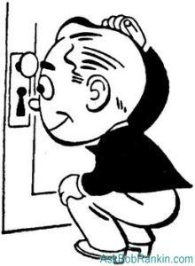
BACKDOORS ARE A VIOLATION OF OUR PRIVACY
Nick Brown
Private information could be exposed
  Google Remote Kill and Install ^{[1]}
  Xiaomi Phones ^{[7]}
  Prism ^{[9]}
Two solutions
  Accept the possible privacy violations
  Use transparent software
http://askbobrankin.com/computer-privacy.jpg
Notes:
-When software has a backdoor that we are not explicitly told about by the provider of the software, this is a violation of our privacy.
-There are two situations where Google’s backdoor into Android could be used for malicious purposes:
Google decides to use it to install malware (unlikely)
A third party figures out how to do it and can mass install malware on many devices.
-A more recent and relevant example was the Chinese smartphone manufacturer, Xiaomi. It was discovered that information such as the phone’s IMEI number, IMSI number, contacts, and text messages were being sent to a Chinese server, without the permission of the user.
-While it is generally not likely that a software company is going to steal your personal information, it has happened in the past. As private citizens, we have the right to know what software is doing with our personal information, but as users, we also need to be smart about what software we trust.
-We can continue to use software that could be violating our privacy, or we can use software that is transparent about its intentions.

Slide 10


SOFTWARE TRANSPARENCY
Nick Brown
Transparency means letting users know exactly what software is doing
Generally means making software open source ^{[5]}
  Open source does not mean there cannot be a backdoor
  Linus’s Law ^{[6]}
  Linux backdoor attempt ^{[10]}
Software security reviews ^{[8]}
  Static code analysis
  Audits
Open source can help remove security issues
  Borland InterBase/Firebird ^{[8]}
http://opensource.org/logo-usage-guidelines
http://www.defense.gov/multimedia/web_graphics/dod/DODc.gif
Notes:
-To the privacy conscious user, closed source software can be doing anything behind your back, even if the developers say the software is doing only what it advertises.
-With open source software, the functionality of the software is made transparent to the user (so long as the user has the technical skill to understand the source code).
-Obviously, for larger projects it is not feasible for one user to know exactly how everything works, but with an open source project, there is usually a large community of users that can look at the source code and see what is happening. Also, users can usually make and see bug reports, which may include security holes that provide backdoor access to the software.
-Just remember that just because software is open source does not mean that it is secure or doesn’t have backdoors. However, the more popular an open source project is, the less likely it is to have visible security holes because of the amount of people that look at the source code. Also, from a logical standpoint, the developers of open source software would have to take a greater risk to try to purposefully add backdoors to their software, since they can technically be found in the source code, and this would lose the trust and respect of their userbase.
-There is a phenomenon with open source software called Linus’s Law, which states that “given enough eyeballs, all bugs are shallow.” This basically means that as more people look at a project, bugs will be found and fixed more easily. An example of this was when a developer attempted to submit a change to the Linux kernel that would add a backdoor. Someone had broken into the CVS repository and added this change, but it was found and removed quickly due to the number of developers working on the Linux kernel.
-The US Department of Defense has an in depth FAQ about open source software with respect to security and privacy.
-Popular open source software also gets reviewed by third parties. There are static code analysis tools, like Coverity and Fortify, that can be used to automatically look for security issues in code. Also, the devs for OpenBSD and Debian often audit software going into their repositories.
-There has been at least one notable example where proprietary software was made open source, and this reduced security issues, including removing a backdoor. Borland’s InterBase, a database program, had a back door that allowed access to anyone using the username “politically” and the password “correct.” Within 5 months of the software becoming open source, this vulnerability was removed.

Slide 11
CONCLUSION
Nick Brown
Software backdoors are a privacy issue that we should be worried about
Closed source software cannot necessarily be trusted
Open source software, while not necessarily backdoor free, is transparent about what it is doing
As more people use open source software, the more likely it is that it is not doing anything suspicious.
Notes:
-Privacy risks are real when using any software. With closed source software, it is very possible that there are hidden violations of your privacy. Because it is closed source, it is easy for software companies to deny the existence of alleged backdoors.
-With open source software, the user can find out exactly what the software is doing and how it is doing it. While open source software is probably less likely to contain a hidden backdoor, if there is one, it can be seen in the source code. As a piece of open source software gets to be more popular, the software is more likely to be trustworthy because of the amount of people who have seen and work with the source code.

Slide 12
REFERENCES
Nick Brown
[1] Jon Oberheide, Remote Kill and Install on Google Android, https://jon.oberheide.org/blog/2010/06/25/remote-kill-and-install-on-google-android/ (September 14, 2014)
[2] Jonathan Zdziarski, Apple Addresses iOS Surveillance and Forensics Vulnerabilities, http://www.zdziarski.com/blog/?p=3820 (September 14, 2014)
[3] Martin Kaste, Wipeout: When Your Company Kills Your iPhone, http://www.npr.org/2010/11/22/131511381/wipeout-when-your-company-kills-your-iphone (September 14, 2014)
[4] GNU.org, Proprietary Back Doors, http://www.gnu.org/philosophy/proprietary-back-doors.html (September 14, 2014)
[5] Ed Felten, Software Transparency, https://freedom-to-tinker.com/blog/felten/software-transparency/ (September 14, 2014)
[6] Scott Merrill, With Many Eyeballs, All Bugs Are Shallow, http://techcrunch.com/2012/02/23/with-many-eyeballs-all-bugs-are-shallow/ (September 14, 2014)
[7] Mohit Kumar, Xiaomi Phones Secretly Sending Users’ Sensitive Data to Chinese Servers, http://thehackernews.com/2014/08/xiaomi-phones-secretly-sending-users.html (September 15, 2014)
[8] US Department of Defence, Frequently Asked Questions Regarding Open Source Software, http://dodcio.defense.gov/OpenSourceSoftwareFAQ.aspx#Frequently_Asked_Questions_regarding_Open_Source_Software_.28OSS.29_and_the_Department_of_Defense_.28DoD.29 (September 15, 2014)
[9] Glenn Greenwald, Microsoft handed the NSA access to encrypted messages, http://www.theguardian.com/world/2013/jul/11/microsoft-nsa-collaboration-user-data, (September 15, 2014)
[10] Ed Felten, The Linux Backdoor Attempt of 2003, https://freedom-to-tinker.com/blog/felten/the-linux-backdoor-attempt-of-2003/ (September 15, 2014)
12

Slide 13
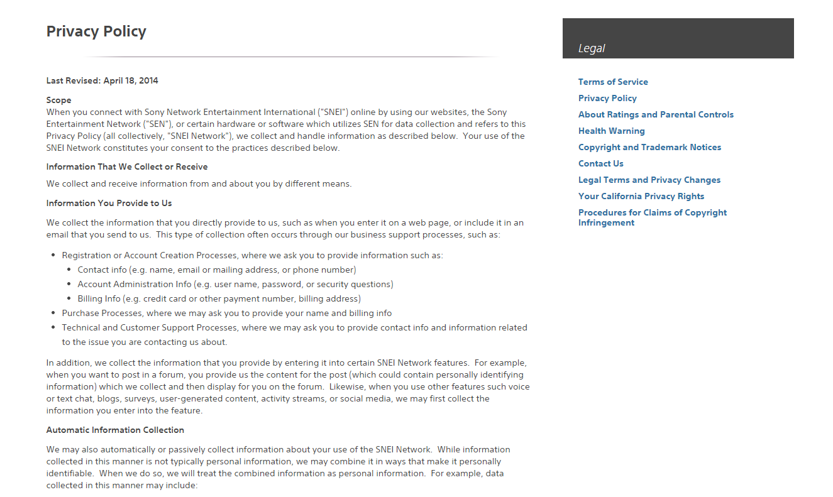
Online game identity
Adam Myers
Online game companies
  Are they improving to keep our personal information secure?
  Information users commonly give
    Contact information
    Account information
    Billing information
Picture: http://www.playstation.com/en-us/legal/user-agreements
Notes:
Online game companies : Are game companies improving their services/tech to keep user information secure? How safe is our name, address, and credit card info?
Contact info: name, emails, phone number
Accout info: username, password, security questions. Cookies that save this info
Billing info (only for online games with paid/monthly services): credit card, billing address

Slide 14

PlayStation network outage
Adam Myers
~77 million accounts stolen
  Prevented use of online service [1]
  Personal identifiable information stolen from each account [2]
  New Terms and Conditions [3]
Picture: http://cdn0.vox-cdn.com/uploads/chorus_image/image/37383186/playstation_network_logo.0_cinema_960.0.jpg
Notes:
*PlayStation network outage: Example of how any online game service could be vulnerable
*77 million accounts stolen: Between April 17-19 2011 77 about 77 million PlayStation network accounts got stolen. Sony sent a delayed warning to its’ users one week later
*Online service: users could not access online play on PS3, PSP, and sony PC games for 24 days. Users also unable to access other services like Hulu or Netflix. It was not until may 14 where ps3 users could download a security patch to gain access to online again.
*Information: Credit card info was safe, but other user information was not.
*Terms and Conditions: To minimize losses, sony made users agree to new term and conditions on September 15 2011 that gave up the users’ right to join together as a group to sue sony over any future security breach.
*Overall: Failure to keep its users’ information secures resulted in profit losses and reputation losses for Sony.

Slide 15
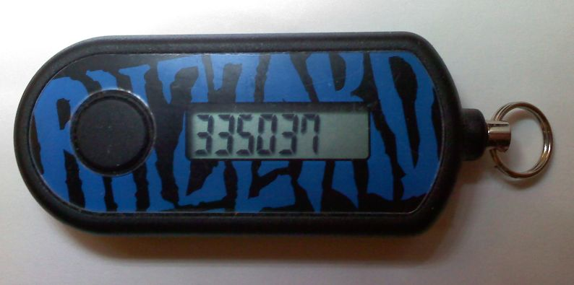
SECURITY MEASURES COMPANIES ARE TAKING
Adam Myers
Two factor authentication [4]
  Authenticators [4]
  Steam Guard [5]
  Optional
Picture: http://www.pcweenie.com/reviews/games/wow4p/_graphics/p10_001_BlizzardAuthenticator.jpg
Notes:
*Two factor authentication: Added level of security on game account that requires two different kinds of information from the user in order to access or authorize access to game account
*Authenticator: Additional layer of security to prevent unauthorized access to a user’s account. Provides the user with a unique one time use authenticator code to use in addition to his or her password. Users account linked to physical device or mobile app. Most large MMO companies have them available (Blizzard, SOE (NOT playstation network))
*Steam Guard: Any unauthorized device must provide additional information. One time use code is sent to email linked to account and must be entered with password to authenticate device for future use.
*Optional: These forms of authentication are optional, and are non-intrusive if someone does not want to enter two kinds passwords each time he or she logs in.
*Overall: non intrusive ways for the user to keep his or her account information more secure

Slide 16
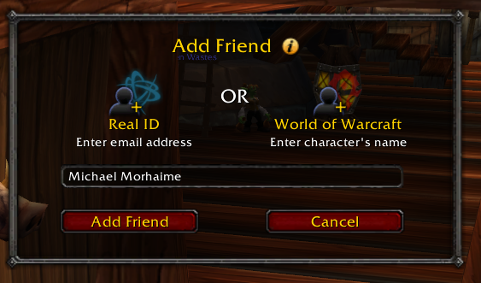
Players want their privacy
Adam Myers
Blizzard Real ID [6]
  Online friends can see users real name
  Initially planned to allow all forum user to see each others Real ID
  Massive outcry; 3 days later, Real ID became optional [7]
Companies’ information security methods have improved, and will continue to improve
Picture: http://media.pcgamer.com/files/2010/07/Real-Id.png
Notes:
Point: Users do care about all personal information they enter being kept private and safe. Even if it is just his or her name. (Real id)
*Real ID – optional level of identity that keeps players connected on Battle.net. Can see each others real name instead of character name, across all blizzard games.
Forums: Initially planned to be required on forums for blizzard games (so everyone would have to show their real name if they wanted to discuss in forums). Blizzard forums and other game related forums out cried against this, and Blizzard announced three days later that Real Id would be optional for forums as well.
Companies: More and more game companies are implementing some form of two factor authentication, whether it is an email or an authenticator linked to a user’s account. If users outcry at the idea of their real names and nothing else being shown to strangers, how would they react if their home address or credit card information got shown?! Knowing this, online game companies will continue to develop/improve security measures to allow users to keep their information private and safe.
QUESTIONS?!

Slide 17
References
Adam Myers
[1] Richmond, Shane (2011-04-26). "Millions of internet users hit by massive Sony PlayStation data theft". London: Telegraph. 2011-04-29.
[2] Kazuo Hirai's Letter to the U.S. House of Representatives". a photo set by Flickr user PlayStation.Blog. Flickr. https://www.flickr.com/photos/playstationblog/sets/72157626521862165/. 2011-10-20
[3] "New Sony Terms of Service Ban Class Action Lawsuits, Is that Legal?". http://gdn9.com/story-25130-New-Sony-Terms-of-Service-Ban-Class-Action-Lawsuits-Is-that-Legal.html. 15 September 2011
[4] https://www.soe.com/soeauthenticator/faq/#19 September 15 2014
[5] https://support.steampowered.com/kb_article.php?ref=4020-ALZM-5519 September 15 2014.
[6] Rob Pegoraro http://voices.washingtonpost.com/fasterforward/2010/07/world_of_warcraft_real_names.html. September 16 2014
[7] Brendan Sinclair http://www.cnet.com/news/blizzard-real-id-system-sparks-controversy/ . September 16 2014

Slide 18
Class 6
The End
Keith A. Pray
Instructor
socialimps.keithpray.net
Notes:
This is the end. Any slides beyond this point are for answering questions that may arise but not needed in the main talk. Some slides may also be unfinished and are not needed but kept just in case.

