Slide 1
Class 5
Intellectual Property
Keith A. Pray
Instructor
socialimps.keithpray.net
Notes:
Here’s the title slide. Excited already, aren’t you?
Reminders:
Do not change the format, footers, etc. in the template slides.
Paper writing process: Sources → Notes → Conclusion → Argument → Counter Point → Response

Slide 2
Overview
Review
Assignment
Students Present
Guest Speaker

Slide 3
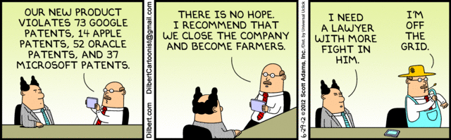

Slide 4
My Reading Notes
pp. 162 Illegal software stats changed since 2009?
pp. 169 SaaS, Google Search example? “…before he gave them the plot.”?
pp. 176 4.4 #2 preferred?
pp. 182 dial-up is not ordinary any more. revenue != profit
pp. 189 blocking 100% seems impossible
pp. 197 4.7.3 reference?
pp. 202 Perhaps friends should not ask you to break the law? Any successful industries operate as a support service?
pp. 203 Is Perl still most popular? Quality study from 2003, change?
pp. 205 GUI argument ignores Android.
pp. 208 who uses tape?
pp. 223 Any news?
End of Chapter questions I liked: 31

Slide 5
Group Quiz
For each On the left answer a–d on Right
Trademark
Copyright
Patent
Trade Secret
What kind of IP does it protect?
What qualifications does the IP have to meet to be protected?
How long does the protection last?
Give a specific example of IP currently protected?
Notes:
Trademark
Used to denote a product or service.
Apply in specific areas of commerce. Only applies in specified area of business
Indefinite term as long as in use and protected against becoming a common noun or verb.
You do not have to register a trademark unless you want to bring litigation before a federal court (there are other benefits too)
Copyright
Expression, not ideas: Fuzzy. E.g. derivative works, characters, merchandising, plots.
Mickey Mouse, Tarzan.
US Default : Original Author, Exception: work for hire, Transferred: yes
Rights: Publication, Performance / exhibition, Adaptation to other media, Excerpting, Attribution, Derivative works
US Term: Lifetime of author plus 70 years., 95 years for companies.
Governed by US law and international treaties (e.g. WIPO).
Fair Use: News reporting, reviews, etc., Scholarly / educational use, Private, non-commercial use, Lending libraries and archives
Fair Use restrictions: Admission charge, Re-transmission
In general, you can: Read, view, play, etc., Copy for personal use., Time-shift.
In general, you cannot: Copy for others., Transfer to someone else but keep a copy., Show / perform it publicly.
What about video rentals?
Rationale: Encourage creativity. Encourage dissemination. Balance between private and public good. It’s a social contract.
Patent
A mechanism, process, or composition of matter.
Something patentable must be: Novel. Useful. Non-obvious. Described clearly. Must do what it says.
Usual term 20 years.
Utility and plant patents: 20 years.
Design patents last 14 years. (ornamental design of functional item)
Provisional patent gives 1 year, before full patent
Trade Secret
You must take steps.
Enforceable by: Contracts, Laws against industrial espionage.

Slide 6
Assignment - Self Search 1/3
Discussion Board
Post ways one can search for information about a person. Do not repeat an entry already made.
Use each search method listed to produce 2 profiles as an appendix of your paper. Provide a brief description if you’d rather not list the details.
  Profile 1: all information someone might think is you
  Profile 2: all information you know is you.
  You are not responsible for methods posted after Monday 8AM.
For each search method result:
  Exactly how did the data get there?
  How can this data be used?
  Is this a secondary use?
  Did you authorized use of the data? If not and you want to, request its use be discontinued and post the correspondence.
Dig deeper than a basic search engine’s (Google, etc.) results.

Slide 7
Assignment - Self Search 2/3
1 Page Paper
Use your search results to help support your conclusion.
This assignment requires you revisit the Discussion Board frequently as new search methods are posted, subscribe to it.
Conclusion idea examples (not comprehensive):
  What impression would a potential employer have of you given these results, assuming they also had a resume and possibly a cover letter from you?
  What would your elder family members (or equivalent) think?
  Are you comfortable with what you found or did not find?
  Do you believe protecting your privacy is important or needed?

Slide 8
Assignment - Self Search 3/3
Profile 2
Is You
1 Page
Paper
Filter
Inspiration
Search Methods
…
…
…
…
Filter
Profile 1
Could Be You

Slide 9
Overview
Review
Assignment
Students Present
Guest Speaker

Slide 10
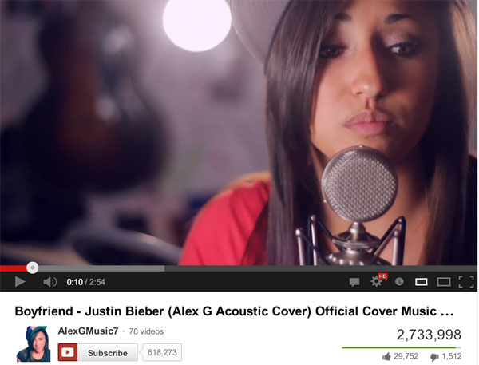
Do YouTube cover music videos break copyright law?
Dan Murray
Copyright
  You own your works
  Companies usually own songs
  Licensing
Notes:
Copyright is complicated. The basic (and I mean basic) idea is that if you make something new and creative, it’s yours. That’s it. You write a book, you write a song, you draw a picture, as soon as you make a copy of it, bam. You own the rights to it. You have the copyright. [1] In the case of music, once you’ve recorded a song, you own the copyright to that song. In most cases, (at least in most big cases, cases of songs one would be covering on YouTube, for example), a company produces a song for an artist, and the artist signs a contract, and the company owns the copyright. One way you can get permission to cover a song is to get a mechanical license through a third party organization (e.g. The Harry Fox agency). Another way, probably the best way, is to get in direct contact with the company who produced the song and get a license directly from them. So if you don’t do either of those, but you put up a cover video anyway, that’s copyright infringement, right?

Slide 11
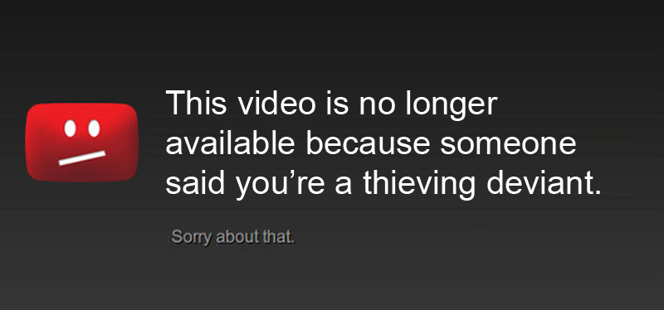
YouTube’s Blanket License
Dan Murray
Agreements with music labels
Content ID
Notes:
Well…no. Not quite. In 2012, YouTube signed an agreement with 8 music companies saying that if someone covered their song on YouTube, they would get a portion of the ad revenue. At this point, YouTube already had an agreement of similar terms with the “big four” music labels: Sony, EMI, Universal, and Warner. As part of these agreements, YouTube implemented the “Content ID” tool, which checks videos for copyrighted material. [2] Once a song has been identified by Content ID, the copyright owner gets notified. At that point, the copyright owner has 4 options (well, technically 5). They can mute the audio that matches their music, they can block the video altogether, they can monetize the video by running ads against it, or they can track the video’s viewership statistics. [3] Alternatively, they can do absolutely nothing and just ignore it, but that doesn’t often happen.

Slide 12
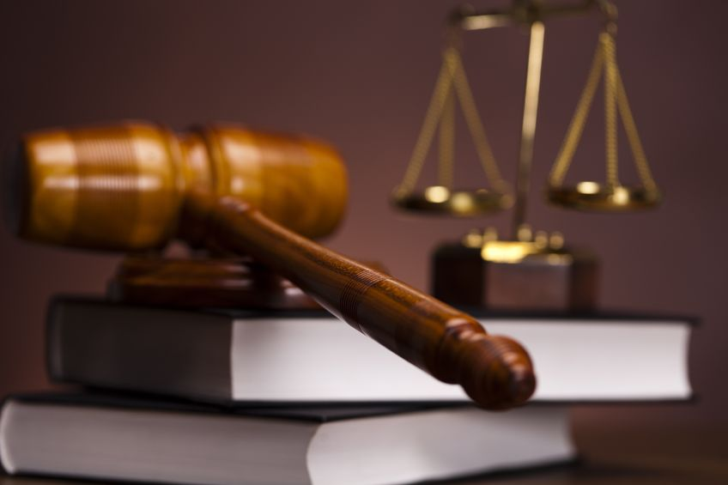
Legal Consequences of copyright infringement
Dan Murray
Injunctions
Impounding and disposition of infringing articles
Liability of damages
  Paying up
Notes:
Now, according to copyright law, there are a few consequences for copyright infringement. [4] An injunction is “a judicial order that restrains a person from beginning or continuing an action threatening or invading the legal rights of another.” [Google dictionary] It’s essentially a very severe form of “don’t do it again.” At any time during a case where copyright infringement is involved, the court may impound the copyrighted material until the case is concluded. In such cases that copyright is infringed upon by someone damaging another’s work, the infringer is liable for said damages and any profits gained from the infringement.

Slide 13
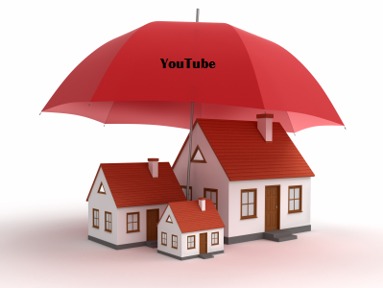
YouTube protects its users (and itself)
Dan Murray
Blanket license
Content ID
Options for companies
Notes:
Basically, YouTube takes care of it’s users. I’m sure it certainly helped get some legal troubles out of their own hair too, but by establishing the agreements with the music companies I mentioned before, the users of YouTube don’t have to worry as much about copyright infringement as they used to, and they don’t have to go through the potentially expensive process of getting licenses for every song they want to cover and make a music video for. So the answer to my initial question, do YouTube cover videos break copyright law, is: not really. While you haven’t signed into a contract with the producing company or gotten a proper license, YouTube protects you in most cases.

Slide 14
References
Dan Murray
[1] US copyright law chapter 1, http://copyright.gov/title17/92chap1.pdf, Web. 11 Sept. 2014.
[2] Robertson, Adi. "YouTube Signs Music Licensing Deal with BMG and Eight Other Publishers." The Verge. http://www.theverge.com/2012/6/6/3067636/youtube-music-licensing-deal-bmg, 6 June 2012. Web. 11 Sept. 2014.
[3] "How Content ID Works." - YouTube Help. https://support.google.com/youtube/answer/2797370, Web. 11 Sept. 2014.
[4] US copyright law chapter 5, http://copyright.gov/title17/92chap5.html, Web. 11 Sept. 2014.

Slide 15
Crowdsourcing and intellectual property
Fangwen Yuan
Crowdsourcing:
activities that are traditionally performed by a small group of professionals to be outsourced to an unknown, large community of individuals. [1]
Crowdsourcing V.S. Outsourcing [2]
Functions
labor force
rewards
quality assurance
Crowdsourcing V.S. Open source
definition
Notes:
Keywords of Crowdsourcing: unknown, online, large
Crowdsourcing V.S. Open Source:
Definition: C: computer industry, use and development free of license
Crowdsourcing V.S. Outsourcing:
Function: C: subdivide tedious work or collect ideas from broad scale
O: may involve transferring employee or assets
Labor force: C: unknown online community
O: certain third-party organization, fixed staffing model
Rewards: C: small incentives for participants OR selected winner rewarded only
O: headcount, prepayments
Quality assurance: C: no bottom line
O: Service Level Agreement

Slide 16




Types of Crowdsourcing
Fangwen Yuan
Crowd Voting [3][4]
Yelp, IMDb, Amazon Customer Ratings
Crowd Creation [5]
TopCoder, 99 Designs
Crowd Wisdom
Quora, Dell IdeaStorm
Crowd Funding
Kickstarter
Notes:
Crowd Voting: Reviews and Ratings
Crowd Creation: Professional Tasks, Designs
Crowd Wisdom: Idea & Data Collection
Crowd Funding: Fund Raising

Slide 17
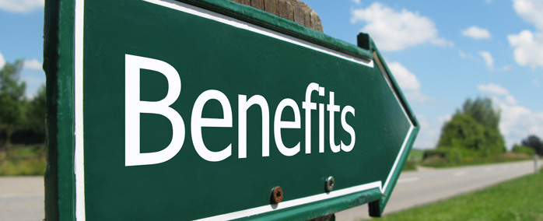
Benefits from Crowdsourcing
Fangwen Yuan
vast yet inexpensive resource
Flexible labor force
fresh perspectives from amateurs
avoid complex hiring process
First-hand ideas from potential customers
Notes:
Vast resource: Tomnod project of searching for missing flight, 3 million people engaged
Flexibility: no limitation on time, location, career
First hand ideas from potential customers: participants and consumers exactly same group of people, advertising

Slide 18
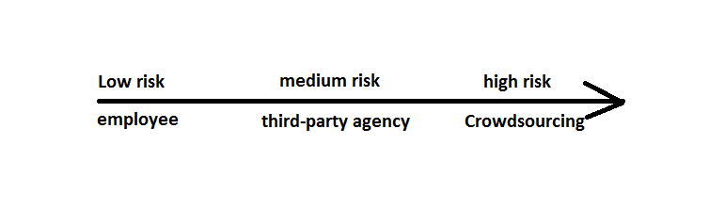
RISKS of Crowdsourcing – IP issues
Fangwen Yuan
Internally Sourced: a) company control b) works made for hire
Agency-Sourced: a) written agreements on IP issues
b) warranties & indemnification
Crowdsourcing: a) contract validity problems
b) insurance may not cover liability
c) work not considered a work made for hire [3]
Image Source: Marc Lieberstein and Ashford Tucker, Crowdsourcing and Intellectual Property Issues, http://www.acc.com/legalresources/quickcounsel/caipi.cfm, retrieved on 09-11-2014
Notes:
<speaker notes>

Slide 19
Minimize RISKS of Crowdsourcing
Fangwen Yuan
Be aware of IP issues in materials submitted through crowdsourcing
      copyrights, patents, trademarks
Require warranty of originality from contributor
Make clear provision of payments and rewards
Determine term of use by third-party companies and websites [3]
Notes:
Third-party companies: Facebook

Slide 20
Conclusion
Fangwen Yuan
Crowdsourcing is in general a friendly practice
  economic, flexible, fresh perspective
Companies have to be aware of potential IP issues
  Payment provision
  Originality
  Trademark, patents, copyrights
More regulations is needed in this industry
  IP law within the context of crowdsourcing

Slide 21
References
Fangwen Yuan
[1] Howe, J, Crowdsourcing: A Definition, http://crowdsourcing.typepad.com/cs/2006/06/crowdsourcing_a.html , retrieved on 09-11-2014
[2] The Difference between Crowdsourcing and Outsourcing, http://www.outsource-force.com/blog/the-difference-between-crowdsourcing-and-outsourcing, retrieved on 09-11-2014
[3] ABC: An introduction to Outsourcing. (n.d.) www.chnsourcing.com , retrieved on 09-11-2014
[4] Marc Lieberstein and Ashford Tucker, Crowdsourcing and Intellectual Property Issues, http://www.acc.com/legalresources/quickcounsel/caipi.cfm, retrieved on 09-11-2014
[5] TopCoder: Mission, http://www.topcoder.com/mission, retrieved on 09-11-2014

Slide 22
Class 5
The End
Keith A. Pray
Instructor
socialimps.keithpray.net
Notes:
This is the end. Any slides beyond this point are for answering questions that may arise but not needed in the main talk. Some slides may also be unfinished and are not needed but kept just in case.

