Slide 1
Class 4 Freedom Of Speech
Keith A. Pray
Instructor
socialimps.keithpray.net
Notes:
Here’s the title slide. Excited again, aren’t you? You should be.

Slide 2
Overview
Review
Assignment
Students Present
Notes:
Here’s the title slide. Excited already, aren’t you?
Perhaps show Epic Rap Battles of History: Steve Jobs vs. Bill Gates (lyrics a bit much for class)
https://www.youtube.com/watch?v=njos57IJf-0
This might be better:
Dave Audé vs Luciana - You Only Talk In #HASHTAG
http://www.youtube.com/watch?v=53wIN87lJn0

Slide 3
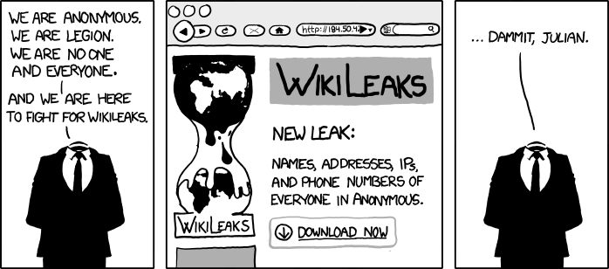
http://www.xkcd.com/834/

Slide 4
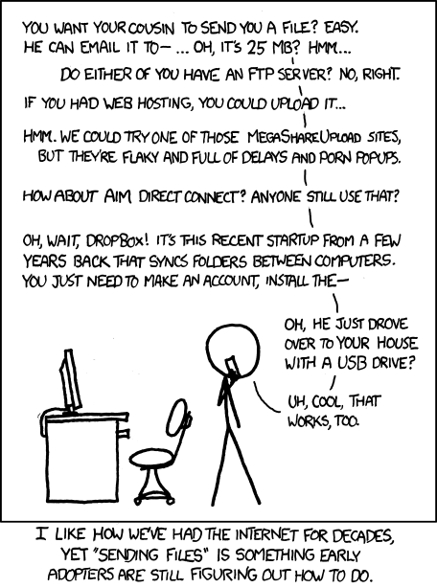
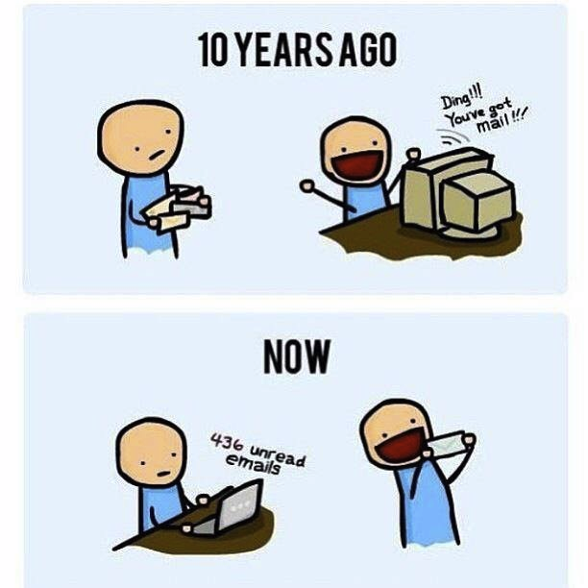
http://xkcd.com/949/
Notes:
Source for left image unknown, if you know where this came from please let me know.

Slide 5
My Reading Notes
pp. 110 What powers the cell phones and towers? “everyday tasks” not apparent from image.
pp. 111 “over a billion” contradicts pp. 38. [6] from 2008.
pp. 118 [17] from 2005, how is the quality of Wikipedia now?
pp. 131 Is 20% realistic? What will search engines and facial recognition be capable of? Rule Utilitarian ignores the private setting.
pp. 132 Do any filters use imgage processing?
pp. 135 Social Contract - Least restrictive/harmful way to achieve goal?
pp. 138 IM stats from 2002
pp. 139 Sting refs, latest from 2003.
pp. 144 addiction def, ignorance = !addict ?
pp. 146 More accurate to say addicted to single app?
pp. 159 2015 is © of text, time for update
End of Chapter questions I liked: 19, 26 (libel? Yes), 30 (http://en.wikipedia.org/wiki/Wikipedia:Citing_Wikipedia ),

Slide 6
Group Quiz
Name two methods some governments use to control access to information.
A large company has a policy prohibiting employees from blogging about company products.
Name two possible reasons for the policy.
Does it violate the First Amendment? Why?
Is it reasonable? Why?
What does “URL” stand for and what is it?
Notes:
Censorship (religious, governmental, private). Adult authentication. Global dissemination. Freedom of Speech not an absolute right.

Slide 7

Assignment
One page paper
Open source software development tools, friends or foes?
Extra Credit – One page paper
Is WPI’s IT Acceptable Use Policy morally acceptable?
Remember to work on your group project.
See full group project description on course website.
Notes:
Or review right now.
http://opensource.org/files/osi_logo_300X400_90ppi.png
Accessed 2014-09-08

Slide 8
Overview
Review
Assignment
Students Present
Notes:
Here’s the title slide. Excited already, aren’t you?
Perhaps show Epic Rap Battles of History: Steve Jobs vs. Bill Gates (lyrics a bit much for class)
https://www.youtube.com/watch?v=njos57IJf-0
This might be better:
Dave Audé vs Luciana - You Only Talk In #HASHTAG
http://www.youtube.com/watch?v=53wIN87lJn0

Slide 9
Social Media
Kevin Zhao
Social Media =/= Social Networking
Social Media
The content that is created and/or uploaded. ^{[1]}
Videos, blogs, podcasts, newsletters, pictures, etc.
Many platforms for social media
Websites such as Facebook, Twitter, YouTube, etc.
72% of all internet users are active of social media sites.^{[2]}
What effects does social media have on everyday society?
Notes:
Hello, today I will talk about social media and the impact that it has had on our society.
First off, social media is not the same thing as social networking. Fairly common misconception.
Specifically, social media is the actual content that is created and shared with others. Videos, blogs, podcasts, and newsletters are among some of the many forms that social media can take.
There are many ways that social media can reach other people. Websites like Facebook, Twitter and YouTube allow users to create and upload their content for others to look at. In fact, the number of people on social media sites consists of almost three-fourths of all internet users.
So the question is, what effect does social media have?

Slide 10
Negative effects of Social Media
Kevin Zhao
Unreliable News Articles
Less fact-checking, more crowd-checking. ^{[3]}
“Publish first, correct if necessary.”
Less objective, more personal. ^{[3]}
Distractions
Students say social media sites distract them from completing assignments. ^{[4]}
Companies can waste $10 million per year because of social media distractions. ^{[5]}
Notes:
Let’s first see what negative effects social media has had.
Journalists have started to become less thorough in their work, often putting out articles that reflect consumer opinion rather than an organization’s statements. Fewer journalists fact-check their work, often correcting it after it has been published. They have also started to share their own personal opinion, which is worrying because they should be objective when reporting news facts.
Social media is also costing people time and money. Companies are especially hurt if an employee is checking sites like Facebook as the worker’s productivity comes to a standstill.

Slide 11
Positive Effects of Social Media
Kevin Zhao
Expose people to new ideas
More information allows for more exposure
Learn about related topics
Increased awareness
ALS Ice Bucket challenge, raised over $100 million.
“Arab Spring” demonstrations.^{[6]}
Improved Literacy
Children that use social media have improved reading and writing skill.^{[7]}
Notes:
Despite all the problems that social media causes, there are multiple positives as well.
Social media sites often expose their users to topics that they might find interesting, while social media helps to express those ideas.
Due to the large number of people using and viewing social media, people become more aware of the world around them. The ALS Ice Bucket challenge helped to notify America of Lou Gehrig’s disease, a nerve-based disease, and has raised over . There was also the “Arab Spring”, which was briefly detailed in the book. The protesters utilized social media to help get the word out about their cause.
Children use social media quite often. Due to the constant exposure of information, they tend to develop early communication skills, and are more literate as a result.

Slide 12
Conclusion
Kevin Zhao
Social media has positive and negative effects
Unreliable and a distraction.
Can be used to educate users.
Find balance.
Have some exposure, but limit it.
Questions?
Notes:
In conclusion, like all technologies, social media both benefits and detriments society. The news you get can be unreliable and distract you from what you are doing, but you may be able to learn and benefit from it.
Overall, I believe social media had definitely benefitted society more than it has hurt it. We can definitely use Social Media to our advantage, but not so much that we become distracted or totally reliant on it.
I will now open the floor to questions.

Slide 13
References
Kevin Zhao
[1] Fauzia Burke, “Social Media vs. Social Networking”, http://www.huffingtonpost.com/fauzia-burke/social-media-vs-social-ne_b_4017305.html (9/7/2014)
[2] Jeff Bullas, “22 Social Media Facts and Statistics You Should Know in 2014”, http://www.jeffbullas.com/2014/01/17/20-social-media-facts-and-statistics-you-should-know-in-2014/ , (9/7/2014)
[3] “2014 Study impact of Social Media on News: more crowd-checking, less fact-checking”, http://www.ing.com/Newsroom/All-news/NW/2014-Study-impact-of-Social-Media-on-News-more-crowdchecking-less-factchecking.html (9/7/2014)
[4] Phil Dunn, “Students say social media interfere with homework”, http://www.usatoday.com/story/news/nation/2013/01/15/students-social-media-homework-distraction/1835461/ (9/7/2014)
[5] Jolie O’Dell “Social Media Distractions Are Costing Businesses Major Money” , http://mashable.com/2011/05/27/digital-distraction-survey/ (9/7/2014)
[6] Quinn, Michael J. Ethics for the Information Age, 6th Edition (Pearson Education, 2011) p. 122
[7] “How Social Media has Changed the world? 5 Impacts of Social Media in Our Lives”, http://webseo22.hubpages.com/hub/How-Social-Media-Has-Changed-the-World-Impact-of-Social-Media-on-Our-Lives (9/7/2014)

Slide 14
Class 4 The End
Keith A. Pray
Instructor
socialimps.keithpray.net
Notes:
This is the end. Any slides beyond this point are for answering questions that may arise but not needed in the main talk. Some slides may also be unfinished and are not needed but kept just in case.

