Slide 1
Class 8
Privacy
Keith A. Pray
Instructor
socialimps.keithpray.net
Notes:
Here’s the title slide. Excited again, aren’t you?
Mention last paper will not be handed back today due to lack of conclusions, arguments, counter points… thought you’d like us to take the time to be more flexible in finding these required elements.

Slide 2
Mid Term Survey Results
Notes:
Not all feedback incorporated, many 1 off comments that I would be happy to discuss, just bring them up.
Some requests for less wit, some for more.

Slide 3
Overview
Privacy
Assignment
Students Present

Slide 4
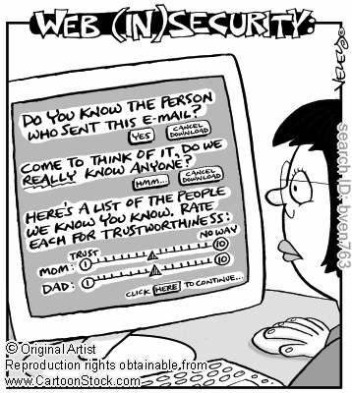
Notes:
Accessed 2011-09-19

Slide 5
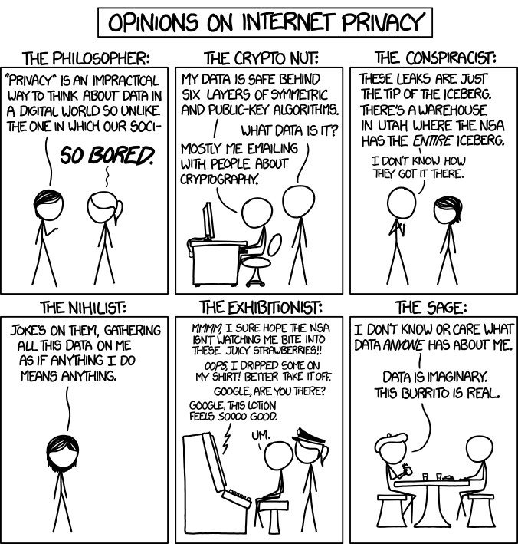
http://xkcd.com/1269/
Notes:
1. Accessed 2014-04-14

Slide 6
Group Quiz
List two problems with using biometrics for identification.
List two advantages of using biometrics for identification.
Describe two tools people can use to protect their privacy on the Web.
For Daniel Solove’s taxonomy of privacy give an example not listed in the book of the 4 categories.

Slide 7
Overview
Privacy
Assignment
Students Present

Slide 8
Assignment
One Page paper:
  Will eliminating anonymity make computers more secure?
  Sources could include legislation not covered in your text concerning computer related crimes.

Slide 9
Overview
Privacy
Assignment
Students Present

Slide 10
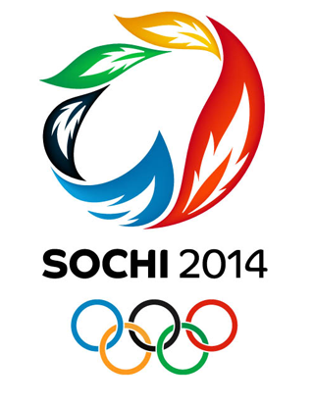
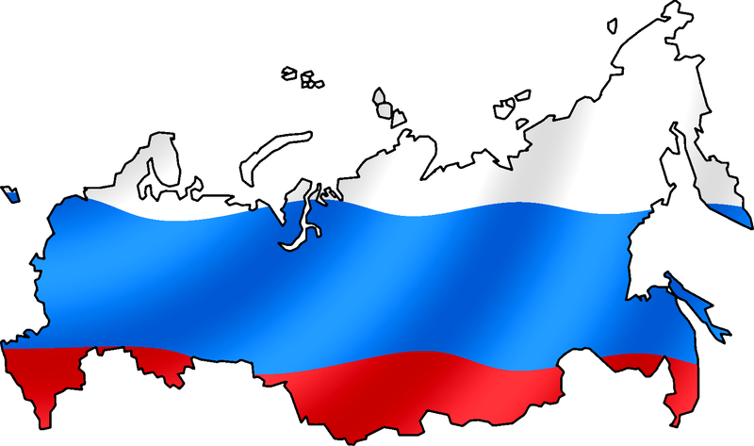
Information Privacy and the Russian Government
Keaton Smith
http://www.mediabistro.com/prnewser/files/2014/02/Sochi-2014-Company-Olympics.png, accessed 10 April 2014
http://upload.wikimedia.org/wikipedia/commons/thumb/e/e5/Russian_Flag_with_map.png/800px-Russian_Flag_with_map.png, accessed 10 April 2014
Notes:
Using Sochi Olympics as a case study for the attitude of the Russian government on information privacy—provides a unique glimpse into the structure and policies of Russian government, being such a large and public event.

Slide 11


Precedents in the Olympics
Keaton Smith
Electronic communications monitoring
CCTV cameras and facial recognition
http://upload.wikimedia.org/wikipedia/en/thumb/4/47/2002_Winter_Olympics_logo.svg/450px-2002_Winter_Olympics_logo.svg.png, accessed 10 April 2013
http://en.academic.ru/pictures/enwiki/50/200px-London_Olympics_2012_logo.svg.png, accessed 10 April 2013
Notes:
Surveillance has been a big thing in the Olympics in the past—the sheer magnitude of the event makes it a target for terrorism.
That many people in close proximity can simply cause tension as well. Governments do need some way to ensure safety.
Tactics of the United States at Salt Lake City, 2002: monitoring electronic (email, cell phone) communications around the venue
Filtered for key words and analyzed for potential threat
Tactics of Great Britain at London, 2012: closed circuit television (CCTV) cameras all around the city

Slide 12
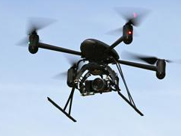
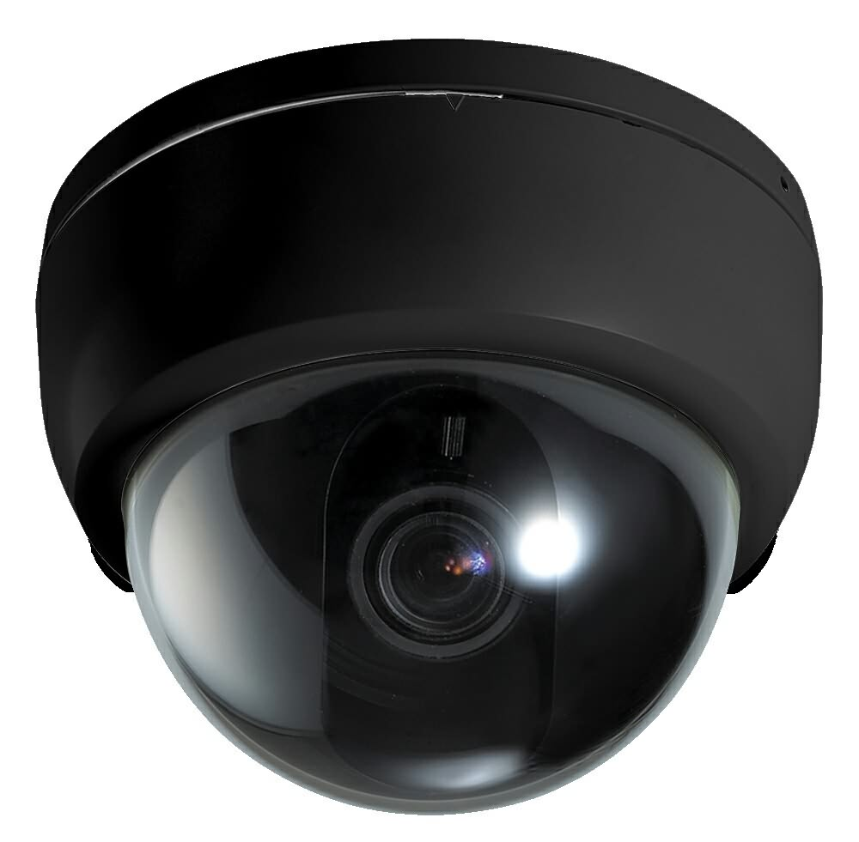
Sochi 2014 Practices
Keaton Smith
Surveillance drones and cameras
Wifi and 4G with deep packet search
Physical screenings and searches
http://www.sysconinfo.com/images/Dome-Cameras-Security-Camera-2MCCTV-2M-D1700N.jpg, accessed 10 April 2013
http://www.slate.com/content/dam/slate/articles/technology/future_tense/2013/02/130211_FUT_SurveillanceDrone.jpg.CROP.article568-large.jpg, accessed 10 April 2013
Notes:
Surveillance cameras everywhere (even monitoring showers)
Surveillance drones flying around
Monitoring all electronic forms of communication (calls, texts, emails)
Free wifi (which included deep packet searching to allow for keyword monitoring of all web communication)
Physical screenings
Vehicle searches

Slide 13
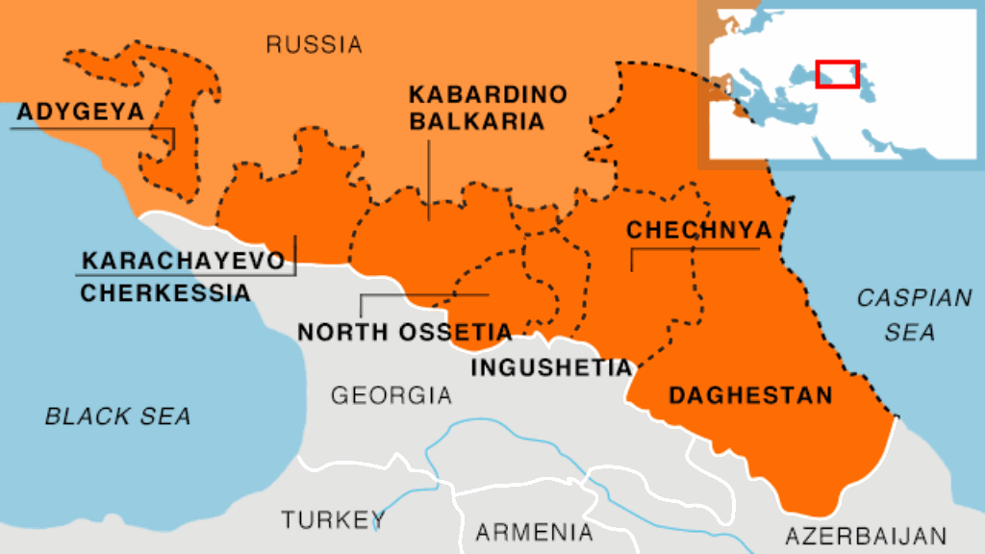
Reasons for Sochi Security
Keaton Smith
http://gdb.rferl.org/401335D4-EB2A-4363-893D-EF6FBAAE8E3F_mw1024_n_s.gif, accessed 10 April 2014
Notes:
There are definitely legitimate reasons for the increase in security at Sochi—threats were received from terrorist groups in the North Caucasus (very near to Sochi). Some response was certainly needed in order to ensure the safety of athletes and spectators.

Slide 14
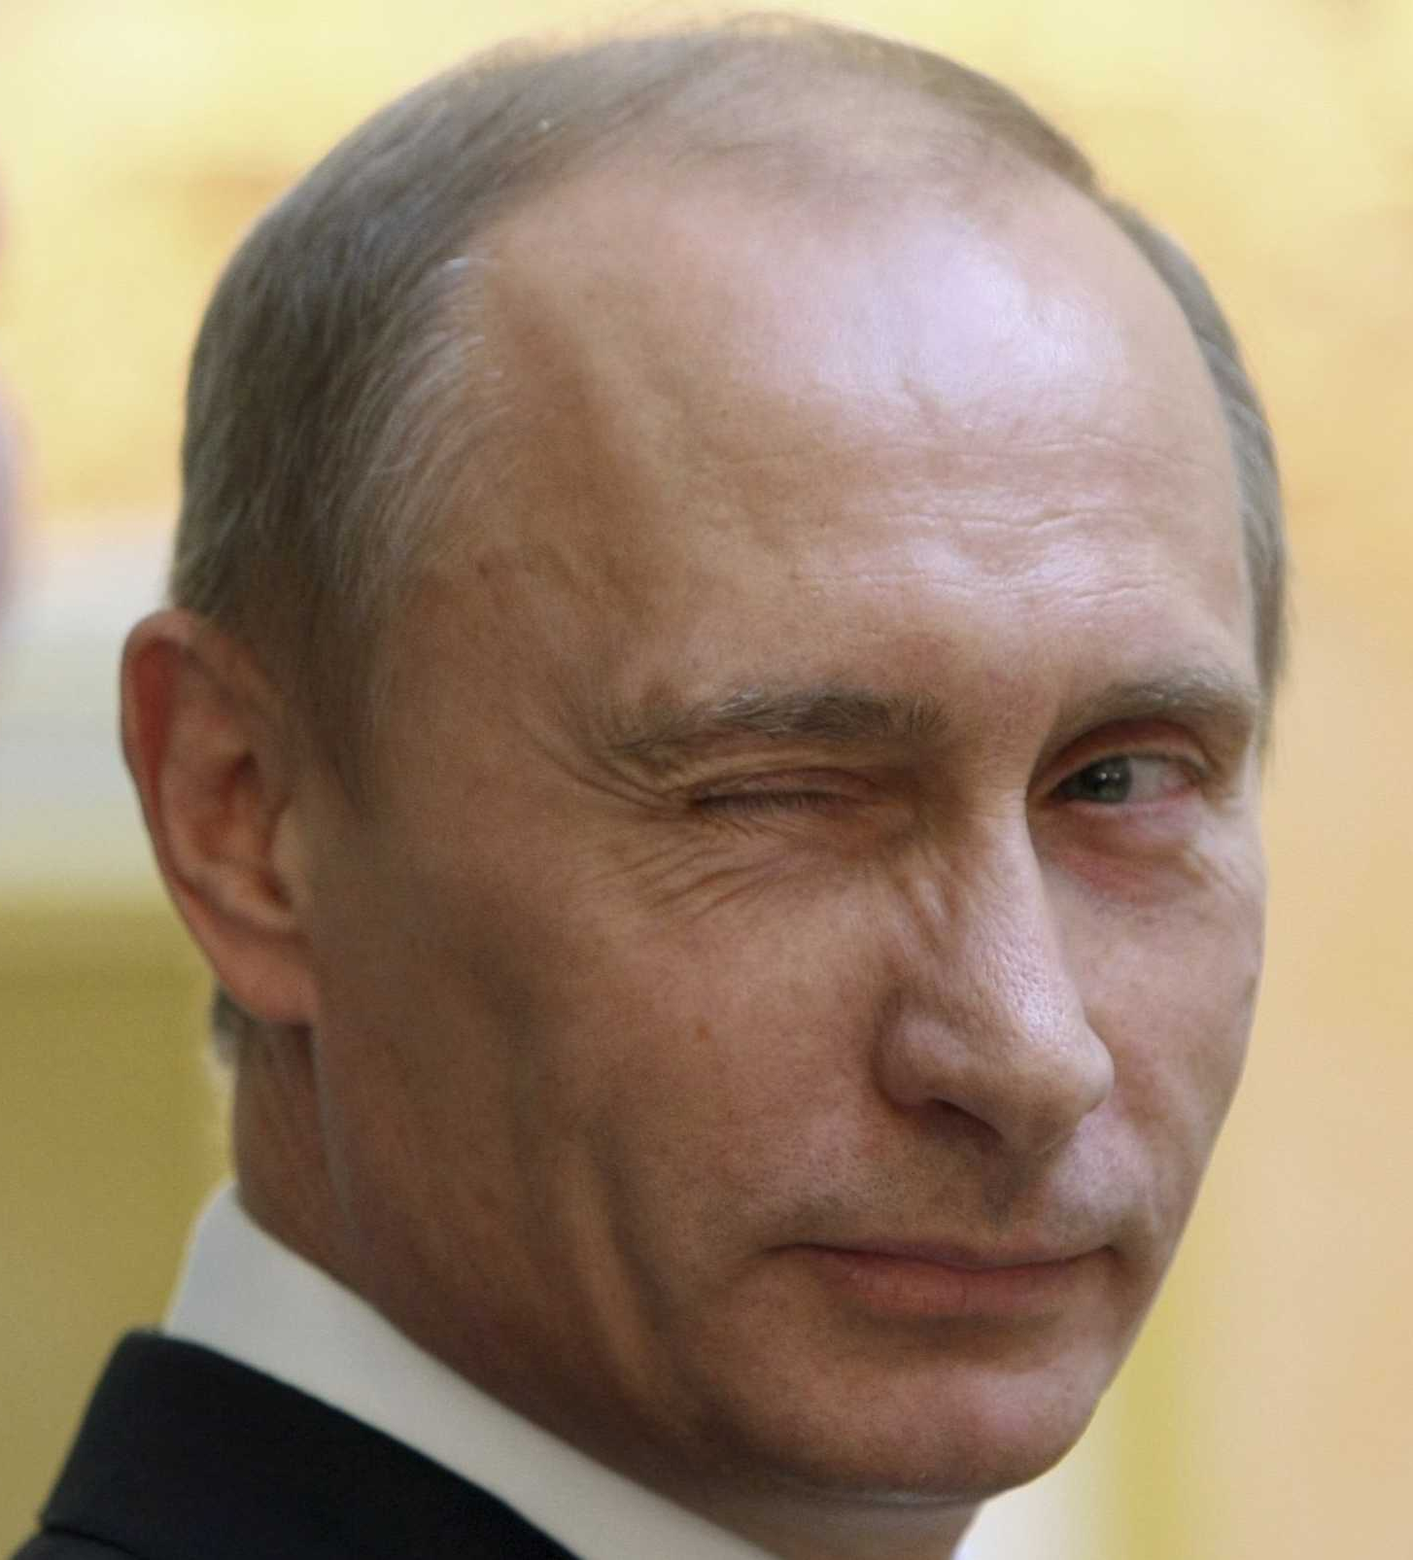
Attitude of the Russian Government
Keaton Smith
Policies are more in favor of government action than previous Olympics
Seems more relaxed about personal privacy infringement
http://static2.businessinsider.com/image/5232093ceab8ea8a68966704/meet-the-pr-firm-that-helped-vladimir-putin-troll-the-entire-country.jpg
Notes:
However, despite the reasons for the increased surveillance, the Russian government may have taken it too far with respect to personal privacy infringement.
“Admission” of bathroom surveillance – official came out with it, but then the government tried to cover it up
Don’t need to show search warrants (but still required to get them)
No need to go through service providers to get data—government has direct
How much of the surveillance was for the protection of the people at the Olympics and how much was for the protection of the government against rebels?
All this might point to more…nonchalance on the part of the government. More willingness to compromise personal privacy in favor of their own goals.

Slide 15
Sources
Keaton Smith
Brown, Hayes, “New Report Details Massive NSA Domestic Surveillance Around Salt Lake City Olympics”, http://thinkprogress.org/security/2013/08/21/2501621/nsa-surviellance-salt-lake/ (10 April 2014)
Johnson, Kevin, “Eyes in the sky watching everyone in London, at Olympics”, http://usatoday30.usatoday.com/sports/olympics/london/story/2012-07-31/surveilance-cameras-london-olympics-police/56614022/1 (10 April 2014)
Business Insider, “13 Security Measures That Will Put A ‘Ring of Steel’ Around The Sochi Olympics”, http://www.businessinsider.com/security-sochi-olympics-russia# (10 April 2014)
Ingersoll, Geoffrey, “Russian Deputy PM: We’re Surveilling Sochi’s Showers”, http://www.businessinsider.com/hotel-shower-surveillance-footage-in-sochi-shows-sabotage-2014-2 (10 April 2014)
Galperin, Eva and O’Brien, Danny, “Russia Blocks Access to Major Independent News Sites”, https://www.eff.org/deeplinks/2014/03/russia-blocks-access-major-independent-news-sites (10 April 2014)
M., Kalyani, “Russian Government Installs Olympic Surveillance”, https://spideroak.com/privacypost/cloud-security/russian-government-installs-surveillance-for-2014-winter-olympics-2/ (10 April 2014)
Notes:
<Your notes here.>

Slide 16
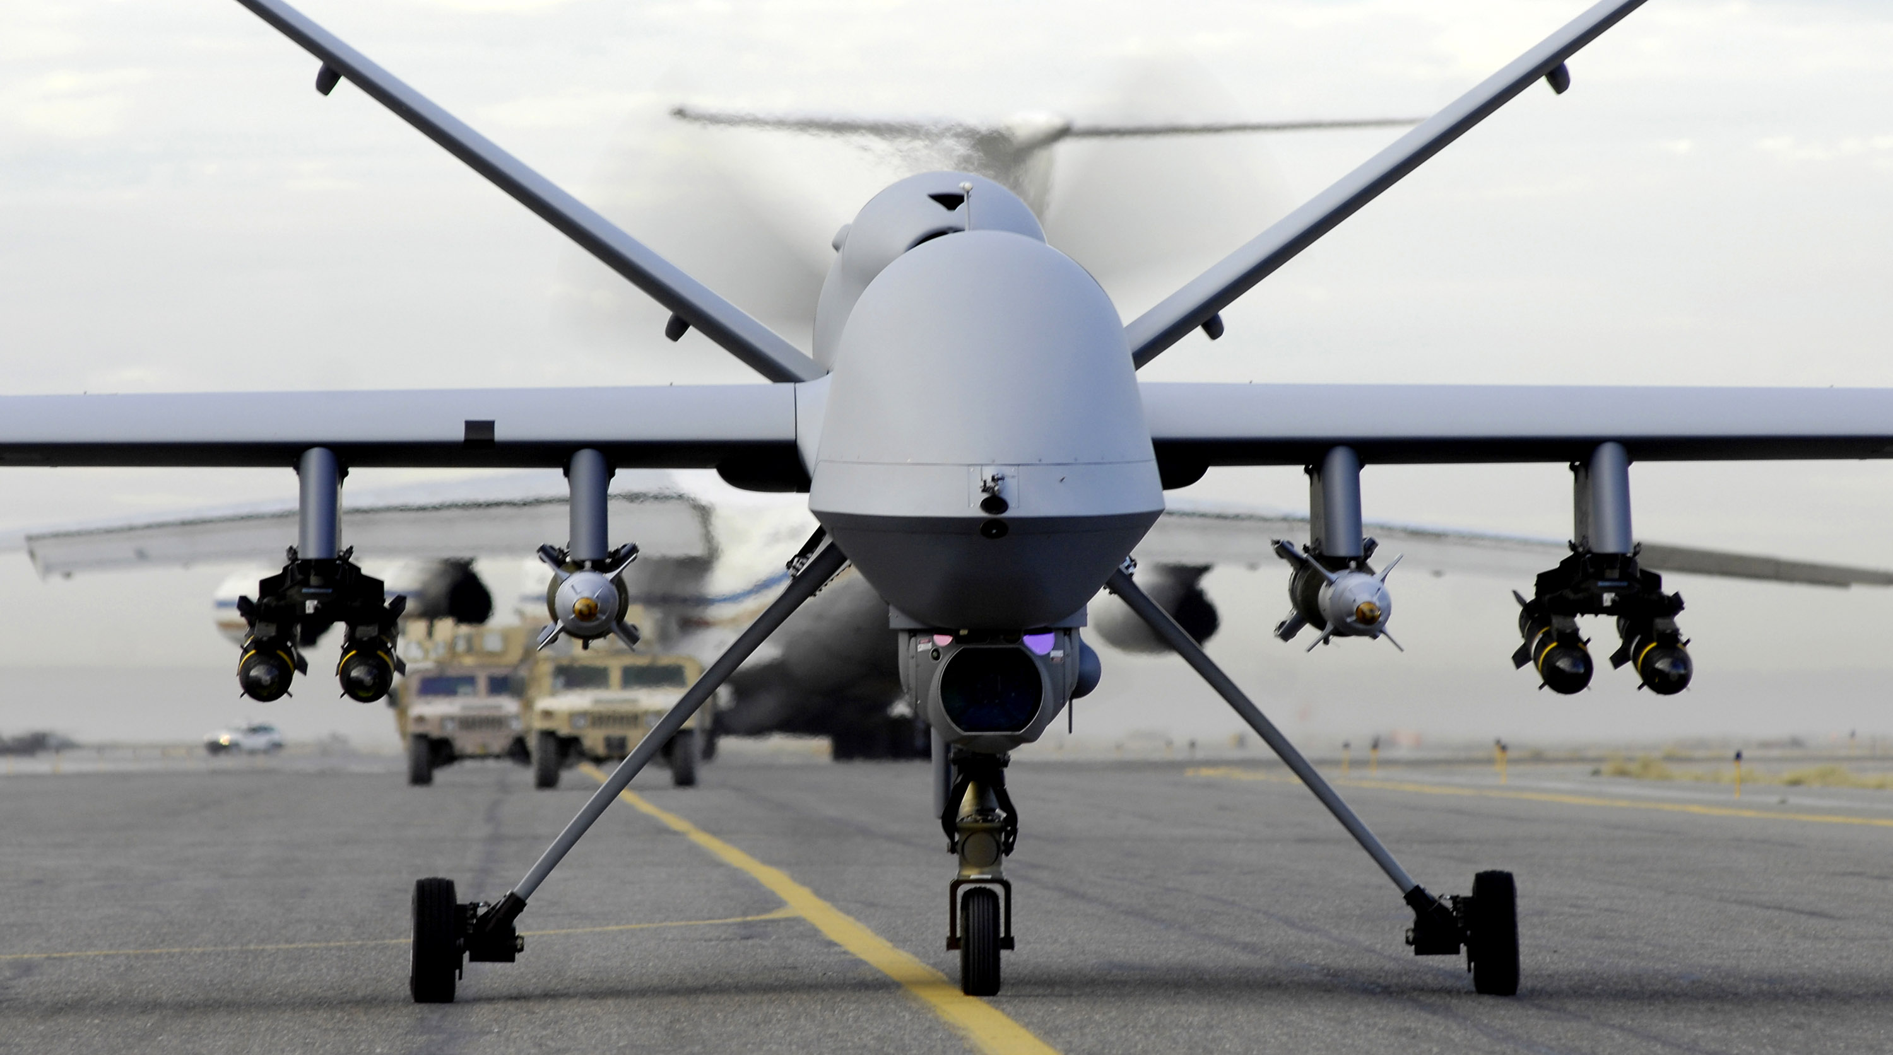
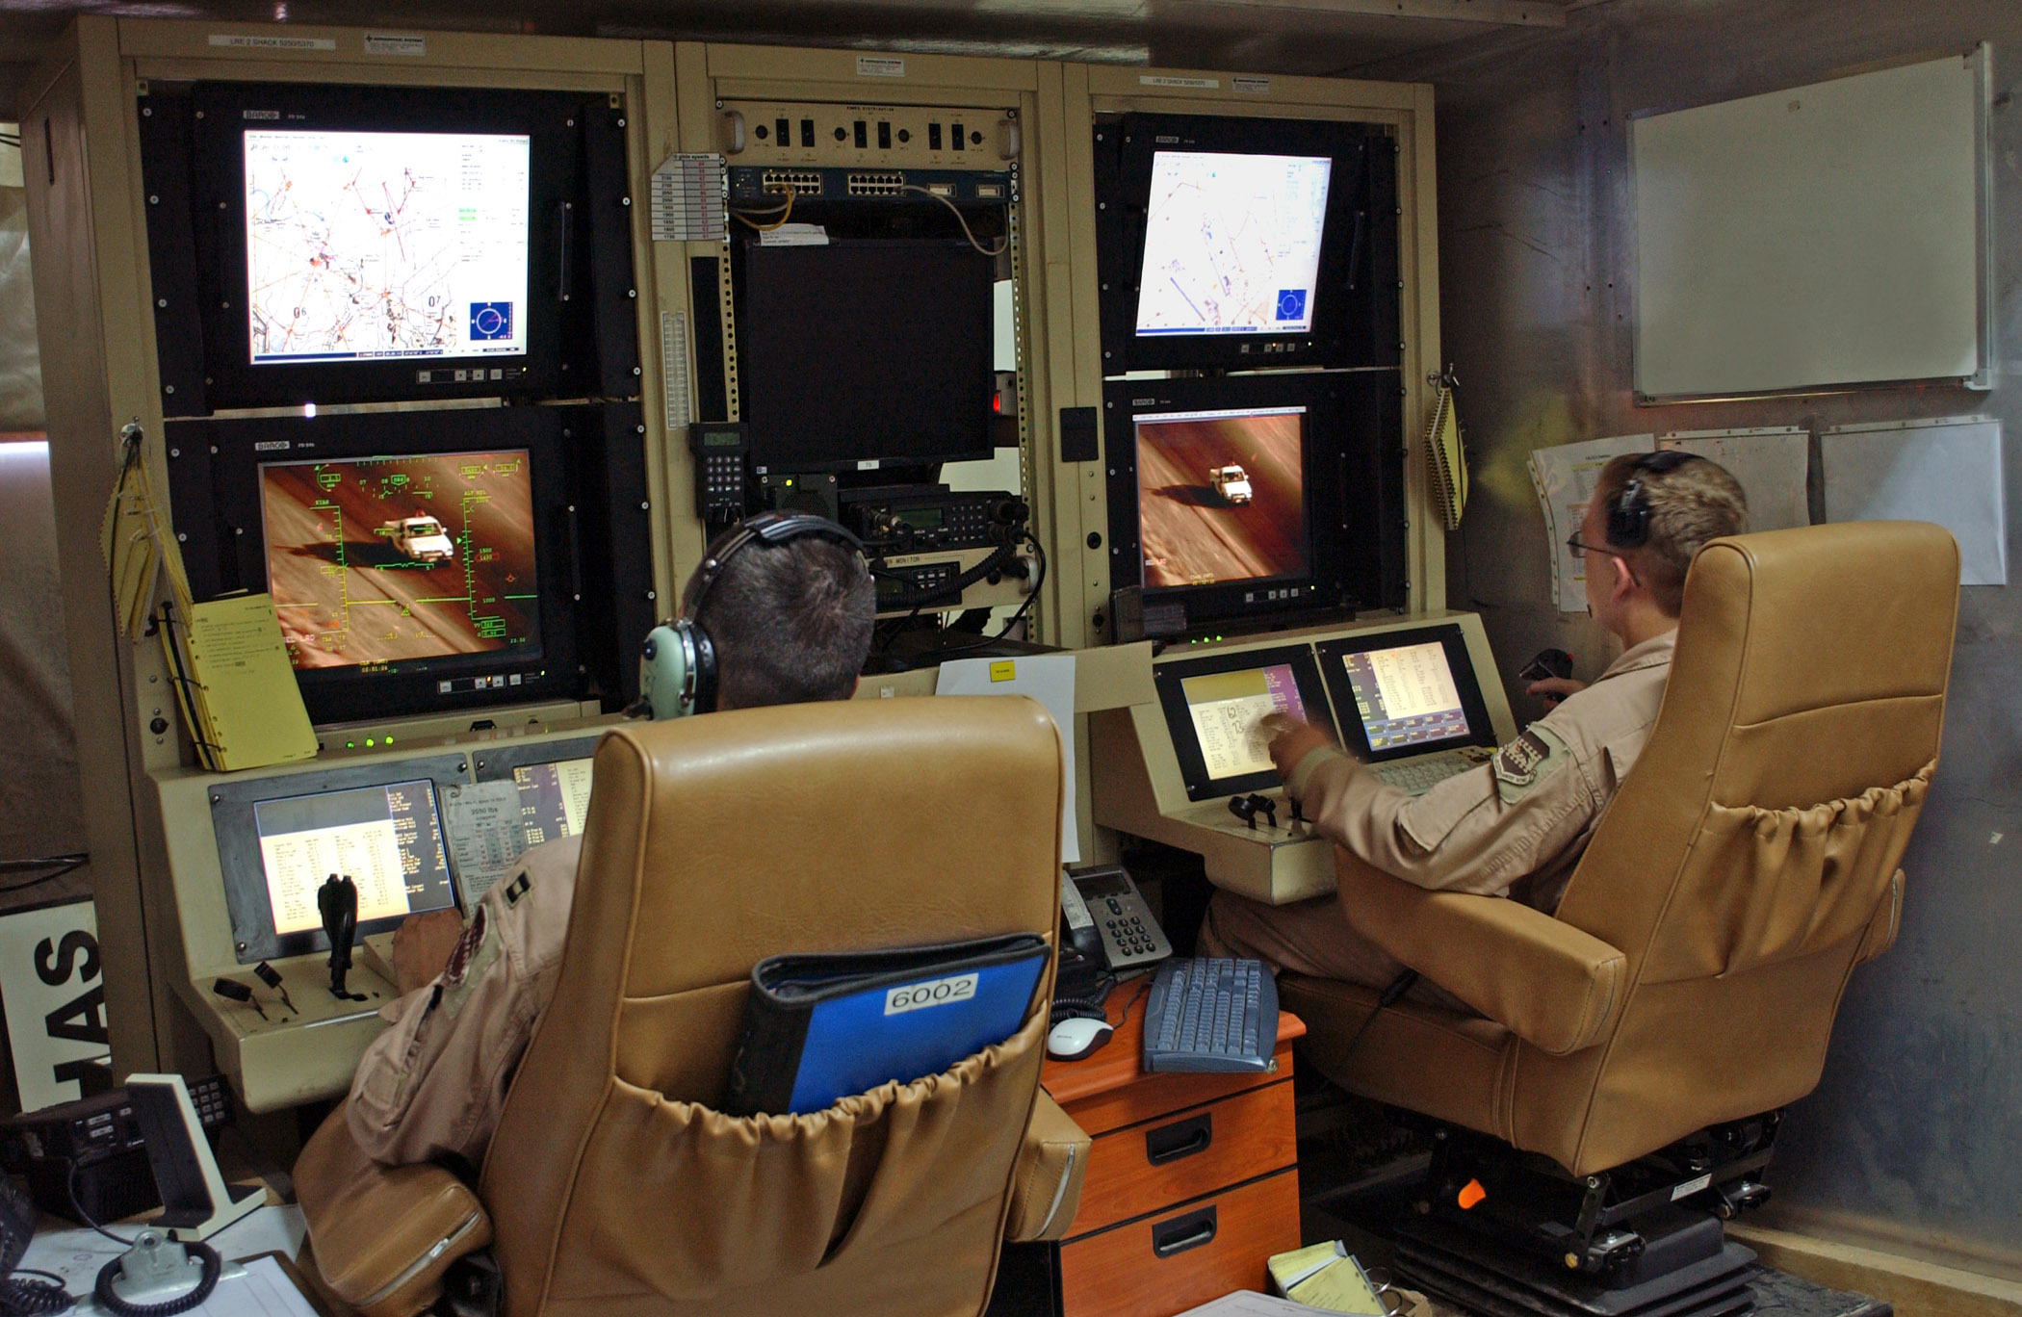
What is Drone?
Yihao Zhou
An unmanned aerial vehicle (UAV)
Control autonomously by onboard computers
Or remote control of a pilot on the ground
Usually contains different sensors
Images From: http://en.wikipedia.org/wiki/General_Atomics_MQ-9_Reaper
Notes:
An unmanned aerial vehicle (UAV), commonly known as drone, is an aircraft without a human pilot aboard. Its flight is controlled either autonomously by onboard computers or through the remote control of a pilot on the ground or in another vehicle. The drone usually contains many different sensors, including cameras, GPS, or laser spectroscopy, etc. Depending on its purpose, the drone can have different sensors.

Slide 17
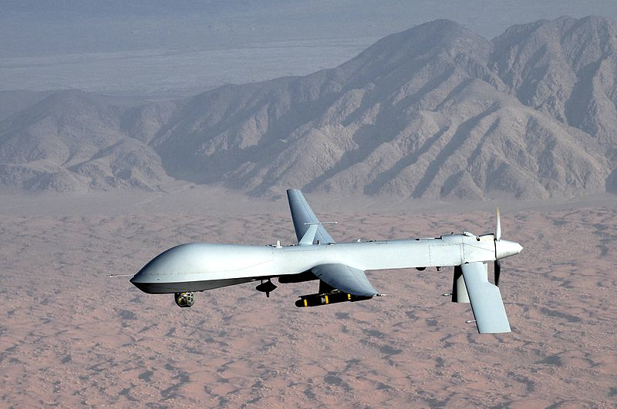
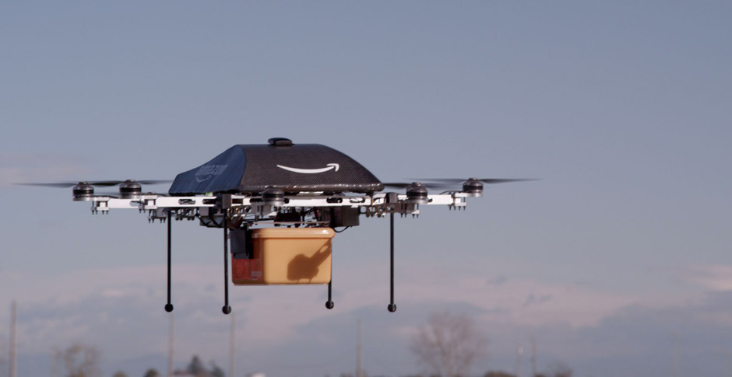
What does drone do?
Yihao Zhou
Military
  Target and decoy
  Reconnaissance
  Logistics
Commercial
  Monitoring
  Home security
  Package delivering
Civil
  Domestic policing
  Domestic surveillance
http://en.wikipedia.org/wiki/General_Atomics_MQ-1_Predator
http://www.amazon.com/b?node=8037720011
Notes:
In terms of the functionality, the drones typically fall into the three categories, which are military, commercial and civil.
The drone was first designed to be used in military in order to find enemy target, provide a reconnaissance and logistics. The most famous combat drones US Air force used in Iraq and Afghanistan are MQ-1 Predator and MQ-9 Reaper.
For commercial use, drone can be used to monitor the large factory or farm. Individual can use drone for home security. Recently, Amazon announces it will start delivering package using drones.
For government, drones can be used to help local police for law enforcement. Government can also use drone for large scale domestic surveillance.

Slide 18
Domestic Policing & Surveillance
Yihao Zhou
Polices in Canada and US are using drones Searching and detecting criminals
Cost less than using helicopter
The CBP used MQ-9 UAVs in border area to watch the illegal immigrants and smuggling Marijuana
Notes:
Many polices in Canada and US are using drones to enhance their police force. The drone can be used in searching and detecting criminals so that polices know when and how to take actions. It cost less money comparing of using helicopter.
In 2005, the US Customs and Border Protection ordered a Predator B UAV for border protection, specifically for watching illegal immigrants and smuggling marijuana. That one crashed in 2006 by accident. Currently the CBP operates nine drones.
It also loaned drones to other domestic agencies, like FBI, ICE for other purposes.
In 2011, a cattle rancher from North Dakotan was arrested because he refused to return his cows that were walking outside his property and armed with weapon when police coming. As the result, police used Predator to locate the target and let police know when it was safe to make an arrest. He was the first guy who was arrested under the help of drone and his lawyer said that using drone was illegal because it was dispatched without a warrant. However, the court disagreed with it and saying it was not an improper use of drone in this case.

Slide 19
What is drone capable of?
Yihao Zhou
It can track individuals from 25,000 feet automatically
It has drone-based facial recognition and biometrics systems
It has a mind-blowing 1.8 gigapixel camera and cover 36 square miles in one snapshot
Notes:
The MQ-9 UAV is capable of tracking individuals from 25,000 feet above the ground as the result of combining two advanced technologies.
One is drone-based facial recognition and biometrics systems, which can snap images of face quickly and form into a 3D model of face and verify the identity.
Another one is a super high resolution camera with 1.8 gigapixel and can cover 36 square miles in one snapshot.

Slide 20

Conclusion
Yihao Zhou
Warrant and data collection
reports are required
Operator must be accountable and
transparent to public
Avoid domestic drones weaponized
Related laws need to be established
Image from: http://blog.check-and-secure.com/bt-thinks-good-talk-nsa/
Notes:
Due to its mobility and invisibility, the domestic drone technology can be a huge threat to the society if used in a wrong way. So the following suggestions need to be considerate.
Every drone surveillance action need to have a warrant and a detail report of what data is collected
Whoever operating the drone must be accountable and transparent to public
Government should avoid domestic drones carrying any types of weapons
Related laws and regulations need to be established
Otherwise, the drone could be the eye of “Big Brother”, watching you all the time.

Slide 21
Sources
Yihao Zhou
“Unmanned aerial vehicle” http://en.wikipedia.org/wiki/Unmanned_aerial_vehicle 10 April 2014
Jason Koebler “North Dakota Man Sentenced to Jail In Controversial Drone-Arrest Case” http://www.usnews.com/news/articles/2014/01/15/north-dakota-man-sentenced-to-jail-in-controversial-drone-arrest-case 10 April 2014
Jennifer Lynch “Customs & Border Protection Loaned Predator Drones to Other Agencies 700 Times in Three Years According to “Newly Discovered” Records” https://www.eff.org/deeplinks/2014/01/newly-discovered-drone-records-show-customs-border-protection-flew-its-predator 10 April 2014
End the Lie “VADER: drone-based system automatically spots and tracks people from 25,000 feet” http://endthelie.com/2012/12/07/vader-drone-based-system-automatically-spots-and-tracks-people-from-25000-feet/ 10 April 2014
End the Lie “The U.S. military is operating drones domestically and sharing data with law enforcement” http://endthelie.com/2012/06/05/the-u-s-military-is-operating-drones-domestically-and-sharing-data-with-law-enforcement/ 10 April 2014
Notes:
<Your notes here.>

Slide 22
Edward Snowden - Overview
Mi Tian
Outline
  Review the story timeline
  Read the corporate PR reactions
  Discuss the influences
Focus on the facts, not the controversies
  Edward Snowden: Hero or Traitor?
  Privacy vs. security: which is more important?
  Not making judgments
Notes:
Self introduction.
Topic is “Edward Snowden and the NSA scandal”.
The outline shows the structure of my presentation. I will start with a brief review of the story along its timeline. Then I will cite the corporates’ PR reaction and try to read what might be hidden behind the words. Last part I will discuss the influences of the Edward Snowden revelation had on the society and the government.
I’d like to mention before head that this is a very controversial topic, especially around these two questions. I am nobody to argue those controversies or make any judgment on your government or Edward Snowden. So my goal is really to summarize what I learnt about the facts around this event, and perhaps ope n interesting discussions in the class.

Slide 23
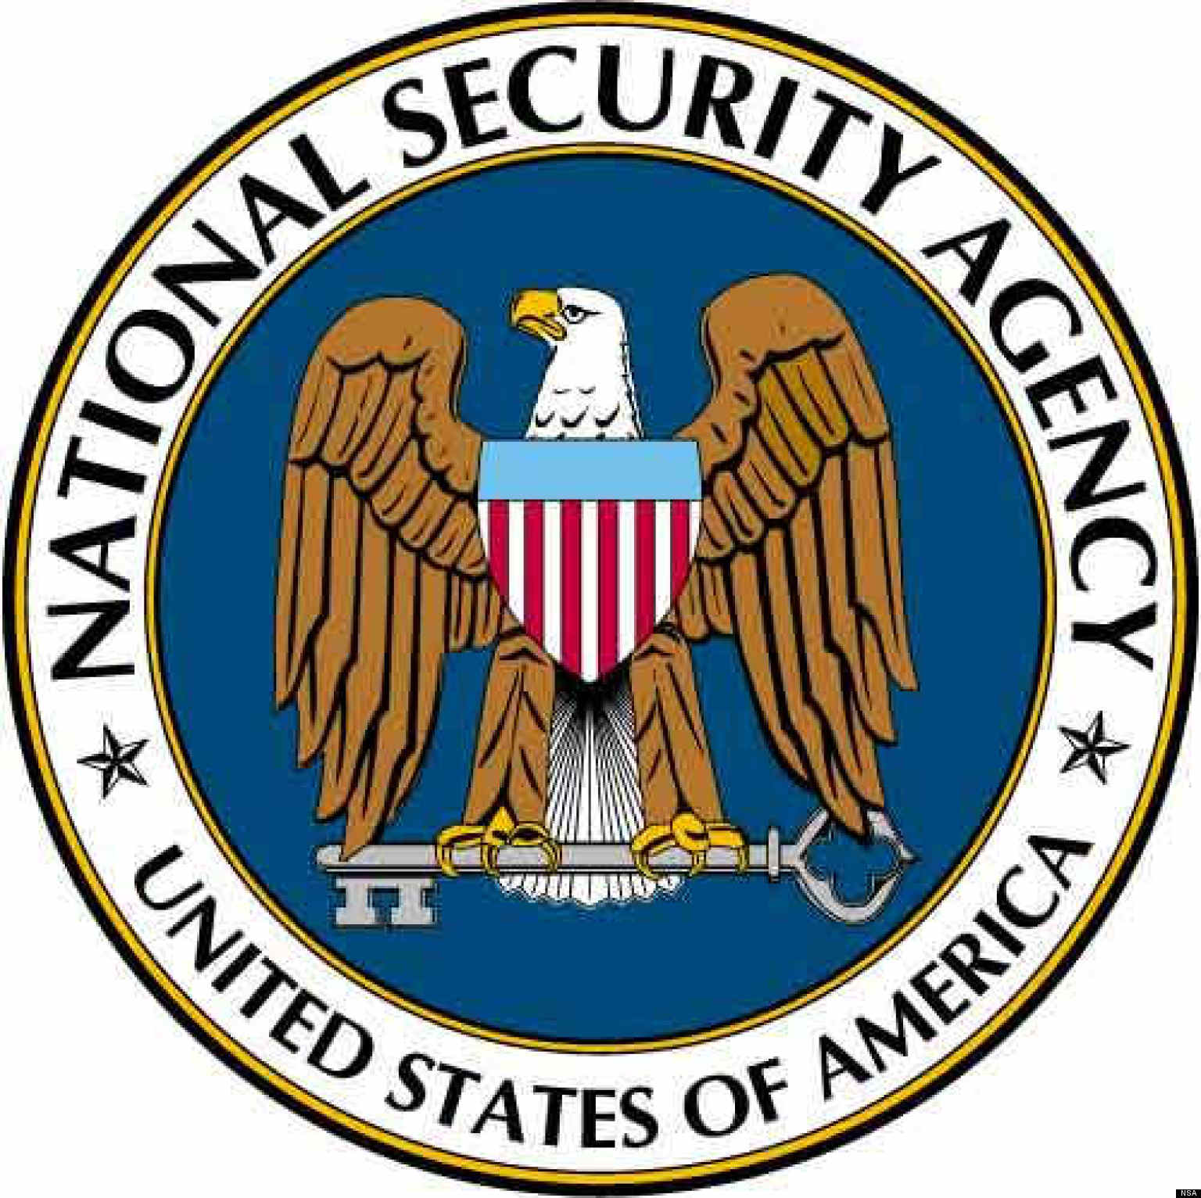
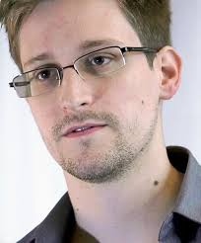
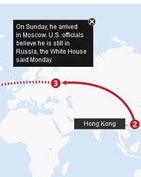
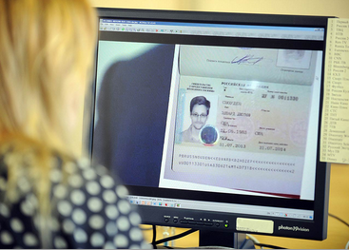
Edward Snowden
Mi Tian
A system engineer working for the NSA
Revealed top-secret NSA project documents [1]
6.5 to 6.8
NSA documents revealed
6.9 to 6.12
Snowden interviews
6.21 to 6.23
Flew to Moscow
8.1
Received 1 year asylum in Russia.
Notes:
On June 7th, 2013, the Guardian revealed top-secret NSA internal documents indicating secret projects developed for years inside the NSA for monitoring the online data of Americans. The project that draw the most attention is the PRISM project, which gives NSA agents access to private user data from nine leading tech companies, including Google, MS, Apple, Yahoo, and so on. This program covers so many companies and different forms of online data that it basically allows NSA to monitor anyone, anywhere, and at any time.
The document also shows the PRISM program has been developed for at least five years. If Snowden did not reveal this, the public would never know who is looking at, processing, and storing their private everyday information.
Several days later, Edward Snowden, a system engineer who worked for the NSA, revealed himself in two interviews in Hong Kong. He claimed that he was the one who revealed the secret documents, and justified his reason as that he could not stand anymore to live in a country that spies everyone, at any time, in any form.
In ten days, US issued a request to Hong Kong government to extradite Snowden. But the next day, Snowden took a flight to Moscow to seek asylum.
He stayed in the Moscow airport for 39 days until getting a 1 year asylum certificate from Russia.

Slide 24
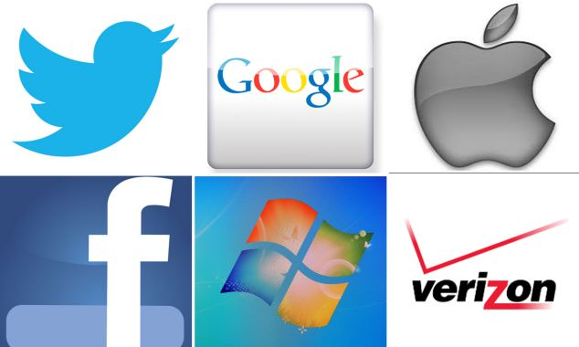
Corporate PR Reactions
Mi Tian
Washington Posts initial report about PRISM [4]
  “it gives NSA direct access to corporate servers”
Google, Facebook, Yahoo!, Apple react [3]
  “We do not provide them direct access”
  “We have never heard of PRISM”
Speculation of how PRISM works [2]
  No direct access to corporate servers
  Request (NSA) → filter (FBI) → response (corporate)
Notes:
This revelation shocked everyone, not only US citizens, but also people from all over the world, because the documents shows the surveillance is primarily targeted at foreign citizens, such as people from China, the mid-east, and North Korea.
It put the NSA and the nine corporates at the center of the storm. The nine companies had to make quick PR move.
Looking at their statements, we can find two clear trends. It seems all companies were biting on Washington Post’s phrase in their initial report. First, they all denied providing NSA *direct* access to their servers. But they did not deny providing any type of access to their users’ private data. Second, they all claimed they had never heard of anything called *PRISM*. But it is not uncommon to hold back an internal code name of a project. Sharp analysts start to speculate the meaning behind these reactions.
They believe that these corporates are definitely working with NSA, but the access to user data is definitely not direct. The speculative model of their dataflow is that the NSA agent will request for data (such as email, chat,) when suspicions appear from other sources. The FBI will then process the request to filter out monitors against American citizen. And finally, the corporate will have their people or some automatic software to query the data, and send back to NSA. This may be why all the companies are denying “direct” access.

Slide 25
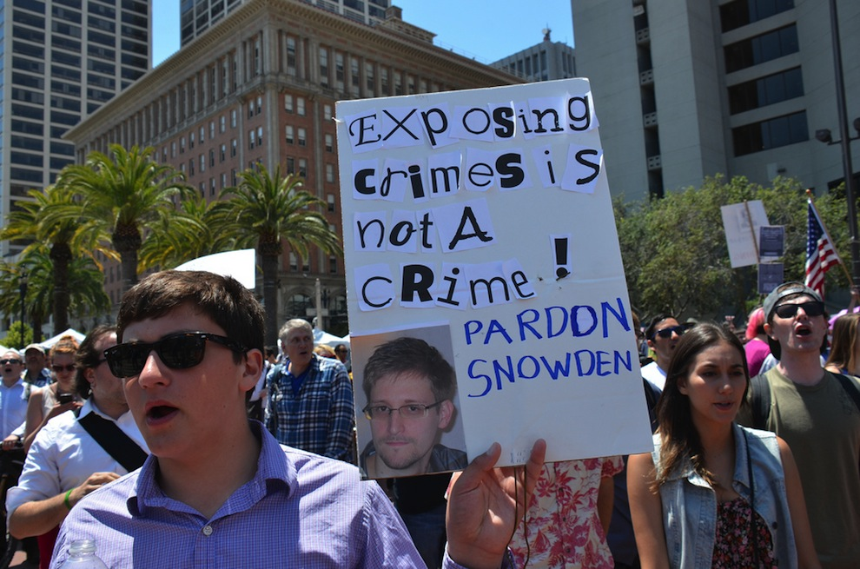
Influences
Mi Tian
International debate
  Edward Snowden: Hero or Traitor? [5]
  Privacy vs. security: which is more important?
Domestic pressure on US government
  Society asks for transparency in government activity
International pressure on US government
  NSA spies on Hong Kong and Chinese citizens [1]
  NSA spied during 2010 G8 and G20 summit [6]
Notes:
The influences of this scandal is huge, broad, and far reaching. It raised international debate, some questioning Edward Snowden’s conduct while others argue whether individual privacy should be sacrificed to improve national security. After 911, security became extremely critical, and surveys have shown that more than 60 percent of US citizens agreed to have government look at people’s communication record for security. But how can we regulate the government’s power, as the NSA documents have clearly shown they are gaining access to almost every information?
Also, because of the scandal, the US government faces overwhelming pressure from both the domestic and the international society. Citizens call for transparency of the government activity, and other countries are furious about the US’s spy activity against their citizens and leaders.

Slide 26
Influences (cont.)
Mi Tian
US citizens are more careful with their online activity
  So are terrorists!
NSA forced to consider privacy seriously [1]
  NSA admits privacy violations
  NSA hunt for insider threats
Raise privacy awareness internationally [1]
  Netherland spies on ordinary citizens
  Australia aids in covert data collection
Notes:
On the other hand, the scandal also raised the public’s awareness of privacy internationally. People all over the world, especially Americans, are more concerned about their online privacy when they sign up services. But on the other hand, the terrorists also become more cautious now, knowing the existence of PRISM. This make anti-terrorism more difficult to perform in the US.
The NSA learnt its lesson, and reports have indicated they are more cautious about privacy issues their work could apply to the targeted people. This is a good thing. However, reports are also showing NSA is conducting internal investigations to hunt for the next Snowden before he or she comes out.

Slide 27
Conclusion
Mi Tian
Edward Snowden took great risks to reveal the NSA scandal.
Ignited a new round of debate over “privacy and government”.
Impacts on society, government, corporate.
Notes:
To conclude, I reviewed the timeline of Edward Snowden’s revelation of the NSA secret projects. And showed slides of the NSA document to demonstrate how much impact PRISM has on privacy.
I also cited the corporates’ reaction to the event, and quoted analysis behind the PR phrases.
The scandal triggered a new round of debate over the privacy and government all over the world, which is why I feel it is relevant to this lecture.
And lastly, I listed many impacts this event had on the society, the government, and the corporates. Although I said not to make judgment, I do feel that it is important that Snowden stood out to tell the truth, because the public have the right to know, especially when it concerns their own privacy.

Slide 28
Sources
Mi Tian
[1] Al Jazeera. “Timeline of Edward Snowden’s revelations”. 04/09/14. http://america.aljazeera.com/articles/multimedia/timeline-edward-snowden-revelations.html
[2] Ashkan Soltani. “PRISM: solving for X”. 04/09/14.http://ashkansoltani.org/2013/06/14/prism-solving-for-x/
[3] John Herrman. “Direct Access is the defining phrase of the NSA scandel”. 04/09/14. http://www.buzzfeed.com/jwherrman/direct-access-is-the-defining-phrase-of-the-nsa-scandal
[4] The Washington Post. “NSA slides explain the PRISM data-collection program”. 04/09/14. http://www.washingtonpost.com/wp-srv/special/politics/prism-collection-documents/
[5] Mike, Krumboltz, Yahoo News, “Is Edward Snowden a traitor or a hero? The debate continues”. 04/10/14. http://news.yahoo.com/is-edward-snowden-a-traitor-or-a-hero--the-debate-continues-200122522.html
[6] Greg Weston, Glenn Greenwald, Ryan Gallagher (CBC News) “New Snowden docs show US spied during G20 in Toronto” 04/10/14. http://www.cbc.ca/news/politics/new-snowden-docs-show-u-s-spied-during-g20-in-toronto-1.2442448.
Notes:
These are the sources I based my presentation on.

Slide 29
Privacy & Security
Tushar Narayan
the tradeoffs
Scope: United States
Notes:
I will be talking about the tradeoff between privacy of information and national security – if there exists such a tradeoff.
I will be limiting my discussion to the United States.

Slide 30



Why is this a concern?
Tushar Narayan
In 2013:
Verizon telephone records collected by NSA [1]
NSA gathers data on social network activity [2]
NSA attacks Google, Yahoo! data centers [3]
NSA can hack Tor [4]
Verizon logo: http://www.mcwade.com/DesignTalk/wp-content/uploads/2010/04/VerizonLogo1.jpg
Google logo: https://evbdn.eventbrite.com/s3-s3/eventlogos/1832816/google.png
Yahoo! logo: http://assets.fontsinuse.com/static/use-media-items/15/14246/full-2048x768/52c4c6bc/Yahoo_Logo.png
Notes:
This is a concern because the prevalence of data collection has been growing. For example, in 2013…
Glenn Greenwalk, “NSA collecting phone records of millions of Verizon customers daily”, http://www.theguardian.com/world/2013/jun/06/nsa-phone-records-verizon-court-order (April 10, 2014)
James Risen, “N.S.A. Gathers Data on Social Connections of U.S. Citizens”, http://www.nytimes.com/2013/09/29/us/nsa-examines-social-networks-of-us-citizens.html?pagewanted=all (April 10, 2014)
Barton Gellman and Ashkan Soltani, “NSA infiltrates links to Yahoo, Google data centers worldwide, Snowden documents say”, http://www.washingtonpost.com/world/national-security/nsa-infiltrates-links-to-yahoo-google-data-centers-worldwide-snowden-documents-say/2013/10/30/e51d661e-4166-11e3-8b74-d89d714ca4dd_story.html (April 10, 2014)
Timothy Lee, “Everything you need to know about the NSA and Tor in one FAQ”, http://www.washingtonpost.com/blogs/the-switch/wp/2013/10/04/everything-you-need-to-know-about-the-nsa-and-tor-in-one-faq/ (April 10, 2014)

Slide 31
And the cause for concern increased in 2014
Tushar Narayan
NSA can record “100 percent” of foreign telephone calls [5]
NSA targets German companies and Chancellor [6]
Notes:
And it has only grown in 2014.
Barton Gellman and Ashkan Soltani, “NSA surveillance program reaches ‘into the past’ to retrieve, replay phone calls”, http://www.washingtonpost.com/world/national-security/nsa-surveillance-program-reaches-into-the-past-to-retrieve-replay-phone-calls/2014/03/18/226d2646-ade9-11e3-a49e-76adc9210f19_story.html (April 10, 2014)
Sam Frizell, “NSA Targeted German Companies: Der Spiegel”, http://time.com/42594/nsa-german-companies-angela-merkel/ (April 10, 2014)

Slide 32
What does the government collect?
Tushar Narayan
if you live in the United States
You
Your telephone records
Metadata on handset used
Credit card records
Rough location information
Social media posts
Online connections
Notes:
So what exactly can the government collect? These are a few of the details about you that the government has the capabilities to collect.
Your telephone records, along with location information on where you were when you made the call.
Your credit card records.
Your social media connections and posts.
Your phone’s make, software version, etc.
That’s a lot of information.
Data from: Michael Pearson, “How does U.S. data collection affect me?”, http://www.cnn.com/2013/06/06/politics/nsa-verizon-records-questions/ (April 10, 2014)

Slide 33
The national information apparatus
Tushar Narayan
854,000 people
1,271 governmental organizations
1,931 private companies
51 organizations
Notes:
In 2010
About 854,000 people held top-secret security clearances,
1,271 governmental organizations and 1,931 private companies worked on counterterrorism, national security and intelligence.
Redundancy – 51 organizations track the flow of money from and to terrorists. This does reduce the risk of compromise.
Increases the complexity of the system and makes it harder for organizations to share information
Washington Post, “Top Secret America – A Washington Post Investigation”, http://secure.afa.org/edOp/2010/Washington_Post_Intelligence_Series.pdf (April 10, 2014)
Dana Priest and William Arkin, “A hidden world, growing beyond control”, http://projects.washingtonpost.com/top-secret-america/articles/a-hidden-world-growing-beyond-control/ (April 10, 2014)

Slide 34
Majority of Americans Approve Tracking Calls
Tushar Narayan
“NSA getting secret court orders to track calls of millions of Americans to investigate terrorism…”
Type: All telephone calls
Org.: NSA
Court orders to telephone companies to hand over data to NSA.
Notes:
Even though the security apparatus is very complicated and has access to a lot of information, a majority of Americans approve of it. For example, 57% are okay with their phone calls being tracked if it helps national security.
“Majority Views NSA Phone Tracking as Acceptable Anti-terror Tactic”, http://www.people-press.org/2013/06/10/majority-views-nsa-phone-tracking-as-acceptable-anti-terror-tactic/ (April 10, 2014)

Slide 35
Do the programs help national security?
Tushar Narayan
The practicality: pattern-based data mining does not work for counterterrorism [11]
Large volume of data over-powers analysis capabilities [11]
In fact, the reverse could occur
  2009 Christmas day underwater bomber [12]
  Instance of overcrowded databases endangering our security
Notes:
I found a source which included statements from experts from the DOD to the National Academics of Science that all reached the conclusion that pattern-based data mining is ineffective for counterterrorism. Instead, they recommend traditional investigative work, based off legitimate leads to avoid targeting countless innocent people.
In fact, the amount of data contained by agencies is hampering their investigative capabilities. The failure to capture the 2009 Christmas day underwater bomber was largely blamed to the volume data that crushed the analysis capabilities of intelligence agencies.
Brennan Center for Justice at New York University School of Law, “What the Government Does with Americans’ Data”, http://www.brennancenter.org/sites/default/files/analysis/What%20The%20Government%20Does%20with%20Americans%27%20Data%20-%20Summary.pdf (April 11, 2014)
Philip Caulfield, “Christmas 2009 'underwear bomber' targeted Detroit because it was the cheapest flight: report”, http://www.nydailynews.com/news/national/christmas-2009-underwear-bomber-targeted-detroit-cheapest-flight-report-article-1.118654 (April 11, 2014)

Slide 36
Do the programs help national security?
Tushar Narayan
The legality: the Privacy and Civil Liberties Oversight Board’s report on NSA phone program, January 2014
The statute upon which the program was based, Section 215 of the USA Patriot Act, “does not provide an adequate basis to support this program.” [13]
No identifiable instance where telephone records changed the outcome of a counterterrorism operation. [14]
Notes:
Independent Government watchdog
“Moreover, we are aware of no instance in which the program directly contributed to the discovery of a previously unknown terrorist plot or the disruption of a terrorist attack.”
Rich McCormick, “NSA's phone data collection program is illegal, says government watchdog”, http://www.theverge.com/2014/1/23/5337312/nsa-phone-bulk-data-collection-is-illegal-says-privacy-and-civil-liberties-board (April 10, 2014)
Ellen Nakashima, “Independent review board says NSA phone data program is illegal and should end”, http://www.washingtonpost.com/world/national-security/independent-review-board-says-nsa-phone-data-program-is-illegal-and-should-end/2014/01/22/4cebd470-83dd-11e3-bbe5-6a2a3141e3a9_story.html (April 10, 2014)

Slide 37
Do the programs help national security?
Tushar Narayan
The morality: used by NSA analysts to spy on spouses and lovers [16]
Used by the FBI to target political and social activists [16]
Collection of personal information tramples over the freedom of speech and the right to due process [16]
Notes:
Robin Koerner, “Privacy vs. Security: A False Dichotomy”, http://www.huffingtonpost.com/robin-koerner/privacy-vs-security-a-fal_b_4698157.html (April 11, 2014)
Brennan Center for Justice at New York University School of Law, “What the Government Does with Americans’ Data”, http://www.brennancenter.org/sites/default/files/analysis/What%20The%20Government%20Does%20with%20Americans%27%20Data%20-%20Summary.pdf (April 11, 2014)

Slide 38
In conclusion
Tushar Narayan
If there is no measurable result from government data collection, why is the government persisting in these programs?
The government should stop the information collection programs it currently has in place, and provide tangible evidence of such progress.
*sources available upon request – they are contained in the presenter notes for each slide

Slide 39
Class 8
The End
Keith A. Pray
Instructor
socialimps.keithpray.net
Notes:
This is the end. The slides beyond this point are for answering questions that may arise but not needed in the main talk. Some slides may also be unfinished and are not needed but kept just in case. In this particular presentation there are no further slides but it will say this on The End for most of them so I figured I’d get you ready for it now.

Slide 40
My Reading Notes (4th Edition) 5.1-5.7
pp. 221 Funny caption “…finishes Googling you” considering last chapter was on IP.
pp. 222 Backwards: “You violate someone’s privacy when you treat him or her as a means to an end.”
pp. 224 “Taking away…privacy…moral capital…no means to develop personal relationships” 1984?
pp. 224 ex-spouses only rate higher than potential rivals/enemies?
pp. 233 Kantian should try considering non-secret monitoring as Rule Utilitarian did for a fair comparison.
pp. 233 Last sentence, the nanny would not quit, the nanny would just not take the job in the first place.
pp. 238 Calling in sick to go to ski resort not best example for arguing to protect privacy.
pp. 238 How “new” is RFID?
pp. 239 Is scanning for medical condition chip implants standard practice?
pp. 240 Is Biometrics overkill for switching between different web browser profiles?
pp. 240 Does spyware have to communicate over an internet connection?
pp. 241 Shouldn’t credit card issuers take “reasonable steps” even without a fraud alert?
pp. 241 Year of the Family Education Rights and Privacy Act?
pp. 242 Video Privacy, why not cover all media? Any previous attempts to enact such a law before Bork?
pp. 243 Genetic Information Nondiscrimination Act of 2008, when did Gattaca come out?
pp. 245 What was the result of claims against H&R Block?
pp. 246 NCIC privacy violations, how do first 2 bullets apply?
pp. 247 OneDOJ, did they finish constructing it yet?
pp. 249 filing a tax return is voluntary, awesome!
Notes:
- RFID has been under development since 1945, with modern demonstrations in the 1970’s according to Wikipedia, anyone want to find a more reliable source?
FERPA – first went into effect in 1974. There have been extensions to it since. Anyone want find out more?

Slide 41
My Reading Notes (4th Edition) 5.8-5.11
pp. 256 Did VoIP etc. modify systems so they could be “wiretapped” ?
pp. 259 Does 191 out of 361 seem like a good conviction rate? How does this compare to other crimes?
pp. 260 “…a few innocent bystanders…” 47% Upper bound from previous pp. more than a few.
pp. 267 Identity theft = Misuse of another’s identity. How does one correctly use another’s identity?
pp. 271 How does 4 follow from statement? Fallacy?
pp. 273 Is the premise in 2nd paragraph a fallacy?
pp. 276 Will decryption times change given distributed computing, bot networks, quantum computers, etc.?
pp. 281 Was it decided people do not have a natural right to privacy?
Notes:
- RFID has been under development since 1945, with modern demonstrations in the 1970’s according to Wikipedia, anyone want to find a more reliable source?
FERPA – first went into effect in 1974. There have been extensions to it since. Anyone want find out more?

Slide 42
A Privacy Quote
“The right of the people to be secure in their persons, houses, papers, and effects, against unreasonable searches and seizures, shall not be violated, and no Warrants shall issue, but upon probable cause, supported by Oath or affirmation, and particularly describing the place to be searched, and the persons or things to be seized.”
  -- Fourth Amendment to the US Constitution
Notes:
Any guiding principles or laws from other countries?
Any references covered in class with similar notions? Satire? Utopian or Dystopian stories?

Slide 43
Privacy
Why do people want it?
Keep private from whom?
Is there any benefit in not having this stuff private?
Who wants to know?
Notes:
These are often cultural
Embarrassment, Financial info, Identity theft, Targeting (crime, marketing), Prosecution, Persecution, Discrimination, Denial of services / jobs
Examples: Demographic: Race, religion, ethnicity, disability, Financial, Associates, Buying habits, Rentals, Reading, Web surfing, Credit card, Memberships, Purchases, Email, Newsgroups
Friends, spouse, Co-workers, boss, General public, Government, Businesses, Criminals
Medical Records (Drug interactions, Family history, Genetic counseling),
Product recommendations (Other books you would like, Accessories for things you own, Gift registry),
Criminal investigations (Bail jumpers, Credit card & check fraud, Buying habits, Gun “fingerprinting”, Immigration / visas),
Job screening (Disqualifications: Violent criminals, Sex offenders, Embezzlers - Qualifications: Degrees, Employment history)
Companies / organizations / individuals: Do something good for them, good or bad for you.
Government: Do something good for them, good or bad for you.
Criminals: Do something good for them, bad for you.

Slide 44
Privacy
Lots of things people would like to keep secret.
Lots of people and organizations who would like to find out.
Lots of things that could be done with the information.
Correlations can be important.
  Beyond secrecy.
Notes:
Some things are public knowledge, e.g. home ownership, phone number, arrests.

Slide 45
Privacy
Expectations of privacy are:
  Cultural
  Philosophical
  Political
  Personal
Who has the right to know?

Slide 46
Government
What kinds of info should a government legitimately have about its citizens or others?
What kinds of info should a government not have?
What good things (for society) could a government do with info?
What bad things could a government do?
Notes:
Decide on level of detail, e.g. certain subgroups, activities,

Slide 47
What Safeguards Are There?
In US:
  Census
  Taxes
    Federal
    Local
  Search warrants
  Wiretaps
  Inter-agency sharing
Notes:
Admissibility of evidence. Why? “Fishing”
Wiretaps have to be secret to work.

Slide 48
Other Factors
Police: outstanding warrants
Combos: child support /driver’s license
Immigration
Public health
Security of Information
Notes:
Taxes. Draft.

Slide 49
Other Factors II
Surveillance
Freedom of association
Anonymity? Newsgroups, email, snail mail, posters & flyers, ads.
Criminal background
Sexual harassment
Discrimination
Gun registration
Notes:
Taxes. Draft.

Slide 50
Companies
What kinds of info should a company legitimately have about its customers, employees, or others?
What kinds of info should a company not have?
What good things (for society) could a company do with info?
What bad things could a company do?

Slide 51
Safeguards
Privacy policies
  Special for children
Sharing within / between companies
Right to correct / comment
Privacy in the workplace
Surveillance of employees & customers
Notes:
E.g. credit report.

Slide 52
Other Business Things
Bankruptcy
Fraud

Slide 53
Technology
Overall computer security
Encryption

