Slide 1
Star Wars Episode IV:
A New Hope
Ziyan Ding, Arthur Dooner, Christian Roberts, Ryan Wiesenberg

Slide 2
Plot Synopsis

Slide 3
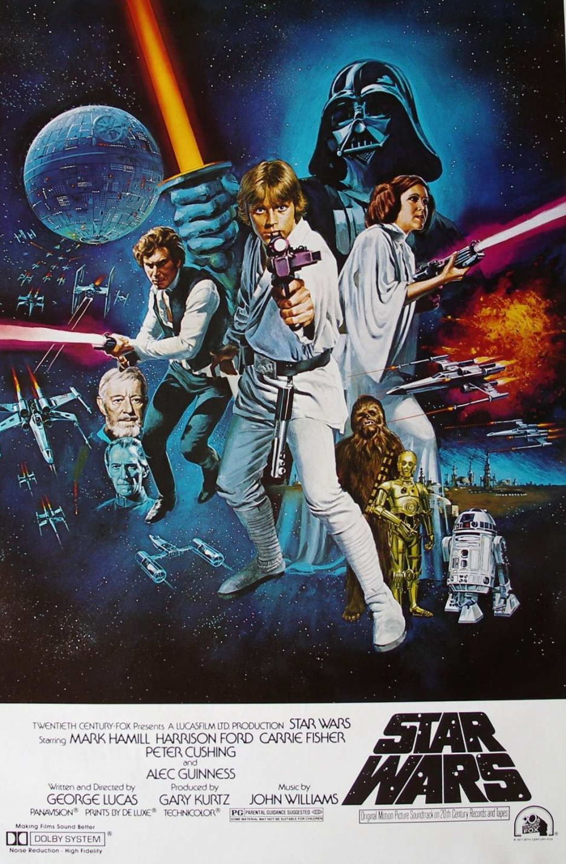
Plot Synopsis
Empire has control of the Galaxy
Rebel Alliance disagrees
Characters
C-3PO - Humanoid droid
R2-D2 - Messenger droid
Darth Vader - Imperial leader
Princess Leia - Rebel agent
Luke Skywalker - Farmer
Obi-Wan - Mysterious vagrant
Journey to Destroy the Death Star
Notes:
Ryan

Slide 4
Movie’s Purpose

Slide 5
Movie’s Purpose
Hero’s Journey
“War” Movie
Not a pure Sci-Fi Movie
Sci-Fi is intrigue, Star Wars is conflict
Humans over Technology and Insurmountable Odds
Technology
Some Fictional
Culture captured by the 1970s
Technology either so far in advance it is implicit OR
Not used to the potential that someone today would recognize
Notes:
Story of Luke through the Galaxy trying to find his place.
No real sci-fi themes, just a war set in space
As such some tech is fictional but none are used beyond a 1970s viewpoint if that
Arthur

Slide 6
Technologies and
Implications

Slide 7
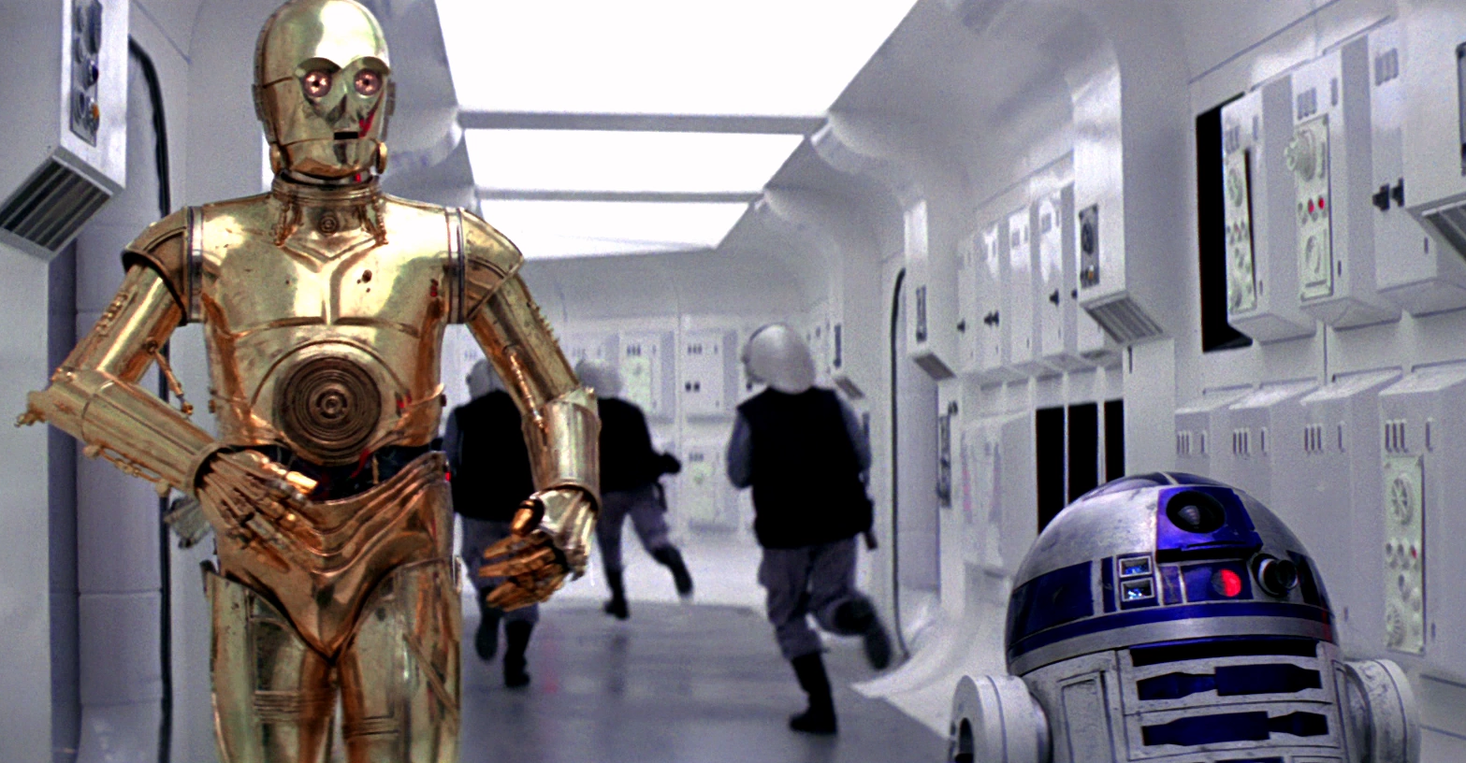
Droids
C-3PO
Most human and humanoid droid
Bridges the gap between tech and humans
Incredibly expositional
R2-D2
Universal interface with stations and ships
Droid communication language
Assistant on the X-Wing and other craft
Varying levels of intelligence based on function
C-3PO and R2-D2
Notes:
Christian

Slide 8
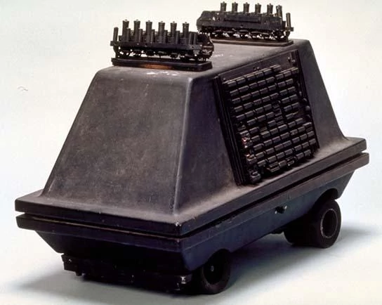
Droid Implications
Makes and Models
R2, MSE
Implicit Trust in Droids
Very Loose Security
Can “Hack” Anything
Droid Treatment
Stolen and Sold by Jawas as “Slaves”
Used as a means to an end
No Respect
Basically left to die when they break, or salvaged
C-3PO is Network Connectivity
Questionable Code of Ethics
MSE-36 (Mouse Droid)
Notes:
Christian
Makes and Models:
Intellectual Property
Implicit Trust:
Errors, Failures and Risks
Information Privacy
Droid Treatment:
Network Connectivity
Freedom of Speech
Crime
Work
Professional Ethics

Slide 9
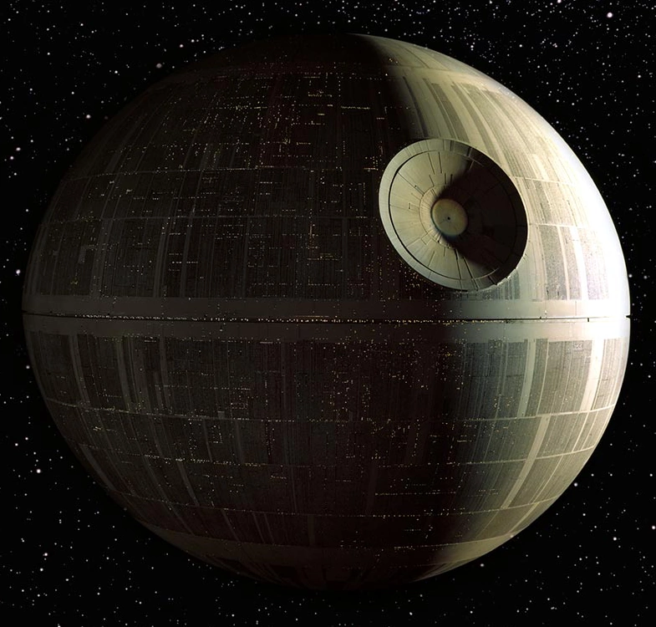
Death Star
Built to Destroy Planets
Large Integrated System
Humans, Droids, Computers
Prisons, Weapon, Army Base
Fast, Large Scale Communication
Computer-Aided Targeting
“Thats No Moon” - Obi-Wan
Death Star
Notes:
Ziyan

Slide 10
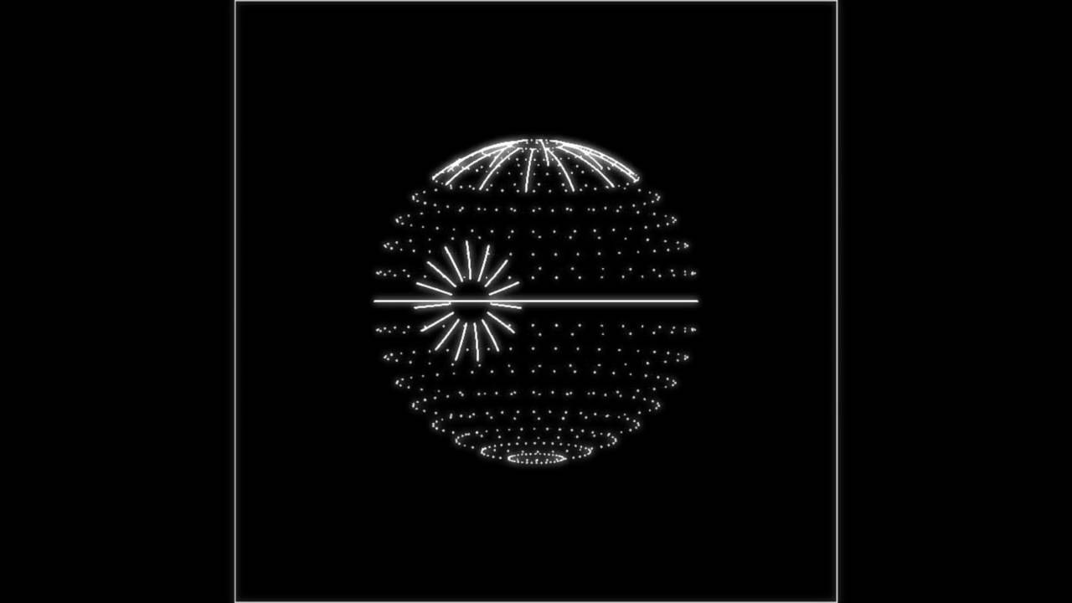
Death Star Implications
Symbol of Oppression
Empire Rules by Fear and Force
Interrogation
Death Star Plans- Trade Secret?
Stolen from the Empire
Full Layout of the Station
Design Flaws and Oversights
R2-D2 can access an universal, unsecured port
Tractor Beam- One point of failure
One point of failure...to destroy the station
Fails the Code of Ethics
Death Star Plans
Notes:
Ziyan
Symbol of Oppression:
Freedom of Speech
Death Star Plans:
Intellectual Property
Information Privacy
Crime <- Treason
Design Flaws and Oversights:
Errors, Failures and Risks
Fails the Code of Ethics:
Professional Ethics

Slide 11
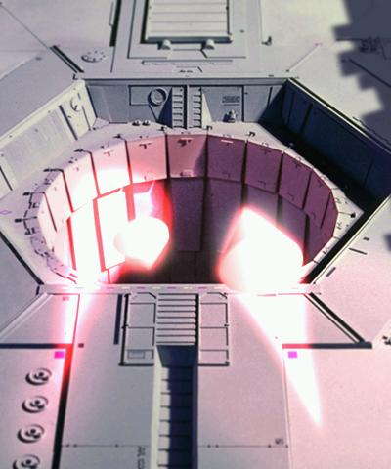
Computers
Targeting Computer
Homing Torpedos
Life-Form Scanning
Screens
Station-wide Interface
Automated Trash Compactors
Doors
Tractor Beams
Guided Torpedos
Notes:
Arthur

Slide 12
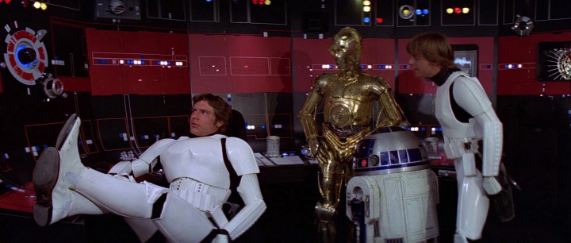
Computers’ Implications
Literally insufficient for the task
Targeting Computers
Data is physically moved around
No concept of digital network connectivity
Incapable of interfacing directly with one another
Enable information gathering, oftentimes people ignore them
Empire overlooking life form scanning
Computer Terminals
Notes:
Arthur
Literally insufficient for the task:
Errors, Failures, and Risks
Professional Ethics

Slide 13
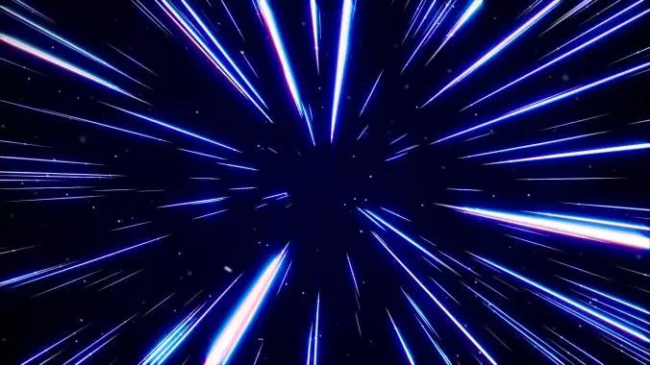
Other Technologies
Interstellar Ships
Mass Produced or just IP?
Hyperspace Travel
“Galaxyization”
Homing Beacon
Galactic GPS
Radios
Intra-Ship
Hyperspace Travel
Notes:
Ryan
Work Technology

Slide 14
Conclusion
Surface level understanding of these powerful technologies
Implementation reflects culture of the era
Humans are flawed, machines cannot be
Significant oversight in how people use the technology they have
Technologies are used once then forgotten about
Notes:
Ryan
Scanning ship for lifeforms only happens once (and was arguably weird when it happened the first time).

